Slide 1
.
ORF 544
Stochastic Optimization and Learning
Spring, 2019
Warren Powell
Princeton University
http://www.castlelab.princeton.edu

Slide 2

Week 8 – Chapter 11
Policy function approximations
Policy search

Slide 3

Policy function approximations

Slide 4
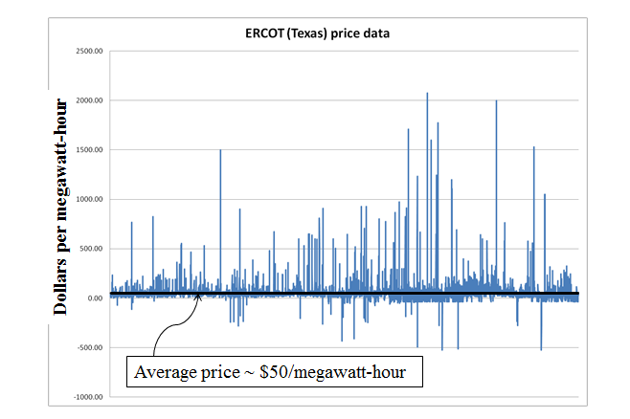

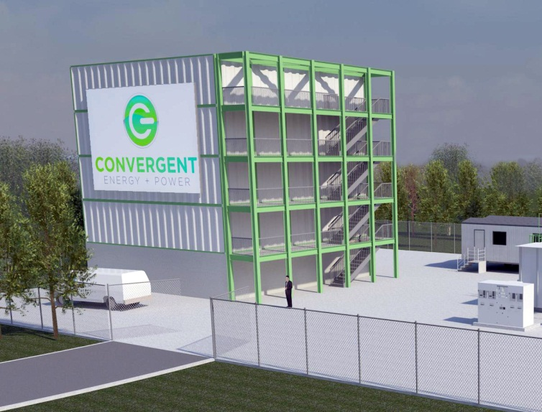
Policy function approximations
Battery arbitrage – When to charge, when to discharge, given volatile LMPs

Slide 5
Policy function approximations
Grid operators require that batteries bid charge and discharge prices, an hour in advance.
We have to search for the best values for the policy parameters

Slide 6
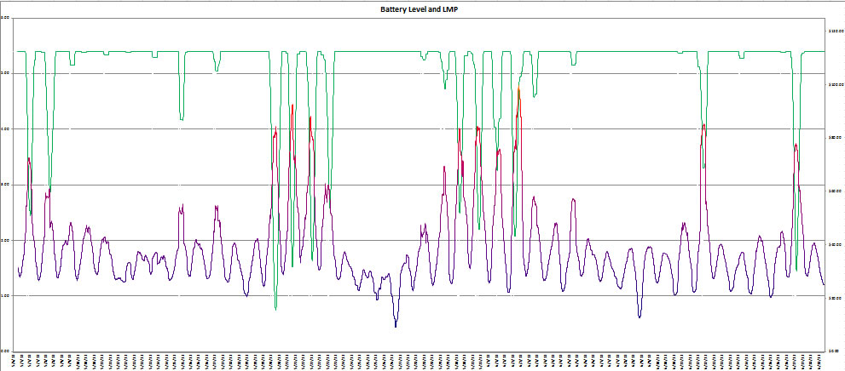
Policy function approximations
Our policy function might be the parametric model (this is nonlinear in the parameters):
Energy in storage:
Price of electricity:

Slide 7
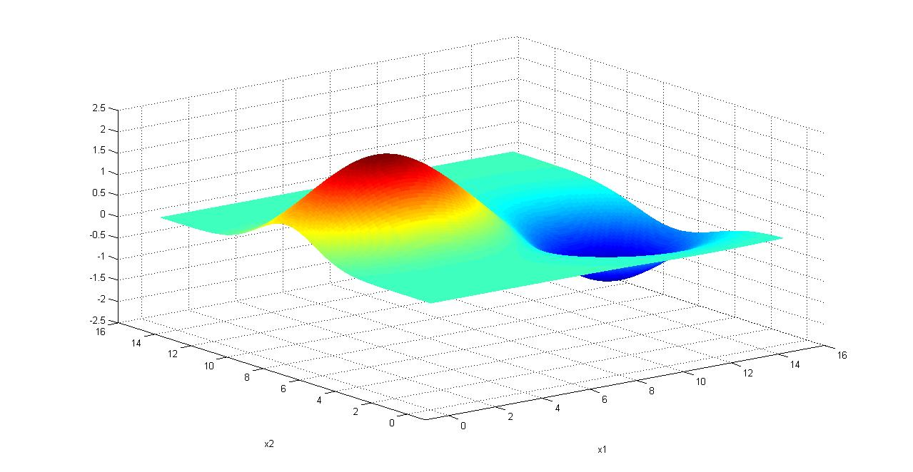
Numerical derivatives
Finding the best policy
  We need to maximize
  We cannot compute the expectation, so we run simulations:
Notes:
7

Slide 8
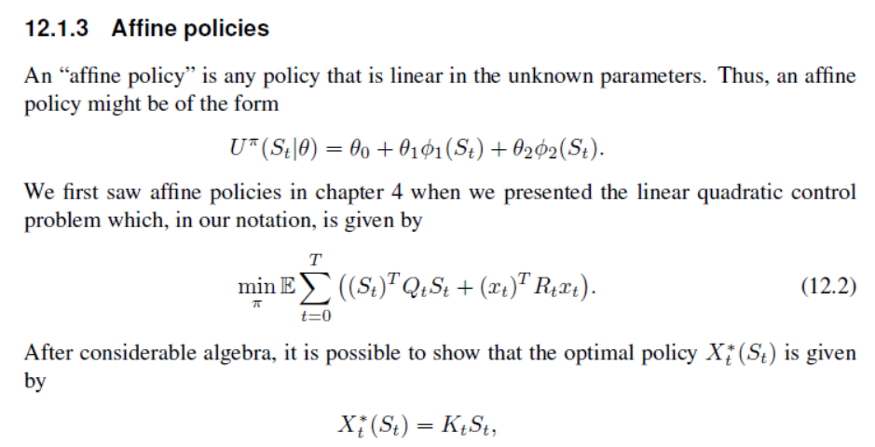
PFAs
  Also called “linear decision rules”

Slide 9
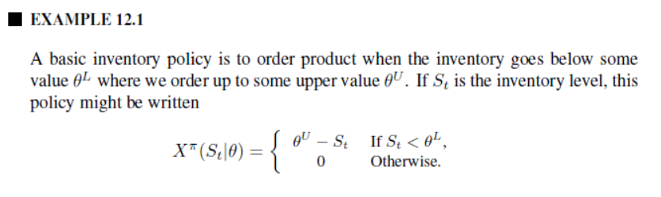
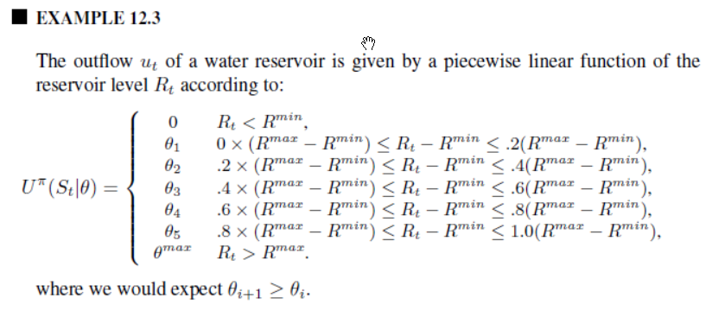

Slide 10
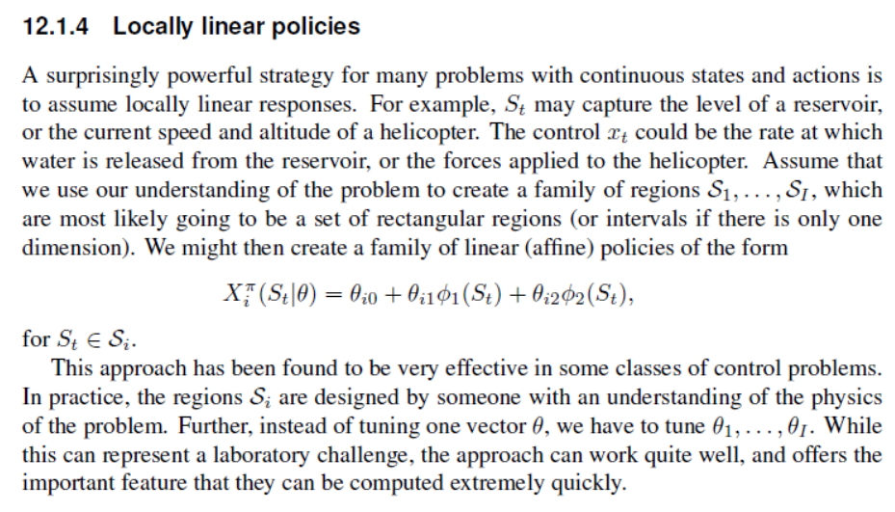
PFAs

Slide 11
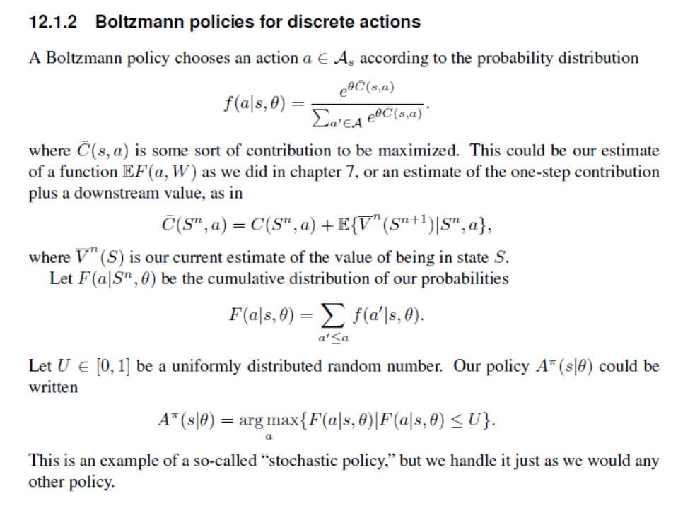
PFAs

Slide 12
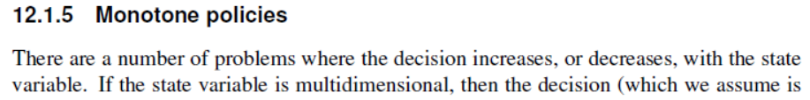
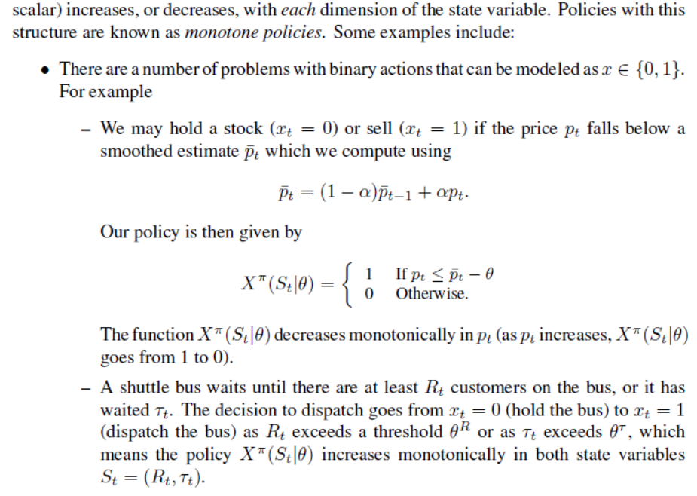
PFAs

Slide 13
PFAs
Neural networks as policies

Slide 14
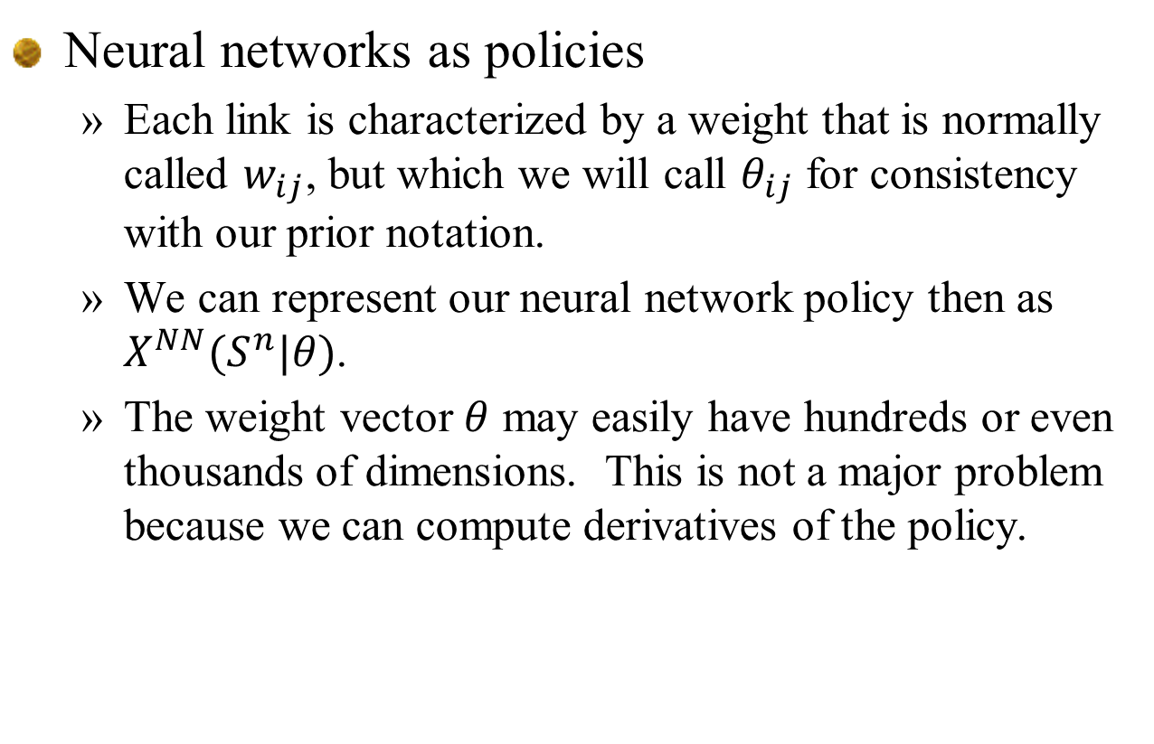
PFAs
Neural networks as policies
  Each link is characterized by a weight that is normally called $w_{ij}$, but which we will call $θ_{ij}$ for consistency with our prior notation.
  We can represent our neural network policy then as $X^{NN}(S^{n}|θ)$.
  The weight vector $θ$ may easily have hundreds or even thousands of dimensions. This is not a major problem because we can compute derivatives of the policy.

Slide 15
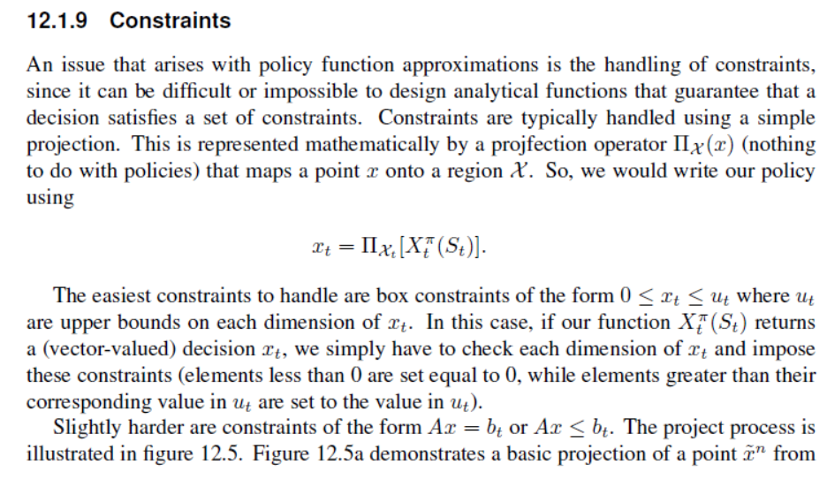
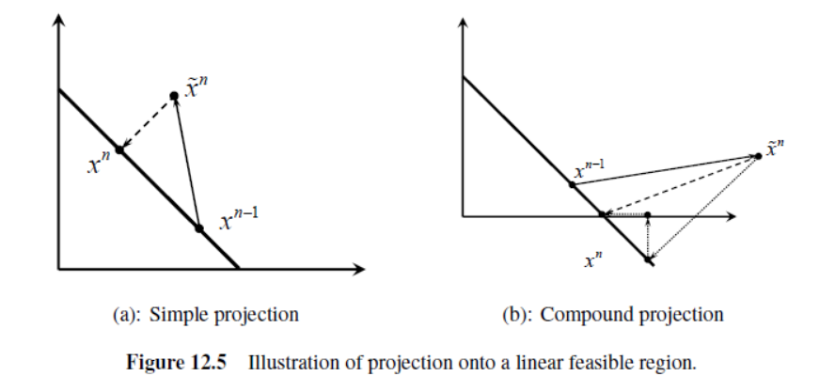
PFAs

Slide 16
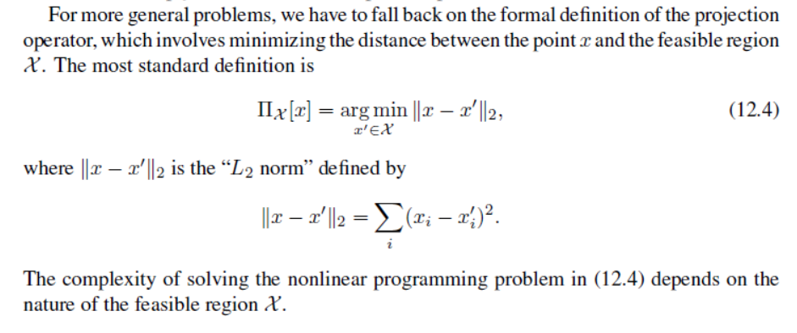
PFAs
Constraints:

Slide 17
Policy search
Derivative-based policy search

Slide 18
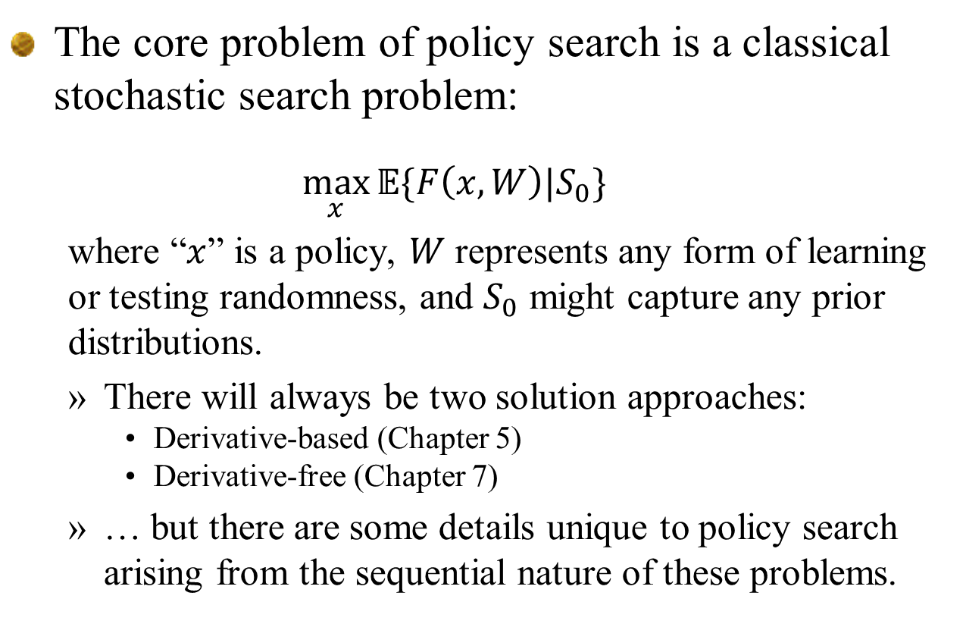
Derivative-based policy search
The core problem of policy search is a classical stochastic search problem:
  $$\max_{x}{𝔼\{F\left(x,W\right)|S_{0}\}}$$
  where “$x$” is a policy, $W$ represents any form of learning or testing randomness, and $S_{0}$ might capture any prior distributions.
  There will always be two solution approaches:
    Derivative-based (Chapter 5)
    Derivative-free (Chapter 7)
  … but there are some details unique to policy search arising from the sequential nature of these problems.

Slide 19
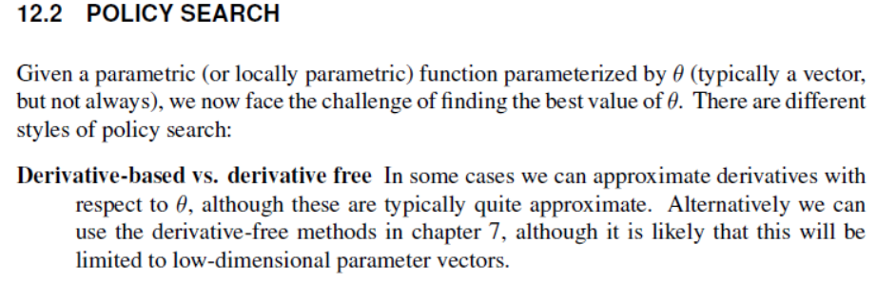
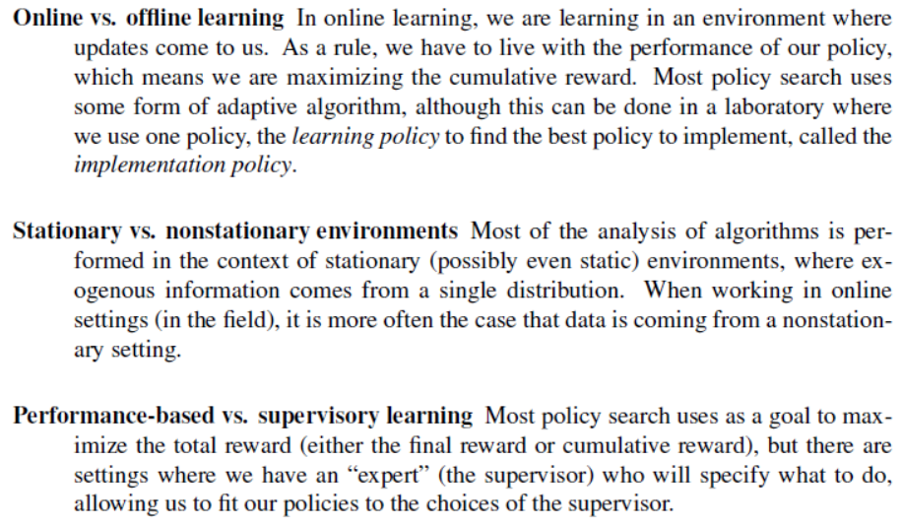
Policy gradient search

Slide 20
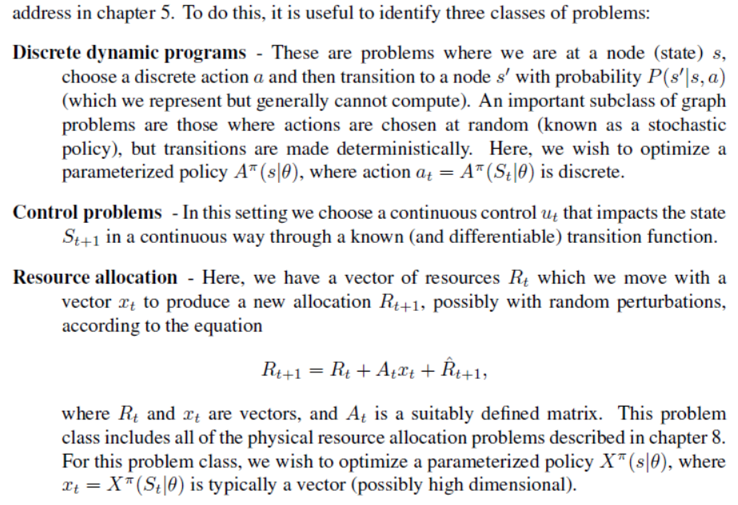
Derivative-based policy search

Slide 21
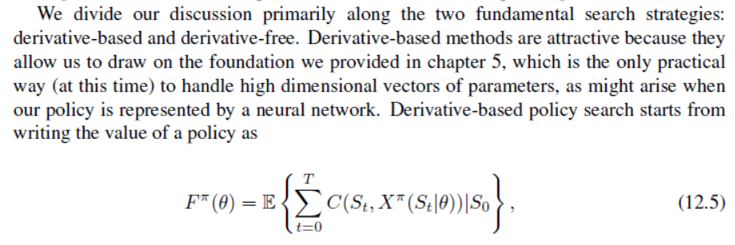
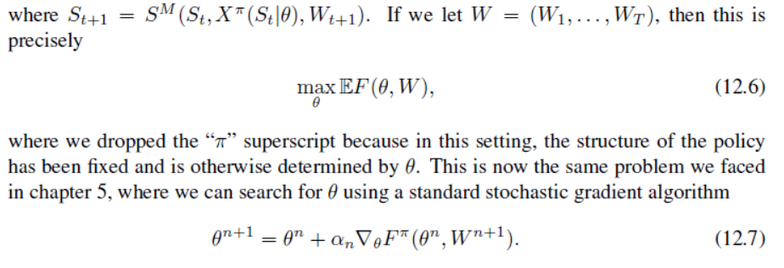
Derivative-based policy search

Slide 22
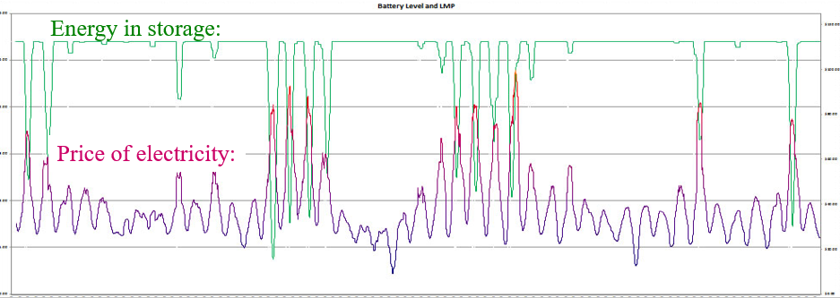
Derivative-based policy search
Finite differences
  We wish to optimize the decision of when to charge or discharge a battery

Slide 23
Derivative-based policy search
Finding the best policy
  We need to maximize
  We cannot compute the expectation, so we run simulations:
Notes:
23

Slide 24
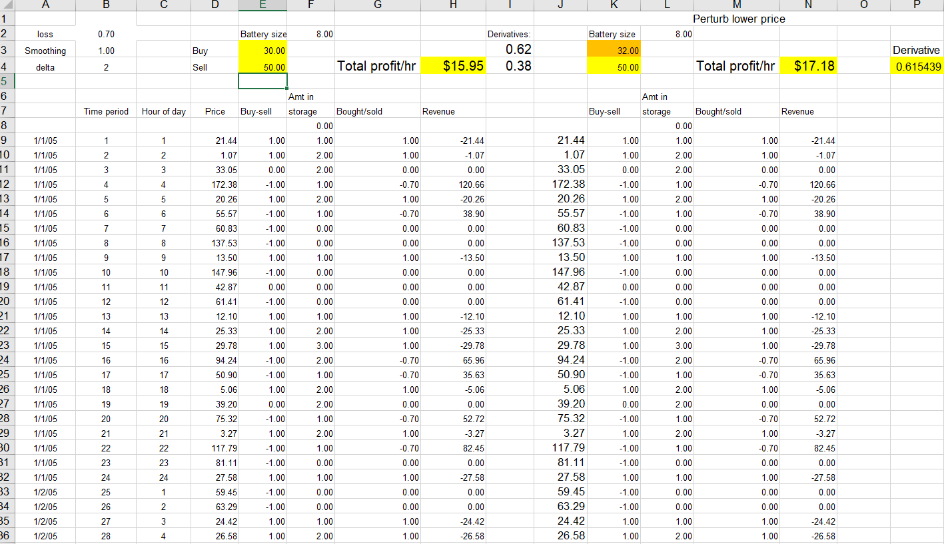
Derivative-based policy search
Simulating finite difference

Slide 25
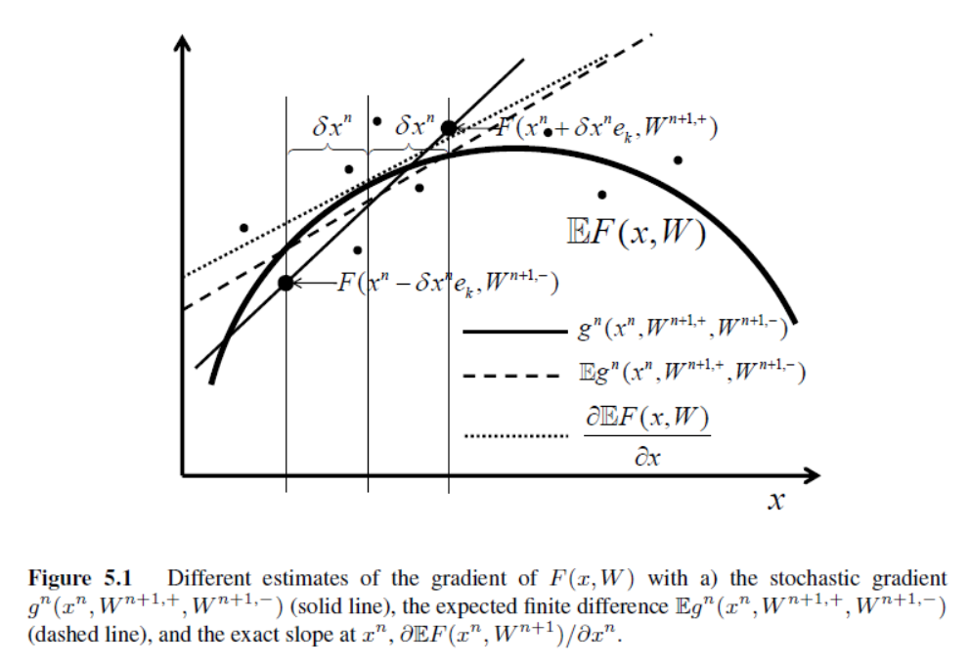
Derivative-based policy search
Finite differences

Slide 26
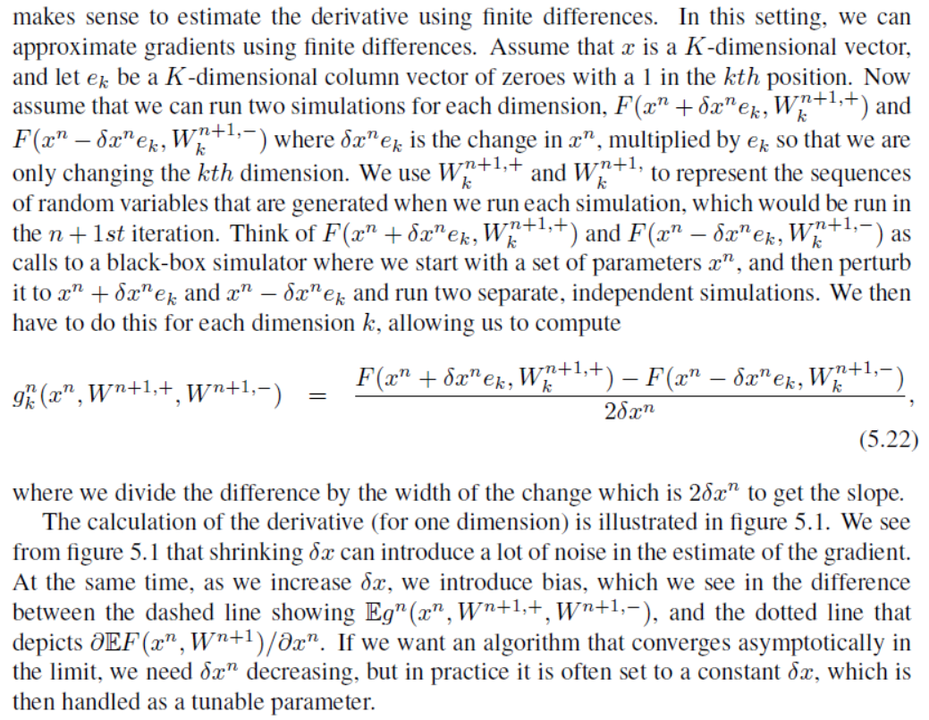
Derivative-based policy search
Finite differences

Slide 27
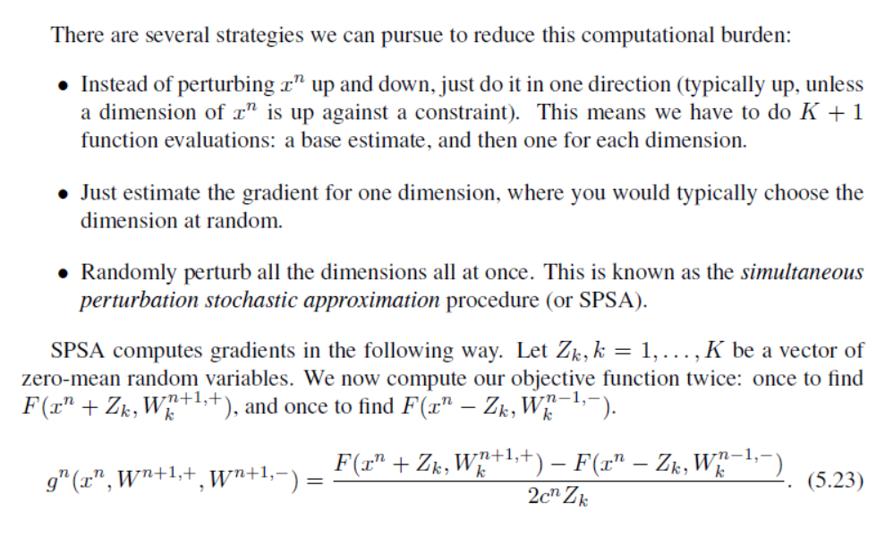
Derivative-based policy search
Finite differences

Slide 28
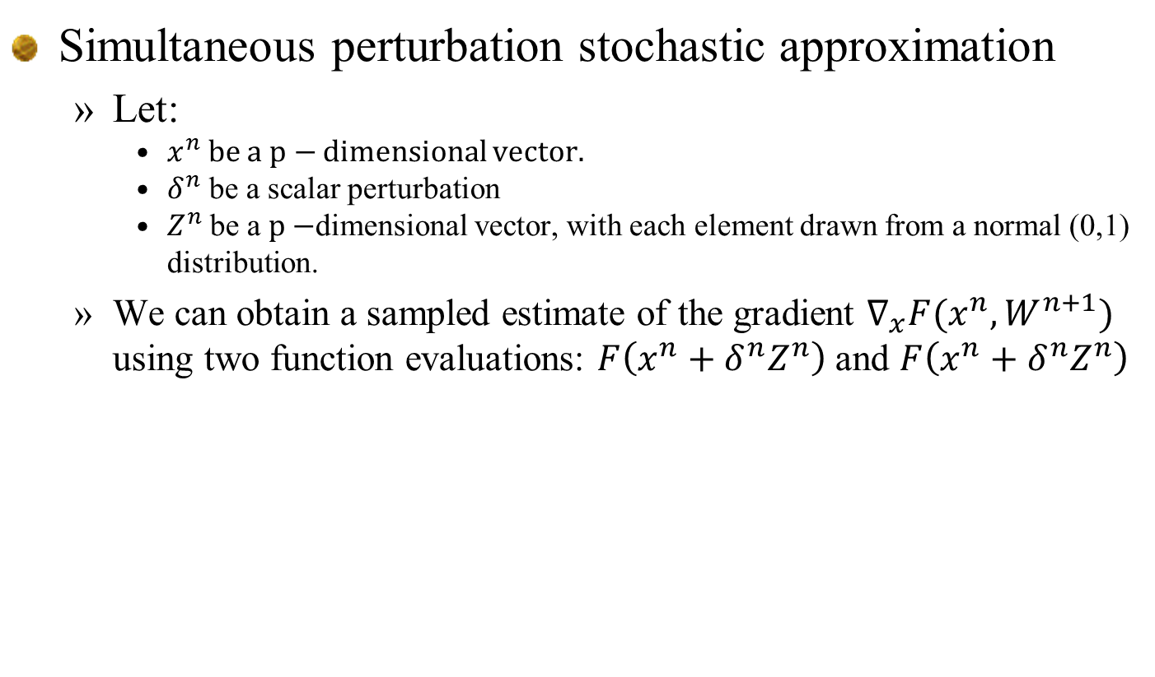
Derivative-based policy search
Simultaneous perturbation stochastic approximation
  Let:
    $x^{n}$ be a $p−$ dimensional vector.
    $δ^{n}$ be a scalar perturbation
    $Z^{n}$ be a $p−$dimensional vector, with each element drawn from a normal (0,1) distribution.
  We can obtain a sampled estimate of the gradient $∇_{x}F(x^{n},W^{n+1})$ using two function evaluations: $F\left(x^{n}+δ^{n}Z^{n}\right)$ and $F\left(x^{n}+δ^{n}Z^{n}\right)$

Slide 29
Policy search
One-dimensional search

Slide 30
Stepsizes for policy search
Notes:
  As we saw before (chapter 5) we trade the elegant simplicity of stochastic gradients for the frustration of designing stepsize rules.
  The next few slides suggest that this application is nonconvex, but unimodular.

Slide 31
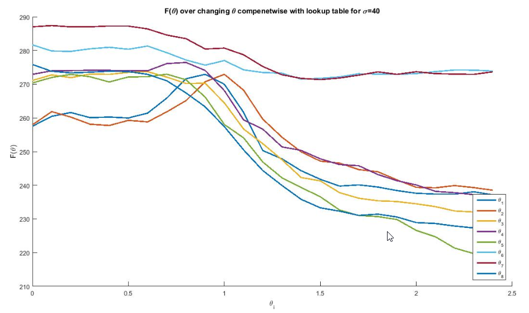

Stepsizes for policy search
One-dimensional contour plots-uncertain forecast
  $θ_{i}$ for i=1,…, 8 hours into the future.

Slide 32
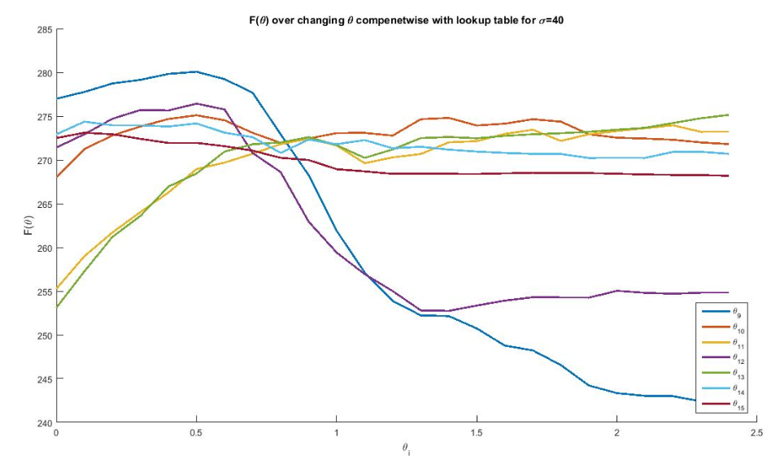

Stepsizes for policy search
One-dimensional contour plots-uncertain forecast
  $θ_{i}$ for i=9,…, 15 hours into the future

Slide 33
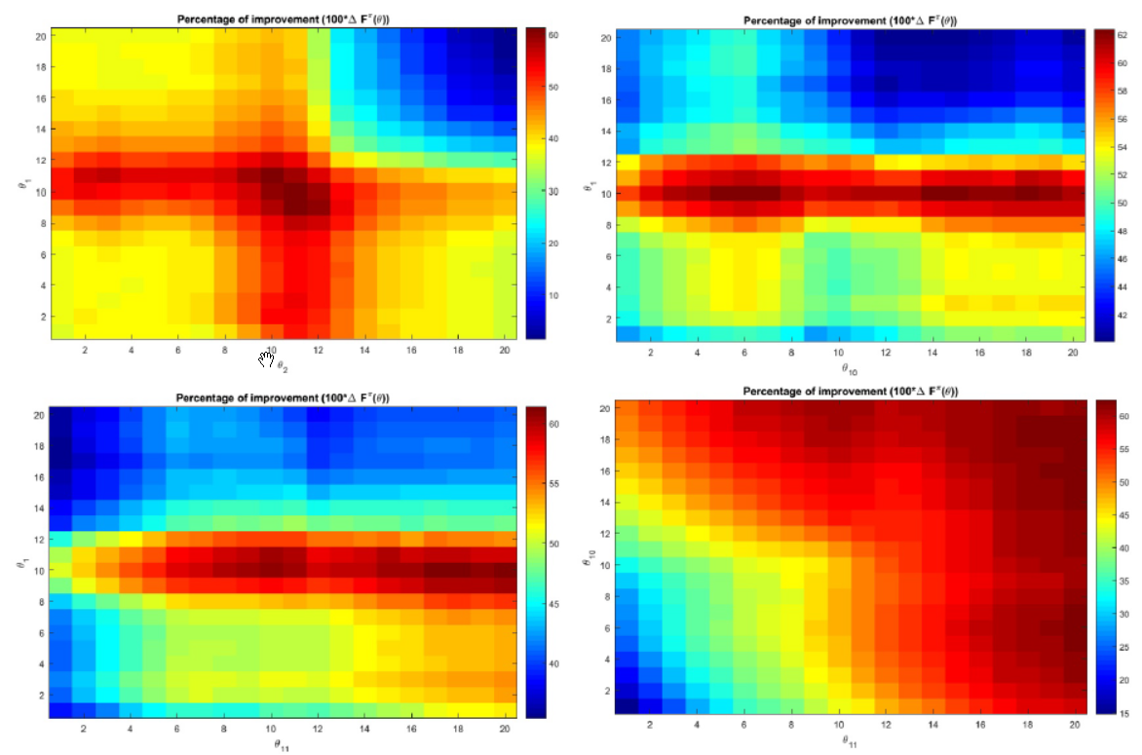
Stepsizes for policy search
2-D contours for uncertain forecasts

Slide 34
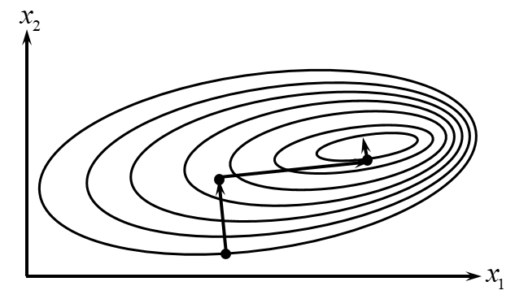
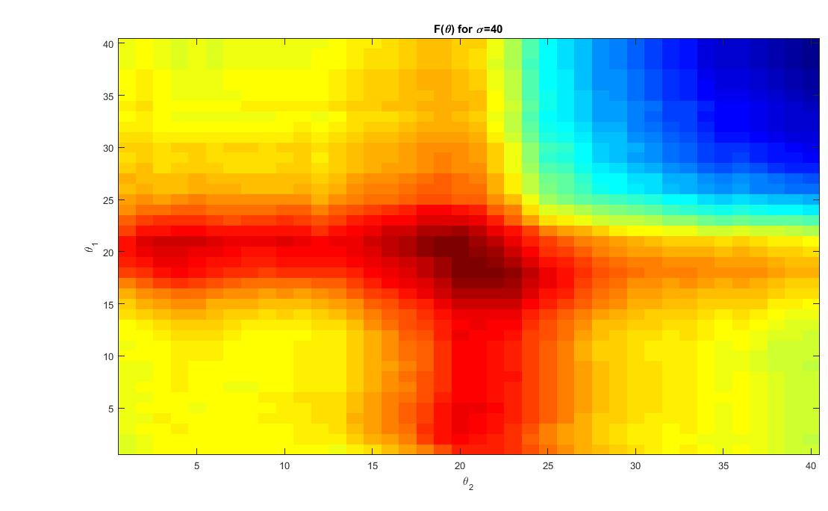
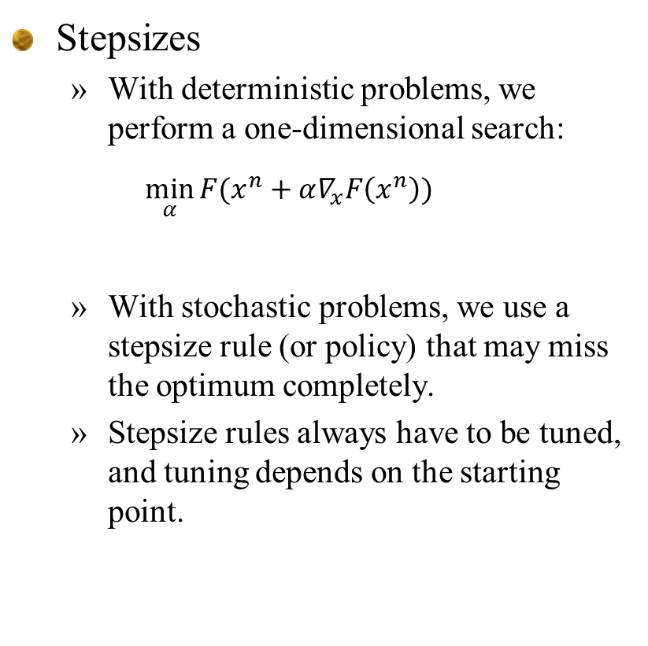
Stepsizes for policy search
Stepsizes
  With deterministic problems, we perform a one-dimensional search:
  $$\min_{α}{F(x^{n}+α∇_{x}F\left(x^{n}\right))}$$
  With stochastic problems, we use a stepsize rule (or policy) that may miss the optimum completely.
  Stepsize rules always have to be tuned, and tuning depends on the starting point.

Slide 35
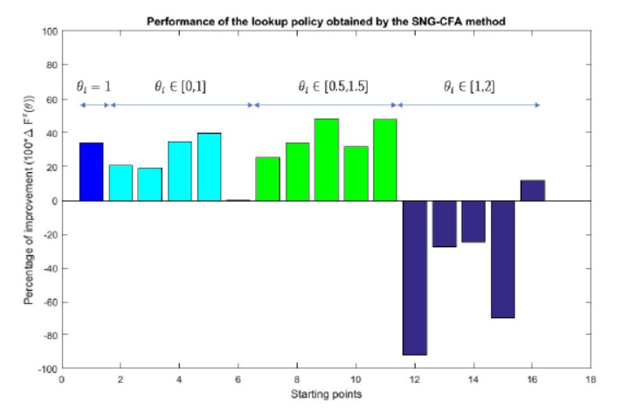
Stepsizes for policy search
Effect of starting points
  Stepsizes tuned for region [0,1].
Pct. Improvement over benchmark lookahead
Starting point

Slide 36
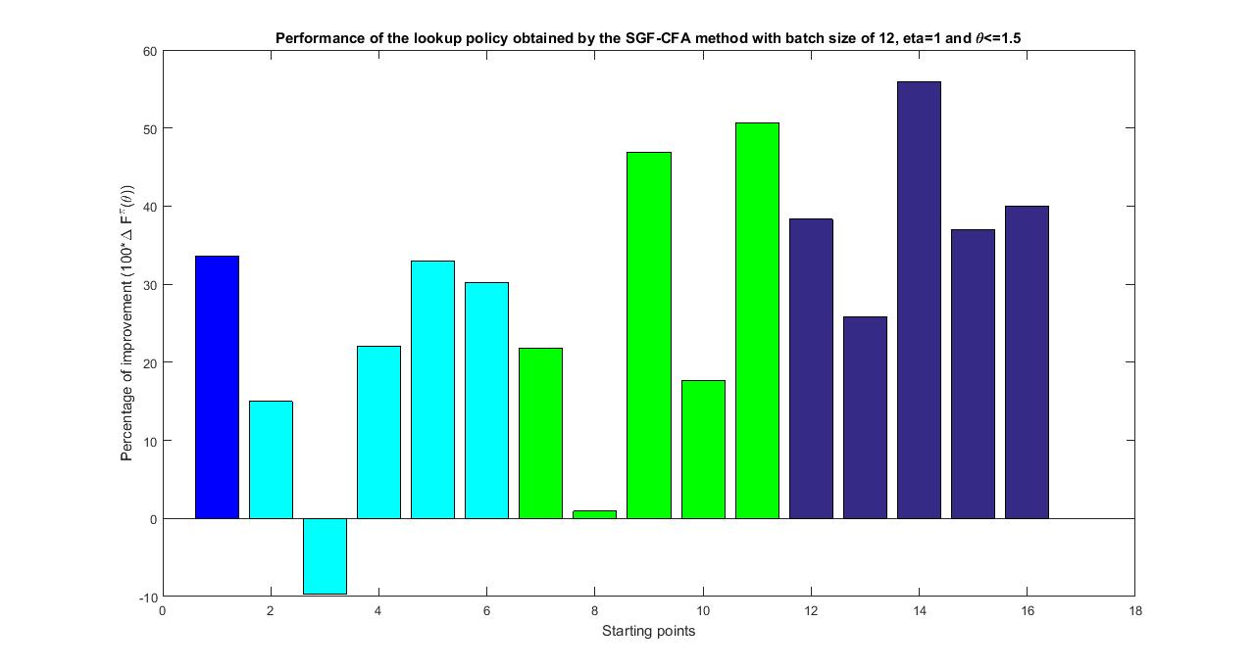



Stepsizes for policy search
Tuning the parameters
  Stepsizes tuned for region [0,2].
$$θ_{i}=1$$
$$θ_{i}∈[0,1]$$
$$θ_{i}∈[0.5,1.5]$$
$$θ_{i}∈[1,2]$$

Slide 37
Stepsizes for policy search
Notes:
  The two previous slides illustrate that tuning the stepsize rules does depend on the starting point.
  Since stepsize rules for stochastic optimization do not perform a one-dimensional search, tuning is critical.
  We have begun experimenting with the idea of using the Fibonacci search, which is an optimal algorithm for doing derivative-free search of deterministic, unimodular functions.
  We have adapted the Fibonacci search for stochastic problems.

Slide 38



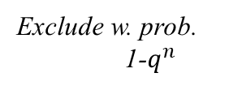
Stepsizes for policy search
Fibonacci numbers: 1, 1, 2, 3, 5, 8, 13, …
Prior
3 5
8
Posterior iter 1
Exclude w. prob. $q^{n}$
Exclude w. prob.
1-$q^{n}$
3 5
8
Posterior iter 2
Exclude w.
prob. $q^{n+1}$
Exclude w. prob. $q^{n}$
2
3 5
8

Slide 39
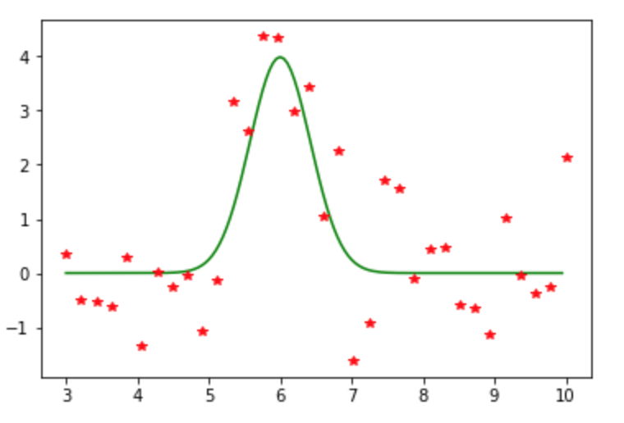
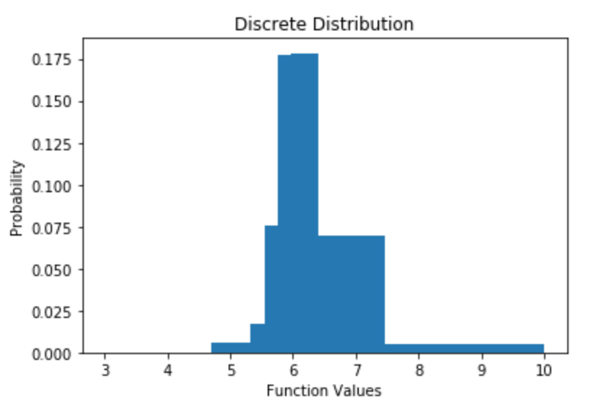
Stepsizes for policy search
Fibonacci search
  Fibonacci search is an optimal algorithms for finding the maximum of a unimodular function.
  This process requires that we be able to evaluate the function deterministically.
  We assume Lipschitz continuity, as well as knowledge of the error distribution. This allows us to estimate the probability that the optimum is toward the left or right.
  We then repeat this multiple times, and create a distribution about where the optimum is.

Slide 40
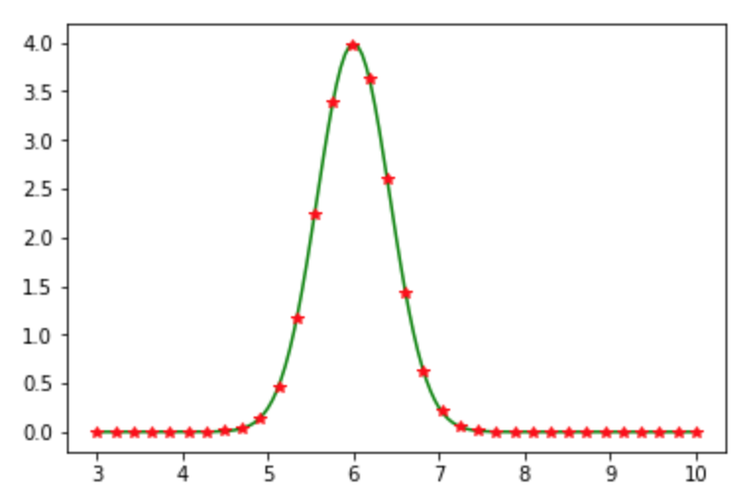
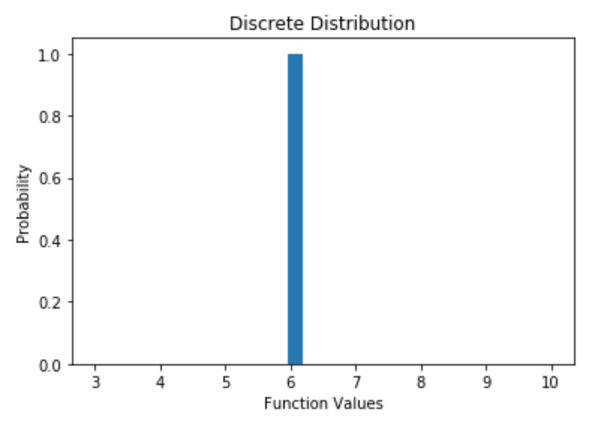
Stepsizes for policy search
Fibonacci search for noisy functions
  34 Fibonacci numbers
  Iterations: 1
  Deterministic response
  Always finds the correct optimum.
Function and observations
Frequency

Slide 41
Stepsizes for policy search
Fibonacci search for noisy functions
  34 Fibonacci numbers
  Iterations: 1
  Medium noise
Function and observations
Frequency

Slide 42
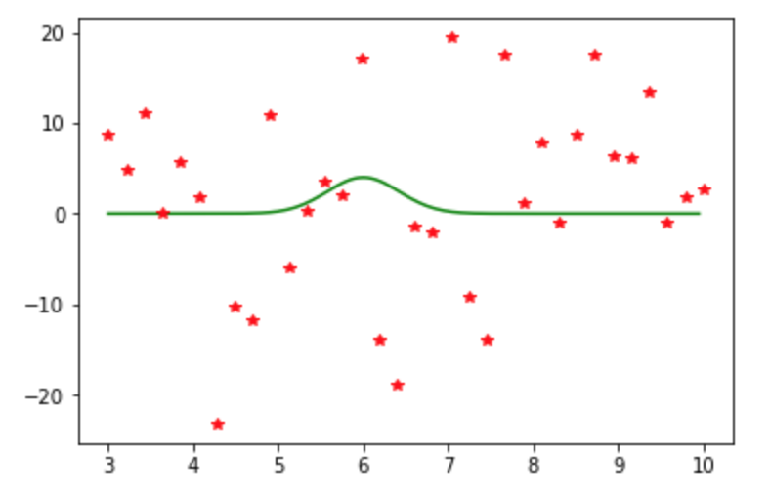
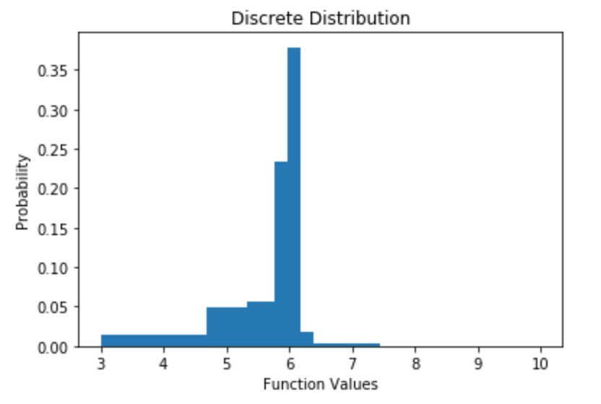
Stepsizes for policy search
Fibonacci search for noisy functions
  34 Fibonacci numbers
  Iterations: 1
  High noise
Function and observations
Frequency

Slide 43
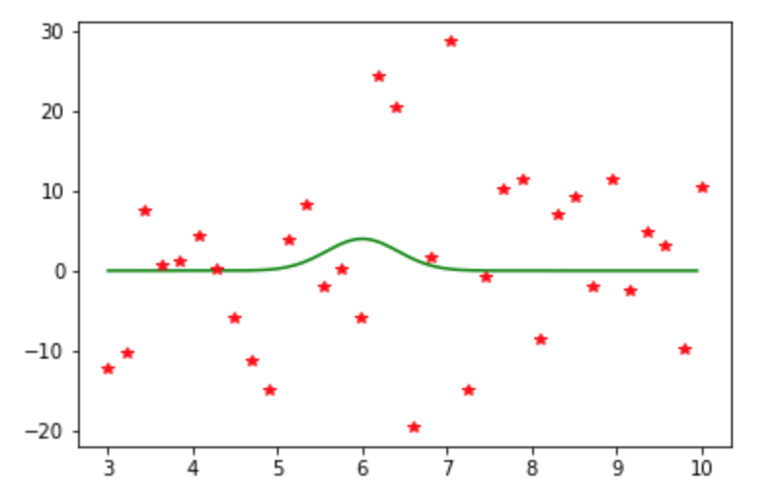
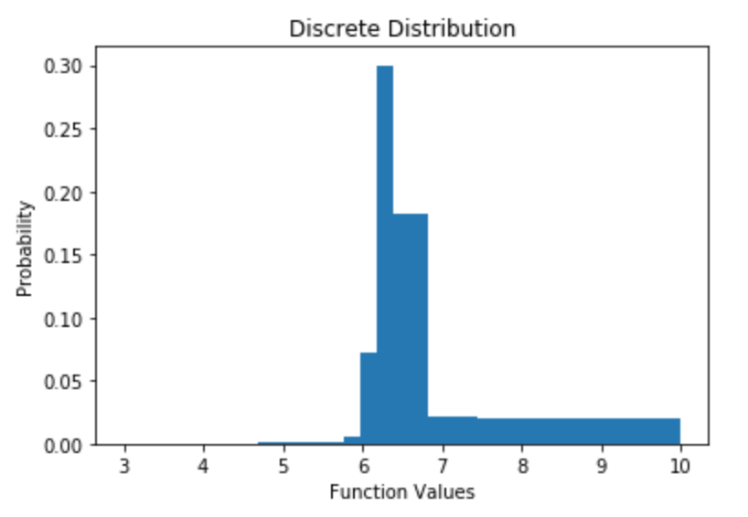
Stepsizes for policy search
Fibonacci search for noisy functions
  34 Fibonacci numbers
  Iterations: 1
  High noise
Function and observations
Frequency

Slide 44
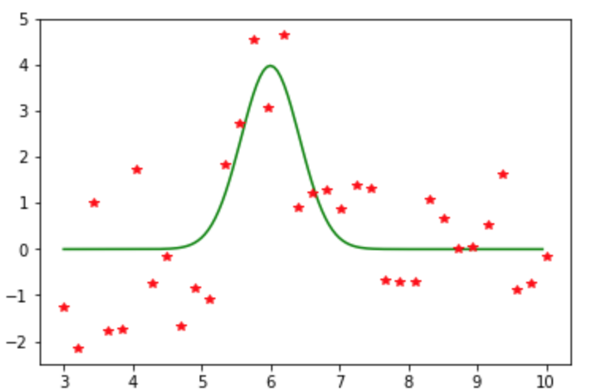
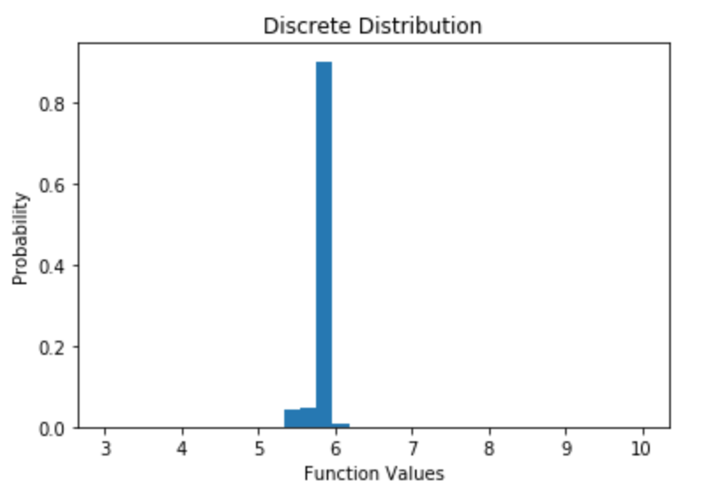
Fibonacci search for noisy functions
  34 Fibonacci numbers
  Iterations: 10
  High noise
  Clearly 10 iterations (340 function evaluations) are not needed.
Function and observations
Frequency

Slide 45
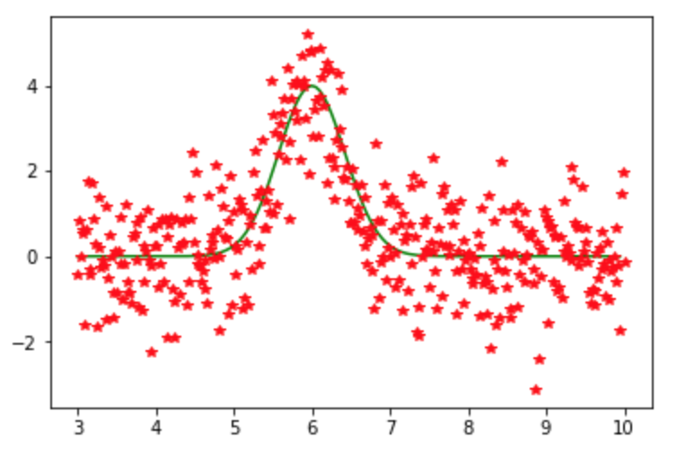
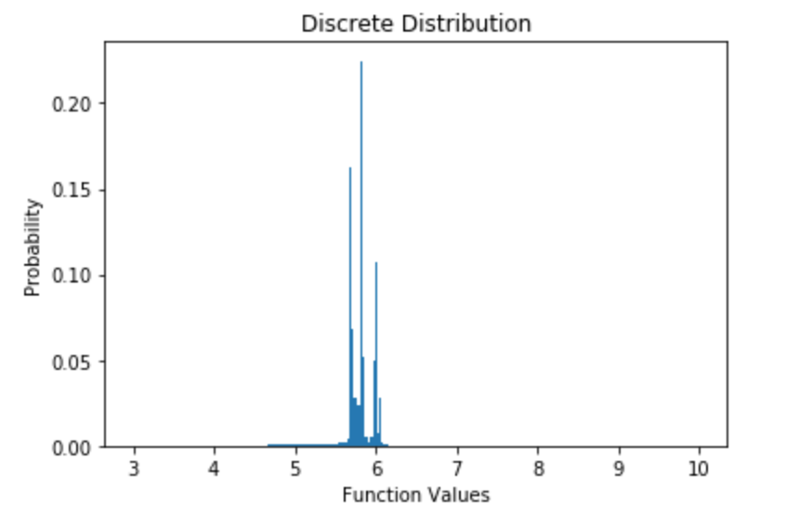
Stepsizes for policy search
Fibonacci search for noisy functions
  377 Fibonacci numbers
  Iterations: 10
  High noise
Function and observations
Frequency

Slide 46
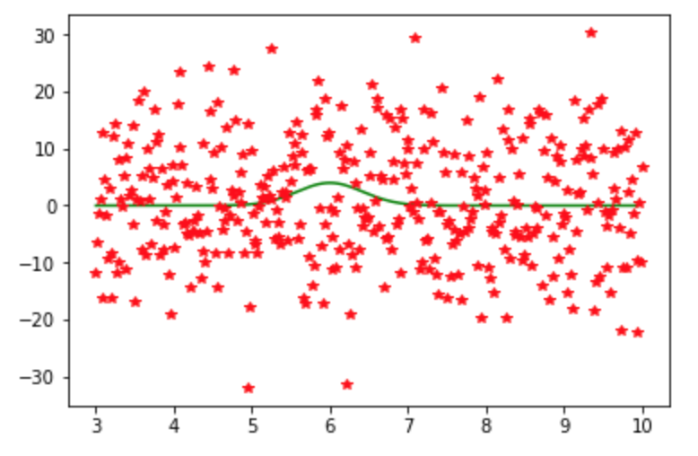

Stepsizes for policy search
Fibonacci search for noisy functions
  377 Fibonacci numbers
  Iterations: 10
  High noise
Function and observations
Frequency

Slide 47
Stepsizes for policy search
Notes
  Even with very high noise, it appears that Fibonacci does a very reliable job of finding a near-optimal point.
  The next step is to see how well this works in a stochastic gradient algorithm.

Slide 48
Policy gradient I
Derivative-based:
Categorical actions – Boltzmann policies

Slide 49
Policy search
There are two classes of sequential decision problems that have yielded two different approaches to doing gradient-based policy search:
  Numerical actions – Here the action is a quantity, and the downstream state is a function of this quantity.
  Categorical actions – These problems are easily viewed as graphs with possibly stochastic transitions. We are not able to take a derivative with respect to the action.

Slide 50

Policy gradient search
Discrete dynamic programs
  Maximizing expected single period reward
  Need to skim this – just highlight “policy gradient theorem.”

Slide 51

Policy gradient search

Slide 52

Policy gradient search

Slide 53

Policy gradient search

Slide 54

Policy gradient search

Slide 55

Policy gradient search

Slide 56


Policy gradient search

Slide 57

Policy gradient search

Slide 58


Policy gradient search

Slide 59

Policy gradient search

Slide 60


Policy gradient search

Slide 61

Policy gradient search

Slide 62
Policy gradient search
Notes:
  The policy gradient search is typically illustrated in the context of Boltzmann, which is characterized by a scalar parameter.
  This can be optimized using specialized search routines for scalar problems.
  It can also be tackled using the SPSA, where the model is viewed as a black-box simulator.
  Even policy gradient search involves the stepsize issue.

Slide 63
Policy gradient II
Derivative-based: Control problems

Slide 64

Policy gradient for control problems
Control problems
  We use “control problem” to describe problems where the downstream state is a continuous function of the decision, captured by the transition function:
  $$S_{t+1}=S^{M}(S_{t},X^{π}(S_{t}|θ), W_{t+1})$$
  We need to capture the effect of changing $θ$ on $x_{t}=X^{π}\left(S_{t} | θ\right),$and then the effect of $x_{t}$ on $S_{t+1}={ S}^{M}\left(S_{t},x_{t},W_{t+1}\right).$

Slide 65

Policy gradient for control problems

Slide 66

Policy gradient for control problems
Applying the chain rule:

Slide 67
Policy gradient for control problems
Notes:
  Now we just have to take the derivative of the:
    Cost/contribution function
    Transition function
    Policy
  This approach is very popular using neural networks. So popular that the derivatives can be computed using libraries such as “Tensorflow.”
  … but, we can also use numerical derivatives.

Slide 68
Policy search
Derivative-free

Slide 69

Derivative-free policy search
Derivative-free policy search
  Apply everything we learned in chapter 7.
  Policy search is typically performed in a simulator, in which case we would use a “final reward” objective:
  $\max_{π}{𝔼\{F}\left(x^{π,N},\hat{W}\right)\left|S^{0}\right\}=𝔼_{S^{0}}𝔼_{W^{1},…,W^{N}|S^{0}}𝔼_{\hat{W}|S^{0}}F(x^{π,N},\hat{W})$
  This is for state-independent problems, but what about state-dependent problems? Instead of learning the implementation decision $x^{π,N}$, we need to learn the implementation decision as a function of the state $S$, which is a policy that we call the implementation policy $X^{π^{imp}}(S)$. We are going to write this as $X^{π^{imp}}(S|θ^{imp})$ to express the likely dependence on tunable parameters to be used in the implementation policy.
  Just as we needed a “learning policy” $π$ to learn the implementation decision $x^{π,N},$we need a learning policy $π^{lrn}$ in the state-dependent case to learn the implementation policy $π^{imp}$.

Slide 70

Derivative-free policy search
Derivative-free policy search
  We are going to assume that we are simulating over time:
  $$(S_{0},x_{0},W_{1},S_{1},…,S_{t}, x_{t}, W_{t+1},…)$$
  Now we need to solve
  $\max_{π^{lrn}}{𝔼\{C}\left(S,X^{π^{imp}}\left(S|θ^{imp}\right),\hat{W}\right)\left|S\right\}$
  This involves three types of uncertainty:
    Bayesian priors on uncertain parameters (if available), which we capture in the initial state $S_{0}$.
    Uncertainty in the process of learning when applying the learning policy $π^{lrn}$ using the realizations of $W_{1},W_{2},…$
    Uncertainty in the process of evaluating the implementation policy $X^{π^{imp}}(S_{t}|θ^{imp})$.

Slide 71


Derivative-free policy search
Derivative-free policy search
  We have to evaluate
  $$\max_{π^{lrn}}{𝔼\{C}\left(S,X^{π^{imp}}\left(S|θ^{imp}\right),\hat{W}\right)\left|S\right\}$$
  We first expand the expectations: $\max_{π^{lrn}}{𝔼_{S_{0}}𝔼_{W_{1},…,W_{T}|S_{0}𝔼_{S_{0}}}^{π^{lrn}}𝔼_{{S|S}_{0}}^{π^{imp}}𝔼_{\hat{W}|S_{0}}\{C}\left(S,X^{π^{imp}}\left(S|θ^{imp}\right),\hat{W}\right)\left|S\right\}$
  Next we have to write this out in a form we can simulate. The hardest part is the expectation over the state $S$ whose distribution reflects the implementation policy. We do this by simulating the implementation policy:

Slide 72

Derivative-free policy search
Derivative-free policy search
  To simulate
  Let:
  $ψ$ be a sample of any variables in a Bayesian prior in $S_{0}$.
  $ω$ be a sampled sequence $W_{1},W_{2},…,W_{T}$(where we follow the learning policy)
  $\hat{ω}$ be a sampled sequence ${\hat{W}}_{1},{\hat{W}}_{2},…,{\hat{W}}_{T}$ (where we follow the implementation policy)
  Now replace each expectation with a sampled estimate.

Slide 73
Derivative-free policy search
Issues:
  Dimensionality of control vector
    Scalar (specialized search algorithms)
    Low dimensional (enumeration?)
    High dimensional (use sampling)
  Creating belief models
    Linear models
    Locally linear
    Correlated beliefs (Gaussian process regression)
  Online (cumulative reward) vs. offline (terminal reward)

Slide 74
Policy search
Locally quadratic knowledge gradient

Slide 75




Knowledge gradient with local quadratic belief
Locally quadratic knowledge gradient
  Uses locally quadratic approximation around proximal point $\overline{x}$.
  Difference between true function and quadratic approx. is Lipschitz
  Encourages learning away from proximal point, but not too far.
$f\left(x | θ\right)=θ_{0}+θ_{1}\left(x−{\overline{x}}^{prox}\right)+θ_{2}{\left(x−{\overline{x}}^{prox}\right)}^{2}$
Belief mode:
$$\hat{y}=f\left(x | θ\right)+β\left(x | \overline{x}\right)+ε$$
Structural uncertainty:
$$β\left(x | \overline{x}\right)∼N(0,κ{\left|x−\overline{x}\right|}^{p})$$
Gaussian noise:
$$ε∼N(0,σ_{ε}^{2})$$
Truth
Error between true function
and quadratic approximation
$${\overline{x}}^{prox}$$
Quadratic
approximation
Estimate of optimal solution

Slide 76

Knowledge gradient with local quadratic belief
Assumes polynomial approx. is
globally accurate.
Assumes polynomial approx. is
locally accurate.
True optimum
Estimated optimum
Statement A: Approved for public release: distribution unlimited

Slide 77

Knowledge gradient with local quadratic belief

Slide 78

Knowledge gradient with local quadratic belief

Slide 79

Knowledge gradient with local quadratic belief

Slide 80

Knowledge gradient with local quadratic belief

Slide 81

Knowledge gradient with local quadratic belief

Slide 82


Knowledge gradient with local quadratic belief

