Slide 1
From Reinforcement Learning to Stochastic Optimization:
A universal framework for sequential decision analytics
Kellogg School of Management
Northwestern University
February 19, 2020
Warren B. Powell
Princeton University
Department of Operations Research
and Financial Engineering

Slide 2
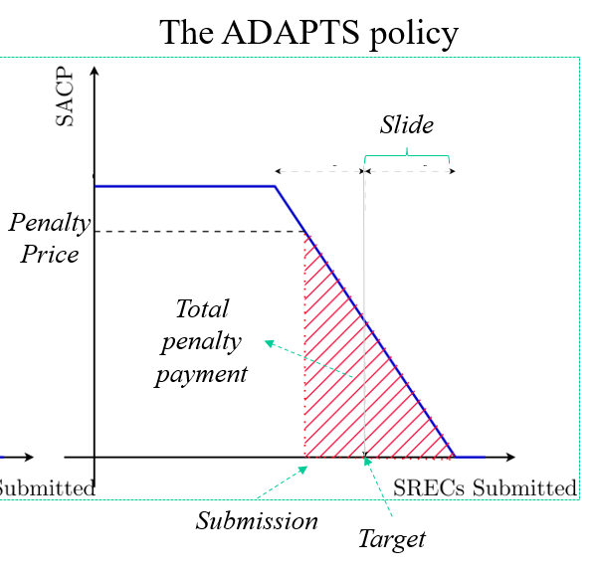

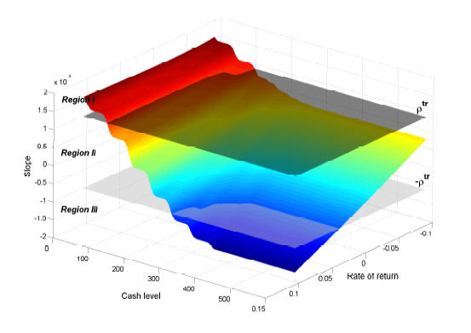
Economics and finance
Analysis of SREC certificates for valuing solar energy credits.
System for valuing 10-year forward contracts for electricity.
Optimizing cash for mutual funds.

Slide 3

E-commerce
Revenue management
  Optimizing prices to maximize total revenue for a particulate night in a hotel.
Ad-click optimization
  How much to bid for ads on the internet.
Personalized offer optimization
  Designing offers for individual customers.

Slide 4
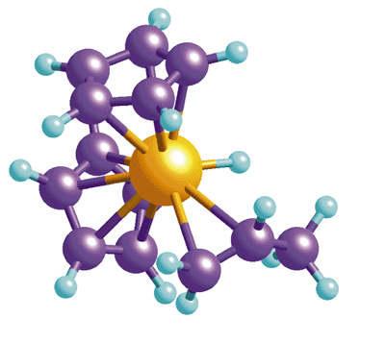
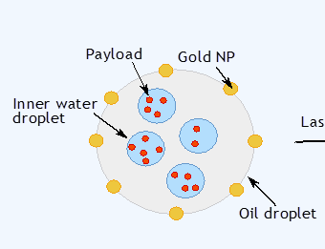
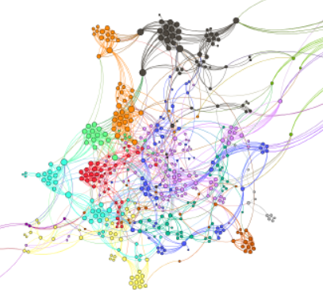
Health applications
Health sciences
  Sequential design of experiments for drug discovery
  Drug delivery – Optimizing the design of protective membranes to control drug release
  Medical decision making – Optimal learning for medical treatments.

Slide 5
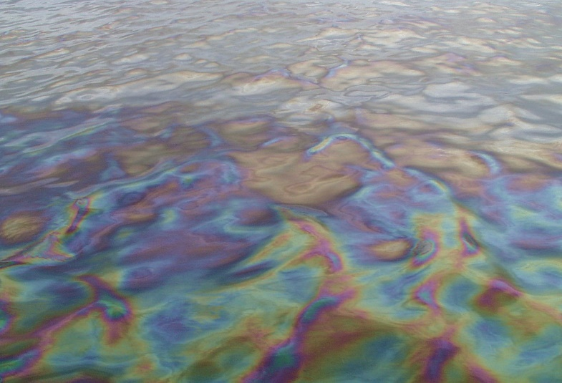
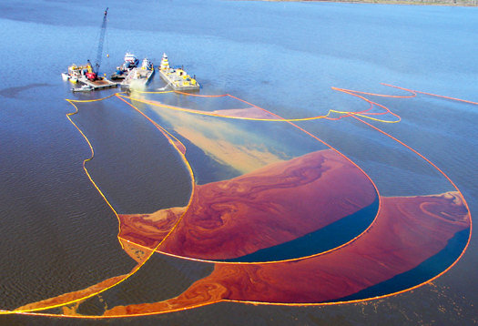
Oil spills
Sensing
  Drones fly over the ocean to detect the presence of oil.
Communication
  Drones coordinate by sharing information.
Mitigation
  Information from drones can be used to guide surface vehicles performing cleanup.

Slide 6
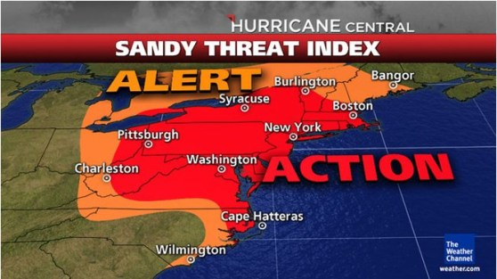
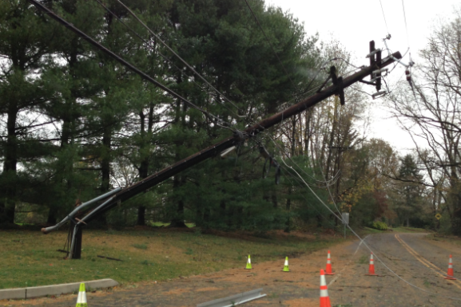
Emergency storm response
Hurricane Sandy
  Once in 100 years?
  Rare convergence of events
  But, meteorologists did an amazing job of forecasting the storm.
The power grid
  Loss of power creates cascading failures (lack of fuel, inability to pump water)
  How to plan?
  How to react?

Slide 7
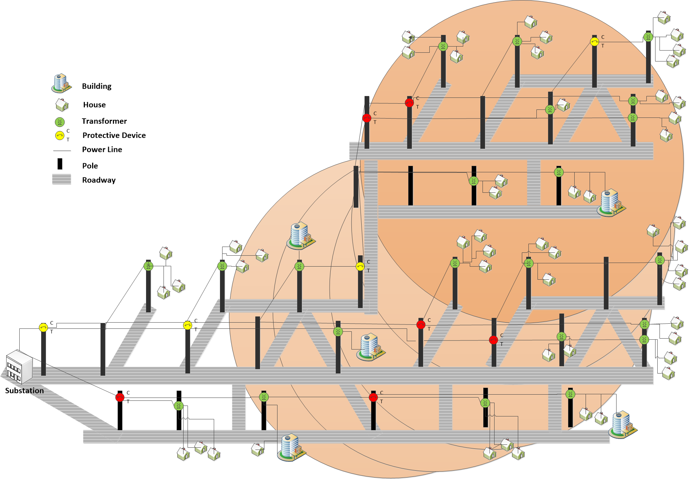
Emergency storm response
0.5
call
0.503
0.503
X
0.503
0.503
0.503
0.503
0.54
0.54
X
0.76
0.064
0.064
0.064
call
0.064
call
0.603
0.603
0.05
X
0
0.02
0.04
0.502
0.502
0
0
0.03
0.04
0.05
0.502
0.502
0.502
0.05
0.67
X
0.67
call
0.26
0.38
0.78
0.6
0.6
X
X
call
call
call

Slide 8
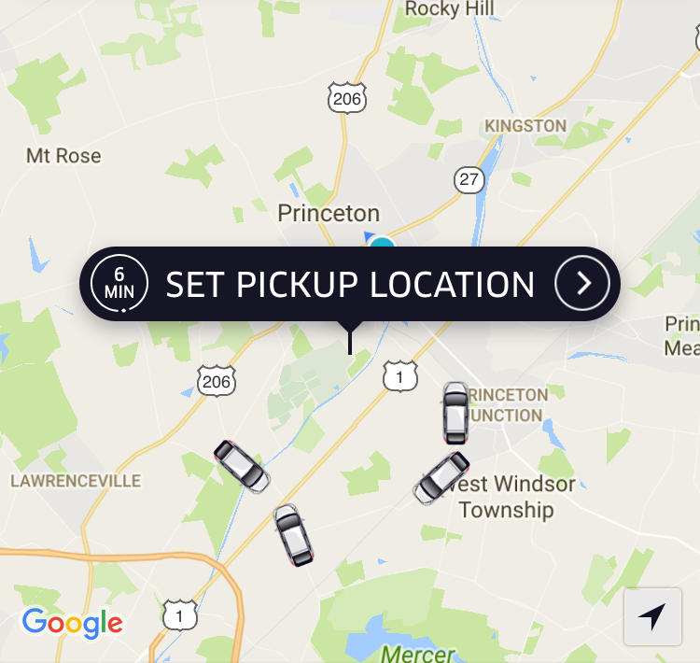
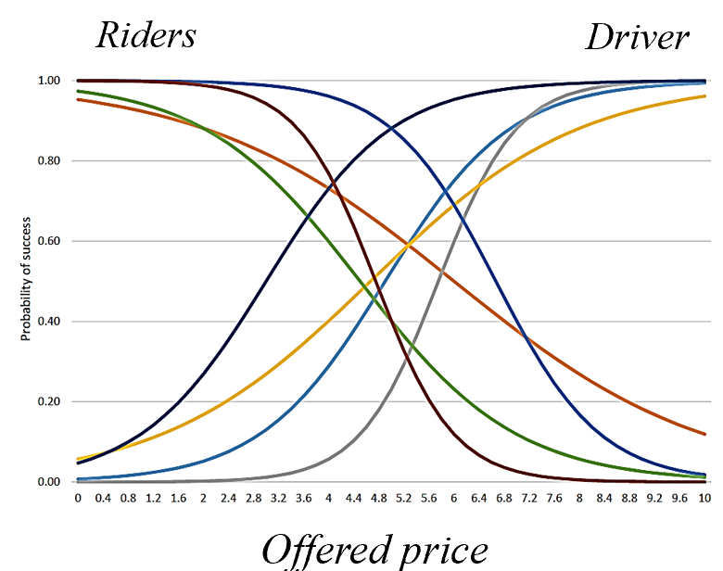
Real-time logistics
Uber/Lyft
  Provides real-time, on-demand transportation.
  Drivers are encouraged to enter or leave the system using pricing signals and informational guidance.
Decisions:
  How to price to get the right balance of drivers relative to customers.
  Real-time management of drivers.
  Pricing (trips, new services, …)
  Policies (rules for managing drivers, customers, …)

Slide 9
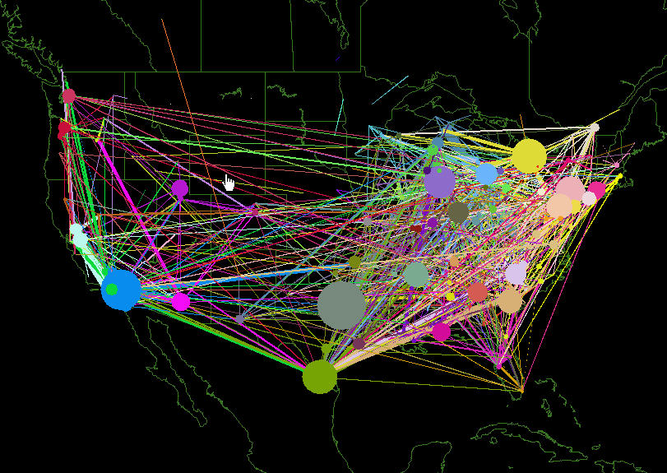
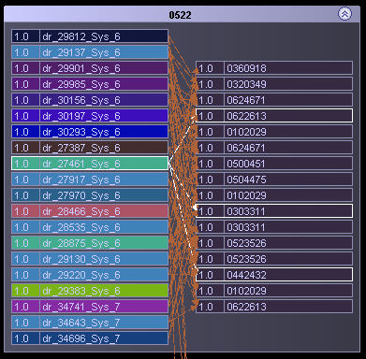
Schneider National

Slide 10
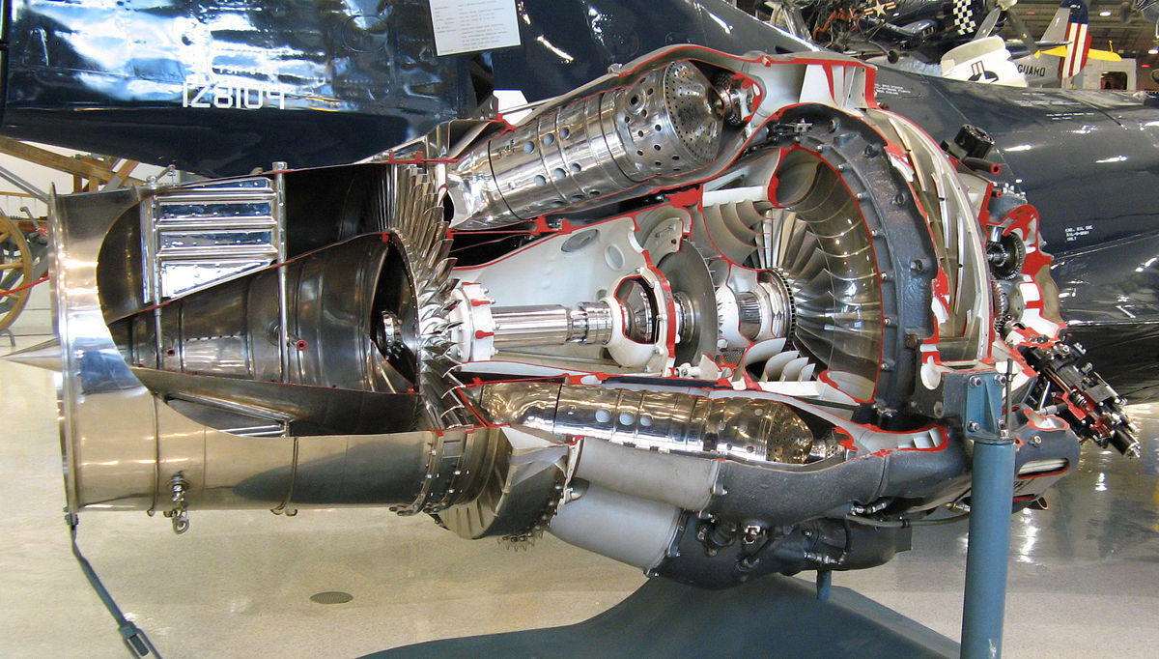
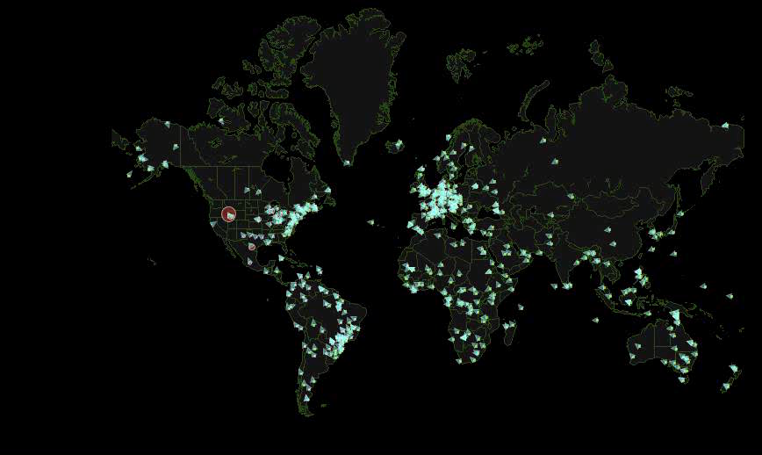
Multiagent supply chain management
Pratt&Whitney jet engines
  Over 1,000 parts
  Median lead time for a part is 120 days. Some lead times are over 300 days.
  Parts often require reworking.
Managing the supply chain
  Challenge is determining when to order parts given the long lead times, and production uncertainties.
  Suppliers work for multiple customers.

Slide 11

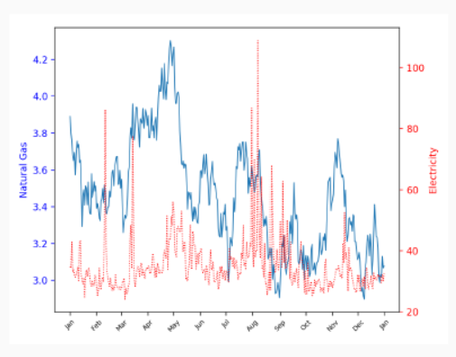
Air Liquide
Uncertainties
  Natural gas prices
  Energy from wind (in Texas)
  Electricity prices
  Demand for gases
Decisions
  Orders for natural gas futures contracts
  How much hydrogen to hold in storage
  Pricing

Slide 12
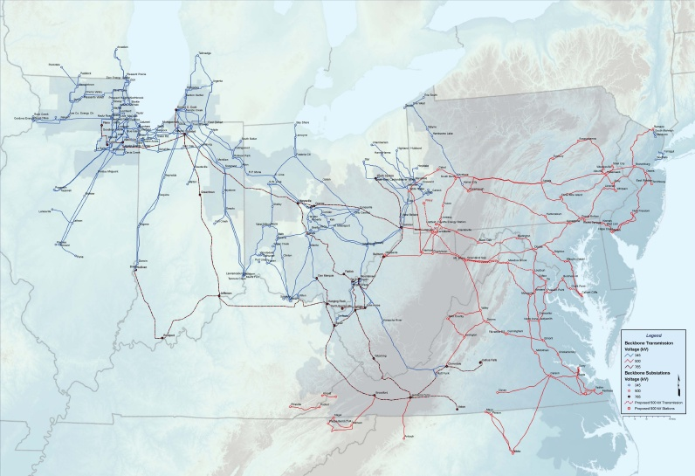
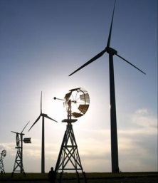
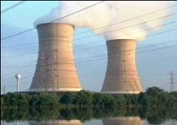
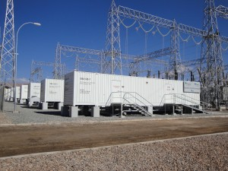
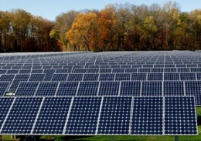
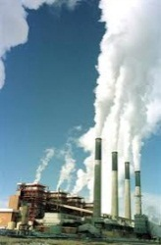
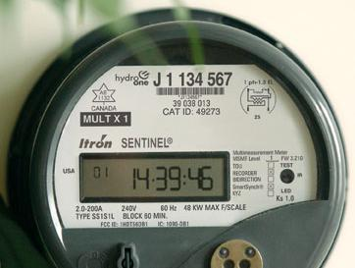
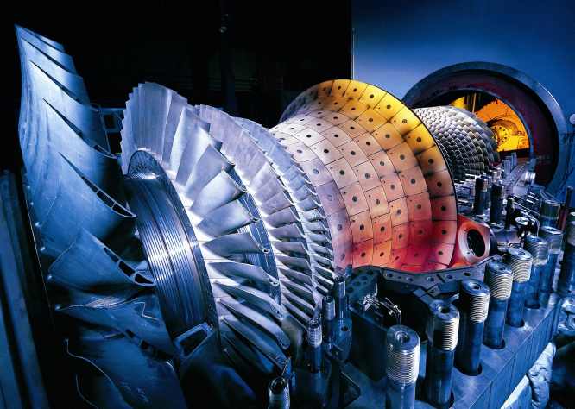
An energy generation portfolio

Slide 13
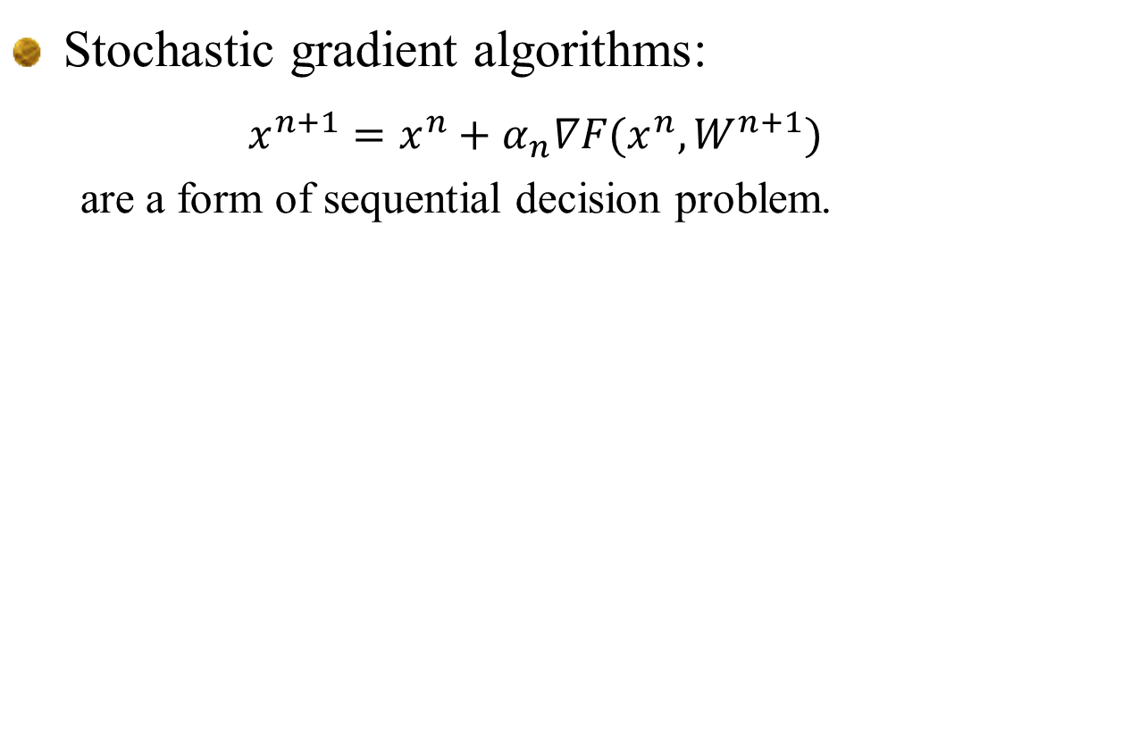
Derivative-based stochastic optimization
13
Stochastic gradient algorithms:
  $$x^{n+1}=x^{n}+α_{n}∇F(x^{n},W^{n+1})$$
  are a form of sequential decision problem.
Notes:
13

Slide 14
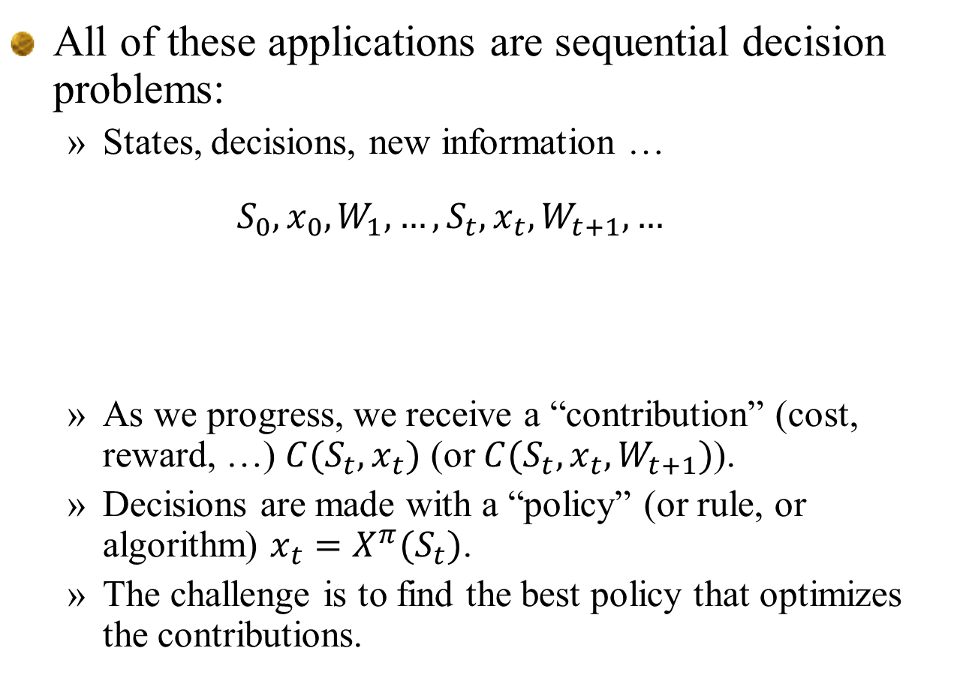
Sequential decision problems
All of these applications are sequential decision problems:
  States, decisions, new information …
  $$S_{0},x_{0},W_{1},…,S_{t},x_{t},W_{t+1},…$$
  As we progress, we receive a “contribution” (cost, reward, …) $C(S_{t},x_{t})$ (or $C(S_{t}, x_{t},W_{t+1})$).
  Decisions are made with a “policy” (or rule, or algorithm) ${x_{t}=X}^{π}(S_{t})$.
  The challenge is to find the best policy that optimizes the contributions.
What we know (or believe)
What we observe (or learn)
What we control

Slide 15
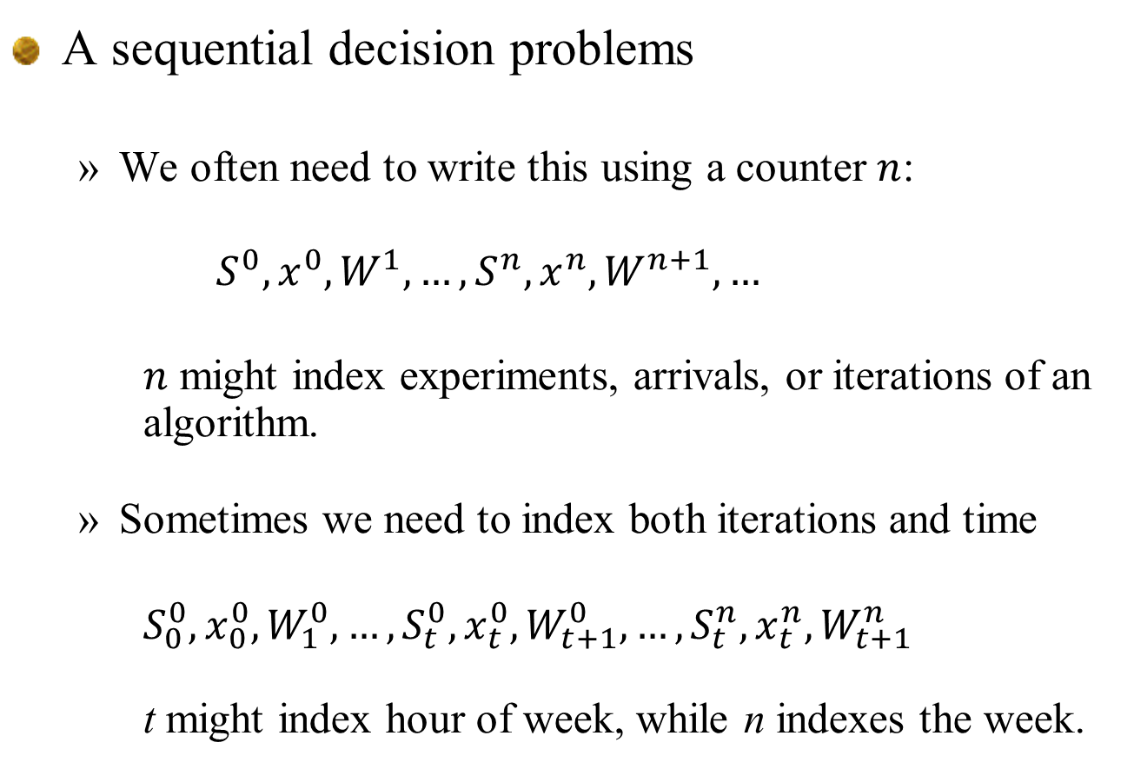
Sequential decision problems
A sequential decision problems
  We often need to write this using a counter $n$:
    $$S^{0},x^{0},W^{1},…,S^{n},x^{n},W^{n+1},…$$
    $n$ might index experiments, arrivals, or iterations of an algorithm.
  Sometimes we need to index both iterations and time
    $$S_{0}^{0},x_{0}^{0},W_{1}^{0},…,S_{t}^{0},x_{t}^{0},W_{t+1}^{0},…,S_{t}^{n},x_{t}^{n},W_{t+1}^{n}$$
    t might index hour of week, while n indexes the week.

Slide 16
Sequential decision problems
Major problem domains
  “Reinforcement learning” - Discrete
  Optimal control – Continuous
  Stochastic programming
  Simulation optimization
  Stochastic search (algorithms)
  Multiarmed bandit problems (“active learning”)
  Games (two agent)
  Multiagent systems

Slide 17
Outline
Elements of a dynamic model
An energy storage illustration
Designing policies
Some observations
Policies for pure learning problems
Policies for state-dependent problems
Pulling it all together

Slide 18
Outline
Elements of a dynamic model
An energy storage illustration
Designing policies
Some observations
Policies for pure learning problems
Policies for state-dependent problems
Pulling it all together

Slide 19
Elements of a dynamic model
Before we can solve complex problems, we have to know how to think about them.
The biggest challenge when making decisions under uncertainty is modeling.
Min E {Σ cx}
Ax = b
x > 0
Organize class
libraries, and set up
communications and
databases
Mathematician
Software

Slide 20
Elements of a dynamic model
For deterministic problems, we speak the language of mathematical programming
  Linear programming:
  For time-staged problems
Arguably Dantzig’s biggest contribution, more so than the simplex algorithm, was his articulation of optimization problems in a standard format, which has given algorithmic researchers a common language.

Slide 21

Stochastic
programming
Approximate
dynamic
programming
Robust
optimization
Decision
analysis
Simulation
optimization
Optimal
learning
Bandit
problems
Dynamic
Programming
and
control
Model
predictive
control
Stochastic
search
Optimal
control
Active
learning
Reinforcement
learning
Online
computation
Markov
decision
processes
Stochastic
control
Simulation
optimization
© Warren Powell 2020
Notes:
Clearing the Jungle of Stochastic optimization – Professor Warren Powell in the Department of Operations Research and Financial Engineering has developed a unified framework for modeling virtually every problem involving optimization under uncertainty. More than just a purely theoretical characterization, he has identified four (meta)classes of policies which provide a clear path to computation (although there is still a lot of work to do for most problems). The framework has identified new problem classes, as well as novel computational strategies. For example, modeling and algorithmic strategies that have long been viewed as competitive (for example, dynamic programming versus stochastic programming) are actually complementary. By building on this integrated framework, we can spend less time focusing on optimizing (making decisions), and more time on an overlooked dimension of stochastic optimization, which is modeling uncertainty.

Slide 22
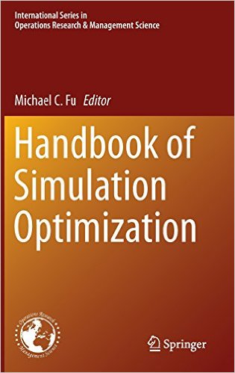

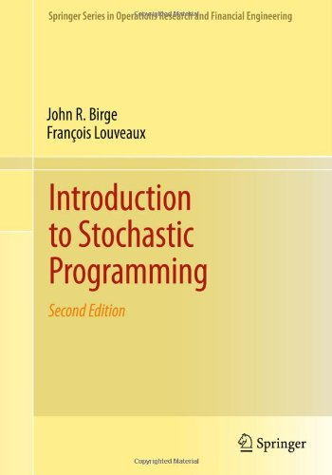
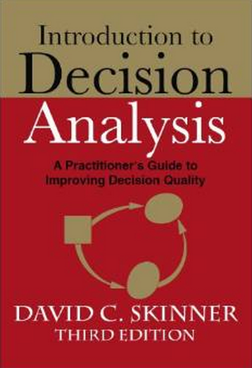
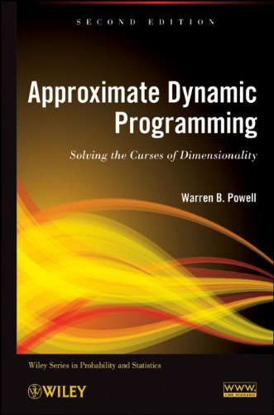
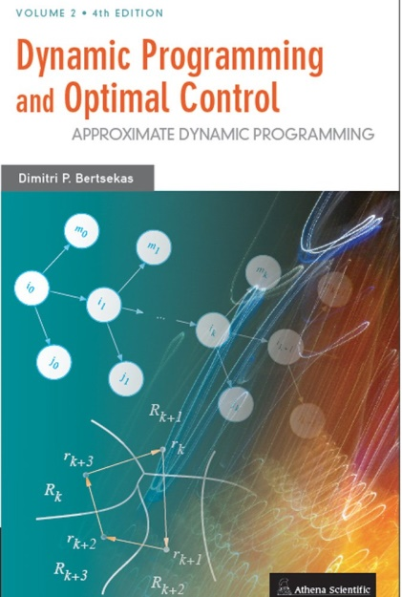


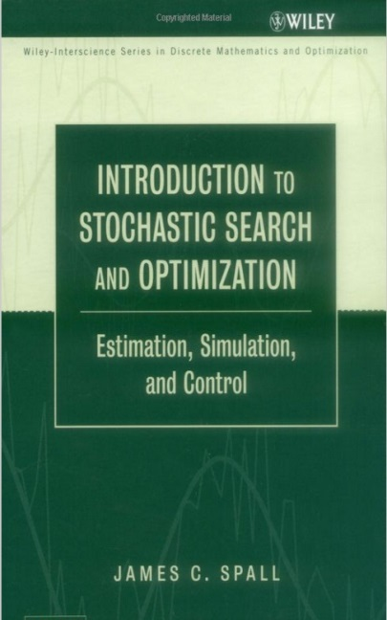


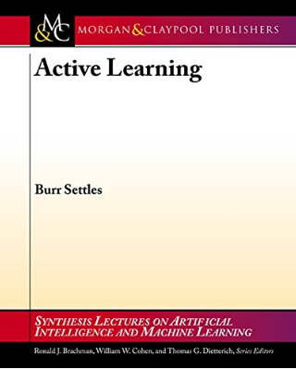
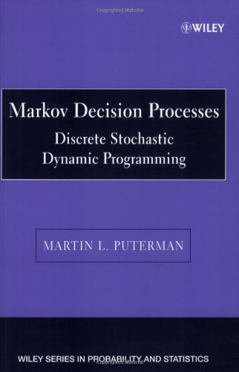
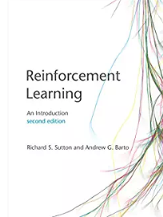

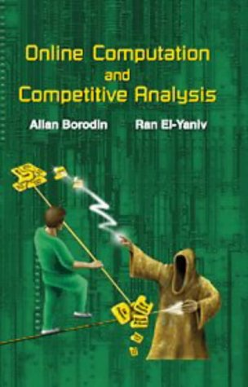

Stochastic
programming
Approximate
dynamic
programming
Robust
optimization
Decision
analysis
Simulation
optimization
Optimal
learning
Bandit
problems
Dynamic
Programming
and
control
Model
predictive
control
Stochastic
search
Optimal
control
Active
learning
Reinforcement
learning
Online
computation
Markov
decision
processes
Stochastic
control
Simulation
optimization
© Warren Powell 2019
Notes:
Clearing the Jungle of Stochastic optimization – Professor Warren Powell in the Department of Operations Research and Financial Engineering has developed a unified framework for modeling virtually every problem involving optimization under uncertainty. More than just a purely theoretical characterization, he has identified four (meta)classes of policies which provide a clear path to computation (although there is still a lot of work to do for most problems). The framework has identified new problem classes, as well as novel computational strategies. For example, modeling and algorithmic strategies that have long been viewed as competitive (for example, dynamic programming versus stochastic programming) are actually complementary. By building on this integrated framework, we can spend less time focusing on optimizing (making decisions), and more time on an overlooked dimension of stochastic optimization, which is modeling uncertainty.

Slide 23
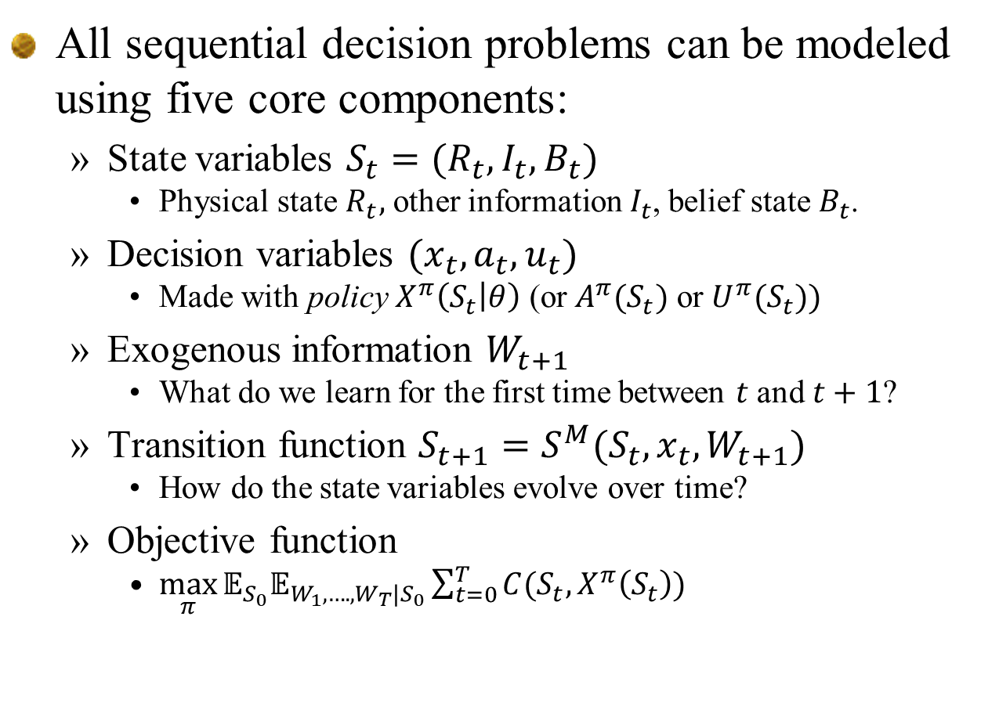
Elements of a dynamic model
All sequential decision problems can be modeled using five core components:
  State variables $S_{t}=(R_{t},I_{t},B_{t})$
    Physical state $R_{t},$ other information $I_{t}$, belief state $B_{t}$.
  Decision variables $(x_{t},a_{t},u_{t})$
    Made with policy $X^{π}\left(S_{t} | θ\right)$ (or $A^{π}(S_{t})$ or $U^{π}(S_{t}))$
  Exogenous information $W_{t+1}$
    What do we learn for the first time between $t$ and $t+1$?
  Transition function $S_{t+1}=S^{M}(S_{t},x_{t},W_{t+1})$
    How do the state variables evolve over time?
  Objective function
    $\max_{π}{𝔼_{S_{0}}𝔼_{W_{1},….,W_{T}|S_{0}}\sum_{t=0}^{T}{C(S_{t},X^{π}\left(S_{t}\right))}}$

Slide 24
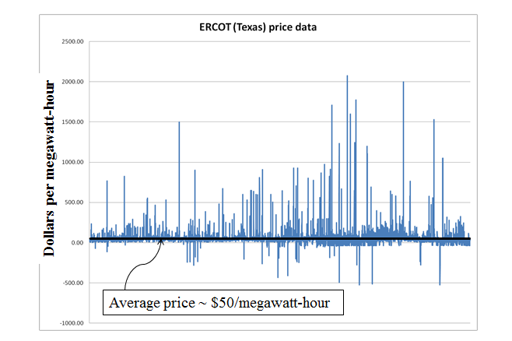
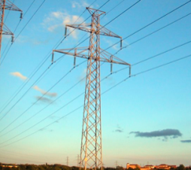
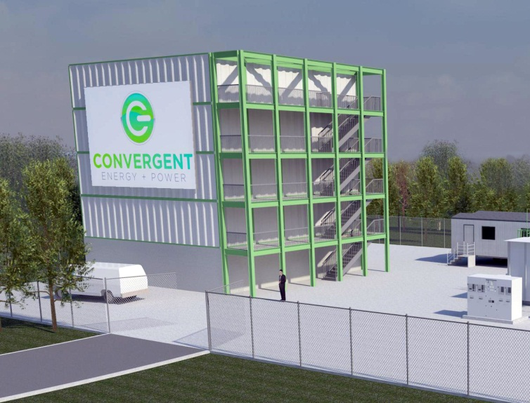
Energy storage example
Battery arbitrage – When to charge, when to discharge, given stochastic prices

Slide 25
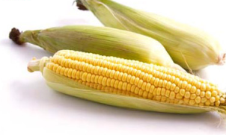
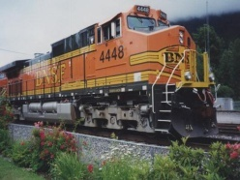
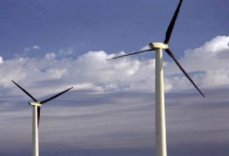
Elements of a dynamic model
The state variable:
Notes:
25

Slide 26
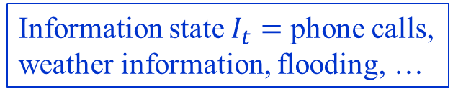
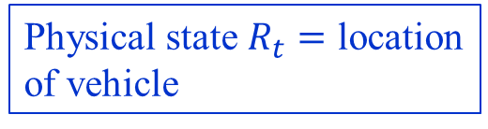
Emergency storm response
0.5
Information state $I_{t}=$ phone calls,
weather information, flooding, …
call
0.503
0.503
X
0.503
0.503
0.503
0.503
0.54
0.54
X
0.76
0.064
0.064
0.064
call
Physical state $R_{t}=$ location
of vehicle
0.064
call
0.603
0.603
0.05
X
0
0.02
0.04
0.502
0.502
0
0
0.03
0.04
0.05
0.502
0.502
0.502
0.05
0.67
X
0.67
call
0.26
0.38
0.78
0.6
0.6
X
X
call
call
call

Slide 27

Emergency storm response
0.5
Information state $I_{t}=$ phone calls,
weather information, flooding, …
call
0.503
0.503
X
0.503
0.503
0.503
0.503
Belief state $B_{t}=$ probability of outage
X
0.54
0.54
0.76
0.064
0.064
0.064
call
Physical state $R_{t}=$ location
of vehicle
0.064
call
0.603
0.603
0.05
X
0
0.02
0.04
0.502
0.502
0
0
0.03
0.04
0.05
0.502
0.502
0.502
0.05
0.67
X
0.67
call
0.26
0.38
0.78
0.6
0.6
X
X
call
call
call

Slide 28
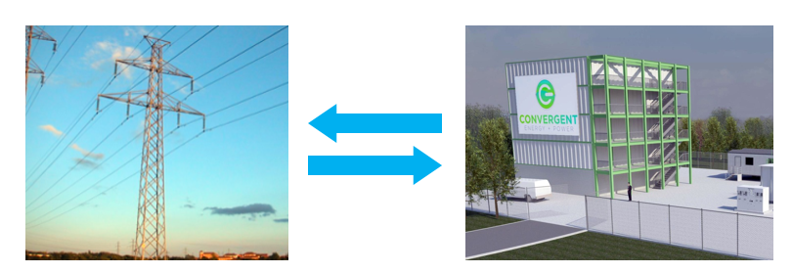

Energy storage example
State variables $S_{t}$
  $R_{t}=$Energy stored in the battery
  $D_{t}=$Current demand
  $p_{t}=$Current grid price
  State variable $S_{t}=(R_{t},{D_{t},p}_{t})$

Slide 29
Elements of a dynamic model
Decisions:
Notes:
29

Slide 30
Elements of a dynamic model
Styles of decisions
  Binary
  Finite
  Continuous scalar
  Continuous vector
  Discrete vector
  Categorical

Slide 31
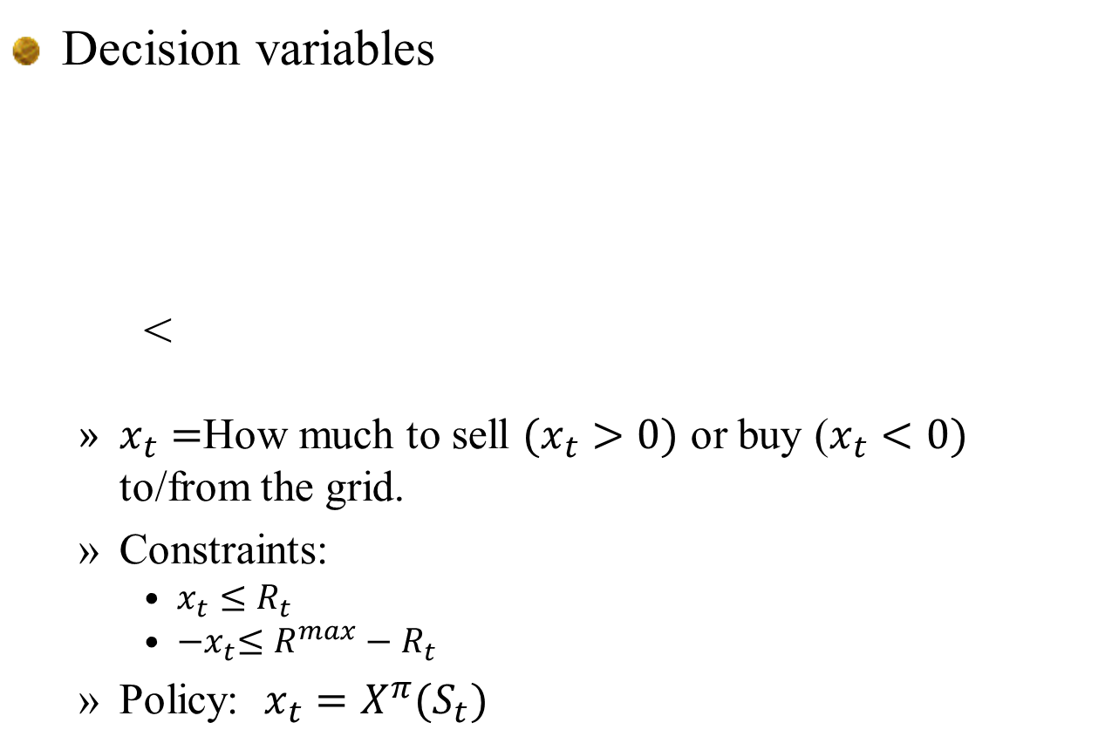
Energy storage example
Decision variables
<
  $x_{t}=$How much to sell $(x_{t}>0)$ or buy ($x_{t}<0)$ to/from the grid.
  Constraints:
    $x_{t}≤R_{t}$
    ${−x}_{t}≤R^{max}−R_{t}$
  Policy: ${x_{t}=X}^{π}(S_{t})$

Slide 32

Elements of a dynamic model
Exogenous information:
Note: Any variable indexed by t is known at time t. This convention, which is not standard in control theory, dramatically simplifies the modeling of information.
$W_{t+1}$ may be a function of the state $S_{t}$ and/or the action $x_{t}$, so we may write it as $W_{t+1}\left(S_{t}, x_{t}\right).$
Notes:
32

Slide 33

Energy storage example
Exogenous information
  $W_{t+1}=$
    ${\hat{p}}_{t+1}=$Change in the electricity price $p_{t}$ between $t$ and $t+1$.
    ${\hat{D}}_{t+1}=$Demand for energy between time $t$ and $t+1$

Slide 34
Modeling dynamic problems
The transition function
Also known as the:
“System model”
“State transition model”
“Plant model”
“Plant equation”
“Transition law”
“Transfer function”
“Transformation function”
“Law of motion”
“Model”
Notes:
34

Slide 35

Energy storage example
Transition function
  $R_{t+1}=R_{t}+ηx_{t}$
  $p_{t+1}=p_{t}+{\hat{p}}_{t+1}$
  $D_{t+1}={\hat{D}}_{t+1}$
For many problems, the transition function can be very complex (“500 lines of Matlab code”).

Slide 36

Elements of a dynamic model
Objective functions
  Cumulative reward (“online learning”)
    Policies have to work well over time.
  Final reward (“offline learning”)
    We only care about how well the final decision $x^{π,N}$ works.
  Risk
  Regret

Slide 37

Energy storage example
Objective function
  $C\left(S_{t},x_{t}\right)=p_{t}x_{t}$
  $\max_{π}{𝔼\left\{\sum_{t=0}^{T}{C(S_{t},X^{π}(S_{t}))}|S_{0}\right\}}$

Slide 38

Energy arbitrage
Our policy function might be the parametric model (this is nonlinear in the parameters):
Energy in storage:
Price of electricity:

Slide 39

Energy arbitrage
Objective function
  Now we do policy search is to find the best parameters $ρ:$
  $$\max_{ρ}{𝔼\left\{\sum_{t=0}^{T}{C(S_{t},X^{π}(S_{t}|ρ))}|S_{0}\right\}}$$

Slide 40

Elements of a dynamic model
The complete model:
  Objective function
    Cumulative reward (“online learning”)
    Final reward (“offline learning”)
    Risk:
  Transition function:
  Exogenous information:

Slide 41
Elements of a dynamic model
Deterministic
  Objective function
  Decision variables:
  Constraints:
    at time t
    Transition function
Stochastic
  Objective function
  Policy
  Constraints at time t
  Transition function
  Exogenous information

Slide 42



Modeling with uncertainty
Stochastic prices
Charge/discharge decisions

Slide 43


From deterministic to stochastic
Imagine that you would like to solve the time-dependent linear program:
To handle uncertainty, engineers will just take an expectation:
This makes no sense, because now $x_{t}$ is a random variable. Mathematicians fix this by adding:
  “Where $x_{t}$ is $F_{t}−$measurable”
  ...this means “searching over functions.”

Slide 44

From deterministic to stochastic
We fix the problem in a simple way.
  Change
  to
  The policy $X^{π}(S_{t})$ has to satisfy constraints at time $t$, while the dynamics are governed by the transition function:

Slide 45
Outline
Elements of a dynamic model
An energy storage illustration
Designing policies
Some observations
Policies for pure learning problems
Policies for state-dependent problems
Pulling it all together

Slide 46

An energy storage example
A more complex model

Slide 47

An energy storage problem
State variables
  We will present the full model, accumulating the information we need in the state variable.
  We will highlight information we need as we proceed. This information will make up our state variable.
D
E
B
G

Slide 48
An energy storage problem
Decision variables
  Constraints;
D
E
B
G

Slide 49
An energy storage problem
Exogenous information
D
E
B
G

Slide 50
An energy storage problem
Transition function
D
E
B
G

Slide 51
An energy storage problem
Objective function
D
E
B
G

Slide 52
An energy storage problem
State variables
  Cost function
  Decision function
    Constraints:
  Transition function

Slide 53
An energy storage example
A time series price model

Slide 54
An energy storage problem
Transition function
  ARIMA price model:
L
E
B
G

Slide 55
An energy storage problem
State variables
  Cost function
  Decision function
    Constraints:
  Transition function

Slide 56
An energy storage example
(Passive) learning the price process

Slide 57

An energy storage problem
Transition function
  ARIMA price model with learning:
L
E
B
G
Need to learn ${\overline{θ}}_{ti}$

Slide 58

Learning in stochastic optimization
Updating the demand parameter
  Let $p_{t+1}$ be the new price and let
  We update our estimate ${\overline{θ}}_{t}$ using our recursive least squares equations:

Slide 59


An energy storage problem
State variables
  Cost function
  Decision function
    Constraints:
  Transition function
Physical state variables
Other information $I_{t}$
Belief state $B_{t}$

Slide 60

An energy storage problem
Types of learning:
  No learning ($θ^{′}s$ are known)
  Passive learning (learn $θs$ from price data)
  Active learning (“bandit problems”)
  Modeling the active learning is the same as passive, but the choice of policy will change.

Slide 61


An energy storage problem
Learning a demand response function
Sampling to maximize revenue:
Sampling to learn demand response:

Slide 62
An energy storage example
Planning with rolling forecasts

Slide 63



Parametric cost function approximation
An energy storage problem:

Slide 64












Parametric cost function approximation
Forecasts evolve over time as new information arrives:
Rolling forecasts, updated each hour.
Forecast made at midnight:
Actual

Slide 65
An energy storage problem
Exogenous information
L
E
B
G

Slide 66
An energy storage problem
Transition function
L
E
B
G

Slide 67
An energy storage problem
State variables
  Cost function
  Decision function
    Constraints:
  Transition function
Endogenous
forecasting
Exogenous
forecasting

Slide 68
Outline
Elements of a dynamic model
An energy storage illustration
Designing policies
Some observations
Policies for pure learning problems
Policies for state-dependent problems
Pulling it all together

Slide 69
Designing policies
We have to start by describing what we mean by a policy.
  Definition:
  A policy is a mapping from a state to an action.
  … any mapping.
How do we search over an arbitrary space of policies?

Slide 70
Designing policies
“Policies” and the English language
Behavior | Formula | Principle
Belief | Habit | Procedure
Bias | Laws/bylaws | Process
Commandment | Manner | Protocols
Conduct | Method | Recipe
Control law | Mode | Ritual
Convention | Mores | Rule
Culture | Patterns | Style
Customs | Plans | Technique
Dogma | Policies | Tenet
Etiquette | Practice | Tradition
Fashion | Prejudice | Way of life

Slide 71
Designing policies
Two fundamental strategies:
  Policy search – Search over a class of functions for making decisions to optimize some metric.
  Lookahead approximations – Approximate the impact of a decision now on the future.

Slide 72
Designing policies
Policy search:
  1) Policy function approximations (PFAs)
    Lookup tables
      “when in this state, take this action”
    Parametric functions
      Order-up-to policies: if inventory is less than s, order up to S.
      Affine policies -
      Shallow neural networks
    Locally/semi/non parametric
      Kernel regression
      Deep neural networks
  2) Cost function approximations (CFAs)
    Optimizing a deterministic model modified to handle uncertainty (buffer stocks, schedule slack)

Slide 73
Designing policies
The ultimate lookahead policy is optimal

Slide 74
Designing policies
Lookahead approximations – Approximate the impact of a decision now on the future:
  An optimal policy (based on looking ahead):
  3) Approximating the value of being in a downstream state using machine learning (“value function approximations”)

Slide 75
Designing policies
Lookahead approximations – Approximate the impact of a decision now on the future:
  An optimal policy (based on looking ahead):
  3) Approximating the value of being in a downstream state using machine learning (“value function approximations”)

Slide 76
Designing policies
Lookahead approximations – Approximate the impact of a decision now on the future:
  An optimal policy (based on looking ahead):
  3) Approximating the value of being in a downstream state using machine learning (“value function approximations”)

Slide 77
Designing policies
Lookahead approximations – Approximate the impact of a decision now on the future:
  An optimal policy (based on looking ahead):
  3) Approximating the value of being in a downstream state using machine learning (“value function approximations”)

Slide 78
Designing policies
The ultimate lookahead policy is optimal
  4) Instead, we have to create an approximation called the lookahead model:
  A direct lookahead policy (DLA) works by solving the lookahead model:

Slide 79
Designing policies
1) Policy function approximations (PFAs)
  Lookup tables, rules, parametric/nonparametric functions
2) Cost function approximation (CFAs)
3) Policies based on value function approximations (VFAs)
4) Direct lookahead policies (DLAs)
  Deterministic lookahead/rolling horizon proc./model predictive control
  Chance constrained programming
  Stochastic lookahead /stochastic prog/Monte Carlo tree search
  “Robust optimization”
Policy search
Lookahead approximations

Slide 80

Available at jungle.princeton.edu

Slide 81
Designing policies
Notes:
  Policies in the “policy search class” are simpler, and as a result this is what you are most likely going to see (and use) in practice.
  “The price of simplicity is tunable parameters”
  Tuning is hard!

Slide 82
Outline
Elements of a dynamic model
An energy storage illustration
Designing policies
Some observations
Policies for pure learning problems
Policies for state-dependent problems
Pulling it all together

Slide 83
Modeling uncertainty

Slide 84
Modeling uncertainty
Classes of uncertainty (modelers perspective)
  Observational uncertainty
  Prognostic uncertainty (forecasting)
  Experimental noise/variability
  Transitional uncertainty
  Inferential uncertainty
  Model uncertainty
  Systematic exogenous uncertainty
  Control/implementation uncertainty
  Algorithmic noise
  Goal uncertainty
Modeling uncertainty in the context of stochastic optimization is a relatively untapped area of research.

Slide 85
From machine learning to policy search

Slide 86

From machine learning to policy search
Classes of machine learning problems in stochastic optimization
  1) Approximating the objective
  $\overline{F}(x|θ)≈𝔼F(x,W)$.
  2) Designing a policy $X^{π}\left(S | θ\right)$.
  3) A value function approximation
  ${{\overline{V}}_{t}(S_{t}|θ)≈V}_{t}(S_{t})$.
  4) Designing a cost function approximation:
    The objective function ${\overline{C}}^{π}\left(S_{t},x_{t}|θ\right)$.
    The constraints $X^{π}(S_{t}|θ)$
  5) Approximating the transition function
  ${\overline{S}}^{M}(S_{t},x_{t},W_{t+1}|θ)≈S^{M}(S_{t},x_{t},W_{t+1})$

Slide 87






From machine learning to policy search
From machine learning to sequential decisions
Machine learning
Policy search
$$\min_{θ}\frac{1}{N}\sum_{n=1}^{N}{{\left(y^{n}−f\left(x^{n} | θ\right)\right)}^{2}}$$
$$\max_{π}𝔼\sum_{t=0}^{T}{C(S_{t},X^{π}(S_{t}))}$$
$$\min_{f∈ℱ}{\min_{θ∈Θ^{f}}\frac{1}{N}\sum_{n=1}^{N}{{\left(y^{n}−f\left(x^{n} | θ\right)\right)}^{2}}}$$
$$\max_{f∈ℱ}{\max_{θ∈Θ^{f}}𝔼\sum_{t=0}^{T}{C(S_{t},X^{f}(S_{t}|θ))}}$$
PFAs
All four classes!
Contribution function
Big data!
Transition function: $S_{t+1}=S^{M}(S_{t},x_{t},W_{t+1})$
Exogenous information: $(S_{0},W_{1},W_{2},…,W_{T})$

Slide 88
Problem classes

Slide 89

Problem classes
State-independent problems
  The problem does not depend on the state of the system.
  The only state variable is what we know (or believe) about the unknown function , called the belief state $B_{t}$, so $S_{t}=B_{t}$.
State-dependent problems
  Now the problem may depend on what we know at time t:
  Now the state is $S_{t}=(R_{t},p_{t},B_{t})$

Slide 90

Problem classes
Offline (final reward)
  We can iteratively search for the best solution, but only care about the final answer.
  Asymptotic formulation:
  Finite horizon formulation:
Online (cumulative reward)
  We have to learn as we go
“ranking and selection”
or
“stochastic search”

Slide 91

Problem classes

Slide 92
Outline
Elements of a dynamic model
An energy storage illustration
Designing policies
Some observations
Policies for pure learning problems
Policies for state-dependent problems
Pulling it all together

Slide 93

Designing policies
Policy search:
  Policy function approximations (PFAs)
    We can try an excitation policy by adding noise:
Tunable parameter

Slide 94
Designing policies
Policy search:
  2) Cost function approximations (CFA)
  Upper confidence bounding
  Interval estimation
  Thompson sampling
$x^{n}=argmax_{x}{\hat{μ}}_{x}^{n}$ ${\hat{μ}}_{x}^{n}∼N{\left({\overline{μ}}_{x}^{n},{{(θ}^{TS}\overline{σ}}_{x}^{n}\right)}^{2})$

Slide 95


Designing policies
Tuning
  Interval estimation
Budget = 50
Budget = 250

Slide 96
Designing policies
Lookahead approximations –
  3) Policies using value function approximations (VFAs)
1
2
3
4
5
Current state of knowledge
New state of knowledge
Decision to make a measurement

Slide 97
Designing policies
Lookahead approximations –
  4) Direct lookaheads (DLAs) – We would like to solve:
  Instead, we have to create an approximation called the lookahead model:
  A direct lookahead policy (DLA) works by solving the lookahead model:

Slide 98
Designing policies
Test problem
  21 arms, with varying priors:
  … and varying measurement noise:
    Standard deviations range from 3 to 53.

Slide 99

Designing policies
The value of information given current beliefs:
Value of information
Budget (number of experiments)

Slide 100

Designing policies
Lookahead approximations
  4) Direct lookaheads
  One step lookahead
    Knowledge gradient
    Expected improvement
  Restricted multistep lookahead
    KG(*) – consider $θ$-step lookahead for one arm at a time.
  Deterministic lookahead
    Designed for small budgets and noisy measurements
  Full tree search
    MCTS?

Slide 101




Deterministic lookahead policy
Optimize allocations over all arms given current beliefs stepping backward over arms $a=M,…,1:$
  The optimal solution is an allocation $x_{1},…,x_{a},…, x_{A}$ over arms $a=1, …, M$. We assume we know the S-curves, so this is a deterministic DLA (Det-DLA).
Value of $R_{a}−x_{a}$ experiments
spread over arms $a+1, …, A$
Value of information
$$C(R_{a},x_{a})$$
$$x_{a}$$

Slide 102
Simulations
Policy performance
Regret

Slide 103
Simulations
Policy performance
Regret

Slide 104
Outline
Elements of a dynamic model
An energy storage illustration
Designing policies
Some observations
Policies for pure learning problems
Policies for state-dependent problems
Pulling it all together

Slide 105
Outline
Policies for state-dependent problems
  Policy function approximations (PFAs)
  Cost function approximations (CFAs)
  Value function approximations (VFAs)
  Direct lookahead policies (DLAs)
  Hybrid direct lookahead/CFA

Slide 106
Outline
Policies for state-dependent problems
  Policy function approximations (PFAs)
  Cost function approximations (CFAs)
  Value function approximations (VFAs)
  Direct lookahead policies (DLAs)
  Hybrid direct lookahead/CFA

Slide 107
PFAs for energy storage
A battery arbitrage problem

Slide 108
Policy function approximations
Battery arbitrage – When to charge, when to discharge, given volatile LMPs

Slide 109
Policy function approximations
Grid operators require that batteries bid charge and discharge prices, an hour in advance.
We have to search for the best values for the policy parameters

Slide 110
Policy function approximations
Our policy function might be the parametric model (this is nonlinear in the parameters):
Energy in storage:
Price of electricity:

Slide 111

Policy function approximations
Finding the best policy
  We need to maximize
  We cannot compute the expectation, so we run simulations:
Notes:
111

Slide 112

Policy function approximations
How do we search for the best $θ?$
  Derivative-based
    Use classical stochastic gradient methods:
    The gradient $∇_{θ}F{(θ}^{n},W^{n+1})$ may be computed analytically, but more often it is computed numerically.
  Derivative-free
    Build a belief model $\overline{F}\left(θ\right)≈𝔼F\left(θ,W\right)$ that approximates our function.
  Both of these approaches are sequential decision problems!

Slide 113
PFAs for energy storage
A more complex energy storage problem in Brazil

Slide 114

Policy function approximation
For our energy system:
  A possible PFA
L
E
R
G
Tunable parameters

Slide 115
Outline
Policies for state-dependent problems
  Policy function approximations (PFAs)
  Cost function approximations (CFAs)
  Value function approximations (VFAs)
  Direct lookahead policies (DLAs)
  Hybrid direct lookahead/CFA

Slide 116

Schneider National

Slide 117

Slide 117
Notes:
117
This is the dispatch room for Schneider National, one of the largest truckload motor carriers in the U.S.

Slide 118
Cost function approximations
Drivers
Demands
Notes:
… to tasks (loads, trains, flights).

Slide 119
Cost function approximations
t
t+1
t+2
The assignment of drivers to loads evolves over time, with new loads being called in, along with updates to the status of a driver.
Notes:
After we make a decision at time t, we then have to do it again at t+1 and t+2

Slide 120
Cost function approximations
A purely myopic policy would solve this problem using
  where
  What if a load it not assigned to any driver, and has been delayed for a while? This model ignores the fact that we eventually have to assign someone to the load.

Slide 121
Cost function approximations
We can minimize delayed loads by solving a modified objective function:
  where
  We refer to our modified objective function as a cost function approximation.

Slide 122
Cost function approximations
We now have to tune our policy, which we define as:
  We can now optimize , another form of policy search, by solving

Slide 123

Cost function approximations
Inventory management
  How much product should I order to anticipate future demands?
  Need to accommodate different sources of uncertainty.
    Market behavior
    Transit times
    Supplier uncertainty
    Product quality

Slide 124
Cost function approximations
Imagine that we want to purchase parts from different suppliers. Let be the amount of product we purchase at time t from supplier p to meet forecasted demand . We would solve
  This assumes our demand forecast is accurate.
Slide 124

Slide 125
Cost function approximations
Imagine that we want to purchase parts from different suppliers. Let be the amount of product we purchase at time t from supplier p to meet forecasted demand . We would solve
  This is a “parametric cost function approximation”
Reserve
Buffer stock
Slide 125

Slide 126
Cost function approximations
An even more general CFA model:
  Define our policy:
  subject to
  We tune by optimizing:
Parametrically
modified costs
Parametrically
modified constraints
Slide 126

Slide 127
Cost function approximations
Other applications
  Airlines optimizing schedules with schedule slack to handle weather uncertainty.
  Manufacturers using buffer stocks to hedge against production delays and quality problems.
  Grid operators scheduling extra generation capacity in case of outages.
  Adding time to a trip planned by Google maps to account for uncertain congestion.

Slide 128
Outline
Policies for state-dependent problems
  Policy function approximations (PFAs)
  Cost function approximations (CFAs)
  Value function approximations (VFAs)
  Direct lookahead policies (DLAs)
  Hybrid direct lookahead/CFA

Slide 129

Q-learning
Mouse in a maze problem
Receive reward = 1

Slide 130

Q-learning
Basic Q-learning algorithm
  Basic update:
  where
  Given a state $s^{n}$ and action $a^{n}$, we simulate our way to state $s′$.
  Need to determine:
    State sampling process/policy
    Action sampling policy

Slide 131

Q-learning
AlphaGo - XXX
  Much more complex state space.
  Uses hybrid of policies:
    PFA
    VFA
    Lookahead (DLA)

Slide 132

Grid level storage
Imagine 25 large storage devices spread around the PJM grid:
Slide 132
Notes:
132
This slide is animated to show how we are graphically depicting the hourly dispatch problem. Transition to next slide.

Slide 133
Grid level storage
Imagine 25 large storage devices spread around the PJM grid:
Slide 133
Notes:
133
This slide is animated to show how we are graphically depicting the hourly dispatch problem. Transition to next slide.

Slide 134
Value function approximations
Notes:
134
This slide is animated to show how we are graphically depicting the hourly dispatch problem. Transition to next slide.

Slide 135
Value function approximations
Monday
Time
:05
:10
:15
:20
Notes:
135
This slide and next illustrate how we solve this for every hour, in sequence, so we also properly handle storage.

Slide 136
Value function approximations
Monday
Time
:05
:10
:15
:20
Notes:
136
This slide and next illustrate how we solve this for every hour, in sequence, so we also properly handle storage.

Slide 137
Value function approximations
Monday
Time
:05
:10
:15
:20
Notes:
137
This slide and next illustrate how we solve this for every hour, in sequence, so we also properly handle storage.

Slide 138
Exploiting concavity
Derivatives are used to estimate a piecewise linear approximation

Slide 139
Approximate dynamic programming
Objective function
Iterations
With luck, your objective function improves

Slide 140

Grid level storage
Congested grid:
  Green and blue circles indicate energy storage

Slide 141

SMART-Solar
Congested grid:
  Green and blue circles indicate energy storage

Slide 142
Outline
Policies for state-dependent problems
  Policy function approximations (PFAs)
  Cost function approximations (CFAs)
  Value function approximations (VFAs)
  Direct lookahead policies (DLAs)
  Hybrid direct lookahead/CFA

Slide 143
General principles

Slide 144



Lookahead policies
Planning your next chess move:
  You put your finger on the piece while you think about moves into the future. This is a lookahead policy, illustrated for a problem with discrete actions.

Slide 145


Slide 146

Lookahead policies
Decision trees:

Slide 147
Lookahead policies
Modeling lookahead policies
  Lookahead policies solve a lookahead model, which is an approximation of the future.
  It is important to understand the difference between the:
    Base model – this is the model we are trying to solve by finding the best policy.
    The lookahead model, which is our approximation of the future using what we know now to help us make better decisions.
  The base model is typically a simulator, or it might be the real world.

Slide 148

Lookahead policies
Lookahead models
  Use tilde variables with double time indices.
The lookahead model
. . . .

Slide 149
Lookahead policies
Lookahead models use six classes of approximations:
  Horizon truncation – Replacing a longer horizon problem with a shorter horizon
  Stage aggregation – Replacing multistage problems with two-stage approximation.
  Outcome aggregation/sampling – Simplifying the exogenous information process
  Discretization – Of time, states and decisions
  Policy restriction – Use a simplified policy in the lookahead
  Dimensionality reduction – We may ignore some variables (such as forecasts) in the lookahead model that we capture in the base model (these become latent variables in the lookahead model).
Slide 149

Slide 150

Lookahead policies
Latent variables
The lookahead state variable
Common simplifications in lookahead models:
  Ignore the updating of estimates of parameters ${\tilde{θ}}_{tt′}={\overline{θ}}_{t}$
  Ignore the adaptive updating of forecasts ${\tilde{f}}_{tt′}^{D}=f_{t}^{D}$
Now our lookahead state variable is

Slide 151
Lookahead policies
We can use this notation to create a policy based on our lookahead model:
Limited horizon
Restricted/simplified set of policies
Sampled set of realizations (or deterministic);
Aggregated staging of decisions and information
Simplified/discretized set of state variables
Simplified/discretized set of decision variables

Slide 152
Inventory ordering problem

Slide 153

Supply chain mgmt. for Pratt & Whitney
Designing policies:
  Policy function approximation
    “(s,S)” inventory policy - $R_{t}$=inventory
    Easy to understand, easy to compute …
    … but ignores incoming flows, future events (e.g. shutdowns)
  What if we want a policy that looks into the future?
Slide 153

Slide 154

Supply chain mgmt. for Pratt & Whitney
A stochastic lookahead policy
  The optimal policy
  We replace the full lookahead with an approximation
  We can replace the expectations with Monte Carlo samples
  Real challenge is designing the “policy within a policy” which can be any of our four classes of policies.
$$X_{t}^{DLA}(S_{t})={argmax}_{x_{t}}\left(C(S_{t},x_{t})+\tilde{𝔼}\left\{\max_{\tilde{π}∈\tilde{Π}}\left\{\tilde{𝔼}\sum_{t′=t+1}^{t+H}{C({\tilde{S}}_{tt′},{\tilde{X}}_{tt′}^{π}({\tilde{S}}_{tt′}))}|{\tilde{S}}_{t,t+1}\right\}|S_{t},x_{t}\right\}\right)$$
Slide 154

Slide 155

Supply chain mgmt. for Pratt & Whitney
Methods for solving the lookahead:
  Deterministic lookahead
    Optimize over a horizon $\left(t,…,t+H\right)$
    This can be a moderately difficult integer program for problems with long horizons
    Ignores significant uncertainties
  Two-stage stochastic programming
    Very hard to solve two-stage stochastic integer programs.
  Parameterized policies
    For our supply chain problem, we could use an (s,S) policy in the lookahead.
    This means running the basic (s,S) simulator for each possible decision $x_{t}$ at time $t$.
    We can also use rules that act on the results of the simulation.
Slide 155

Slide 156




Supply chain mgmt. for Pratt & Whitney
To design a stochastic lookahead policy, we have to find a policy within our lookahead policy:
Alternatively we can use a parameterized approximation ${\tilde{X}}^{\tilde{π}}\left({\tilde{S}}_{tt^{′}} | \tilde{θ}\right).$ This means solving
This requires finding ${\tilde{θ}}_{t}({\tilde{S}}_{t,t+1})$ (!!) So, we replace it with a fixed parameter $θ$ and then solve the parameterized policy:
We are still left with a policy search problem.
$$X_{t}^{DLA}(S_{t})={argmax}_{x_{t}}\left(C(S_{t},x_{t})+\tilde{𝔼}\left\{\max_{\tilde{π}∈\tilde{Π}}\left\{\tilde{𝔼}\sum_{t′=t+1}^{t+H}{C({\tilde{S}}_{tt′},{\tilde{X}}_{tt′}^{π}({\tilde{S}}_{tt′}))}|{\tilde{S}}_{t,t+1}\right\}|S_{t},x_{t}\right\}\right)$$
$$X_{t}^{DLA}(S_{t})={argmax}_{x_{t}}\left(C(S_{t},x_{t})+\tilde{𝔼}\left\{\max_{{\tilde{θ}}_{t}}\left\{\tilde{𝔼}\sum_{t′=t+1}^{t+H}{C({\tilde{S}}_{tt′},{\tilde{X}}_{tt′}^{π}({\tilde{S}}_{tt′}|\tilde{θ}))}|{\tilde{S}}_{t,t+1}\right\}|S_{t},x_{t}\right\}\right)$$
$$X_{t}^{DLA}(S_{t}|θ)={argmax}_{x_{t}}\left(C(S_{t},x_{t})+\tilde{𝔼}\left\{\left\{\tilde{𝔼}\sum_{t′=t+1}^{t+H}{C({\tilde{S}}_{tt′},{\tilde{X}}_{tt′}^{π}({\tilde{S}}_{tt′}|θ))}|{\tilde{S}}_{t,t+1}\right\}|S_{t},x_{t}\right\}\right)$$
Slide 156

Slide 157




Supply chain mgmt. for Pratt & Whitney
Policies:
  Policy function approximation – $θ=(θ^{s},θ^{S})$ policy
  Stochastic lookahead
  So, our stochastic lookahead policy uses a simple $(θ^{s},θ^{S})$ order-up-to policy.
$$θ=(θ^{s},θ^{S})$$
$$X_{t}^{DLA}(S_{t}|θ)={argmax}_{x_{t}}\left(C(S_{t},x_{t})+\tilde{𝔼}\left\{\left\{\tilde{𝔼}\sum_{t′=t+1}^{t+H}{C({\tilde{S}}_{tt′},{\tilde{X}}_{tt′}^{π}({\tilde{S}}_{tt′}|θ))}|{\tilde{S}}_{t,t+1}\right\}|S_{t},x_{t}\right\}\right)$$
$θ$ $=(θ^{s},θ^{S})$
No max operator!
Slide 157

Slide 158














Supply chain mgmt. for Pratt & Whitney
Rollout policy
Order decision now
$$x_{t}$$
Future decisions from (s,S) policy
$$x_{t+1},x_{t+2},….,x_{t+H}$$
$$S$$
$$s$$
$$x_{t}=0$$
$$S$$
$$s$$
$$x_{t}=1$$
$$S$$
$$x_{t}=2$$
$$s$$
$$x_{t}=3$$
$$S$$
$$s$$
Pick the $x_{t}$ that performs the best (using one or more forward simulations)
Slide 158

Slide 159



Supply chain mgmt. for Pratt & Whitney
Rollout policy
$$x_{t}$$
$$W_{t+1}$$
$$x_{t+1},{W_{t+2,},x}_{t+2},W_{t+3},….,x_{t+H}$$
$$S$$
$$s$$
$$S$$
$$s$$
$$x_{t}=1$$
$$S$$
$$s$$
$$S$$
$$s$$
Pick the $x_{t}$ that performs the best (using one or more forward simulations)
Slide 159

Slide 160



Supply chain mgmt. for Pratt & Whitney
Rollout policy
$$x_{t}$$
$$W_{t+1}$$
$$x_{t+1},{W_{t+2,},x}_{t+2},W_{t+3},….,x_{t+H}$$
$$x_{t}=1$$
Pick the $x_{t}$ that performs the best (using one or more forward simulations)
Slide 160

Slide 161



Supply chain mgmt. for Pratt & Whitney
We simulate our $(θ^{s},θ^{S})$ policy for each decision now.
$$S$$
The lookahead model
$$s$$
. . . .
The base model
Slide 161

Slide 162


Supply chain mgmt. for Pratt & Whitney
We simulate our $(θ^{s},θ^{S})$ policy for each decision now.
$$S$$
The lookahead model
$$s$$
. . . .
The base model
Slide 162

Slide 163
Supply chain mgmt. for Pratt & Whitney
We simulate our $(θ^{s},θ^{S})$ policy for each decision now.
$$S$$
The lookahead model
$$s$$
. . . .
The base model
Slide 163

Slide 164


Supply chain mgmt. for Pratt & Whitney
We simulate our $(θ^{s},θ^{S})$ policy for each decision now.
$$S$$
The lookahead model
$$s$$
. . . .
The base model
Slide 164

Slide 165


Supply chain mgmt. for Pratt & Whitney
We simulate our $(θ^{s},θ^{S})$ policy for each decision now.
$$S$$
The lookahead model
$$s$$
. . . .
The base model
Slide 165

Slide 166
Outline
Policies for state-dependent problems
  Policy function approximations (PFAs)
  Cost function approximations (CFAs)
  Value function approximations (VFAs)
  Direct lookahead policies (DLAs)
  Hybrid direct lookahead/CFA

Slide 167
Hybrid direct lookahead/CFA
An energy storage problem:

Slide 168
Four (meta)classes of policies
1) Policy function approximations (PFAs)
  Lookup tables, rules, parametric/nonparametric functions
2) Cost function approximation (CFAs)
3) Policies based on value function approximations (VFAs)
4) Direct lookahead policies (DLAs)
  Deterministic lookahead/rolling horizon proc./model predictive control
  Chance constrained programming
  Stochastic lookahead /stochastic prog/Monte Carlo tree search
  “Robust optimization”
Policy search
Lookahead approximations

Slide 169


Hybrid direct lookahead/CFA
Benchmark policy – Deterministic lookahead
$$X^{DLA}(S_{t})=$$

Slide 170

Hybrid direct lookahead/CFA
Benchmark policy – Deterministic lookahead
$$X^{DLA}\left(S_{t} | θ\right)=$$

Slide 171
Hybrid direct lookahead/CFA
Parametric cost function approximations
  We can simulate the performance of a parameterized policy
  The challenge is to optimize the parameters:

Slide 172
Hybrid direct lookahead/CFA
Lookahead policies peek into the future
  Optimize over deterministic lookahead model
The lookahead model
. . . .
The real process

Slide 173

Hybrid direct lookahead/CFA
Lookahead policies peek into the future
  Optimize over deterministic lookahead model
The lookahead model
. . . .
The real process

Slide 174

Hybrid direct lookahead/CFA
Lookahead policies peek into the future
  Optimize over deterministic lookahead model
The lookahead model
. . . .
The real process

Slide 175

Hybrid direct lookahead/CFA
Lookahead policies peek into the future
  Optimize over deterministic lookahead model
The lookahead model
. . . .
The real process

Slide 176

Hybrid direct lookahead/CFA
One-dimensional contour plots – perfect forecast
0.0 0.2 0.4 0.6 0.8 1.0 1.2

Slide 177

Hybrid direct lookahead/CFA
One-dimensional contour plots-uncertain forecast
0.0 0.2 0.4 0.6 0.8 1.0 1.2

Slide 178


Hybrid direct lookahead/CFA
2-D contours for uncertain forecasts

Slide 179

Hybrid direct lookahead/CFA
Simultaneous perturbation stochastic approximation
  Let:
    $x^{n}$ be a $p−$ dimensional vector.
    $δ^{n}$ be a scalar perturbation
    $Z^{n}$ be a $p−$dimensional vector, with each element drawn from a normal (0,1) distribution.
  We can obtain a sampled estimate of the gradient $∇_{x}F(x^{n},W^{n+1})$ using two function evaluations: $F\left(x^{n}+δ^{n}Z^{n}\right)$ and $F\left(x^{n}−δ^{n}Z^{n}\right)$

Slide 180

Hybrid direct lookahead/CFA
Algorithmic issues:
  Stepsize rules
    We use a standard gradient-based method:
    $${x^{n+1}=x}^{n}+α∇_{x}F\left(x^{n}{,W}^{n+1}\right)$$
    We face the usual challenge of choosing stepsize rules (we used RMSProp), and tuning the parameter(s) in the stepsize rule (this is an optimization problem within the optimization problem).
  We use “mini-batches” to reduce the noise when evaluating the function in SPSA.
  We also used gradient smoothing:
    $${\overline{g}}^{n+1}=\left(1−η\right){\overline{g}}^{n}+η∇_{x}F(x^{n},W^{n+1})$$
    $${x^{n+1}=x}^{n}+α_{n}{\overline{g}}^{n}$$

Slide 181




Hybrid direct lookahead/CFA
Tuning the parameters
  Stepsizes tuned for region [0,2].
$$θ_{i}=1$$
$$θ_{i}∈[0,1]$$
$$θ_{i}∈[0.5,1.5]$$
$$θ_{i}∈[1,2]$$

Slide 182

Hybrid direct lookahead/CFA
Mini-batch = 20
Mini-batch = 1
Mini-batch
= 10
Mini-batch = 40
Number of function evaluations

Slide 183
Outline
Elements of a dynamic model
An energy storage illustration
Designing policies
Some observations
Policies for pure learning problems
Policies for state-dependent problems
Pulling it all together

Slide 184
An energy storage problem
Consider a basic energy storage problem:
  We are going to show that with minor variations in the characteristics of this problem, we can make each class of policy work best.

Slide 185
An energy storage problem
We can create distinct flavors of this problem:
  Problem class 1 – Best for PFAs
    Highly stochastic (heavy tailed) electricity prices
    Stationary data
  Problem class 2 – Best for CFAs
    Stochastic prices and wind (but not heavy tailed)
    Stationary data
  Problem class 3 - Best for VFAs
    Stochastic wind and prices (but not too random)
    Time varying loads, but inaccurate wind forecasts
  Problem class 4 – Best for deterministic lookaheads
    Relatively low noise problem with accurate forecasts
  Problem class 5 – A hybrid policy worked best here
    Stochastic prices and wind, nonstationary data, noisy forecasts.

Slide 186
An energy storage problem
The policies
  The PFA:
    Charge battery when price is below p1
    Discharge when price is above p2
  The CFA
    Optimize over a horizon H; maintain upper and lower bounds (u, l) for every time period except the first (note that this is a hybrid with a lookahead).
  The VFA
    Piecewise linear, concave value function in terms of energy, indexed by time.
  The DLA (with deterministic forecasts)
    Optimize over a horizon H (only tunable parameter) using forecasts of demand, prices and wind energy
  The lookahead CFA (with parameterized forecasts)
    Use a lookahead policy (deterministic), but with a tunable parameter that improves robustness.

Slide 187

An energy storage problem
Each policy is best on certain problems
  Results are percent of posterior optimal solution
  … any policy might be best depending on the data.
Joint research with Prof. Stephan Meisel, University of Muenster, Germany.

Slide 188
Stochastic
programming
Approximate
dynamic
programming
Robust
optimization
Decision
analysis
Simulation
optimization
Optimal
learning
Dynamic
Programming
and
control
Model
predictive
control
Stochastic
search
Optimal
control
Bandit
problems
Reinforcement
learning
Online
computation
Markov
decision
processes
Stochastic
control
Simulation
optimization
Notes:
Clearing the Jungle of Stochastic optimization – Professor Warren Powell in the Department of Operations Research and Financial Engineering has developed a unified framework for modeling virtually every problem involving optimization under uncertainty. More than just a purely theoretical characterization, he has identified four (meta)classes of policies which provide a clear path to computation (although there is still a lot of work to do for most problems). The framework has identified new problem classes, as well as novel computational strategies. For example, modeling and algorithmic strategies that have long been viewed as competitive (for example, dynamic programming versus stochastic programming) are actually complementary. By building on this integrated framework, we can spend less time focusing on optimizing (making decisions), and more time on an overlooked dimension of stochastic optimization, which is modeling uncertainty.

Slide 189

Stochastic search
Stochastic
programming
Derivative-based
Derivative-free
Simulation
optimization
Policy search
(PFAs)
Cost function
approx. (CFAs)
Value function
approx. (VFAs)
Multi-armed bandits
/optimal learning
Reinforcement
learning/ADP
Lookahead policies
(DLAs)
Markov decision
processes
Optimal control
© Warren Powell 2020
Notes:
As the screen animates, it starts by breaking “stochastic search” (the oldest of the communities) into the two core communities of derivative-based and derivative-free stochastic optimization (both dating to the 1950’s). Next I animate four boxes representing the four classes of policies (PFAs, CFAs, VFAs and DLAs).
I then rotate around the different communities doing different forms of stochastic optimization, first showing which of the four classes of policies which describes how the community started. But each community seems to eventually discover that the technique that started in the community does not solve all problems. When this happens, the community seems to evolve to embrace some or all of the four classes.
This evolution is illustrated above for each of the seven major communities working in some form of stochastic optimization. A nice illustration is reinforcement learning. The first edition of the seminal book “Reinforcement Learning” by Sutton and Barto, published in 1998, focused on value function approximations (Q-factors in their notation). The second edition, published in 2018, now includes examples of all four classes of policies (“policy gradient search”, upper confidence bounding, Q-learning, and Monte Carlo tree search).

Slide 190
Outline
Educational materials

Slide 191
Educational materials
More information is available at
  Jungle.princeton.edu
Scroll down to “Educational materials” to find:
  A 25 page article in EJOR
  Material for undergraduate course:
    Sequential decision analytics and modeling
  Material for graduate level course
    Reinforcement Learning and Stochastic Optimization

Slide 192
Educational materials
Undergraduate course: Sequential Decision Analytics and Modeling.
  There is an undergraduate level book that can be accessed at jungle.Princeton.edu or directly from:
    http://tinyurl.com/sequentialdecisionanalytics
  This uses a teach-by-example style.
  Prerequisite is an undergraduate course in probability and statistics (one chapter uses linear programming, but can be read without a course in linear programming)
  There is an undergraduate course with complete lecture notes in powerpoint at
    http://www.castlelab.princeton.edu/orf-411/

Slide 193

Can be accessed at jungle.princeton.edu

Slide 194


Slide 195
Sequential decision analytics
In addition:
  There is a link to a python library of exercises on github. There are 10 modules for 10 different chapters.
  Each chapter follows a specific modeling style. You may write your own chapters at
    http://tinyurl.com/sequentialdecisionanalyticspub
    All material is available at jungle.Princeton.edu

Slide 196
Sequential decision analytics
There is also a 700+ page graduate level book written entirely around the unified framework.
  The book can be downloaded from jungle.princeton.edu
  The prerequisite is also an undergraduate course in probability and statistics, but the presentation is much more methods driven.
  This is a work in progress. I hope to finish the book by fall, 2020.

Slide 197


Slide 198
Educational initiatives
I would like to work with schools to develop courses on sequential decision analytics:
  Sequential decision analytics and modeling
    Audience – Undergraduate/masters IE students
    Course will start from real-world problems, identify core elements (metrics, decisions, sources of uncertainty), which are then translated into the universal modeling framework. Students will design/tune policies, and then turn to implementation.
  Reinforcement learning and stochastic optimization
    Audience – Masters/Ph.D. from multiple departments.
    This course will focus on modeling and covering all the classes of policies in some depth, with emphasis on modeling and computation over theory.

Slide 199
Educational initiatives
Sequential decision analytics and modeling
  Focus: translating real-world decision problems into mathematical models using the unified framework. The course could span initial problem identification (identifying metrics, decisions, sources of uncertainty), model formulation, uncertainty identification and quantification, and policy design.
  Audience – Undergraduate IE students
  Prerequisite – Course in probability and statistics
  Programming – Python modules are provided. These can be run from a spreadsheet without doing any programming, or exercises can be designed that require most re-programming.

Slide 200
Educational initiatives
Reinforcement learning and stochastic optimization
  Focus: Emphasis on modeling a wide range of problems into the universal framework, and covering the four classes of policies (for both learning and state-dependent problems) in depth.
  Audience – MSE/Ph.D. students drawn from a wide range of departments.
  Prerequisite – Course in probability and statistics.
  Assignments – There are numerous exercises in the book, but I found it useful to let each student pick a topic at the beginning of the course. I then structured questions that could be answered in the context of this application.

Slide 201

Thank you!
More material is available at: jungle.princeton.edu
Please be sure you are on the signup list so I can send you followup information (link is at the top of jungle.Princeton.edu).
Look under “Educational materials“

