Slide 1
A Unified Framework for
Sequential Decision Analytics
Olin Business School
University of Washington, St. Louis
November 5-6, 2019
Warren B. Powell
Princeton University
Department of Operations Research
and Financial Engineering

Slide 2

Mixed learning/resource allocation problems

Slide 3
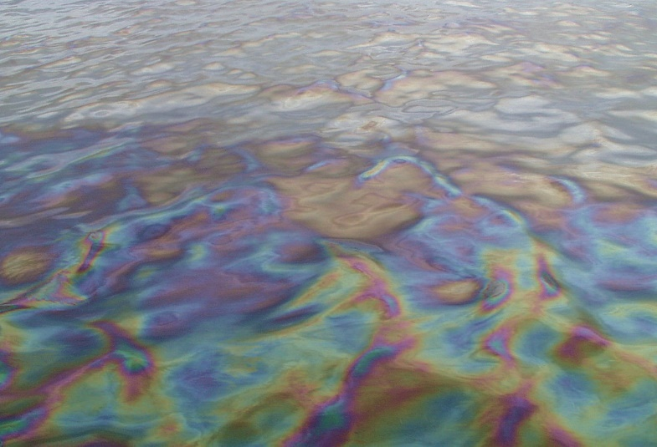
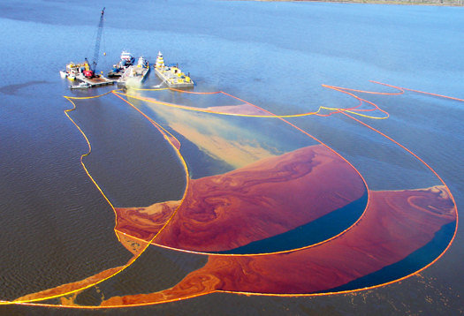
Mixed learning/resource allocation
Sensing
  Drones fly over the ocean to detect the presence of oil.
Communication
  Drones coordinate by sharing information.
Mitigation
  Information from drones can be used to guide surface vehicles performing cleanup.

Slide 4
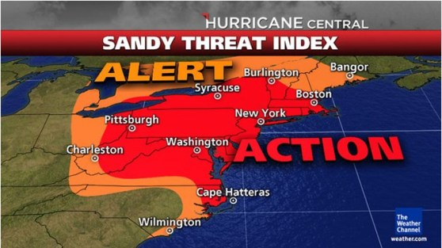
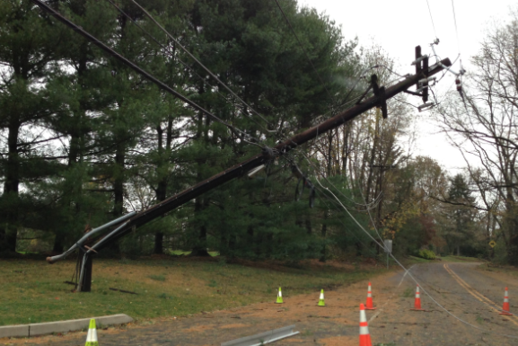
Mixed learning/resource allocation
Hurricane Sandy
  Once in 100 years?
  Rare convergence of events
  But, meteorologists did an amazing job of forecasting the storm.
The power grid
  Loss of power creates cascading failures (lack of fuel, inability to pump water)
  How to plan?
  How to react?

Slide 5
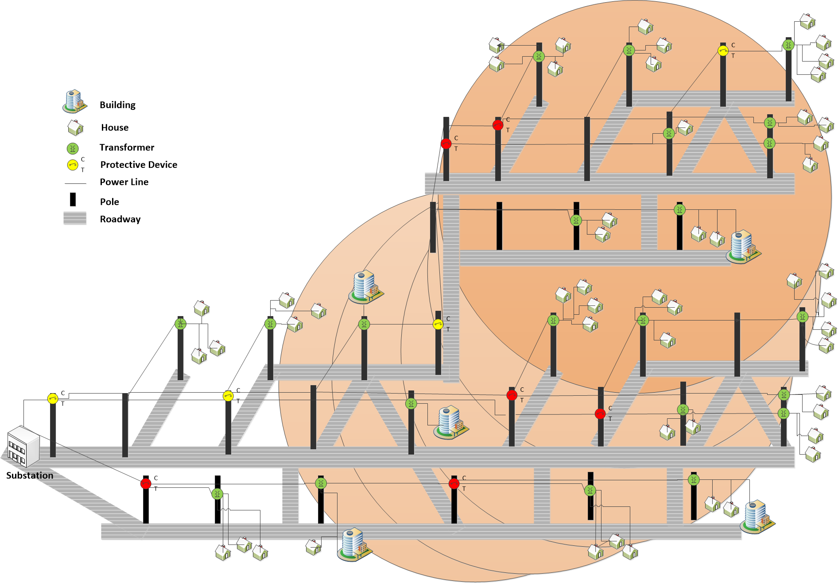
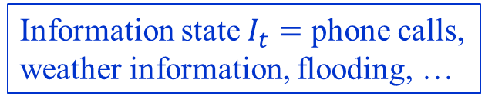
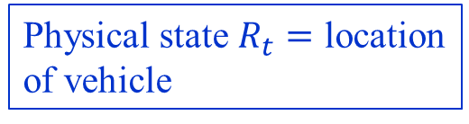
Mixed learning/resource allocation
0.5
Information state $I_{t}=$ phone calls,
weather information, flooding, …
call
0.503
0.503
X
0.503
0.503
0.503
0.503
0.54
0.54
X
0.76
0.064
0.064
0.064
call
Physical state $R_{t}=$ location
of vehicle
0.064
call
0.603
0.603
0.05
X
0
0.02
0.04
0.502
0.502
0
0
0.03
0.04
0.05
0.502
0.502
0.502
0.05
0.67
X
0.67
call
0.26
0.38
0.78
0.6
0.6
X
X
call
call
call
Slide 5

Slide 6

Mixed learning/resource allocation
0.5
Information state $I_{t}=$ phone calls,
weather information, flooding, …
call
0.503
0.503
X
0.503
0.503
0.503
0.503
Belief state $B_{t}=$ probability of outage
X
0.54
0.54
0.76
0.064
0.064
0.064
call
Physical state $R_{t}=$ location
of vehicle
0.064
call
0.603
0.603
0.05
X
0
0.02
0.04
0.502
0.502
0
0
0.03
0.04
0.05
0.502
0.502
0.502
0.05
0.67
X
0.67
call
0.26
0.38
0.78
0.6
0.6
X
X
call
call
call
Slide 6

Slide 7
Mixed learning/resource allocation
The ultimate lookahead policy is optimal
  Instead, we have to create an approximation called the lookahead model:
  A lookahead policy works by solving the lookahead model:
Slide 7

Slide 8
Mixed learning/resource allocation
To design a stochastic lookahead policy, we have to find a policy within our lookahead policy:
  For active learning problems, we need a stochastic lookahead to capture that if the truck traverses a link, it might see a tree down.
  This means that to find a policy for our stochastic optimization problem, we have to solve a stochastic optimization problem.
  We used Monte Carlo tree search, but this is an umbrella for a wide range of methods.
  If we choose, we can create a lookahead model that ignores active learning.
We are still left with a policy search problem.
Slide 8

Slide 9
Decision Outcome Decision Outcome Decision
Slide 9

Slide 10
Mixed learning/resource allocation
Monte Carlo tree search:
Selection
Expansion
Simulation
Backpropagation
Action selection
Sampling
Tree policy
Rollout
policy
(a) (b) (c) (d)
C. Browne, E. Powley, D. Whitehouse, S. Lucas, P. I. Cowling, P. Rohlfshagen, S. Tavener, D. Perez, S. Samothrakis and S. Colton, “A survey of Monte Carlo tree search methods,” IEEE Transactions on Computational Intelligence and AI in Games, vol. 4, no. 1, pp. 1–49, March 2012.
Slide 10

Slide 11
Mixed learning/resource allocation
Advantages of MCTS
  Insensitive to complex state variables
  No problem handling high dimensional belief states.
Disadvantages
  Computationally expensive
  Updating of belief states within MCTS tree can, in particular, be expensive.
  Classical MCTS cannot handle large action spaces (e.g. vector-valued decisions)
  MCTS also struggles with longer horizons
Slide 11

Slide 12
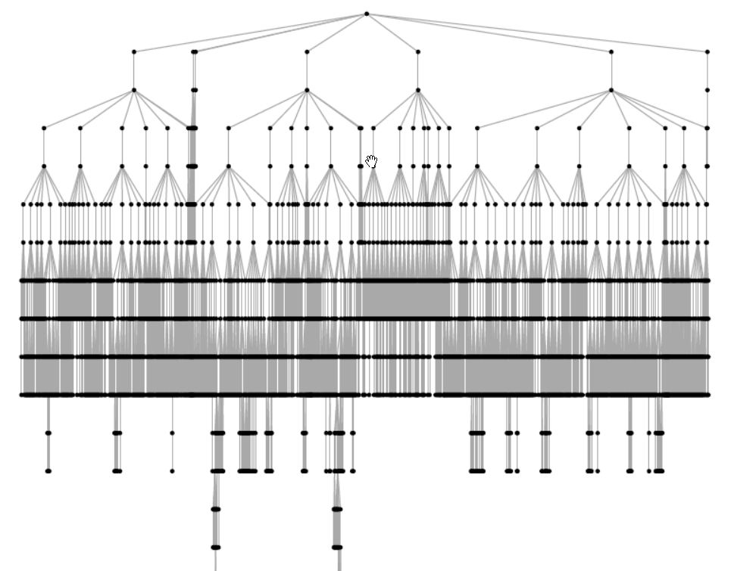
Slide 12

Slide 13
Mixed learning/resource allocation
We can then simulate this lookahead policy over time:
The lookahead model
. . . .
The base model
Slide 13

Slide 14
Mixed learning/resource allocation
We can then simulate this lookahead policy over time:
The lookahead model
. . . .
The base model
Slide 14

Slide 15
Mixed learning/resource allocation
We can then simulate this lookahead policy over time:
The lookahead model
. . . .
The base model
Slide 15

Slide 16
Mixed learning/resource allocation
We can then simulate this lookahead policy over time:
The lookahead model
. . . .
The base model
Slide 16

Slide 17
Mixed learning/resource allocation
0.5
Information state $I_{t}=$ phone calls,
weather information, flooding, …
call
0.503
0.503
X
0.503
0.503
0.503
0.503
Belief state $B_{t}=$ probability of outage
X
0.54
0.54
0.76
0.064
0.064
0.064
call
Physical state $R_{t}=$ location
of vehicle
0.064
call
0.603
0.603
0.05
X
0
0.02
0.04
0.502
0.502
0
0
0.03
0.04
0.05
0.502
0.502
0.502
0.05
0.67
X
0.67
call
0.26
0.38
0.78
0.6
0.6
X
X
call
call
call
Slide 17

Slide 18
Mixed learning/resource allocation
0.5
call
0.503
0.503
X
0.503
0.503
0.503
0.503
0.54
0.54
X
0.76
0.0604
0.0604
0.0604
call
0.0604
call
0.62
0.62
0.08
X
0
0.056
0.51
0.51
0.032
0
0
0.048
0.056
0.08
0.51
0.51
0
0.08
0.99
X
0
call
0.0
0.0
0.0
0.0
0.0
X
X
call
call
call
Slide 18

Slide 19
Mixed learning/resource allocation
0.5
call
0.503
0.503
X
0.503
0.503
0.503
0.503
0.54
0.54
X
0.76
0.06
0.06
0.06
call
0.06
call
0
0
0.0
X
0
0.0
0
0
0.0
0
0
0.0
0.0
0.0
0
0
0
0.0
0
X
0
call
0.0
0.0
0.0
0.0
0.0
X
X
call
call
call
Slide 19

Slide 20
Mixed learning/resource allocation
1 percent call-in
10 percent call-in
100 percent call-in
Perfect information:
Lookahead budget
Slide 20

Slide 21
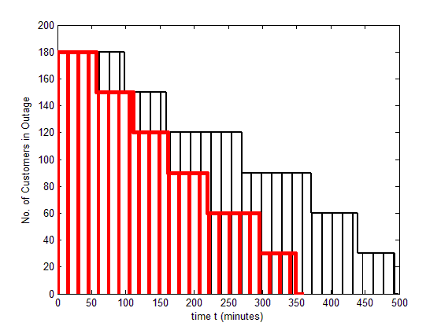
Mixed learning/resource allocation
Comparison to industrial “escalation heuristic”:
Escalation algorithm
55110
Lookahead policy
36150
Slide 21

Slide 22
Mixed learning/resource allocation
MCTS enjoys the property of asymptotic optimality, but there are two ways of achieving this:
  Pessimistic MCTS – this is the standard strategy of using a heuristic to approximate the downstream value of states.
    Involves testing every action.
  Optimistic MCTS (Jiang, al-Kanj and Powell, 2019) – Use a sampled future, then optimize over the future to obtain an optimistic estimate (this is a form of information relaxation).
    No longer requires testing every action, but …
    Computationally more expensive per iteration.
Slide 22

Slide 23
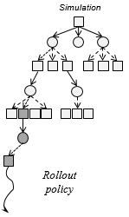

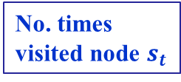
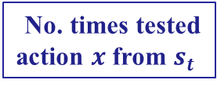
Mixed learning/resource allocation
Pessimistic MCTS
  The bonus term forces exploration of every action infinitely often.
  This can be problematic if the number of actions is large.
No. times
visited node $s_{t}$
Downstream value
No. times tested
action $x$ from $s_{t}$
Slide 23

Slide 24
Mixed learning/resource allocation
From pessimistic to optimistic MCTS
Pessimistic MCTS
Optimistic MCTS
Deterministic
math
program
Slide 24

Slide 25
Mixed learning/resource allocation
Features
  No longer requires that we visit every action infinitely often.
  This means that it can scale to vector-valued decision variables! (This is a first for MCTS)
Limitations
  Solving the lookahead steps is much more expensive.
  Value of optimistic over pessimistic MCTS depends on the number of actions per node, and the performance of the rollout policy for pessimistic MCTS (this might be quite good!).
Slide 25

Slide 26
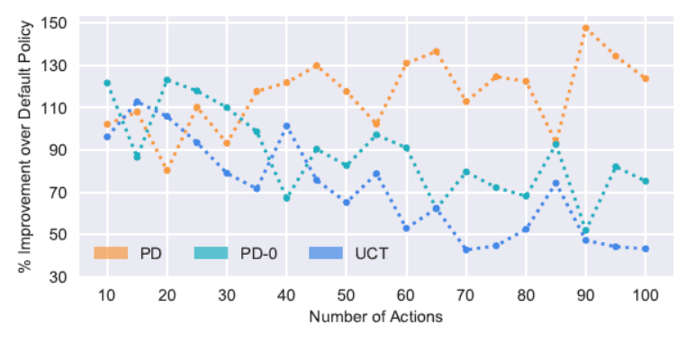
Mixed learning/resource allocation
MCTS vs number of actions
  Optimistic MCTS with and without dual optimization
  Pessimistic MCTS
Optimistic MCTS with dual optimization
Optimistic MCTS without dual optimization
Pct. Improvement over default policy
Pessimistic MCTS
Average number of actions per node
Slide 26

Slide 27
Mixed learning/resource allocation
Other examples:
  Budget constrained bidding for ad-clicks
    Optimize ad-clicks within a budget constraint
  Clinical trials
    Optimize decisions of stop and cancel, stop and go to market, or continue while learning the efficacy of a drug within the budget.
  Laboratory experiments with machine setups
    Determine what experiment to run next, but equipment setups and inventory mean that the time/cost of an experiment depends on the previous experiment.
  For each case, modeling framework, and four classes of policies, are the same. However, the conditions may impact the choice of the best policy.
Slide 27

