Slide 1
A Unified Framework for
Sequential Decision Analytics
Olin Business School
University of Washington, St. Louis
November 5-6, 2019
Warren B. Powell
Princeton University
Department of Operations Research
and Financial Engineering

Slide 2

Policy search

Slide 3

Modeling the policy search problem

Slide 4
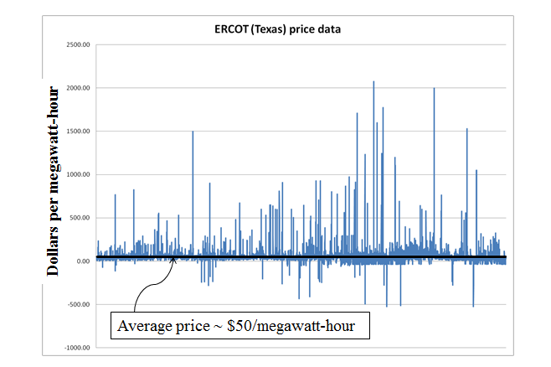

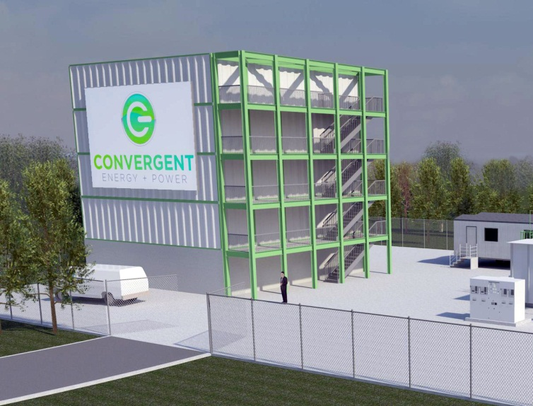
Policy search
Battery arbitrage – When to charge, when to discharge, given volatile LMPs

Slide 5
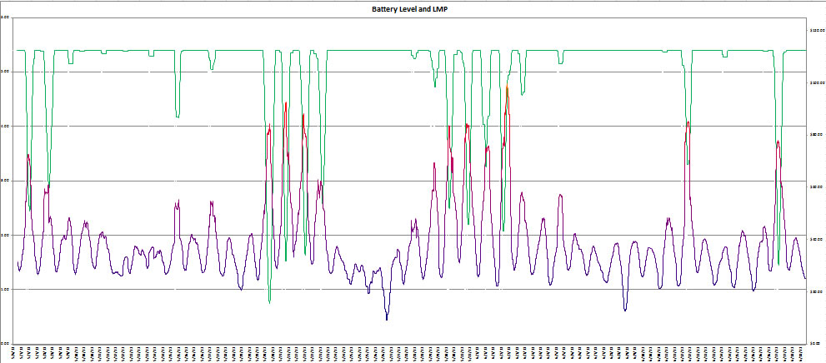
Policy function approximations
Our policy function might be the parametric model (this is nonlinear in the parameters):
Energy in storage:
Price of electricity:

Slide 6
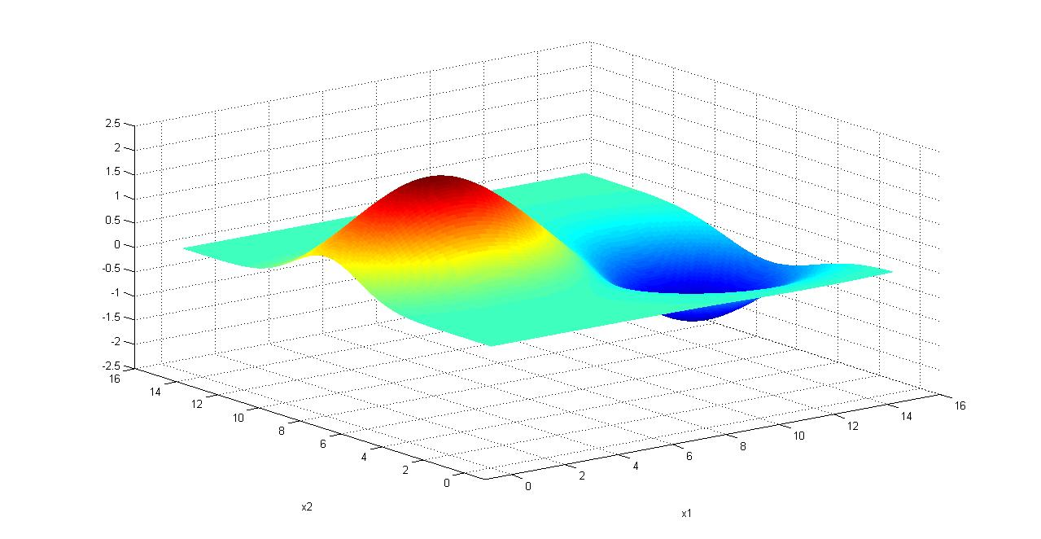
Policy function approximations
Finding the best policy
  We need to maximize
  We cannot compute the expectation, so we run simulations:
Notes:
6

Slide 7
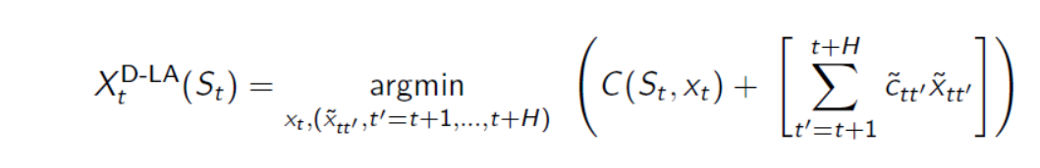


Policy search
Our deterministic lookahead was parameterized by $θ$
$$X^{DLA}\left(S_{t} | θ\right)=$$
Slide 7

Slide 8
Policy search
There are two ways of evaluating a policy:
  In a simulator
    This is what we depend on when doing research into policy search methods.
    Good simulators can be hard to build, but can be important investments.
    Simulators always require some level of modeling approximations.
  In the field
    In most real-world applications, people will build a process for making decisions (a “policy”) which is implemented without testing in a simulator.
    Tuning in the field requires living with the results of experiments. This means maximizing cumulative rewards (the standard objective for multiarmed bandit problems).

Slide 9
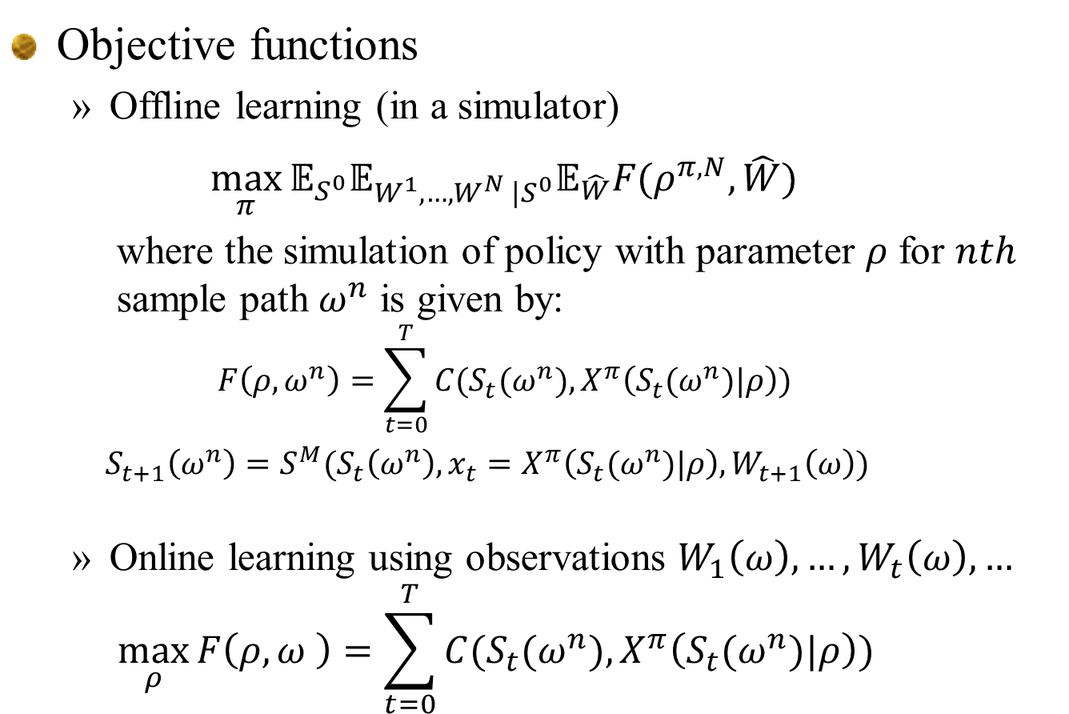
Policy search
Objective functions
  Offline learning (in a simulator)
  $$\max_{π}{𝔼_{S^{0}}𝔼_{W^{1},…,W^{N} |S^{0}}𝔼_{\hat{W}}F(ρ^{π,N},\hat{W})}$$
  where the simulation of policy with parameter $ρ$ for $nth$ sample path $ω^{n}$ is given by:
  $$F\left(ρ,ω^{n}\right)=\sum_{t=0}^{T}{C(S_{t}(ω^{n}),X^{π}\left(S_{t}(ω^{n})|ρ\right))}$$
  $S_{t+1}\left(ω^{n}\right)=S^{M}(S_{t}\left(ω^{n}\right),x_{t}=X^{π}\left(S_{t}(ω^{n})|ρ\right),W_{t+1}\left(ω\right))$
  Online learning using observations $W_{1}\left(ω\right), …, W_{t}\left(ω\right), …$
  $$\max_{ρ}{F\left(ρ,ω \right)=\sum_{t=0}^{T}{C(S_{t}(ω^{n}),X^{π}\left(S_{t}(ω^{n})|ρ\right))} }$$
Slide 9

Slide 10
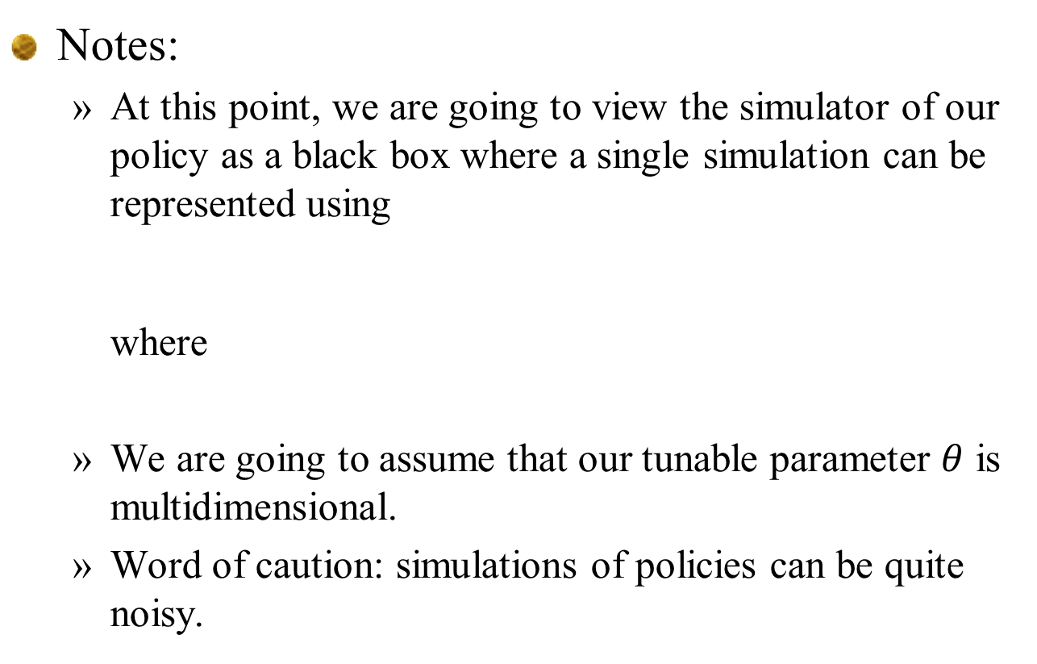
Policy search
Notes:
  At this point, we are going to view the simulator of our policy as a black box where a single simulation can be represented using
  where
  We are going to assume that our tunable parameter $θ$ is multidimensional.
  Word of caution: simulations of policies can be quite noisy.
Slide 10

Slide 11
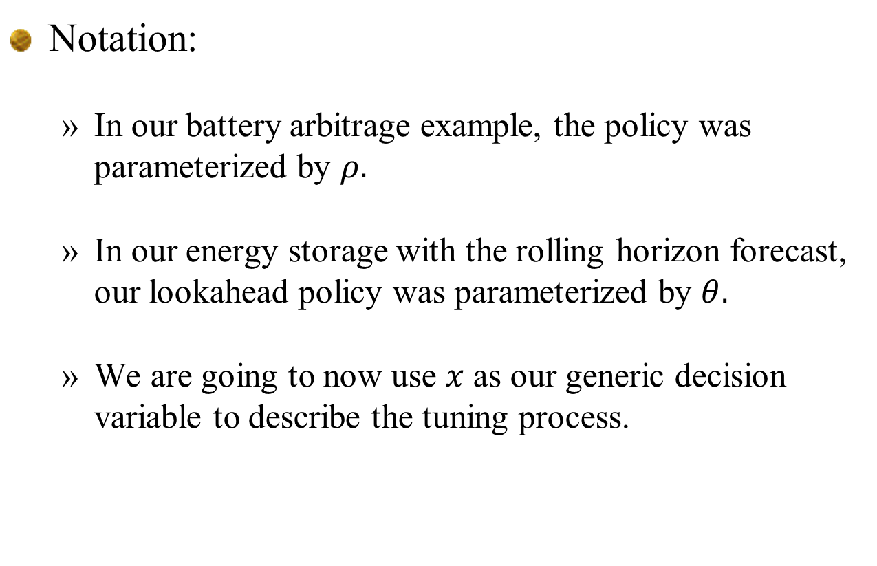
Policy search
Notation:
  In our battery arbitrage example, the policy was parameterized by $ρ.$
  In our energy storage with the rolling horizon forecast, our lookahead policy was parameterized by $θ.$
  We are going to now use $x$ as our generic decision variable to describe the tuning process.

Slide 12
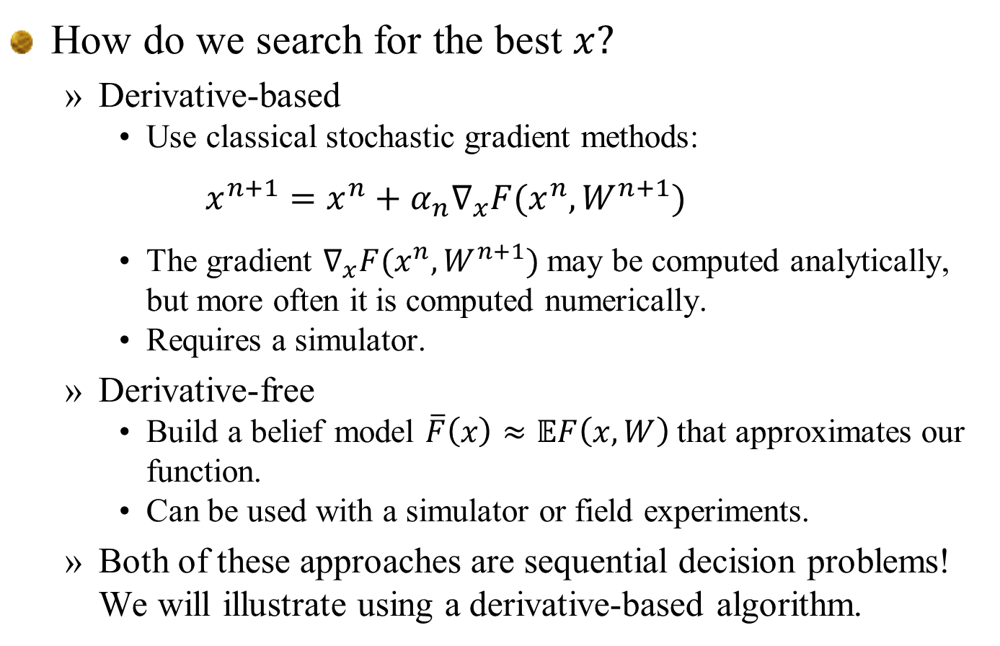
Policy function approximations
How do we search for the best $x?$
  Derivative-based
    Use classical stochastic gradient methods:
    $$x^{n+1}=x^{n}+α_{n}∇_{x}F(x^{n},W^{n+1})$$
    The gradient $∇_{x}F{(x}^{n},W^{n+1})$ may be computed analytically, but more often it is computed numerically.
    Requires a simulator.
  Derivative-free
    Build a belief model $\overline{F}\left(x\right)≈𝔼F\left(x,W\right)$ that approximates our function.
    Can be used with a simulator or field experiments.
  Both of these approaches are sequential decision problems! We will illustrate using a derivative-based algorithm.
Slide 12

Slide 13
Derivative-based stochastic search

Slide 14
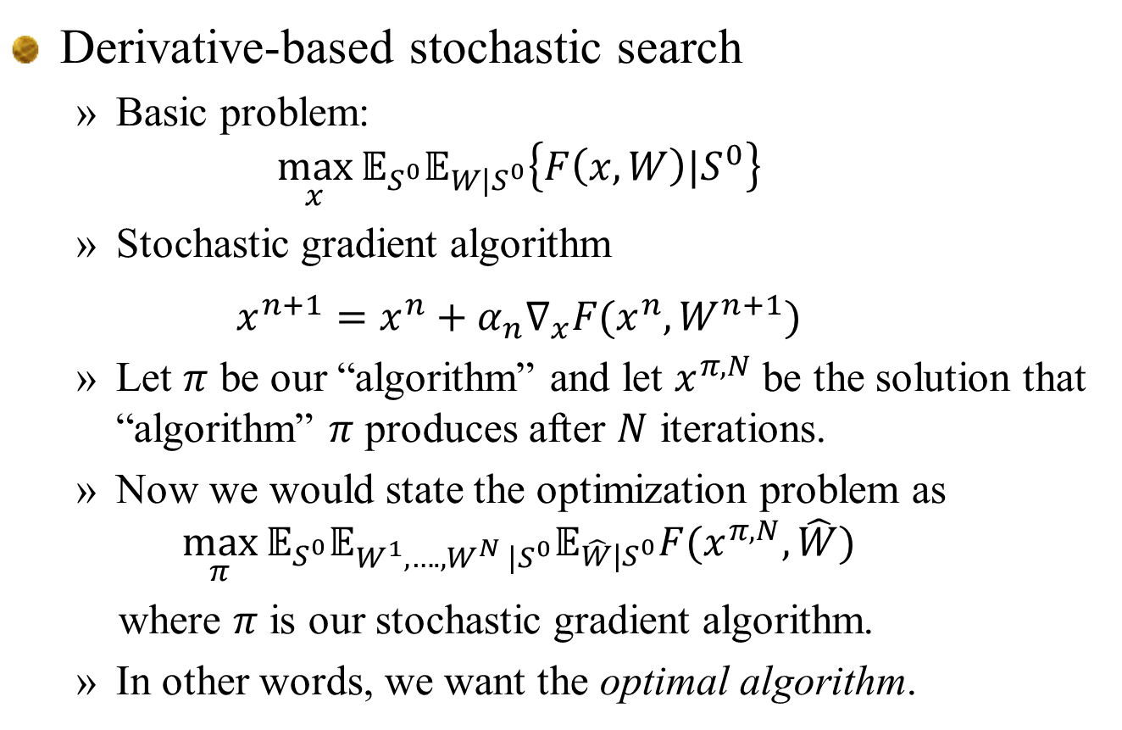
Policy function approximations
Derivative-based stochastic search
  Basic problem:
  $$\max_{x}{𝔼_{S^{0}}𝔼_{W|S^{0}}\left\{F\left(x,W\right)|S^{0}\right\}}$$
  Stochastic gradient algorithm
  $$x^{n+1}=x^{n}+α_{n}∇_{x}F(x^{n},W^{n+1})$$
  Let $π$ be our “algorithm” and let $x^{π,N}$ be the solution that “algorithm” $π$ produces after $N$ iterations.
  Now we would state the optimization problem as
  $$\max_{π}{𝔼_{S^{0}}𝔼_{W^{1},….,W^{N} |S^{0}}𝔼_{\hat{W}|S^{0}}F(x^{π,N},\hat{W})}$$
  where $π$ is our stochastic gradient algorithm.
  In other words, we want the optimal algorithm.
Results of simulation
Slide 14

Slide 15
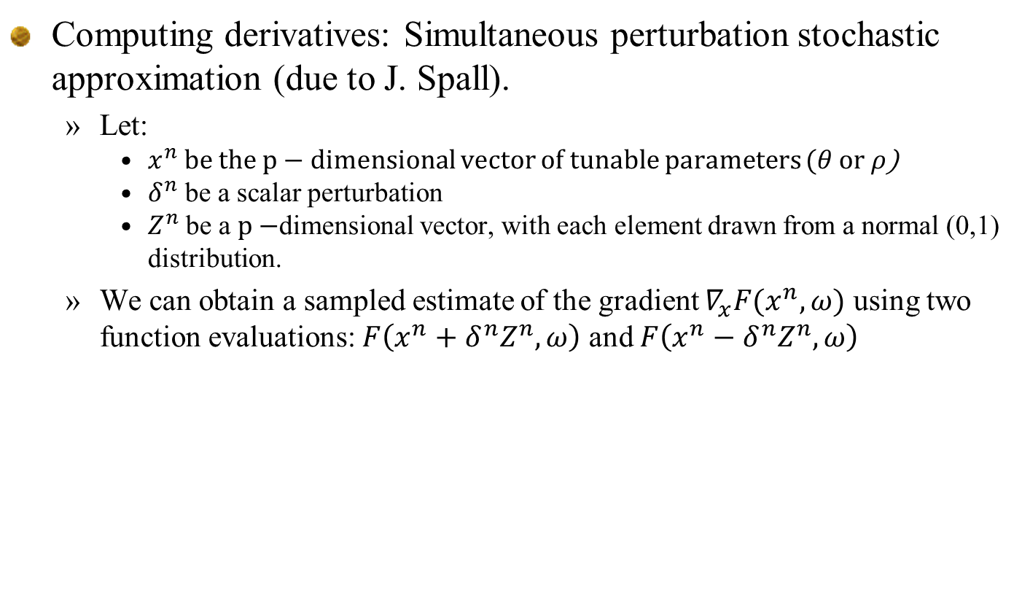
Derivative-based stochastic search
Computing derivatives: Simultaneous perturbation stochastic approximation (due to J. Spall).
  Let:
    $x^{n}$ be the $p−$dimensional vector of tunable parameters ($θ$ or $ρ$)
    $δ^{n}$ be a scalar perturbation
    $Z^{n}$ be a $p−$dimensional vector, with each element drawn from a normal (0,1) distribution.
  We can obtain a sampled estimate of the gradient $∇_{x}F(x^{n},ω)$ using two function evaluations: $F\left(x^{n}+δ^{n}Z^{n},ω\right)$ and $F\left(x^{n}−δ^{n}Z^{n},ω\right)$
Slide 15

Slide 16
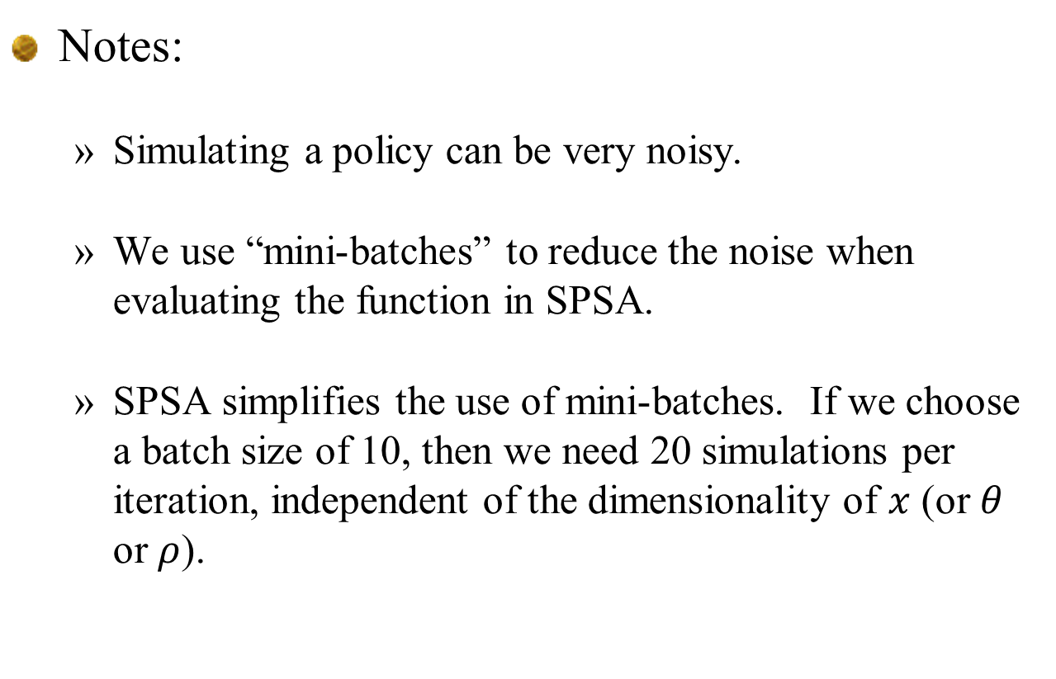
Derivative-based stochastic search
Notes:
  Simulating a policy can be very noisy.
  We use “mini-batches” to reduce the noise when evaluating the function in SPSA.
  SPSA simplifies the use of mini-batches. If we choose a batch size of 10, then we need 20 simulations per iteration, independent of the dimensionality of $x$ (or $θ$ or $ρ$).
Slide 16

Slide 17
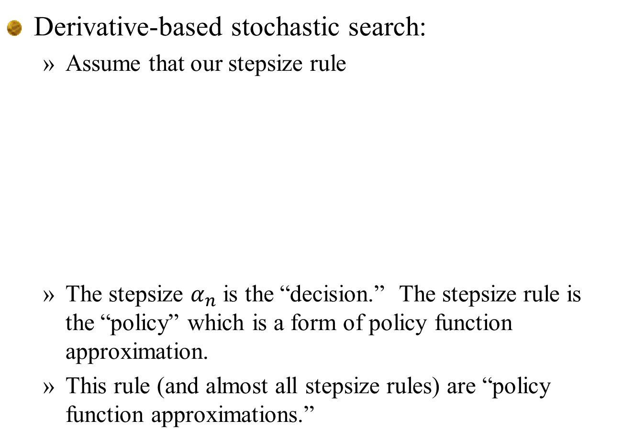
Derivative-based stochastic search
Derivative-based stochastic search:
  Assume that our stepsize rule
  The stepsize $α_{n}$ is the “decision.” The stepsize rule is the “policy” which is a form of policy function approximation.
  This rule (and almost all stepsize rules) are “policy function approximations.”
Slide 17

Slide 18
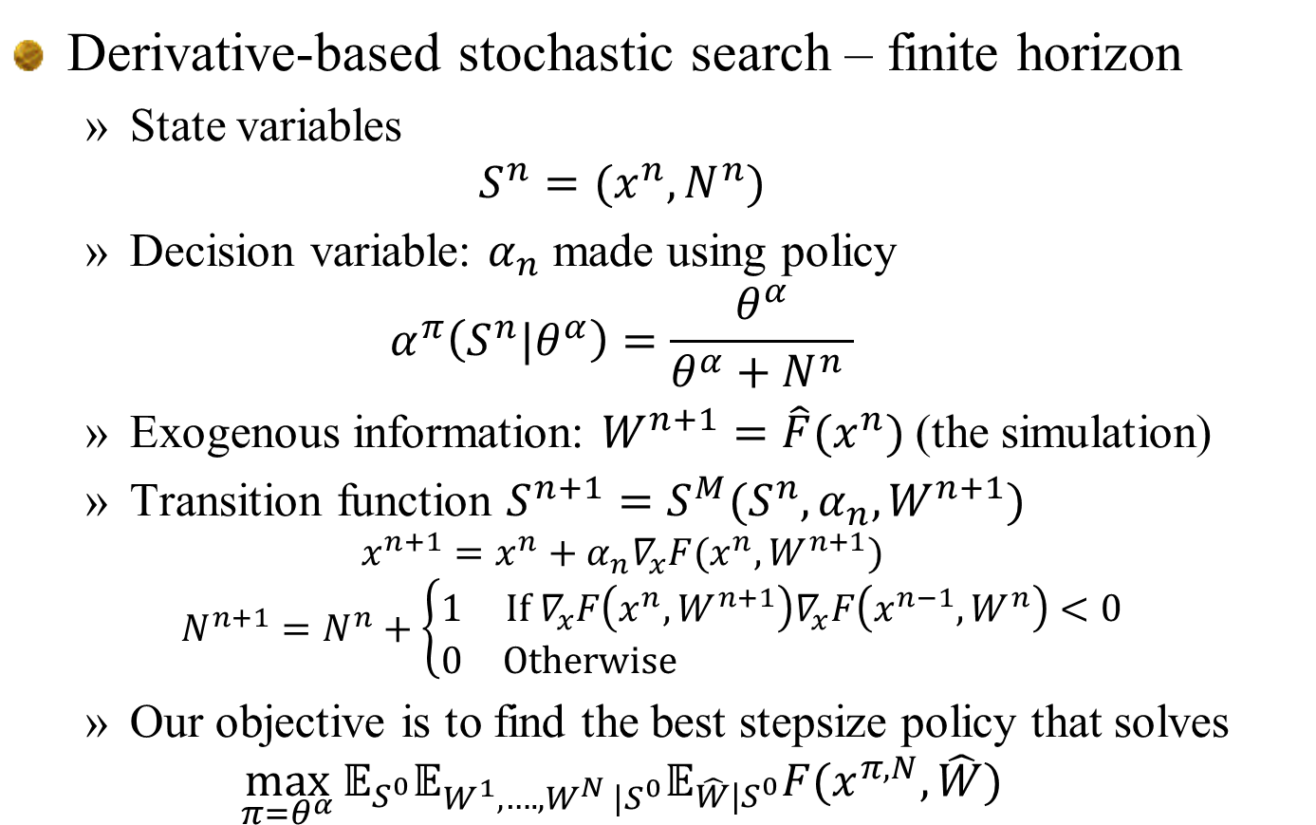
Policy function approximations
Derivative-based stochastic search – finite horizon
  State variables
  $$S^{n}=(x^{n},N^{n})$$
  Decision variable: $α_{n}$ made using policy
  $$α^{π}\left(S^{n}|θ^{α}\right)=\frac{θ^{α}}{θ^{α}+N^{n} }$$
  Exogenous information: $W^{n+1}=\hat{F}(x^{n})$ (the simulation)
  Transition function $S^{n+1}=S^{M}(S^{n},α_{n},W^{n+1})$
  $$x^{n+1}=x^{n}+α_{n}∇_{x}F(x^{n},W^{n+1})$$
  $$N^{n+1}=N^{n}+\left\{\begin{matrix}1 & If{ ∇}_{x}F\left(x^{n},W^{n+1}\right)∇_{x}F\left(x^{n−1},W^{n}\right)<0 \\ 0 & Otherwise \end{matrix}\right.$$
  Our objective is to find the best stepsize policy that solves
  $$\max_{π=θ^{α}}{𝔼_{S^{0}}𝔼_{W^{1},….,W^{N} |S^{0}}𝔼_{\hat{W}|S^{0}}F(x^{π,N},\hat{W})}$$
Slide 18

Slide 19
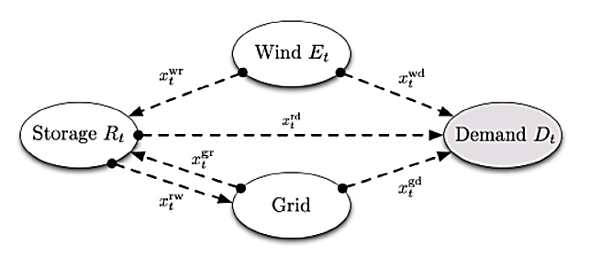

Derivative-based stochastic search
Parametric cost function approximations
  Replace the constraint
with:
  Lookup table modified forecasts (one adjustment term for each time in the future):
  We can simulate the performance of a parameterized policy
  The challenge is to optimize the parameters:
Slide 19

Slide 20
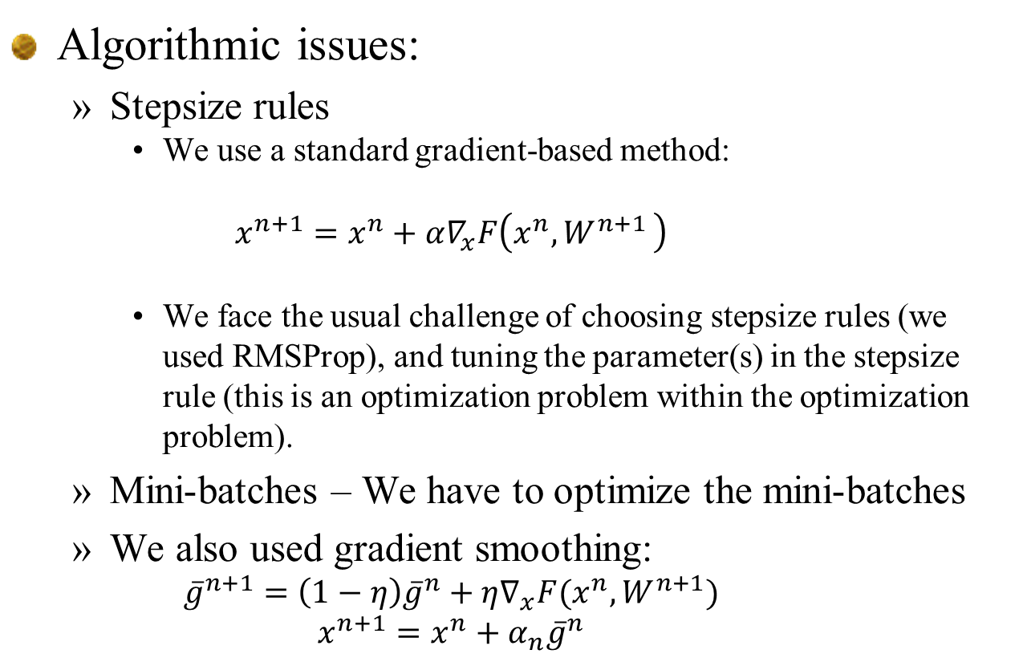
Derivative-based stochastic search
Algorithmic issues:
  Stepsize rules
    We use a standard gradient-based method:
    $${x^{n+1}=x}^{n}+α∇_{x}F\left(x^{n}{,W}^{n+1}\right)$$
    We face the usual challenge of choosing stepsize rules (we used RMSProp), and tuning the parameter(s) in the stepsize rule (this is an optimization problem within the optimization problem).
  Mini-batches – We have to optimize the mini-batches
  We also used gradient smoothing:
    $${\overline{g}}^{n+1}=\left(1−η\right){\overline{g}}^{n}+η∇_{x}F(x^{n},W^{n+1})$$
    $${x^{n+1}=x}^{n}+α_{n}{\overline{g}}^{n}$$
Slide 20

Slide 21
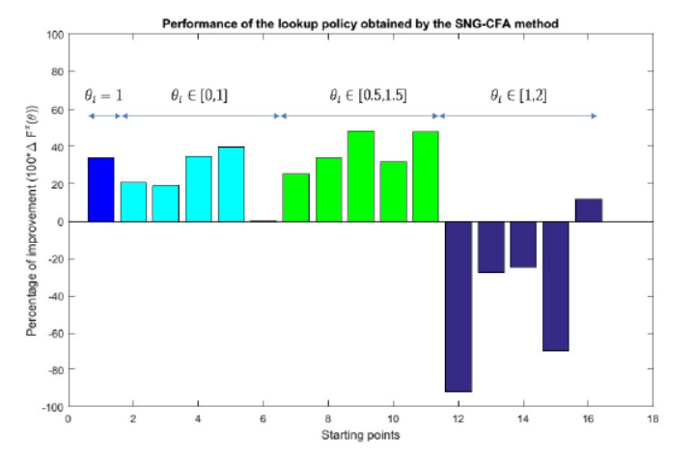
Derivative-based stochastic search
Effect of starting points
  Stepsizes tuned for region [0,1].
Pct. Improvement over benchmark lookahead
Starting point
Slide 21

Slide 22
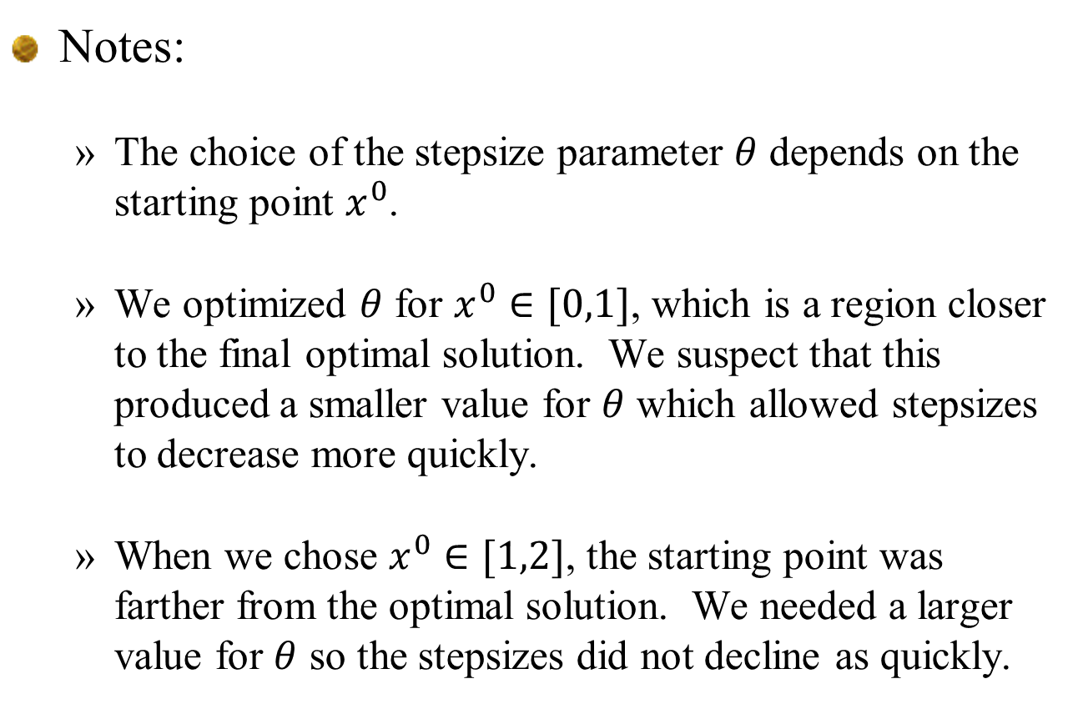
Derivative-based stochastic search
Notes:
  The choice of the stepsize parameter $θ$ depends on the starting point $x^{0}$.
  We optimized $θ$ for $x^{0}∈[0,1]$, which is a region closer to the final optimal solution. We suspect that this produced a smaller value for $θ$ which allowed stepsizes to decrease more quickly.
  When we chose $x^{0}∈[1,2]$, the starting point was farther from the optimal solution. We needed a larger value for $θ$ so the stepsizes did not decline as quickly.

Slide 23
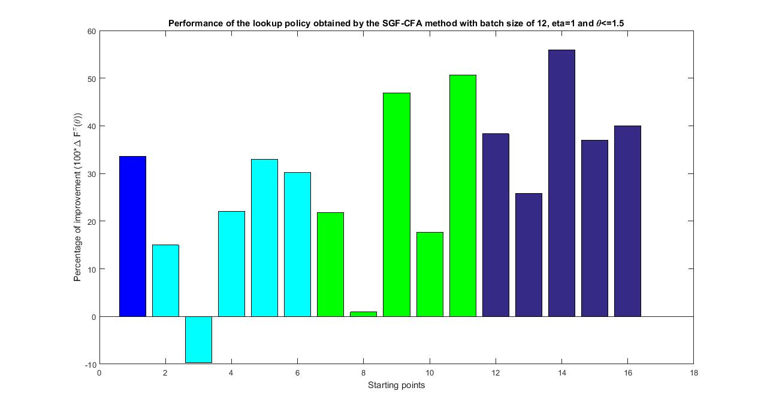



Derivative-based stochastic search
Tuning the parameters
  Stepsizes tuned for region [0,2].
$$θ_{i}=1$$
$$θ_{i}∈[0,1]$$
$$θ_{i}∈[0.5,1.5]$$
$$θ_{i}∈[1,2]$$
Slide 23

Slide 24
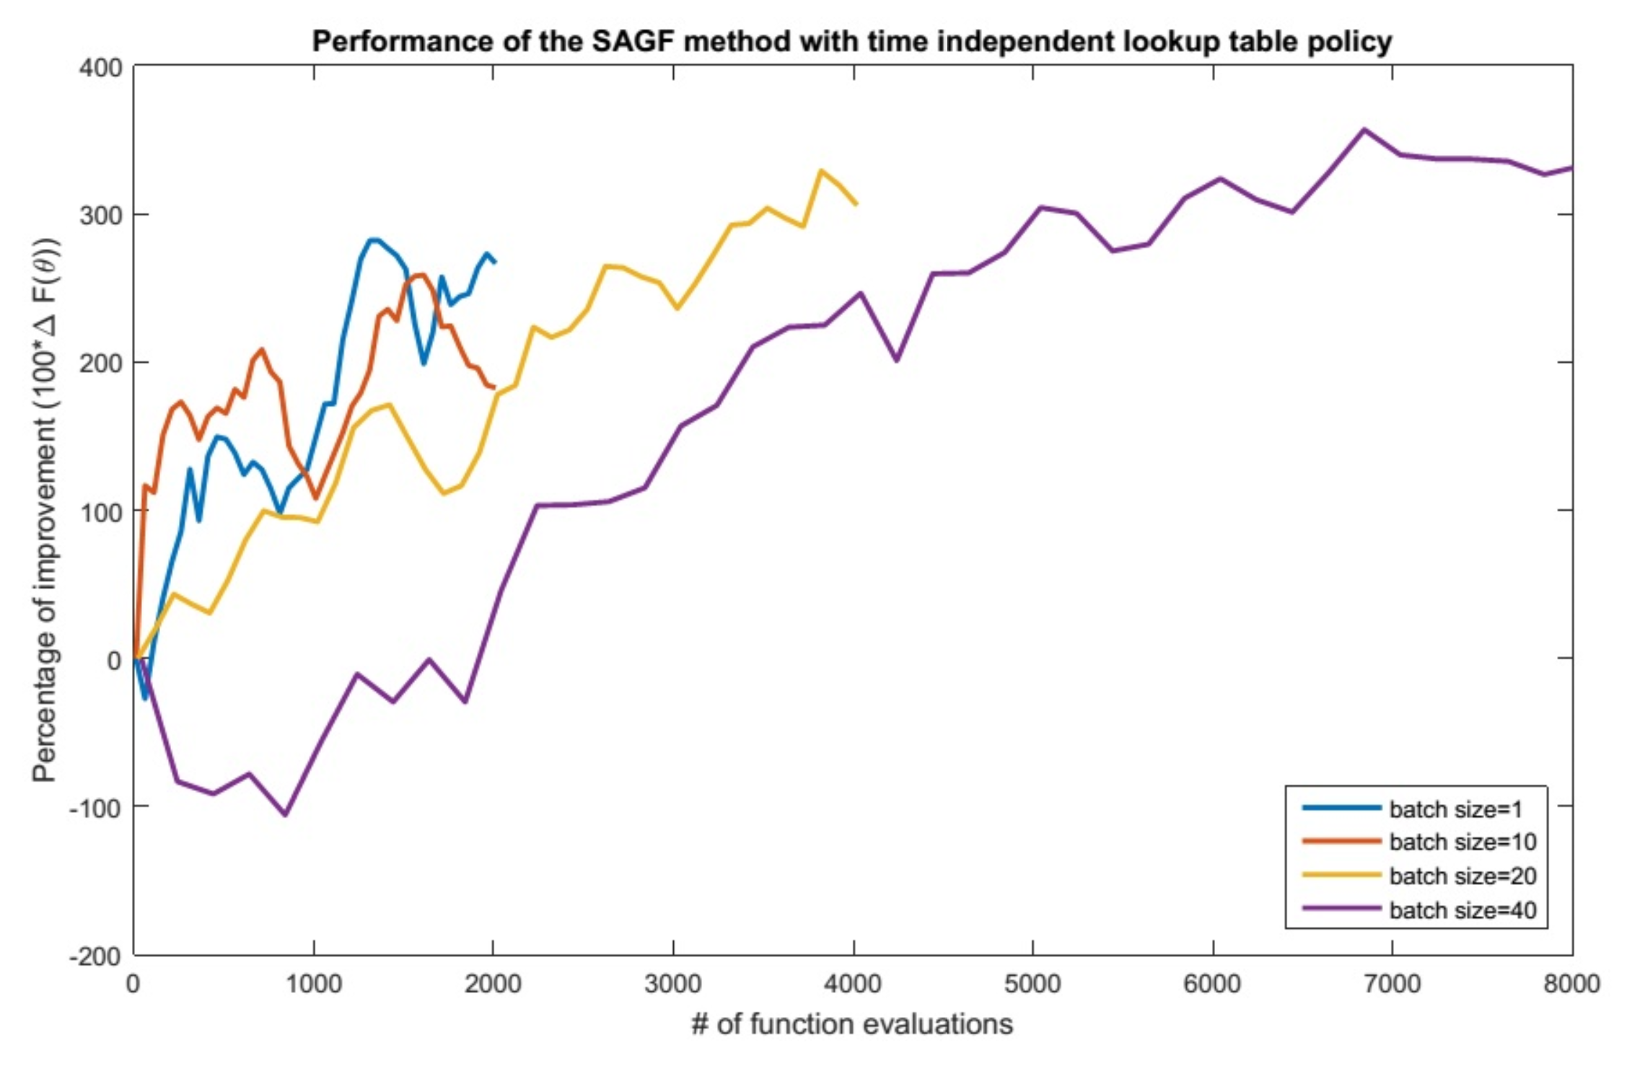
Derivative-based stochastic search
Effect of mini-batches
Mini-batch = 20
Mini-batch = 1
Mini-batch
= 10
Mini-batch = 40
Number of function evaluations
Slide 24

Slide 25
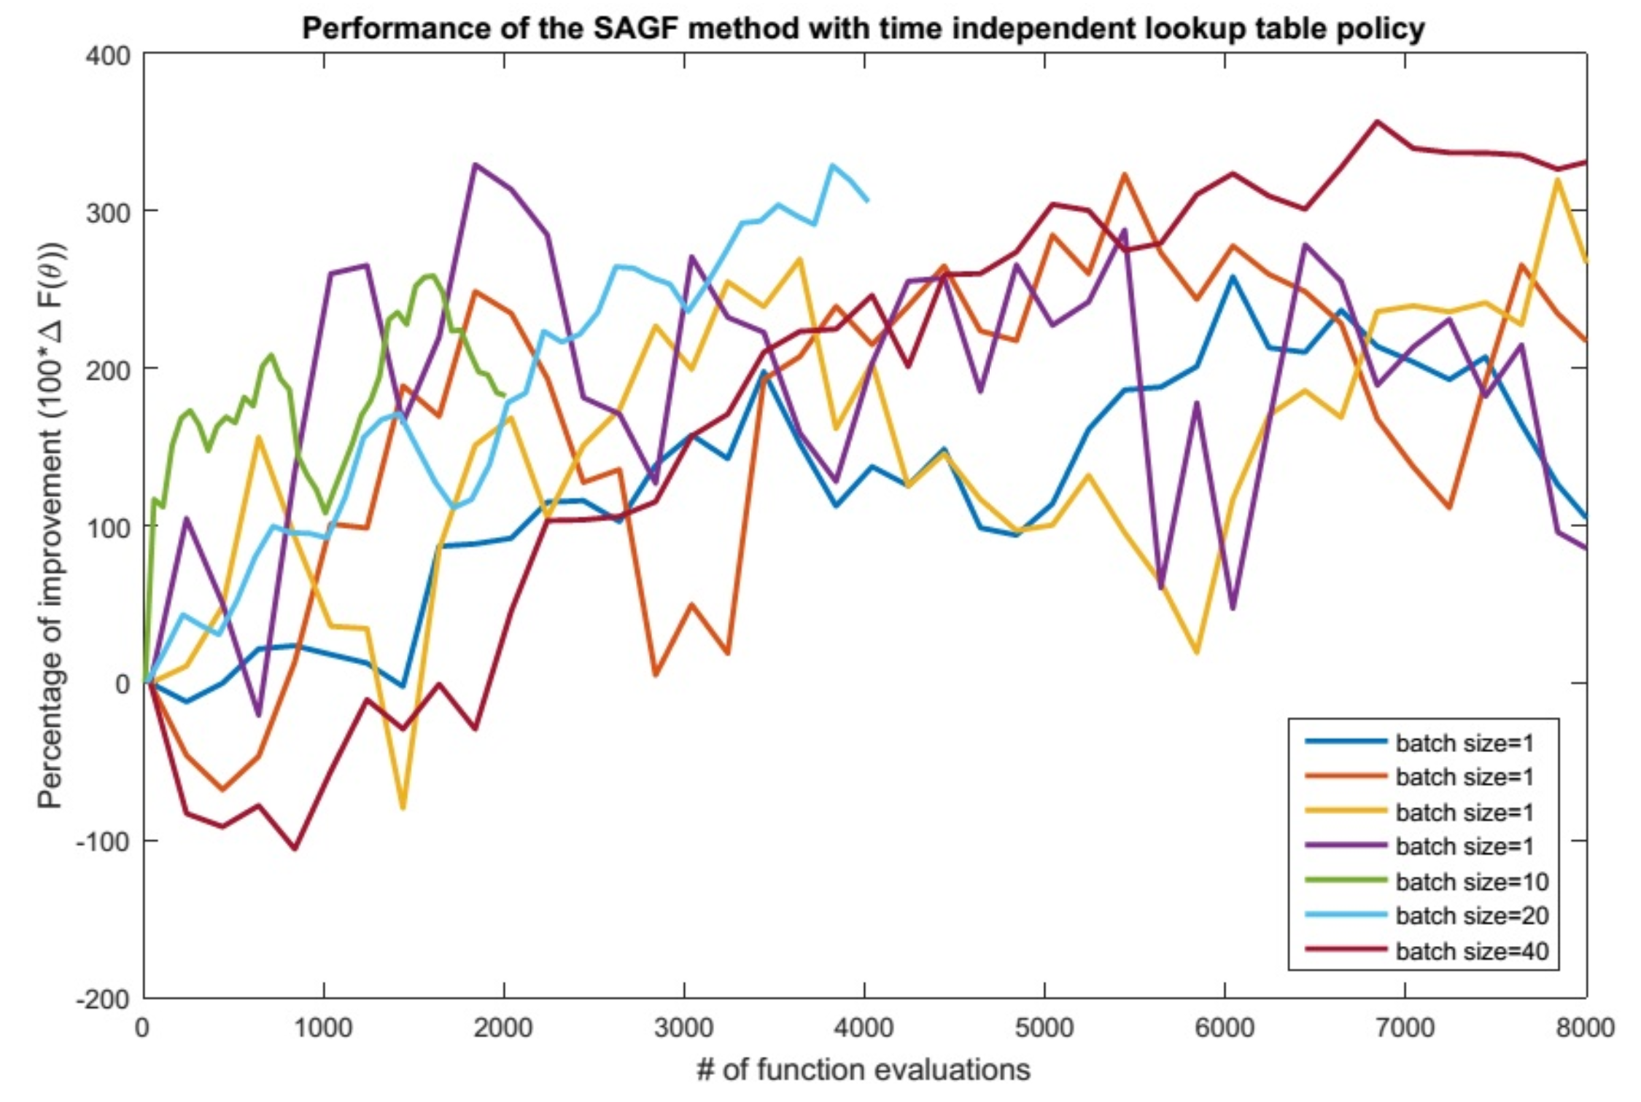
Derivative-based stochastic search
Effect of mini-batches
Mini-batch = 20
Mini-batch = 40
Mini-batch
= 10
Slide 25

Slide 26
Derivative-based stochastic search
Notes:
  The derivatives from SPSA are noisier than from traditional numerical derivatives, but it enables the use of mini-batches, which more than compensates.
  Derivative-based stochastic search requires a simulator.
  Stepsize tuning is key, and you have to be aware that changes in starting points or problem characteristics may require retuning the stepsize. Optimizing the algorithm matters!
Slide 26

Slide 27
Derivative-free stochastic search

Slide 28
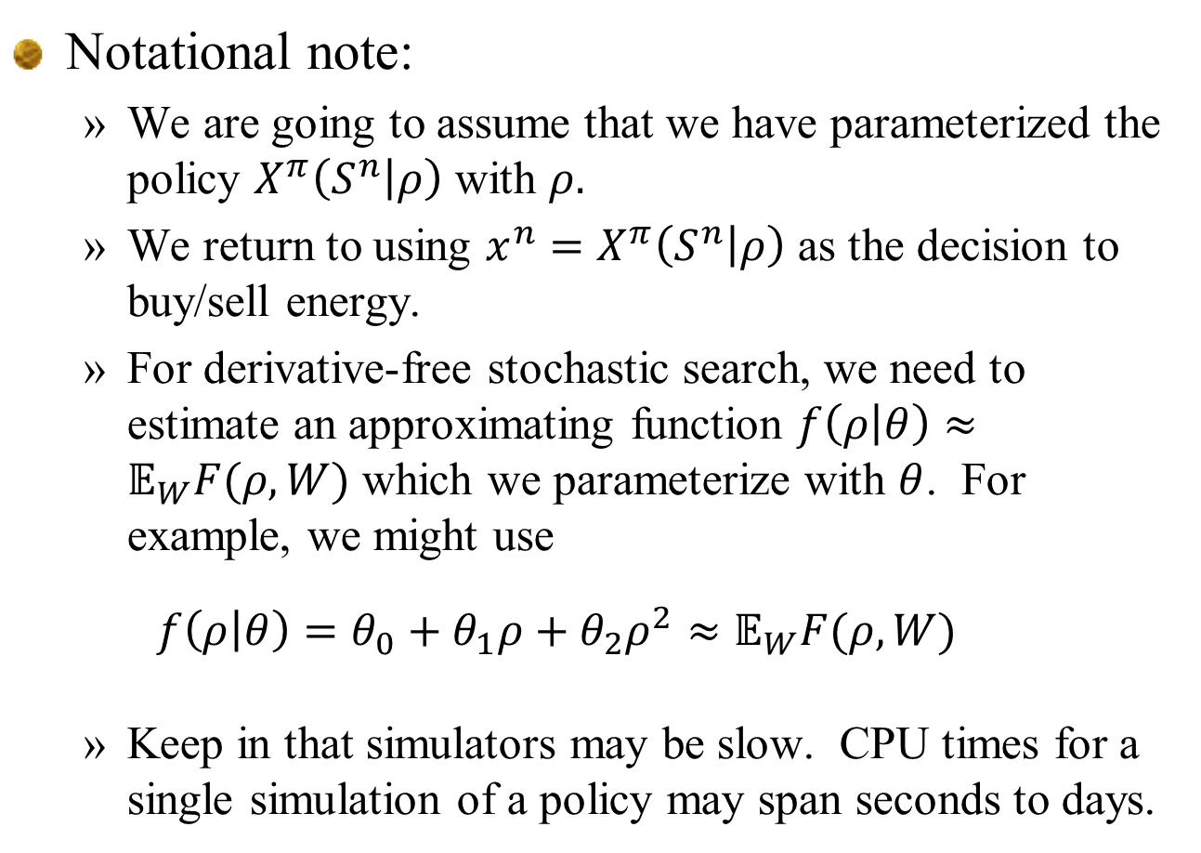
Derivative-free stochastic search
Notational note:
  We are going to assume that we have parameterized the policy $X^{π}\left(S^{n} | ρ\right)$ with $ρ.$
  We return to using $x^{n}=X^{π}\left(S^{n} | ρ\right)$ as the decision to buy/sell energy.
  For derivative-free stochastic search, we need to estimate an approximating function $f\left(ρ | θ\right)≈𝔼_{W}F(ρ,W)$ which we parameterize with $θ$. For example, we might use
  $$f\left(ρ | θ\right)=θ_{0}+θ_{1}ρ+θ_{2}ρ^{2}≈𝔼_{W}F(ρ,W)$$
  Keep in that simulators may be slow. CPU times for a single simulation of a policy may span seconds to days.
Slide 28

Slide 29
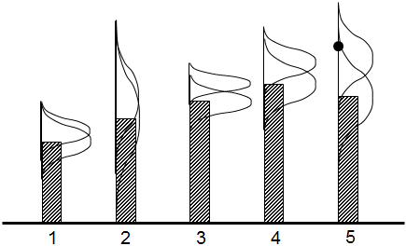
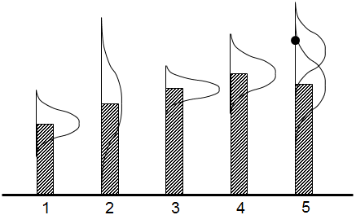
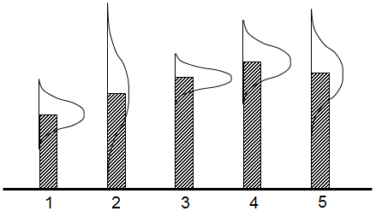
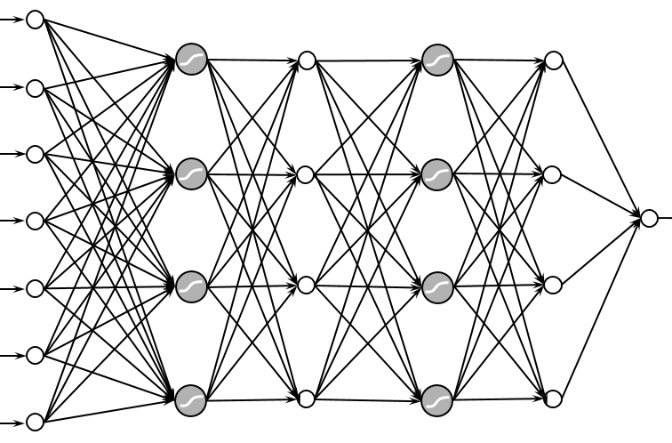
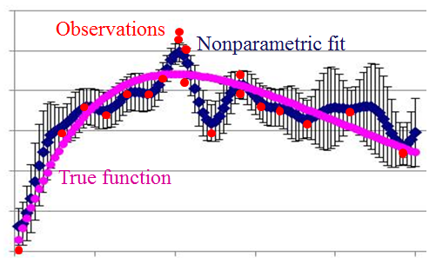
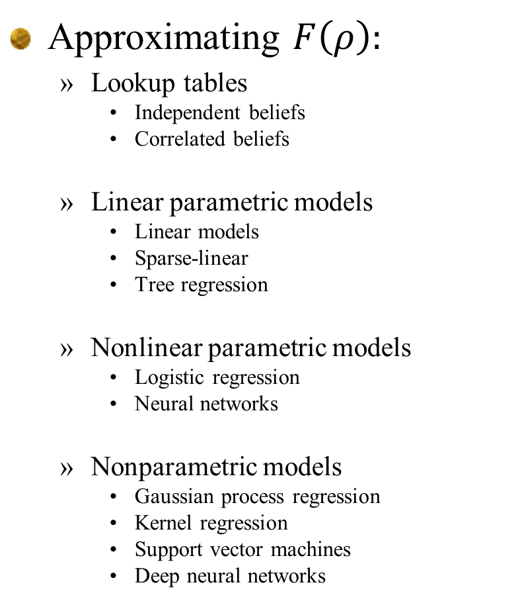
Derivative-free stochastic search
Approximating $F\left(ρ\right):$
  Lookup tables
    Independent beliefs
    Correlated beliefs
  Linear parametric models
    Linear models
    Sparse-linear
    Tree regression
  Nonlinear parametric models
    Logistic regression
    Neural networks
  Nonparametric models
    Gaussian process regression
    Kernel regression
    Support vector machines
    Deep neural networks

Slide 30
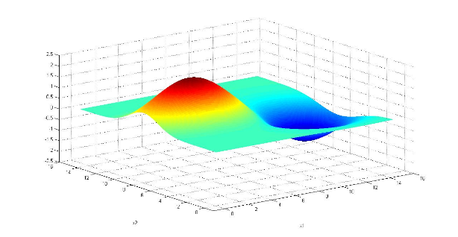


Derivative-free stochastic search
The belief state for a linear model:
  Let${\hat{F}}^{n+1}(ρ^{n})$ be the $n+1st$ observation of the function.
  Let the approximating function be
  We update our estimate $θ^{n}$ using:
$f\left(ρ | θ\right)=θ_{0}+θ_{1}ρ+θ_{2}ρ^{2}$
Slide 30

Slide 31
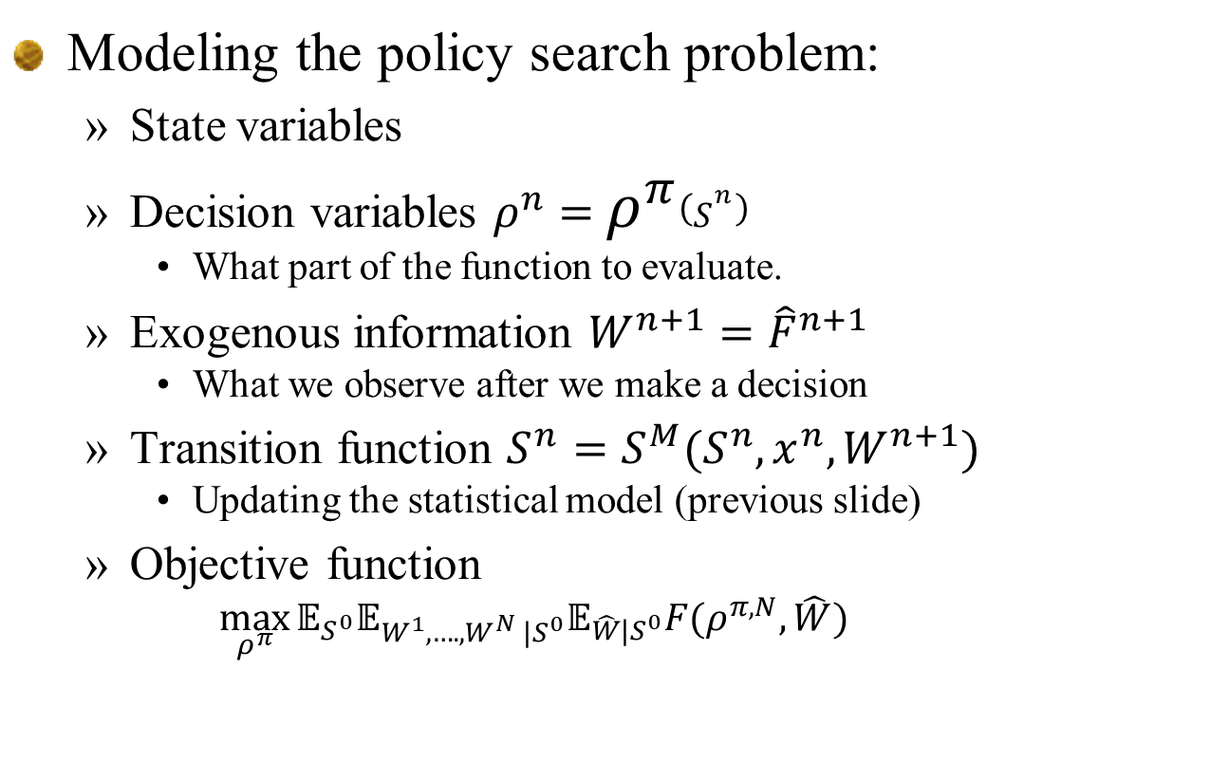
Derivative-free stochastic search
Modeling the policy search problem:
  State variables
  Decision variables $ρ^{n}=$ $ρ^{π}\left(S^{n}\right)$
    What part of the function to evaluate.
  Exogenous information ${W^{n+1}=\hat{F}}^{n+1}$
    What we observe after we make a decision
  Transition function $S^{n}=S^{M}(S^{n},x^{n},W^{n+1})$
    Updating the statistical model (previous slide)
  Objective function
    $$\max_{ρ^{π}}{𝔼_{S^{0}}𝔼_{W^{1},….,W^{N} |S^{0}}𝔼_{\hat{W}|S^{0}}F(ρ^{π,N},\hat{W})}$$
Bayesian prior
Testing/evaluation
Training/learning
Slide 31

Slide 32
Derivative-free stochastic search
Policy function approximations (PFAs):
  Randomized sampling
Cost function approximations (CFAs):
  Bayes greedy with exploration
  Upper confidence bounding
VFA-based policies
DLA policies
  Knowledge gradient (one-step lookahead)
  Multistep lookahead (KG(*), MCTS)
Slide 32

Slide 33
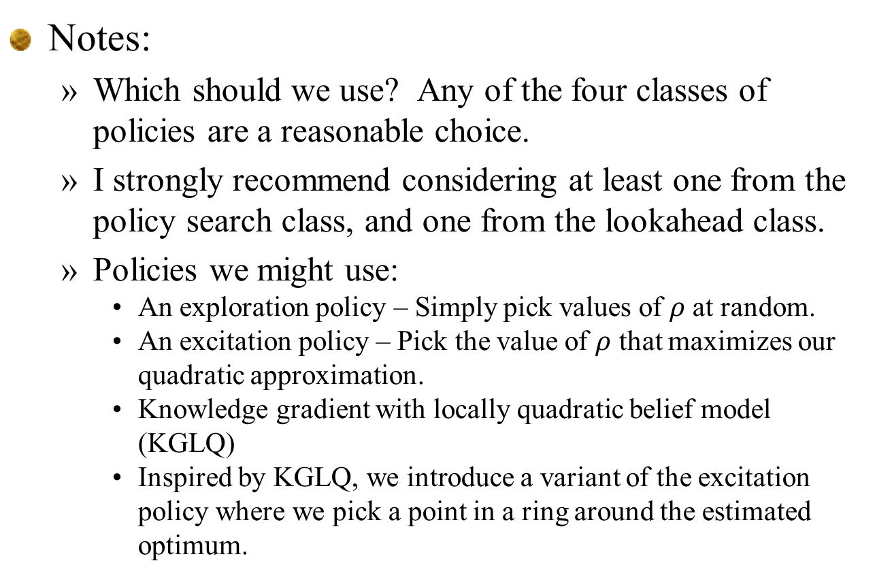
Derivative-free stochastic search
Notes:
  Which should we use? Any of the four classes of policies are a reasonable choice.
  I strongly recommend considering at least one from the policy search class, and one from the lookahead class.
  Policies we might use:
    An exploration policy – Simply pick values of $ρ$ at random.
    An excitation policy – Pick the value of $ρ$ that maximizes our quadratic approximation.
    Knowledge gradient with locally quadratic belief model (KGLQ)
    Inspired by KGLQ, we introduce a variant of the excitation policy where we pick a point in a ring around the estimated optimum.
Slide 33

Slide 34
Locally quadratic knowledge gradient

Slide 35
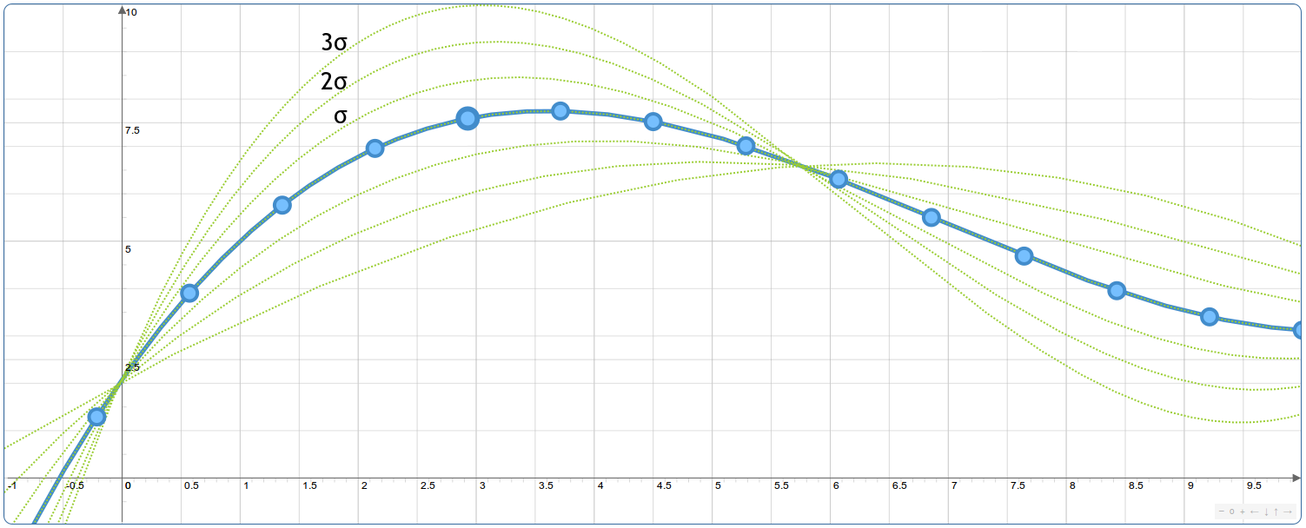
Knowledge gradient with local quadratic belief
Belief models
  Captures the distribution of belief about the surface
Running an experiment here can quickly identify which parameters are correct.
Slide 35

Slide 36
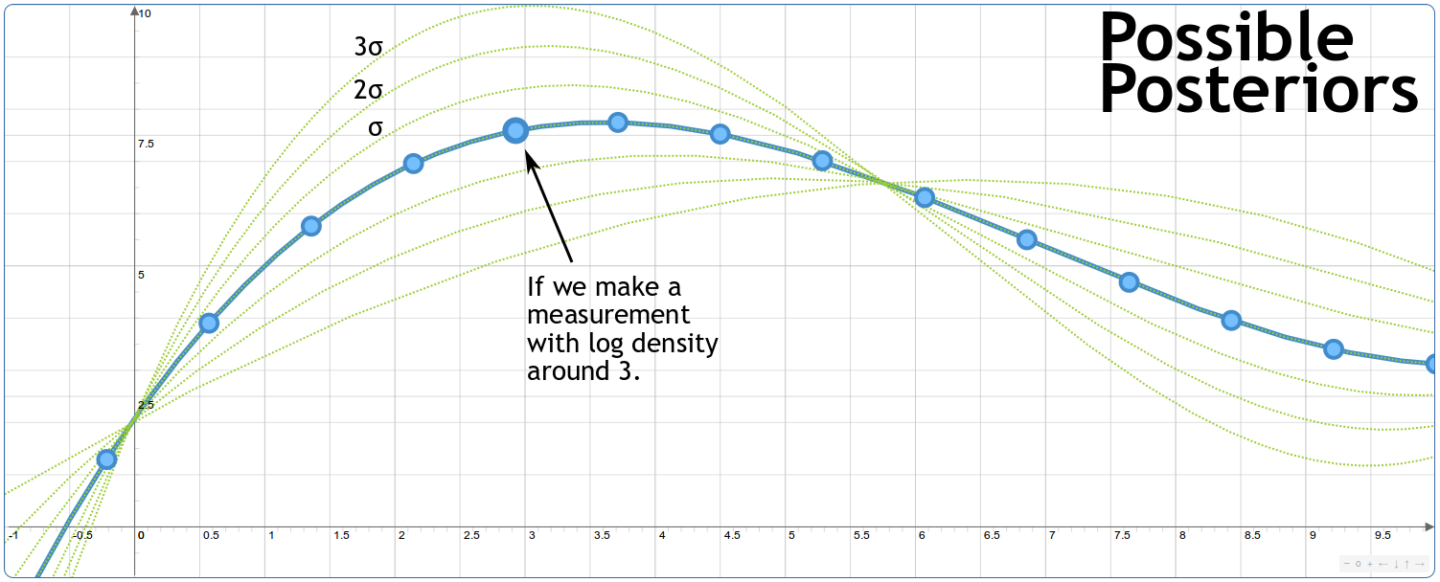

Knowledge gradient with local quadratic belief
The value of information from an experiment x:
Slide 36

Slide 37

Knowledge gradient with local quadratic belief
If we were to stop experimenting now, we would find the value of y that produces the best performance (i.e. maximizing $F(y|B^{n})$).
Slide 37

Slide 38
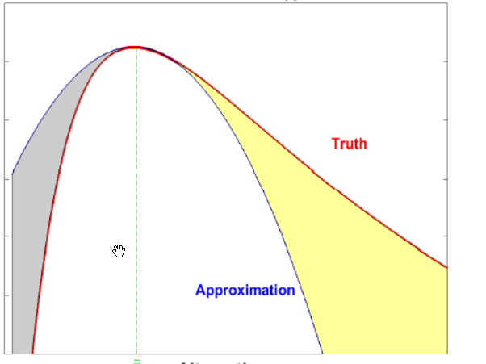





Knowledge gradient with local quadratic belief
Locally quadratic knowledge gradient
  Uses locally quadratic approximation around proximal point $\overline{x}$.
  Difference between true function and quadratic approximation is Lipschitz
  Encourages learning away from proximal point, but not too far.
$f\left(ρ | θ\right)=θ_{0}+θ_{1}\left(ρ−{\overline{ρ}}^{prox}\right)+θ_{2}{\left(ρ−{\overline{ρ}}^{prox}\right)}^{2}$
Belief mode:
$$\hat{y}=f\left(ρ | θ\right)+β\left(ρ | \overline{ρ}\right)+ε$$
Structural uncertainty:
$$β\left(ρ | \overline{ρ}\right)∼N(0,κ{\left|ρ−\overline{ρ}\right|}^{p})$$
Gaussian noise:
$$ε∼N(0,σ_{ε}^{2})$$
Truth=F(x)
$$F(ρ)$$
Truth
Error between true function
and quadratic approximation
$${\overline{ ρ }}^{prox}$$
Quadratic
approximation
Estimate of optimal solution
$$ρ$$

Slide 39
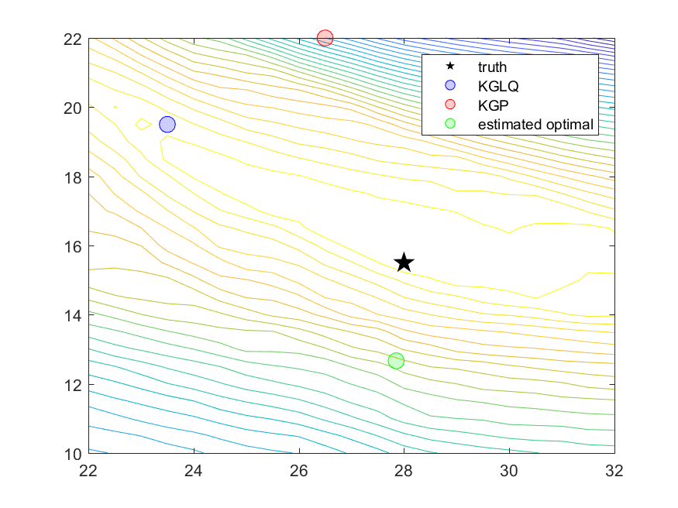


Knowledge gradient with local quadratic belief
Separable approximation:
$$ρ^{discharge}$$
True optimum
$$ρ^{charge}$$

Slide 40


Knowledge gradient with local quadratic belief
… with cross terms
$$ρ^{discharge}$$
True optimum
… requires more data to fit.
$$ρ^{charge}$$

Slide 41
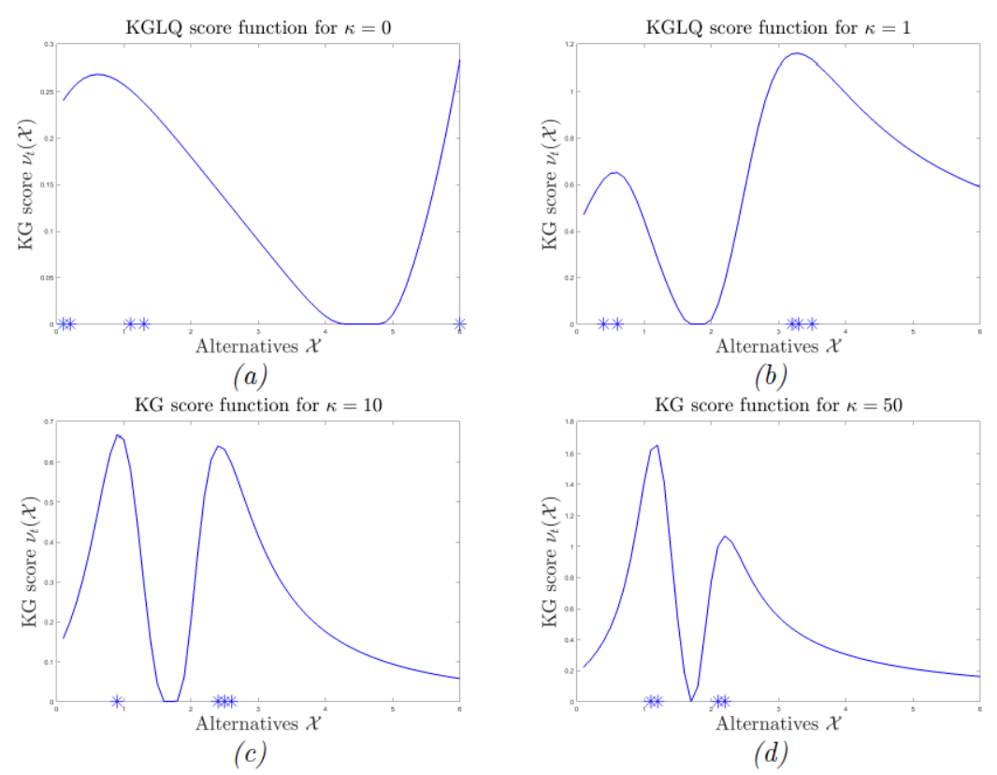





Knowledge gradient with local quadratic belief
As Lipschitz constant $κ$ increases, sampling gets closer to proximal point
$κ=0$
$κ=1$
Value of information
Value of information
$κ=10$
$κ=50$
Value of information
Value of information
Slide 41

Slide 42
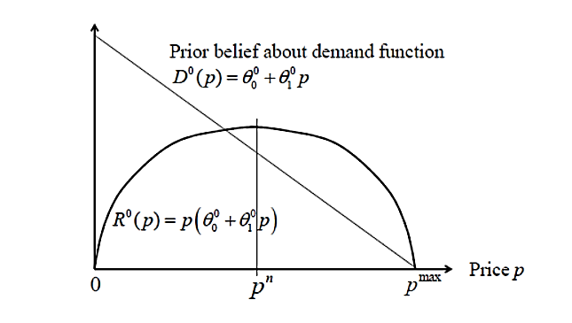
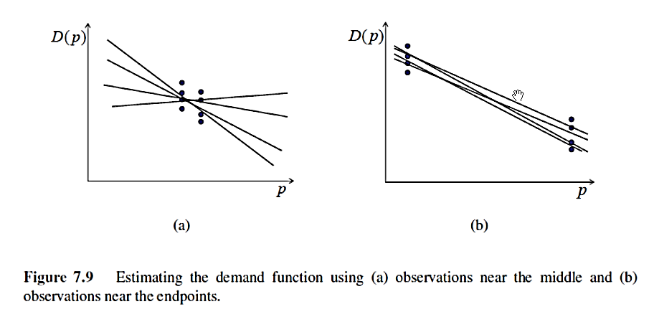
Knowledge gradient with local quadratic belief
Learning a demand response function
Sampling to maximize revenue:
Sampling to learn demand response:
Slide 42

Slide 43



Knowledge gradient with local quadratic belief
Contrast KGLQ vs. “excitation”
  Excitation policy: Find optimal noise and add noise:
  $ρ^{n+1}=\max_{ρ}{{\overline{F}}^{n}\left(ρ|{\overline{θ}}^{n}\right)+ε^{n+1} }$ $ε^{n+1}∼N(0,σ_{ε}^{2})$
KGLQ score function for $κ=1$
$$σ_{ε}^{2}$$
Slide 43

Slide 44
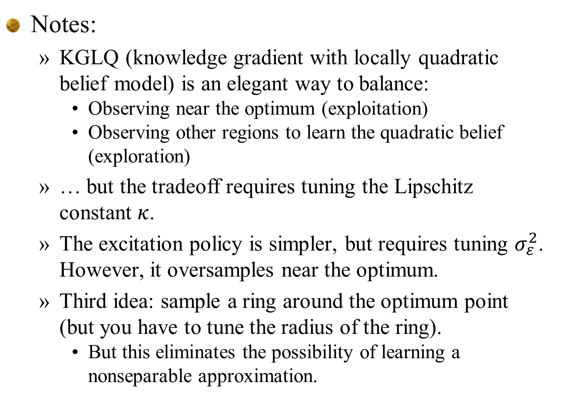
Knowledge gradient with local quadratic belief
Notes:
  KGLQ (knowledge gradient with locally quadratic belief model) is an elegant way to balance:
    Observing near the optimum (exploitation)
    Observing other regions to learn the quadratic belief (exploration)
  … but the tradeoff requires tuning the Lipschitz constant $κ$.
  The excitation policy is simpler, but requires tuning $σ_{ε}^{2}$. However, it oversamples near the optimum.
  Third idea: sample a ring around the optimum point (but you have to tune the radius of the ring).
    But this eliminates the possibility of learning a nonseparable approximation.
Slide 44

Slide 45
Knowledge gradient with local quadratic belief
Separable approximation:
$$ρ^{discharge}$$
True optimum
$$ρ^{charge}$$

Slide 46
Knowledge gradient with local quadratic belief
Assumes polynomial approx. is
globally accurate.
$$ρ^{discharge}$$
Assumes polynomial approx. is
locally accurate.
True optimum
Estimated optimum
$$ρ^{charge}$$

Slide 47
Knowledge gradient with local quadratic belief
$$ρ^{discharge}$$
$$ρ^{charge}$$

Slide 48
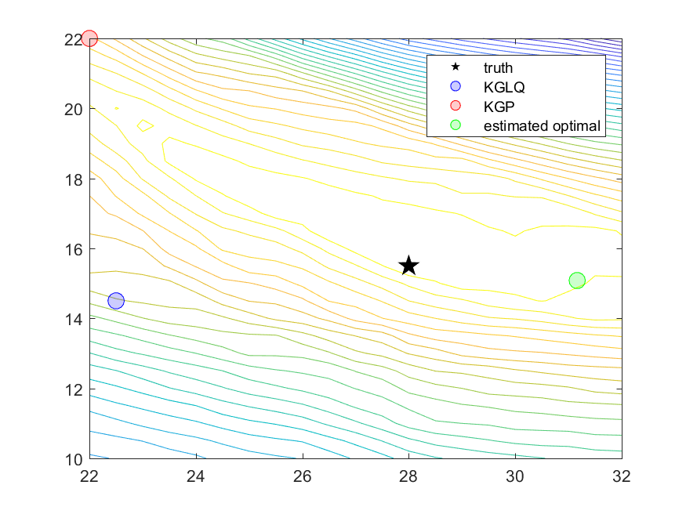
Knowledge gradient with local quadratic belief
$$ρ^{discharge}$$
$$ρ^{charge}$$

Slide 49
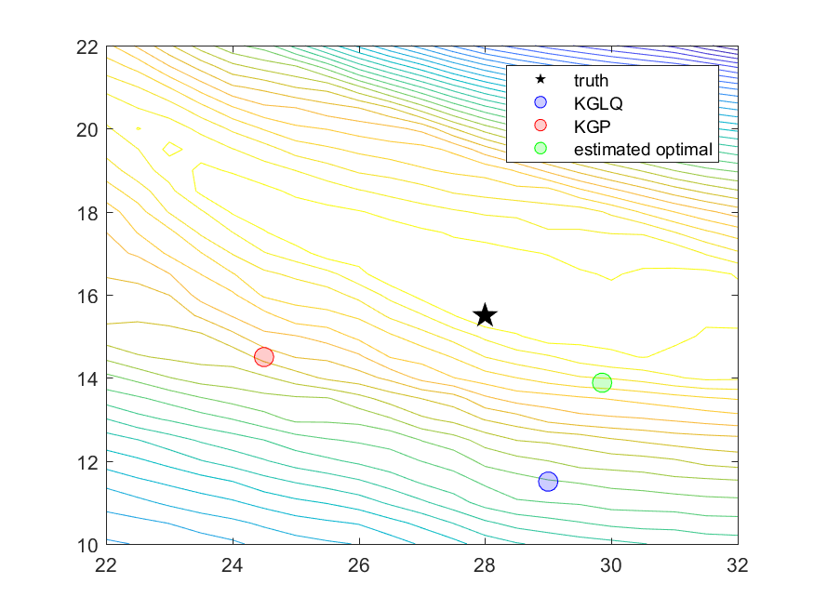
Knowledge gradient with local quadratic belief
$$ρ^{discharge}$$
$$ρ^{charge}$$

Slide 50

Knowledge gradient with local quadratic belief
$$ρ^{discharge}$$
$$ρ^{charge}$$

Slide 51
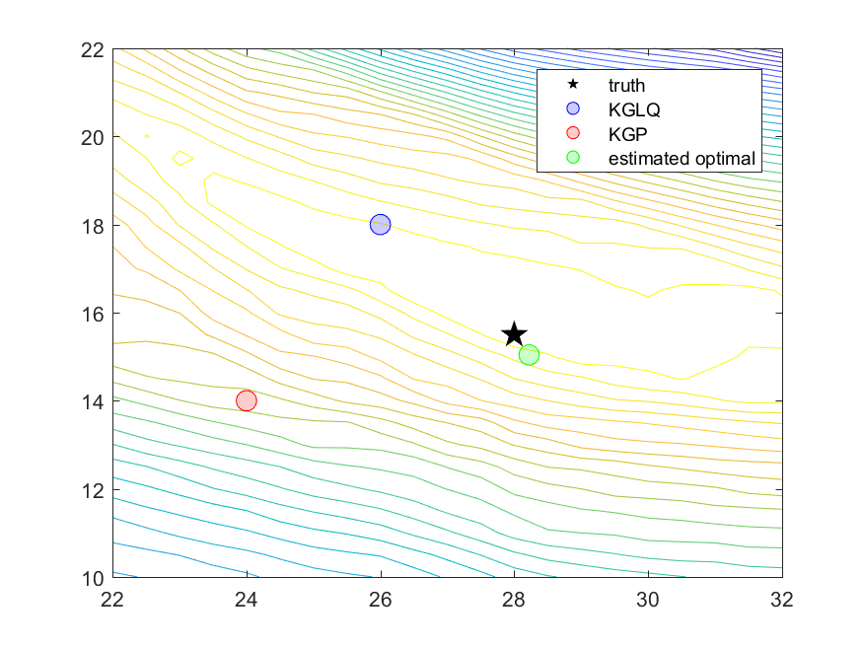
Knowledge gradient with local quadratic belief
$$ρ^{discharge}$$
$$ρ^{charge}$$

Slide 52

Knowledge gradient with local quadratic belief
$$ρ^{discharge}$$
$$ρ^{charge}$$

Slide 53
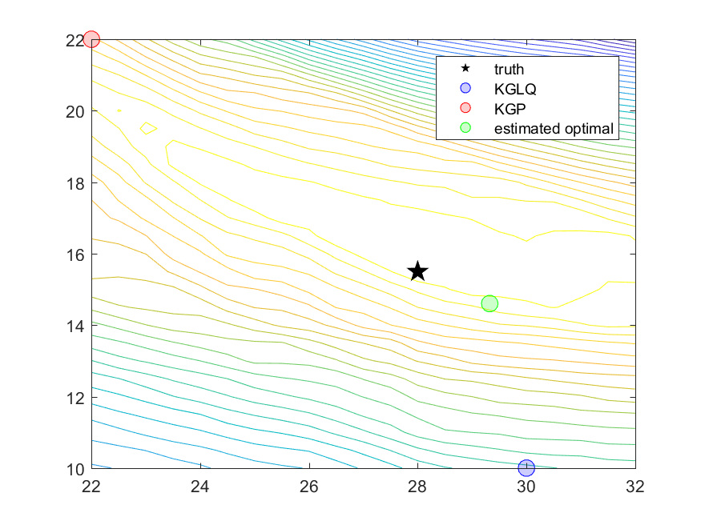
Knowledge gradient with local quadratic belief
$$ρ^{discharge}$$
$$ρ^{charge}$$

Slide 54

Knowledge gradient with local quadratic belief
$$ρ^{discharge}$$
$$ρ^{charge}$$

Slide 55

Knowledge gradient with local quadratic belief
$$ρ^{discharge}$$
$$ρ^{charge}$$

Slide 56

Knowledge gradient with local quadratic belief
$$ρ^{discharge}$$
$$ρ^{charge}$$

Slide 57

Knowledge gradient with local quadratic belief
$$ρ^{discharge}$$
$$ρ^{charge}$$

Slide 58

Knowledge gradient with local quadratic belief
$$ρ^{discharge}$$
$$ρ^{charge}$$

Slide 59

Knowledge gradient with local quadratic belief
$$ρ^{discharge}$$
$$ρ^{charge}$$

Slide 60


Knowledge gradient with local quadratic belief
$$ρ^{discharge}$$
$$ρ^{charge}$$

Slide 61


Knowledge gradient with local quadratic belief
Quadratic belief model
  Truth: $f\left(x | θ\right)=θ_{0}+θ_{1}x+θ_{2}x^{2}$
Slide 61

Slide 62

Knowledge gradient with local quadratic belief
Notes:
  The bimodal heuristic works exceptionally well.
  It is very simple….
  ….but the price of simplicity is tunable parameters!
  KGLQ also requires tuning $κ$, but we might have some insight into its value from the structure of the problem.
Slide 62

