Slide 1
A Unified Framework for
Sequential Decision Analytics
Olin Business School
University of Washington, St. Louis
November 5-6, 2019
Warren B. Powell
Princeton University
Department of Operations Research
and Financial Engineering

Slide 2

Active learning problems

Slide 3

The multiarmed bandit story

Slide 4
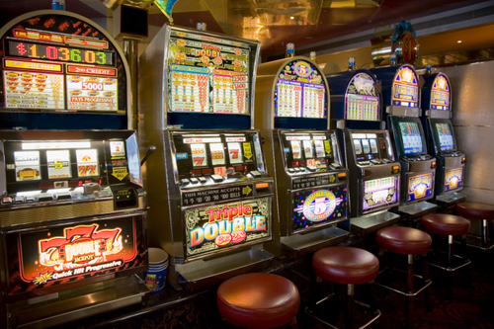

Slide 5





Arms…
Slide 5

Slide 6






… and bandits
Slide 6

Slide 7
Multiarmed bandit problems
What is a “bandit problem”?
  The literature seems to characterize a “bandit problem” as any problem where a policy has to balance exploration vs. exploitation.
  But this means that a bandit “problem” is defined by how it is solved. E.g., if you use a pure exploration policy, is it a bandit problem?
My definition:
  Any sequential decision problem which involves learning, and where we have direct or indirect control over the information that is collected.
Slide 7

Slide 8
Multiarmed bandit problems
I claim:
  … since all derivative-free stochastic optimization problems require learning the function being optimized.
  As of this writing, this is not the case with derivative-based stochastic optimization.
Slide 8

Slide 9
Multiarmed bandit problems
Dimensions of a “bandit” problem:
  The “arms” (decisions) may be
    Binary (A/B testing, stopping problems)
    Discrete alternatives (drug, catalyst, …)
    Continuous choices (price)
    Vector-valued (basketball team, …)
    Multiattribute (attributes of a movie, song, person)
    Static vs. dynamic choice sets
  Information (what we observe)
    Success/failure
    Discrete outcome (Poisson arrivals)
    Exponential family (e.g. Gaussian, exponential, …)
    Heavy-tailed (e.g. Cauchy)
    Data-driven (distribution unknown)
    Stationary vs. nonstationary processes
    Adversarial?
Slide 9

Slide 10
Multiarmed bandit problems
Dimensions of a “bandit” problem:
  Belief models
    Lookup tables (these are most common)
      Independent or correlated beliefs
    Parametric models
      Linear or nonlinear in the parameters
    Nonparametric models
      Locally linear
      Deep neural networks/SVM
    Bayesian vs. frequentist
  Objective function
    Expected performance (e.g. regret)
    Offline (final reward) vs. online (cumulative reward)
      Just interested in final design?
      Or optimizing while learning?
    Risk metrics
Slide 10

Slide 11
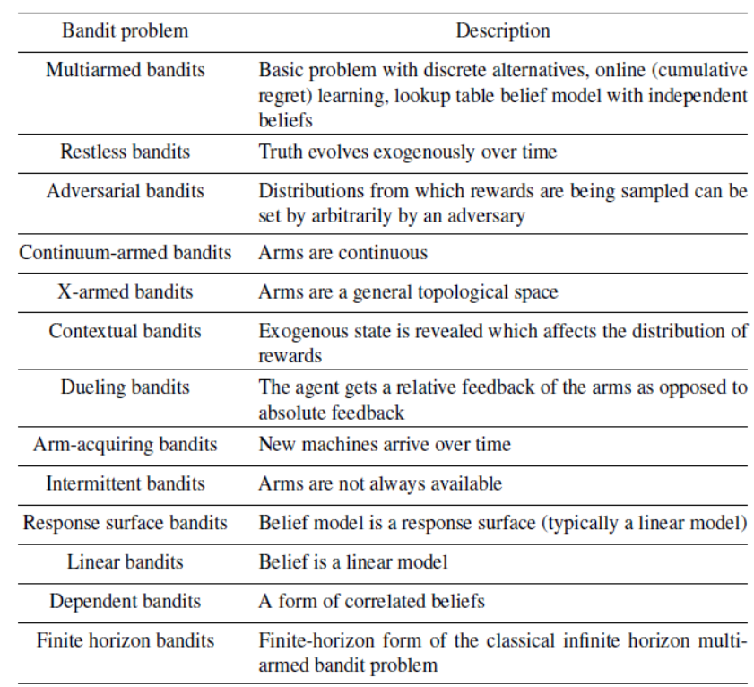
The “bandit” vocabulary

Slide 12
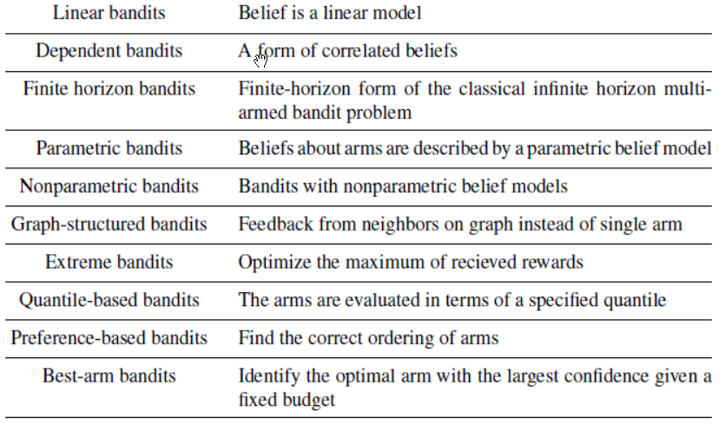
The “bandit” vocabulary

Slide 13
Modeling learning problems

Slide 14
Modeling learning problems
We can divide learning problems into several broad classes:
  Batch learning – This is the classic “big data” setting we have heard so much about.
  “Online” (or recursive) learning – Data comes in a stream that we adapt to. These can be divided into two classes:
    Passive learning – We have no control over the data that is arriving.
    Active learning – Here we directly control or indirectly influence what observations are made. This is the problem class we are most interested in.
Slide 14

Slide 15
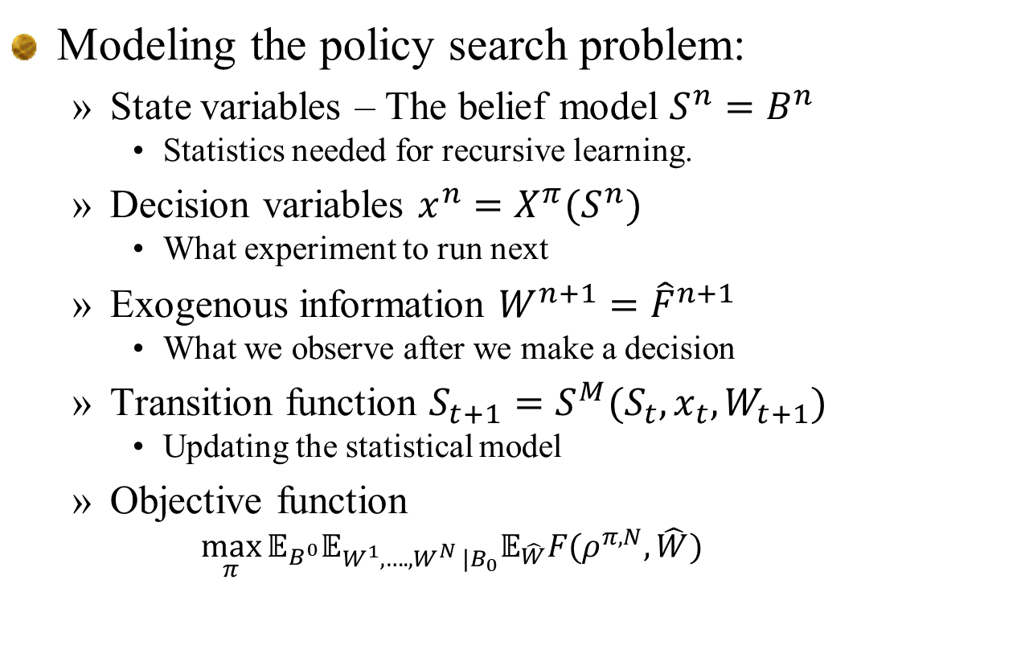
Elements of a learning model
Modeling the policy search problem:
  State variables – The belief model $S^{n}=B^{n}$
    Statistics needed for recursive learning.
  Decision variables $x^{n}=X^{π}(S^{n})$
    What experiment to run next
  Exogenous information ${W^{n+1}=\hat{F}}^{n+1}$
    What we observe after we make a decision
  Transition function $S_{t+1}=S^{M}(S_{t},x_{t},W_{t+1})$
    Updating the statistical model
  Objective function
    $$\max_{π}{𝔼_{B^{0}}𝔼_{W^{1},….,W^{N} |B_{0}}𝔼_{\hat{W}}F(ρ^{π,N},\hat{W})}$$
Slide 15

Slide 16
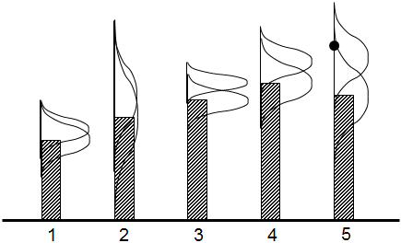
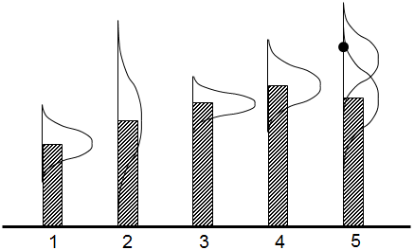
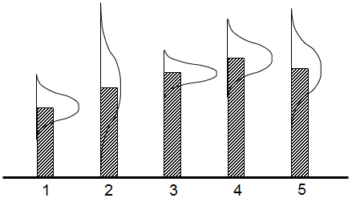
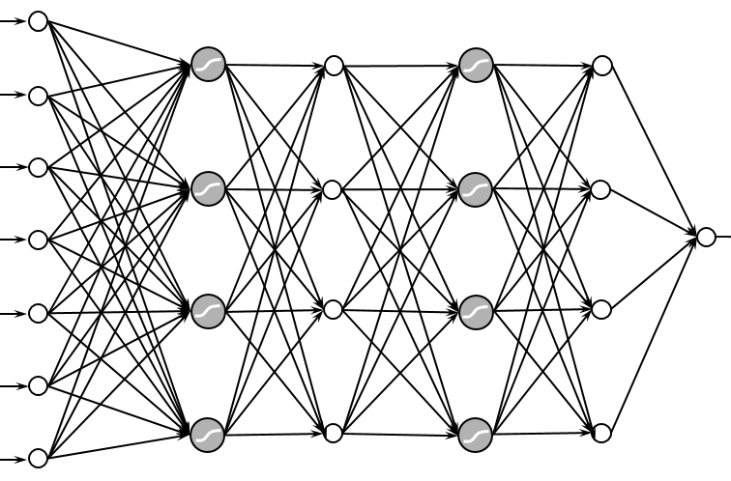
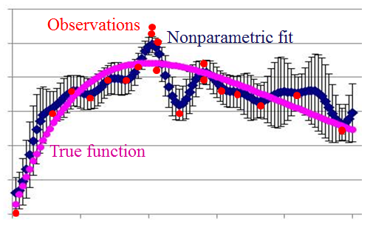
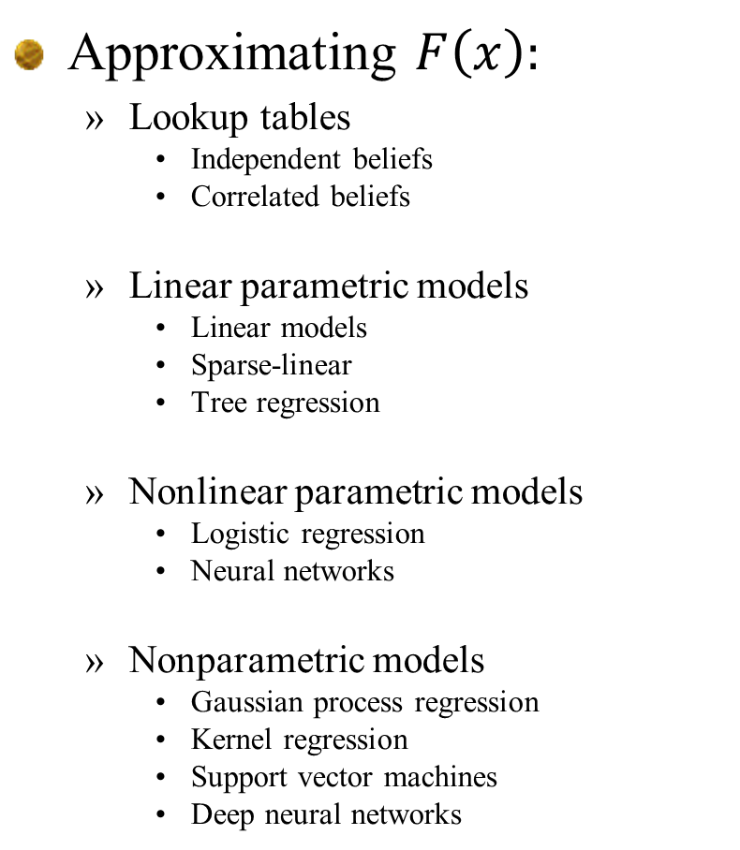
Elements of a learning model
Approximating $F\left(x\right):$
  Lookup tables
    Independent beliefs
    Correlated beliefs
  Linear parametric models
    Linear models
    Sparse-linear
    Tree regression
  Nonlinear parametric models
    Logistic regression
    Neural networks
  Nonparametric models
    Gaussian process regression
    Kernel regression
    Support vector machines
    Deep neural networks

Slide 17
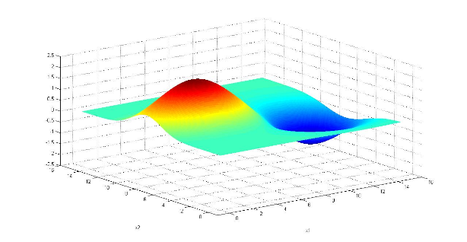

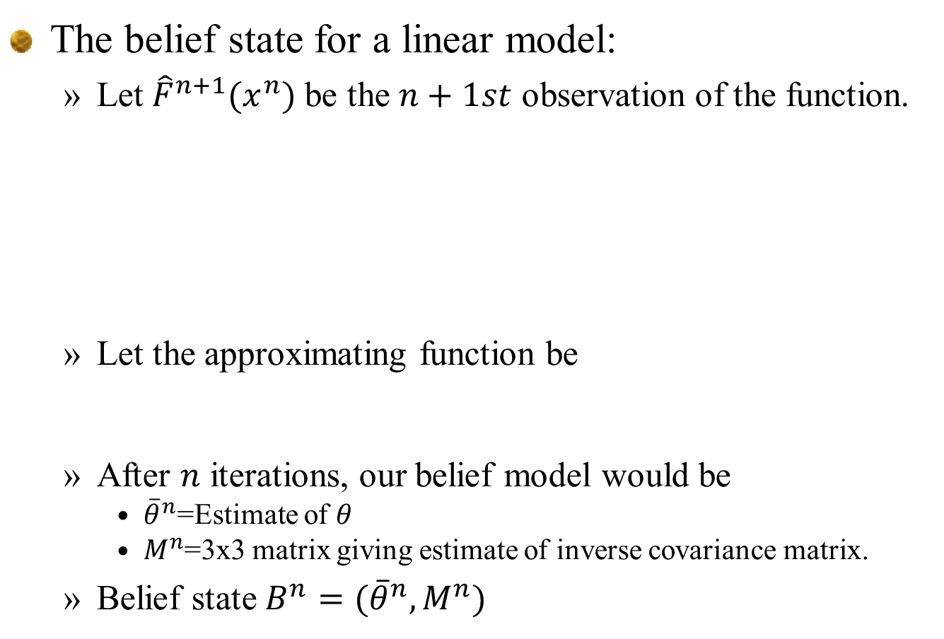
Elements of a learning model
The belief state for a linear model:
  Let${\hat{F}}^{n+1}(x^{n})$ be the $n+1st$ observation of the function.
  Let the approximating function be
  After $n$ iterations, our belief model would be
    ${\overline{θ}}^{n}$=Estimate of $θ$
    $M^{n}$=3x3 matrix giving estimate of inverse covariance matrix.
  Belief state $B^{n}=({\overline{θ}}^{n},M^{n})$
$f\left(x | θ\right)=θ_{0}+θ_{1}x+θ_{2}x^{2}$
Slide 17

Slide 18
Elements of a learning model
Types of decisions for learning problems
  Binary
    Stopping a clinical trial
  Finite
    What drug is best
    The best path, material, ad, …
  Continuous scalar
    Prices, temperatures, dosages,
  Continuous vector
    Parameter tuning for algorithms
  Discrete vector
    How many patients to recruit from different groups
  Categorical
    Best offer to make to a hotel customer (date, room type, breakfast? Spa?)
Slide 18

Slide 19
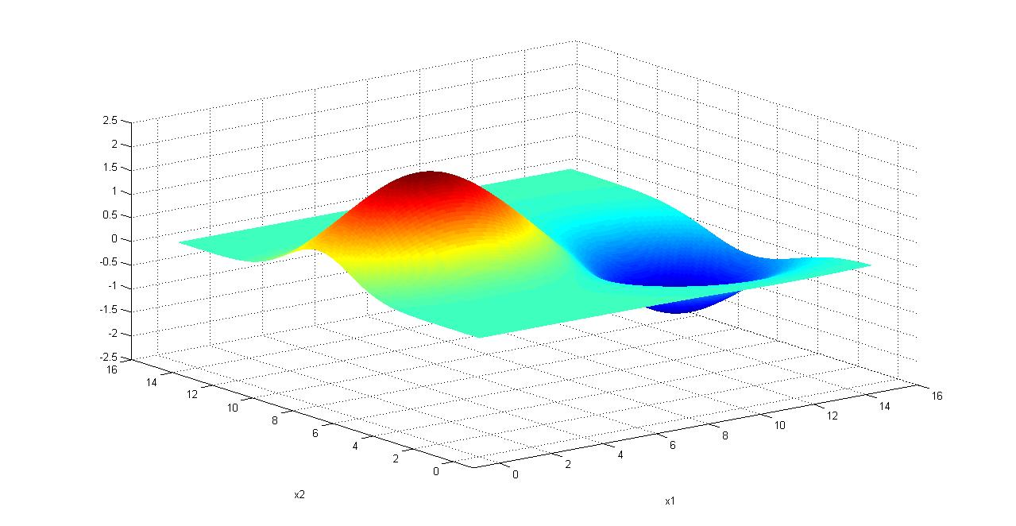

Elements of a learning model
The exogenous information
  We obtain a noisy observation ${\hat{F}}^{n+1}$ our function
Slide 19

Slide 20


Elements of a learning model
The transition function:
  Given our linear belief model:
  We update our estimate $θ^{n}$ using:
$f\left(x | θ\right)=θ_{0}+θ_{1}x+θ_{2}x^{2}$
Slide 20

Slide 21
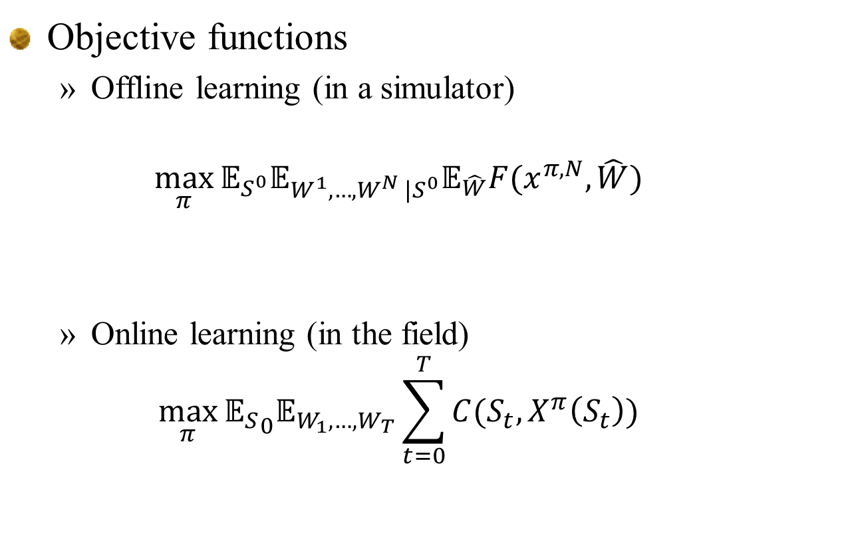
Elements of a learning model
Objective functions
  Offline learning (in a simulator)
  $$\max_{π}{𝔼_{S^{0}}𝔼_{W^{1},…,W^{N} |S^{0}}𝔼_{\hat{W}}F(x^{π,N},\hat{W})}$$
  Online learning (in the field)
  $$\max_{π}{{𝔼_{S}}_{0}𝔼_{W_{1},…,W_{T}}\sum_{t=0}^{T}{C(S_{t},X^{π}\left(S_{t}\right))}}$$
Initial prior
Training/learning
Testing
Initial prior
Acting while learning
Slide 21

Slide 22
Designing policies
Policy function approximations (PFAs):
  Randomized sampling
Cost function approximations (CFAs):
  Bayes greedy with exploration
  Interval estimation
VFA-based policies (the foundation of “Gittins indices”)
DLA policies
  Knowledge gradient (one-step lookahead)
  Multistep lookahead (KG(*), MCTS)
Slide 22

Slide 23
From machine learning to sequential decisions

Slide 24
Bridging learning and optimization
From machine learning to optimization:
  A key difference between machine learning and sequential decisions is the objective function – machine learning needs exogenous data (“big data”).
  Sequential decision problems need to capture physical constraints (which are sometimes complex).
Machine learning
Sequential decisions
“Big dataset”
Contribution function
Slide 24

