Slide 1
A Unified Framework for
Sequential Decision Analytics
Olin Business School
University of Washington, St. Louis
November 5-6, 2019
Warren B. Powell
Princeton University
Department of Operations Research
and Financial Engineering

Slide 2

Belief models

Slide 3

Illustrative learning problems

Slide 4
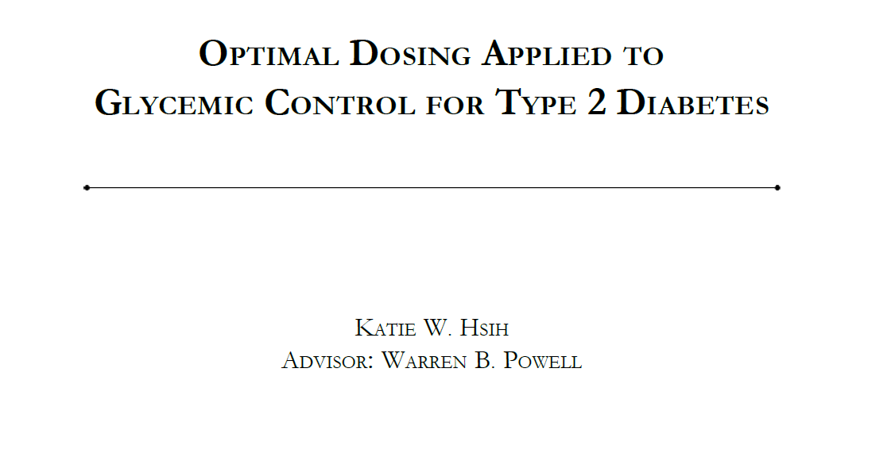
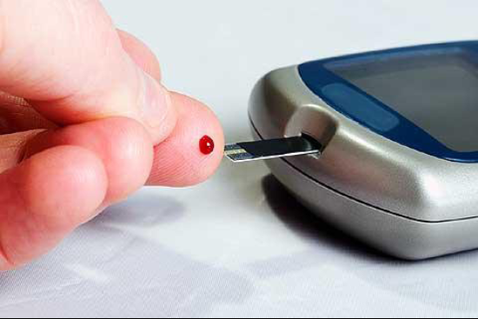
Optimal learning in diabetes
How do we find the best treatment for diabetes?
  The standard treatment is a medication called metformin, which works for about 70 percent of patients.
  What do we do when metformin does not work for a patient?
  There are about 20 other treatments, and it is a process of trial and error. Doctors need to get through this process as quickly as possible.
Slide 4

Slide 5
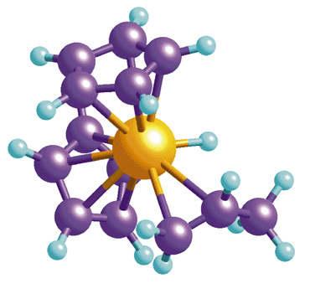
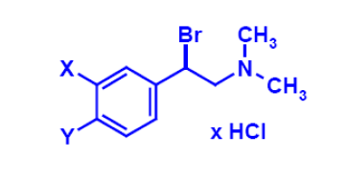

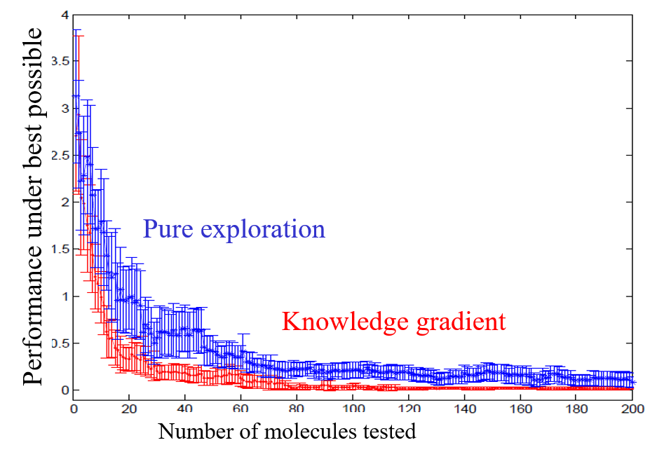
Drug discovery
Optimizing the configuration of molecules
Design of effective policies can accelerate the search process for new drugs.
Slide 5

Slide 6
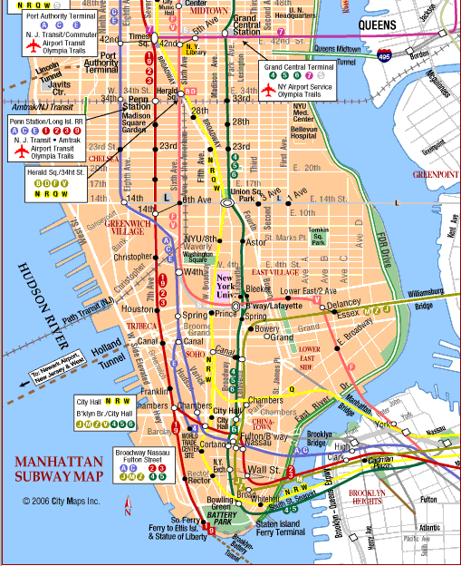
Finding the best path
Figure out Manhattan:
  Walking
  Subway/walking
  Taxi
  Street bus
  Driving
Paths may be intertwined
  Trying one path may inform you about the performance of other paths.
6
Notes:
6

Slide 7
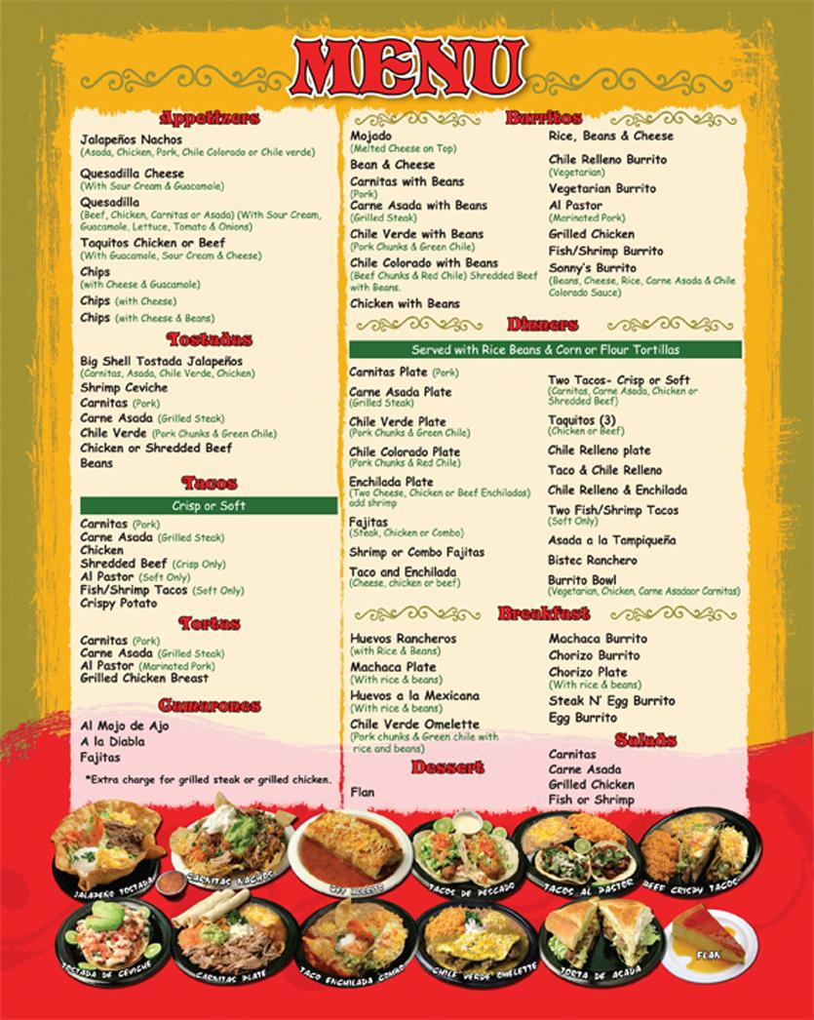
Designing menus
What should you offer?
  No-one will like everything on a menu.
  The trick is to find choices that will satisfy people.
  You will probably need to observe the response to a particular menu over a period of time.
  So, observations are time consuming.

Slide 8


E-commerce
Revenue management
  Optimizing prices to maximize total revenue for a particulate night in a hotel.
Ad-click optimization
  How much to bid for ads on the internet.
Personalized offer optimization
  Designing offers for individual customers.
Slide 8

Slide 9
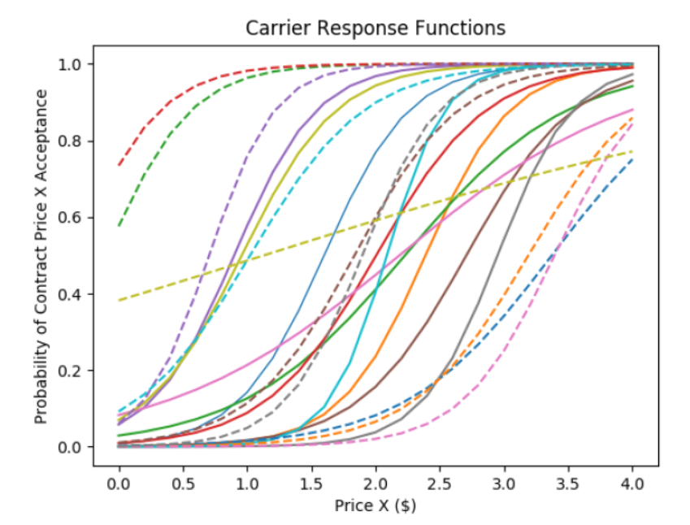
Princeton ad-click game
Learning the bid-response curve
  Varies by hour of week
  Response depends on location, age, gender, device
Clicks
Bid ($/click)
Slide 9

Slide 10
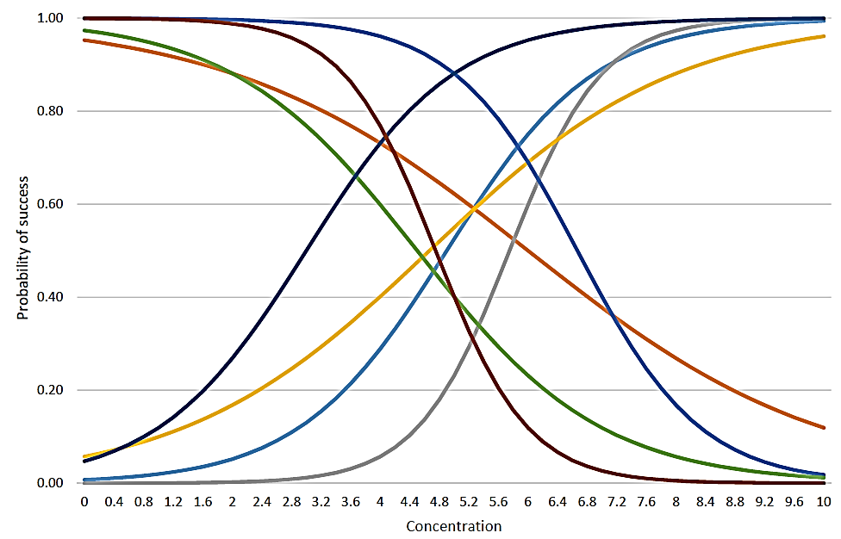
Truckload brokerages
We have to learn the response of shippers and carriers to price
  We propose logistics surves for each:
  Number of offers for each (i,j) pair is relatively small.
  Need to generalize the learning across “traffic lanes.”
Shipper
Carrier
Offered price
Slide 10

Slide 11
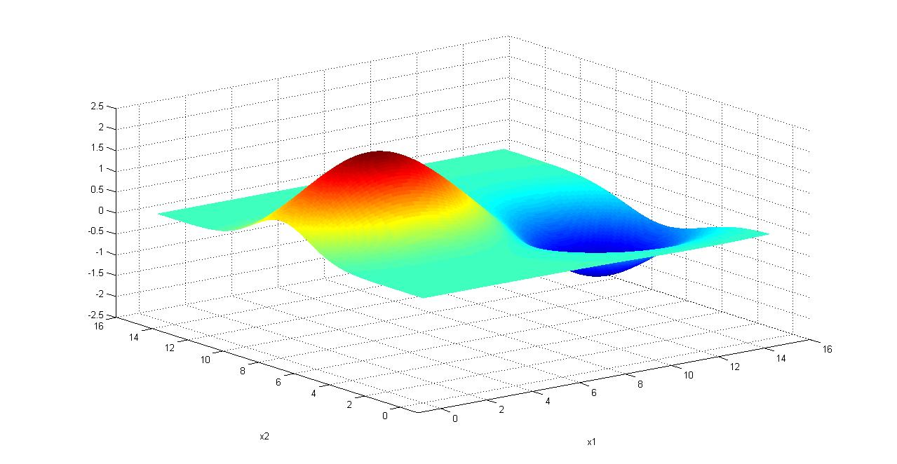
Battery arbitrage
Finding the best policy
  We need to maximize
  We cannot compute the expectation, so we run simulations:
Notes:
11

Slide 12
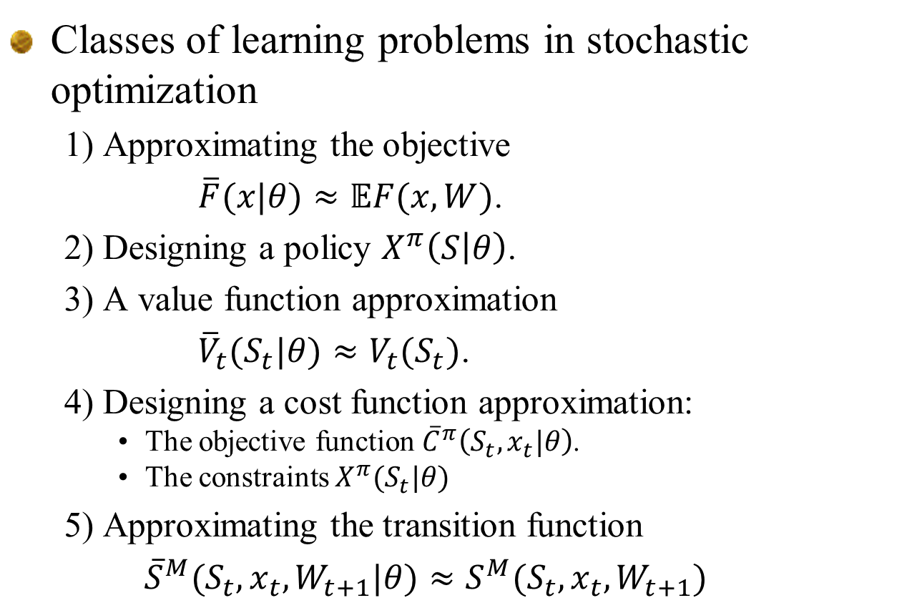
Learning problems
Classes of learning problems in stochastic optimization
  1) Approximating the objective
  $\overline{F}(x|θ)≈𝔼F(x,W)$.
  2) Designing a policy $X^{π}\left(S | θ\right)$.
  3) A value function approximation
  ${{\overline{V}}_{t}(S_{t}|θ)≈V}_{t}(S_{t})$.
  4) Designing a cost function approximation:
    The objective function ${\overline{C}}^{π}\left(S_{t},x_{t}|θ\right)$.
    The constraints $X^{π}(S_{t}|θ)$
  5) Approximating the transition function
  ${\overline{S}}^{M}(S_{t},x_{t},W_{t+1}|θ)≈S^{M}(S_{t},x_{t},W_{t+1})$
Slide 12

Slide 13

Learning challenges
NY Times, August 18 2019
A.I. … is improving … thanks to something called machine learning. But tech executives rarely discuss the labor-intensive process that goes into its creation. A.I. is learning from humans. Lots and lots of humans.

Slide 14

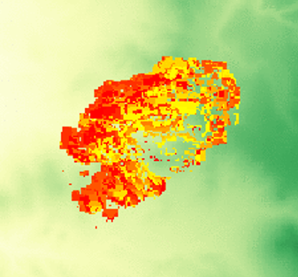
Learning challenges
The learning challenge
From big (batch) data…
… to sequential learning

Slide 15
Sequential learning
From batch to sequential learning:
  Sequential learning requires evolving from little or no data, to an evolving dataset.
  We have to adapt to data as it arrives.
Batch learning
Sequential learning
Slide 15

Slide 16
Elements of a learning problem
Sequential learning problems all consist of:
  Belief state – A statistical model that captures an estimate of some response given an input.
  A decision – This is the input that determines how an experiment is run, the choice of a drug, the price of a product, …
  Exogenous information – This is an observation of how well the experiment has performed, such as the results of the experiment, the response of a patient, the revenue from a product.
  Transition function – These are the equations for updating the statistical model.
  Objective function – This is how we evaluate how we perform over time.
Slide 16

Slide 17
Types of approximation strategies

Slide 18
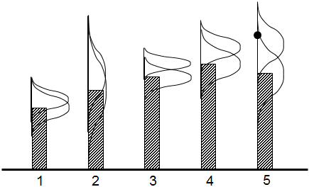
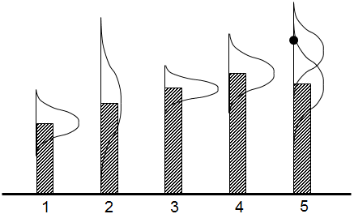
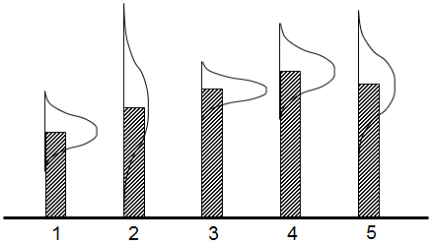
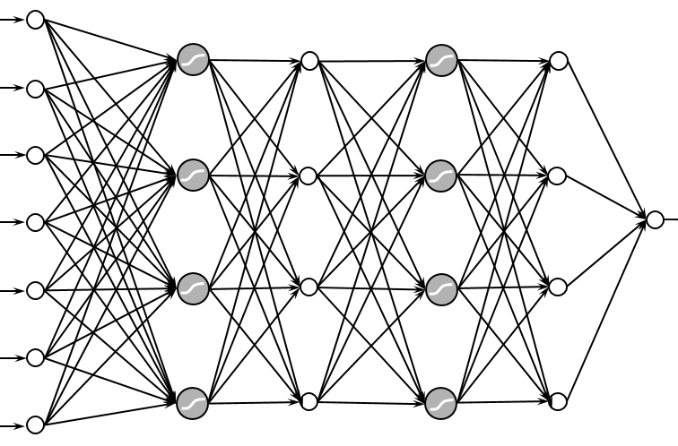
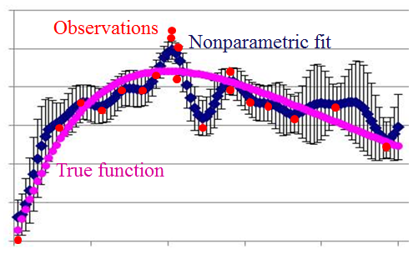
Approximation strategies
Approximation strategies
  Lookup tables
    Independent beliefs
    Correlated beliefs
  Linear parametric models
    Linear models
    Sparse-linear
    Tree regression
  Nonlinear parametric models
    Logistic regression
    Neural networks
  Nonparametric models
    Gaussian process regression
    Kernel regression
    Support vector machines
    Deep neural networks

Slide 19
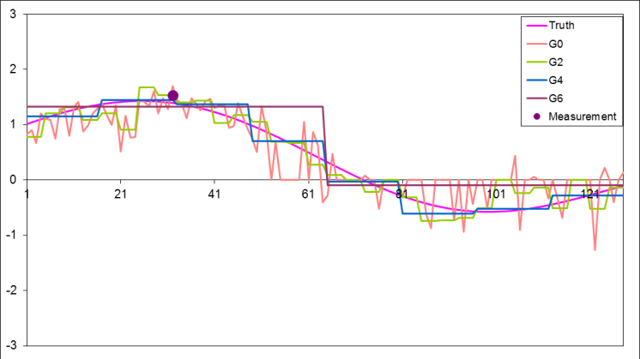
Approximating strategies
Lookup tables
  Independent beliefs
  Correlated beliefs
    A few dozen observations can teach us about thousands of points.
  Hierarchical models
    Create beliefs at different levels of aggregation and then use weighted combinations
Slide 19

Slide 20
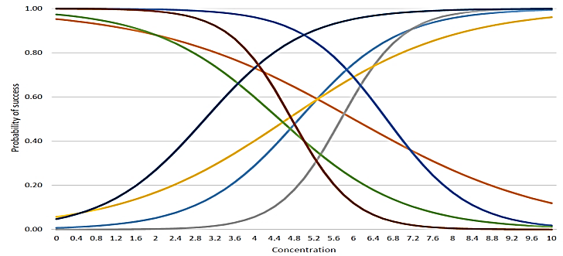
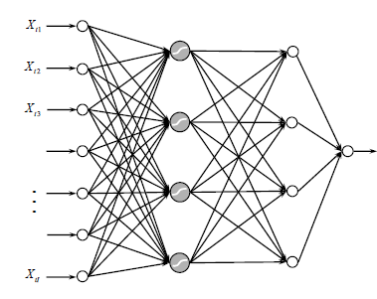
Approximating strategies
Parametric models
  Linear models
    Might include sparse-additive, where many parameters are zero.
  Nonlinear models
    (Shallow) Neural networks
Slide 20

Slide 21
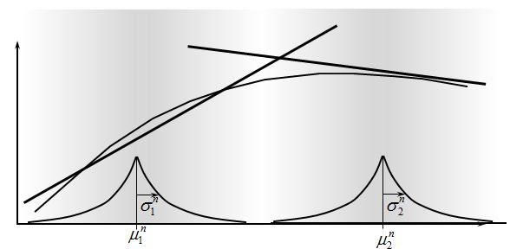
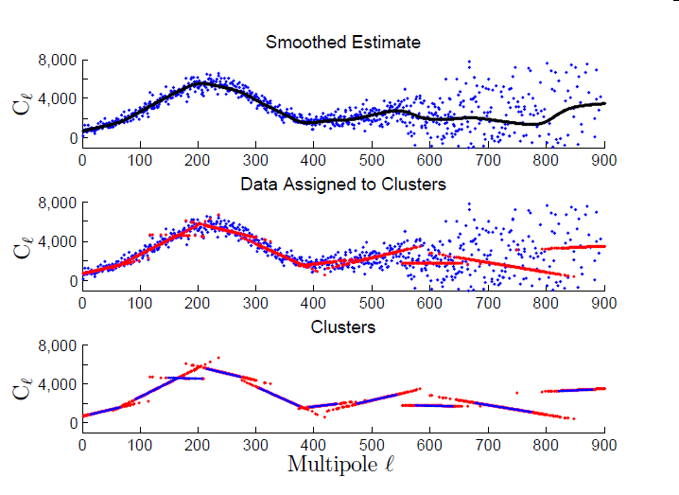
Approximating strategies
Nonparametric models
  Kernel regression
    Weighted average of neighboring points
    Limited to low dimensional problems
  Locally linear methods
    Dirichlet process mixtures
    Radial basis functions
  Splines
  Support vector machines
  Deep neural networks
Slide 21

Slide 22
Approximating strategies
Notes:
  World of “big data” encourages use of high-dimensional architectures:
    Kernel regression
    Locally linear models
    Support vector machines
    Deep neural networks
  Modern uses of neural networks (e.g. image recognition) depend on massive datasets (e.g. millions of records).
  In stochastic optimization, we are often estimating functions iteratively, starting with little or no data and growing.
  There are many applications where we are limited to dozens of iterations, although we will have settings where we may run an algorithm hundreds or even thousands of iterations.
Slide 22

Slide 23
Approximating strategies
What we are going to focus on:
  Lookup tables
    Frequentist vs. Bayesian
    Independent beliefs
    Correlated beliefs
    Hierarchical representations (time permitting)
  Parametric models
    Linear in the parameters
    Nonlinear in the parameters
  Sampled models
    This can be thought of as a nonparametric distribution.
  Recursive estimation
    Classical machine learning is batch
    Our algorithms will always require adaptive learning (known as “online machine learning” in the computer science community).
Slide 23

Slide 24
Lookup tables
Independent beliefs
Bayesian vs. frequentist

Slide 25
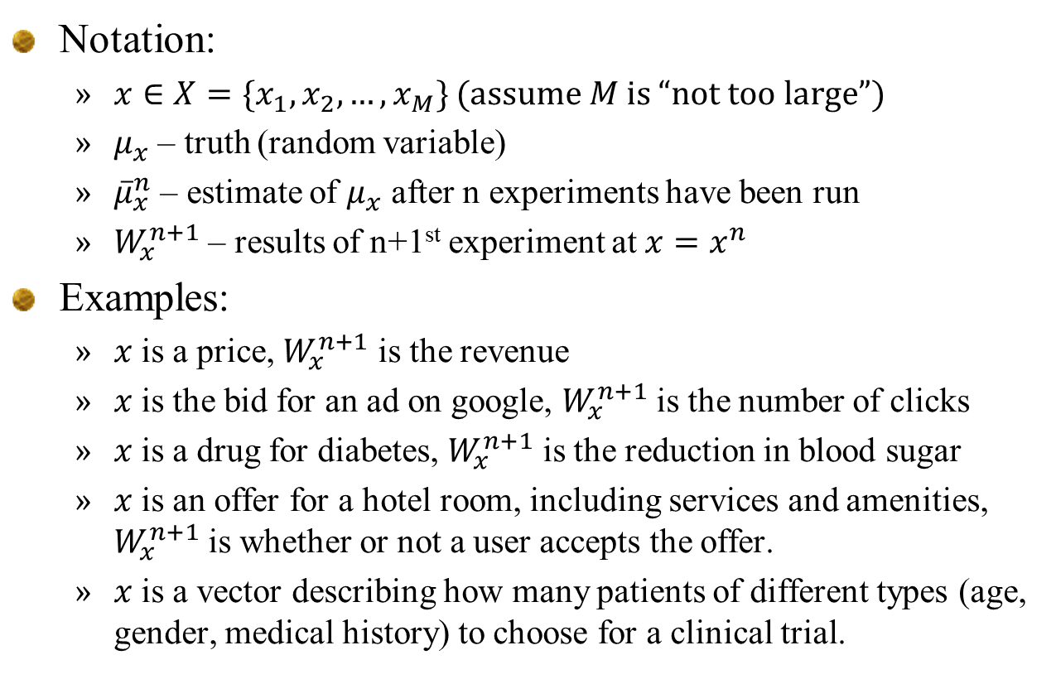
Learning with lookup tables
Notation:
  $x∈X=\{x_{1},x_{2},…, x_{M}\}$ (assume $M$ is “not too large”)
  $μ_{x}$ – truth (random variable)
  ${\overline{μ}}_{x}^{n}$ – estimate of $μ_{x}$ after n experiments have been run
  $W_{x}^{n+1}$ – results of n+1st experiment at $x=x^{n}$
Examples:
  $x$ is a price, $W_{x}^{n+1}$ is the revenue
  $x$ is the bid for an ad on google, $W_{x}^{n+1}$ is the number of clicks
  $x$ is a drug for diabetes, $W_{x}^{n+1}$ is the reduction in blood sugar
  $x$ is an offer for a hotel room, including services and amenities, $W_{x}^{n+1}$ is whether or not a user accepts the offer.
  $x$ is a vector describing how many patients of different types (age, gender, medical history) to choose for a clinical trial.
Slide 25

Slide 26
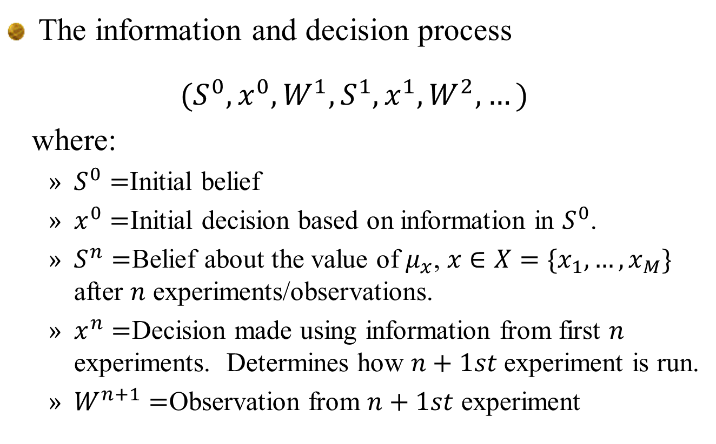
Learning with lookup tables
The information and decision process
$${(S}^{0},x^{0},W^{1},S^{1},x^{1},W^{2},…)$$
where:
  $S^{0}=$Initial belief
  $x^{0}=$Initial decision based on information in $S^{0}$.
  $S^{n}=$Belief about the value of $μ_{x}$, $x∈X=\{x_{1},…,x_{M}\}$ after $n$ experiments/observations.
  $x^{n}=$Decision made using information from first $n$ experiments. Determines how $n+1st$experiment is run.
  $W^{n+1}=$Observation from $n+1st$ experiment
Slide 26

Slide 27
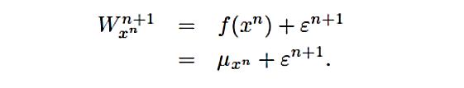
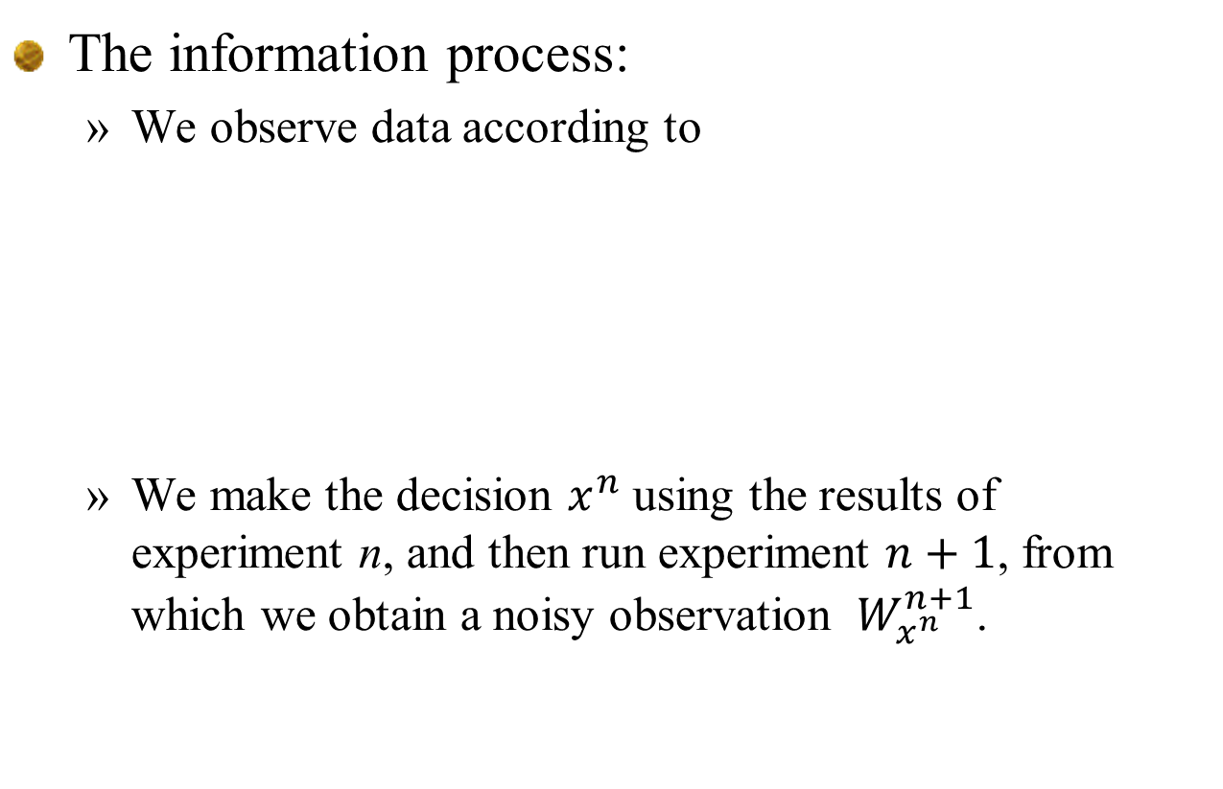
Learning with lookup tables
The information process:
  We observe data according to
  We make the decision $x^{n}$ using the results of experiment n, and then run experiment $n+1$, from which we obtain a noisy observation $W_{x^{n}}^{n+1}$.
Truth
Slide 27

Slide 28
Learning with lookup tables
Frequentist view
  Estimates are based purely on experimental observations.
  Does not require any prior knowledge; similarly, it is not able to use any prior knowledge that might be available.
Slide 28

Slide 29
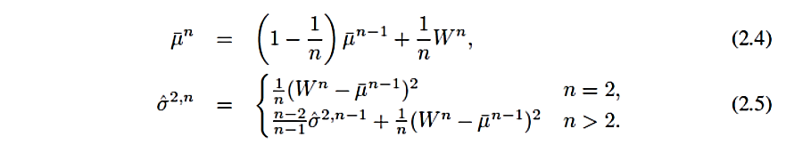
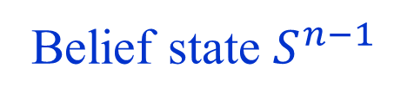
Learning with lookup tables
Frequentist estimation:
  Batch
  Recursive
Belief state $S^{n−1}$
Slide 29

Slide 30
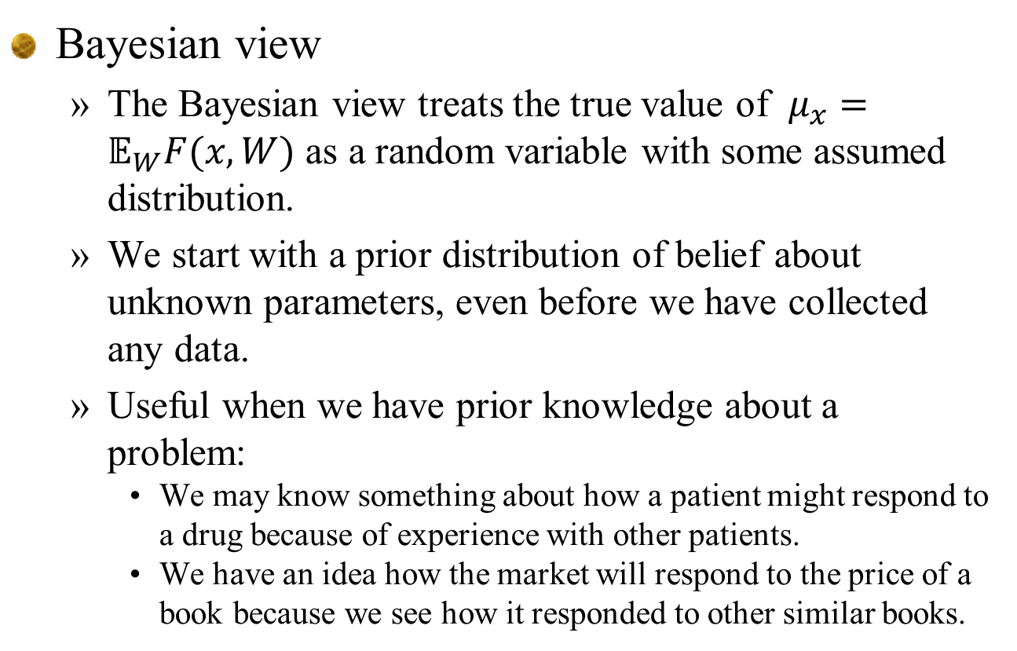
Learning with lookup tables
Bayesian view
  The Bayesian view treats the true value of $μ_{x}=𝔼_{W}F(x,W)$ as a random variable with some assumed distribution.
  We start with a prior distribution of belief about unknown parameters, even before we have collected any data.
  Useful when we have prior knowledge about a problem:
    We may know something about how a patient might respond to a drug because of experience with other patients.
    We have an idea how the market will respond to the price of a book because we see how it responded to other similar books.
Slide 30

Slide 31
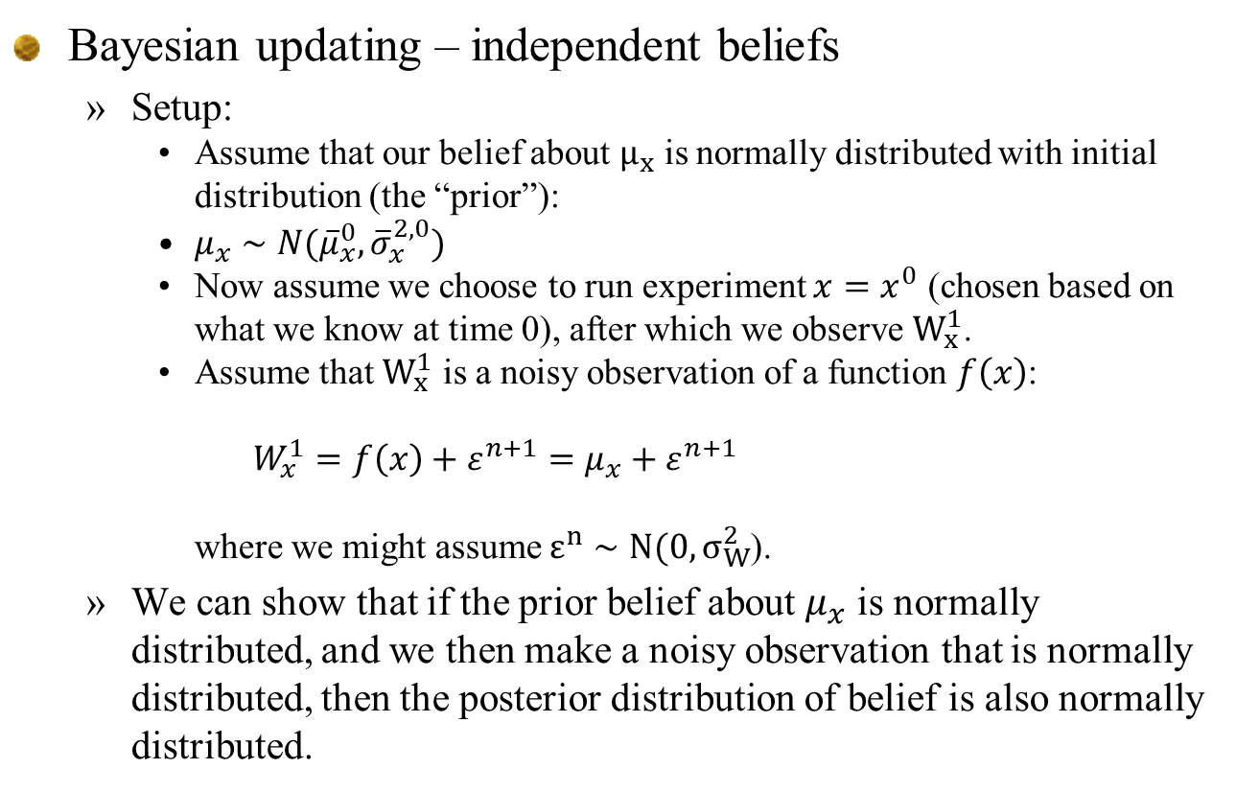
Learning with lookup tables
Bayesian updating – independent beliefs
  Setup:
    Assume that our belief about $μ_{x}$ is normally distributed with initial distribution (the “prior”):
    $μ_{x}∼N({\overline{μ}}_{x}^{0},{\overline{σ}}_{x}^{2,0})$
    Now assume we choose to run experiment $x=x^{0}$ (chosen based on what we know at time 0), after which we observe $W_{x}^{1}$.
    Assume that $W_{x}^{1}$ is a noisy observation of a function $f\left(x\right)$:
      $$W_{x}^{1}=f\left(x\right)+ε^{n+1}=μ_{x}+ε^{n+1}$$
    where we might assume $ε^{n}∼N(0,σ_{W}^{2}$).
  We can show that if the prior belief about $μ_{x}$ is normally distributed, and we then make a noisy observation that is normally distributed, then the posterior distribution of belief is also normally distributed.
Slide 31

Slide 32
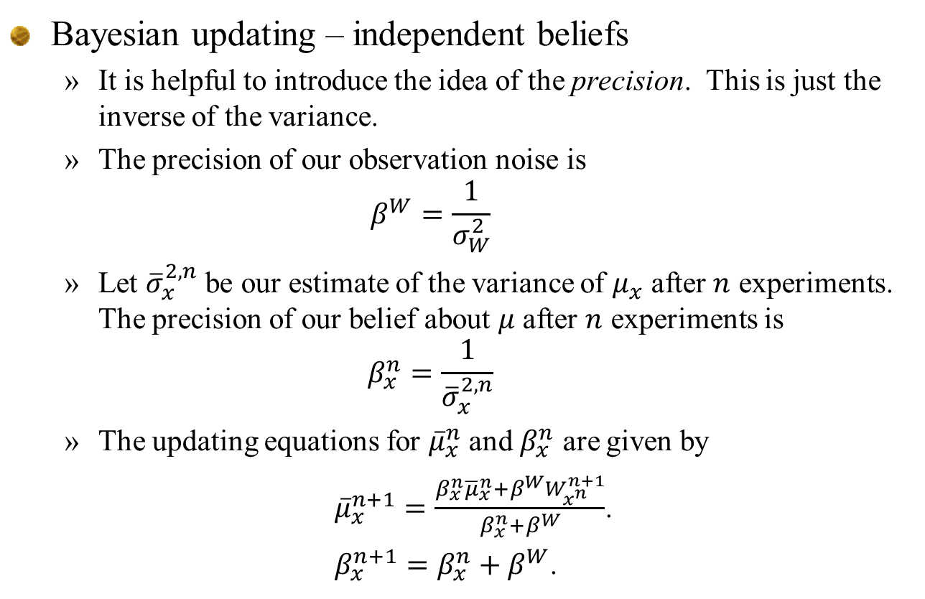
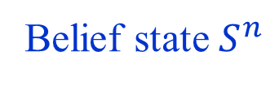
Learning with lookup tables
Bayesian updating – independent beliefs
  It is helpful to introduce the idea of the precision. This is just the inverse of the variance.
  The precision of our observation noise is
  $$β^{W}=\frac{1}{σ_{W}^{2}}$$
  Let ${\overline{σ}}_{x}^{2,n}$ be our estimate of the variance of $μ_{x}$ after $n$ experiments. The precision of our belief about $μ$ after $n$ experiments is
  $$β_{x}^{n}=\frac{1}{{\overline{σ}}_{x}^{2,n}}$$
  The updating equations for ${\overline{μ}}_{x}^{n}$ and $β_{x}^{n}$ are given by
  ${\overline{μ}}_{x}^{n+1}=\frac{{β_{x}^{n}{\overline{μ}}_{x}^{n}+β}^{W}W_{x^{n}}^{n+1}}{{β_{x}^{n}+β}^{W}}$.
  $β_{x}^{n+1}=β_{x}^{n}+β^{W}$.
Belief state $S^{n}$
Slide 32

Slide 33
Lookup tables
Correlated beliefs

Slide 34
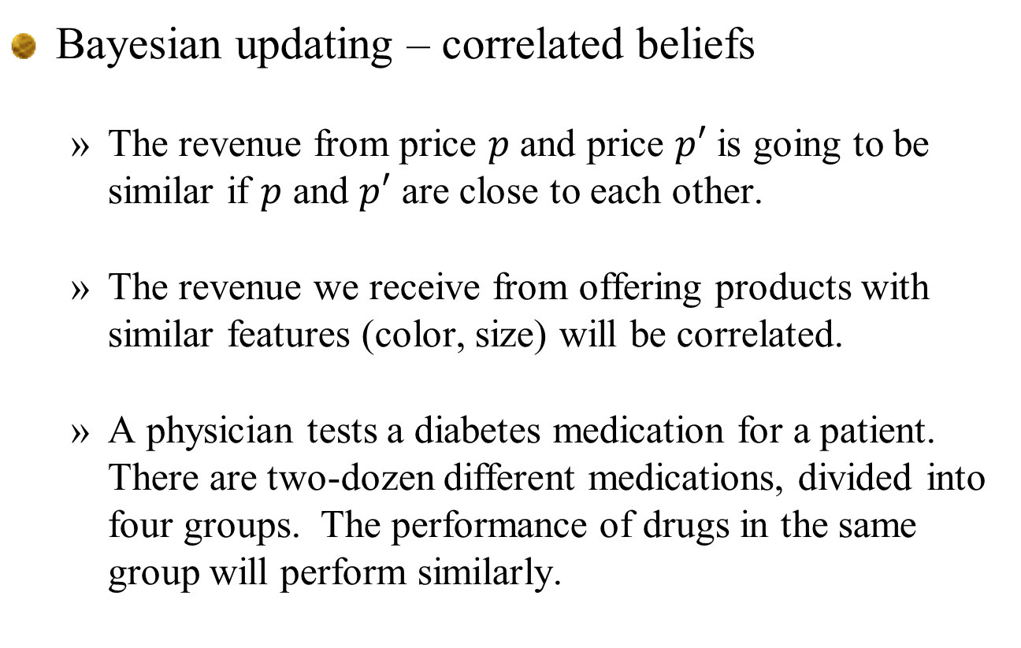
Lookup tables – correlated beliefs
Bayesian updating – correlated beliefs
  The revenue from price $p$ and price $p′$ is going to be similar if $p$ and $p′$ are close to each other.
  The revenue we receive from offering products with similar features (color, size) will be correlated.
  A physician tests a diabetes medication for a patient. There are two-dozen different medications, divided into four groups. The performance of drugs in the same group will perform similarly.
Slide 34

Slide 35
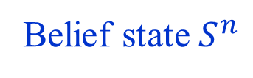
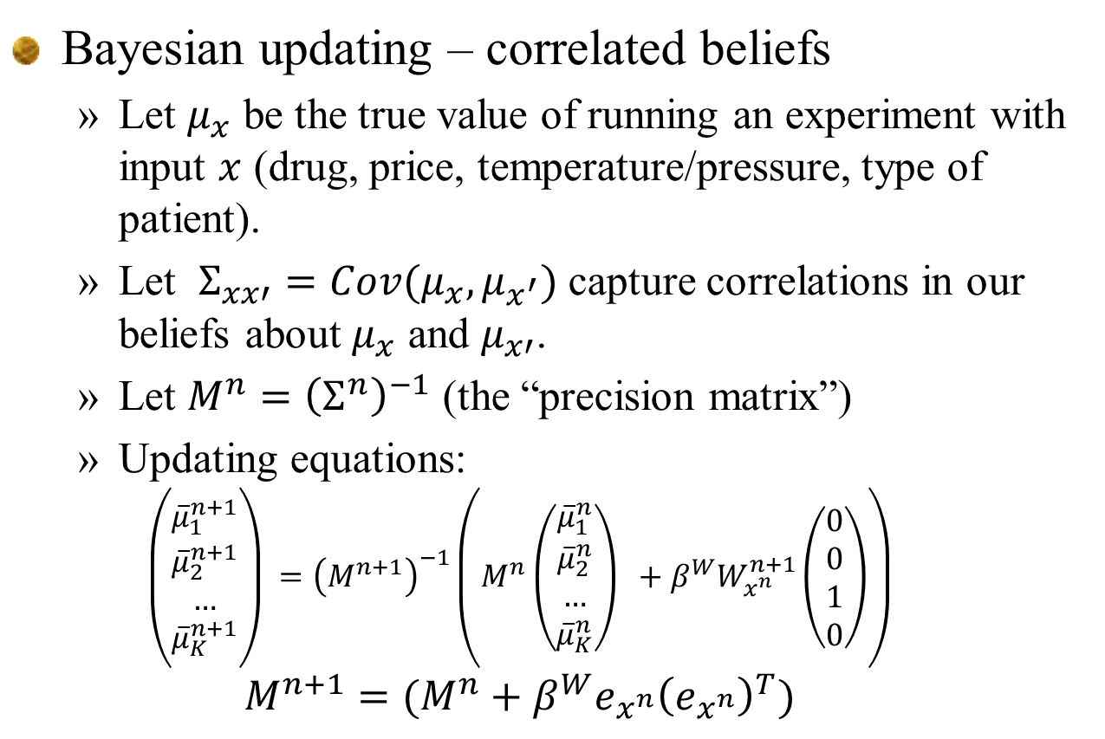

Lookup tables – correlated beliefs
Bayesian updating – correlated beliefs
  Let $μ_{x}$ be the true value of running an experiment with input $x$ (drug, price, temperature/pressure, type of patient).
  Let $Σ_{xx′}=Cov(μ_{x},μ_{x^{′}})$ capture correlations in our beliefs about $μ_{x}$ and $μ_{x′}$.
  Let $M^{n}={\left(Σ^{n}\right)}^{−1}$ (the “precision matrix”)
  Updating equations:
  $$\left(\begin{aligned}{\overline{μ}}_{1}^{n+1} \\ {\overline{μ}}_{2}^{n+1} \\ … \\ {\overline{μ}}_{K}^{n+1}\end{aligned}\right) ={\left(M^{n+1}\right)}^{−1}\left(M^{n}\left(\begin{aligned}{\overline{μ}}_{1}^{n} \\ {\overline{μ}}_{2}^{n} \\ … \\ {\overline{μ}}_{K}^{n}\end{aligned}\right) +β^{W}W_{x^{n}}^{n+1}\left(\begin{aligned}0 \\ 0 \\ 1 \\ 0\end{aligned}\right)\right)$$
  $$M^{n+1}=(M^{n}+β^{W}e_{x^{n}}{\left(e_{x^{n}}\right)}^{T})$$
Belief state $S^{n}$
Entry $x^{n}$
Slide 35

Slide 36
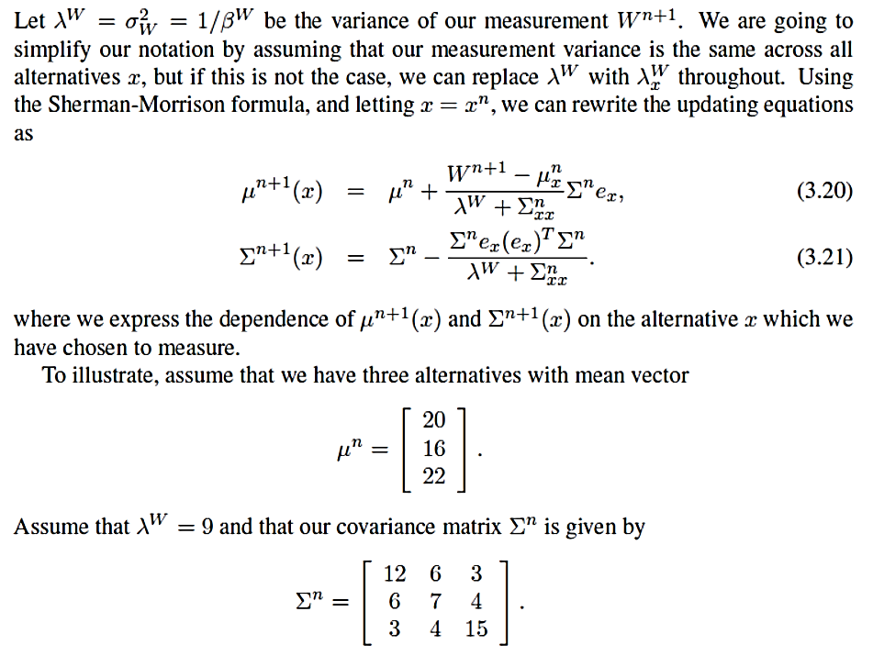
Lookup tables – correlated beliefs
Bayesian updating – correlated beliefs
  The recursive updating equations are quite simple:
  Numerical example:
Slide 36

Slide 37
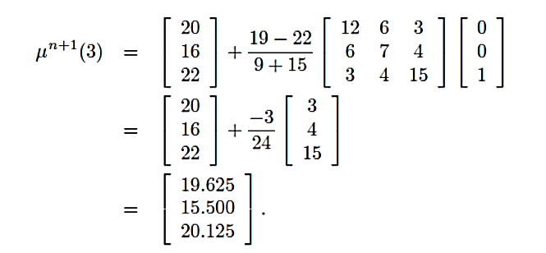

Lookup tables – correlated beliefs
Bayesian updating – correlated beliefs
  Assume we choose $x=3$ and observe $W^{n+1}=19.$
  The updated estimate of the means are then
Slide 37

Slide 38
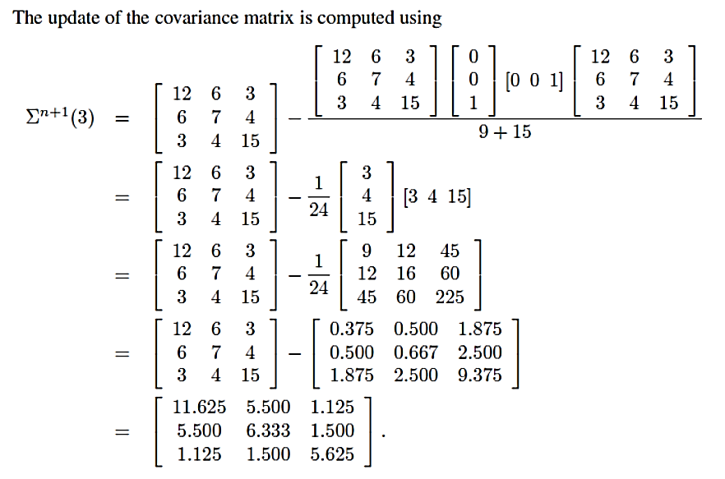
Lookup tables – correlated beliefs
Bayesian updating – correlated beliefs
  The updated covariance matrix is:
Slide 38

Slide 39
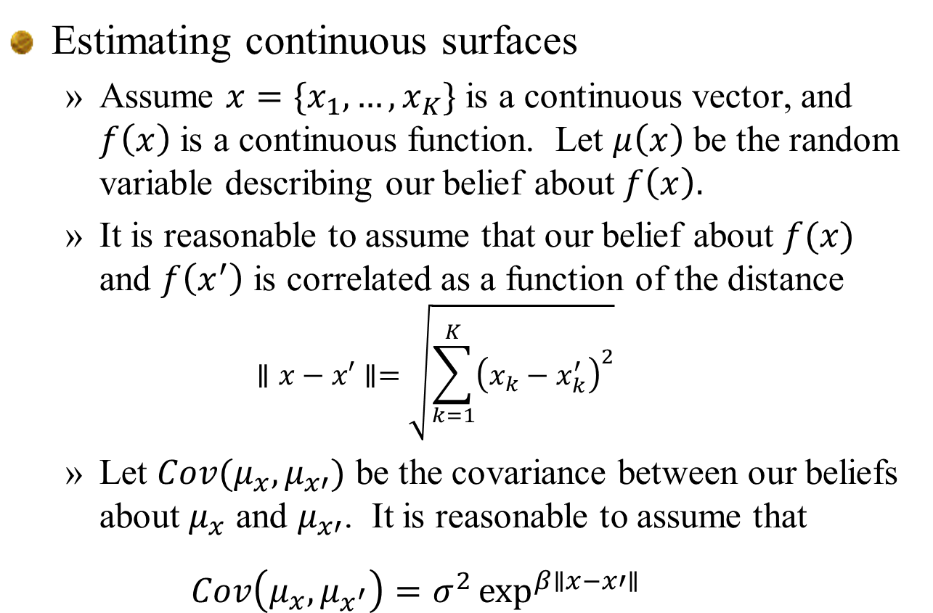
Lookup tables – correlated beliefs
Estimating continuous surfaces
  Assume $x=\{x_{1},…, x_{K}\}$ is a continuous vector, and $f\left(x\right)$ is a continuous function. Let $μ\left(x\right)$ be the random variable describing our belief about $f\left(x\right).$
  It is reasonable to assume that our belief about $f(x)$ and $f\left(x^{′}\right)$ is correlated as a function of the distance
  $$∥x−x′∥=\sqrt{\sum_{k=1}^{K}{{\left(x_{k}−x_{k}^{′}\right)}^{2}}}$$
  Let $Cov(μ_{x},μ_{x′})$ be the covariance between our beliefs about $μ_{x}$ and $μ_{x′}$. It is reasonable to assume that
  $$Cov\left(μ_{x},μ_{x^{′}}\right)=σ^{2}\exp^{β∥x−x′∥}{}$$
Slide 39

Slide 40
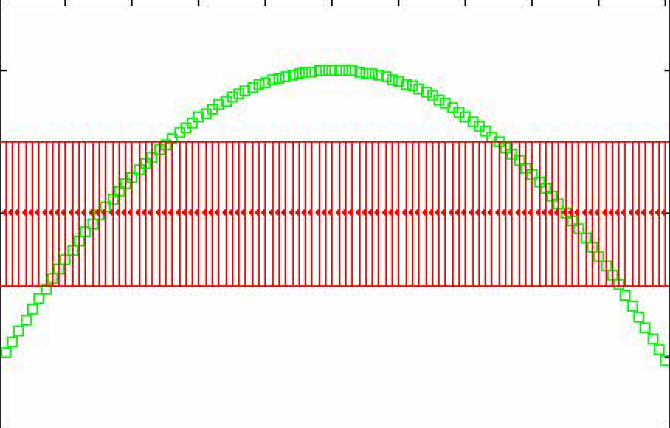
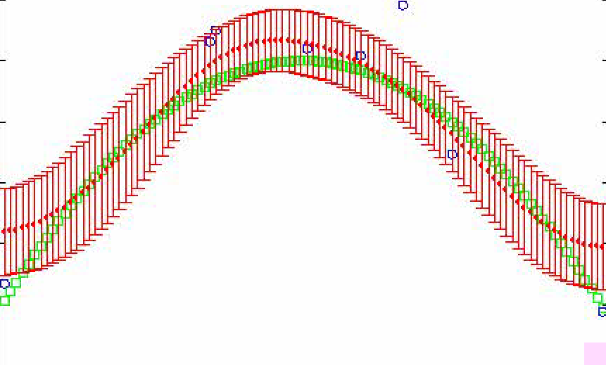
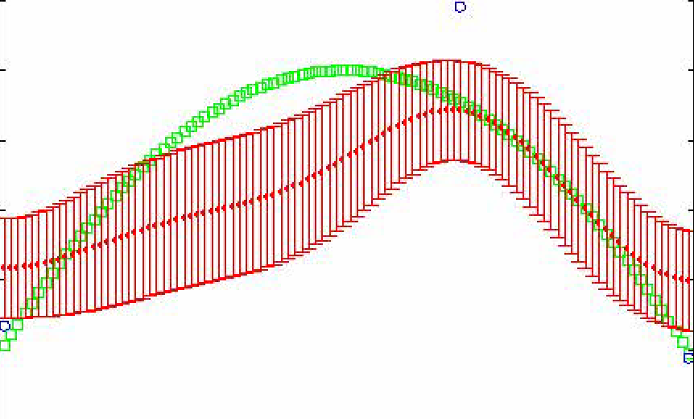
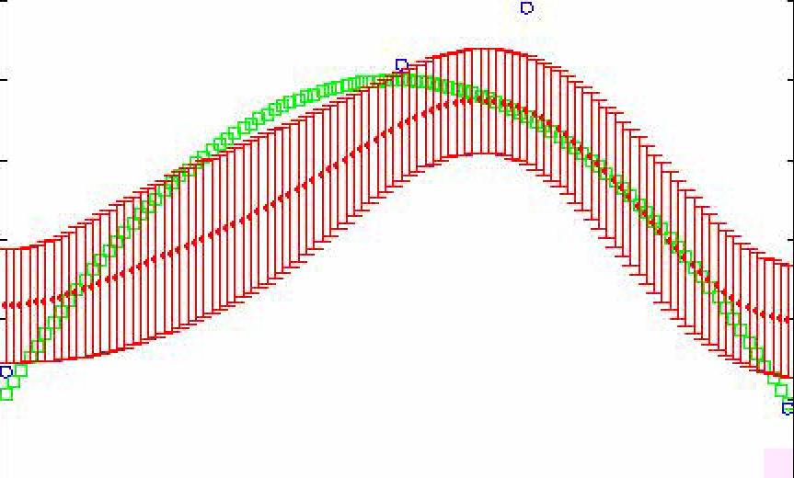
Lookup tables – correlated beliefs
Green = Truth
Red = Belief
Slide 40

Slide 41
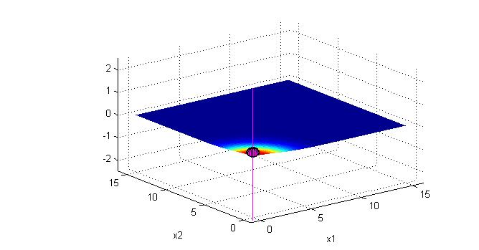
Lookup tables – correlated beliefs
Learning a two-dimensional surface
Notes:
41

Slide 42
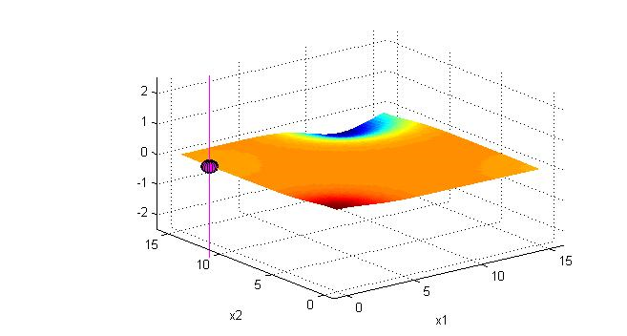
Lookup tables – correlated beliefs
Learning a two-dimensional surface
Notes:
42

Slide 43
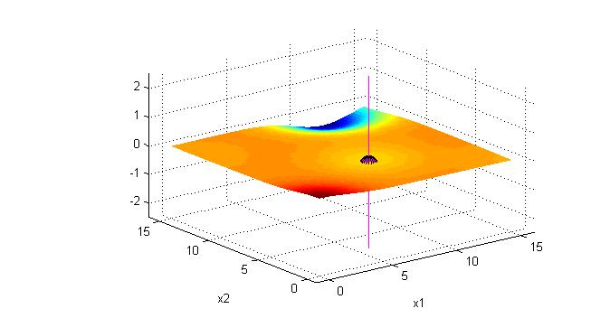
Lookup tables – correlated beliefs
Learning a two-dimensional surface
Notes:
43

Slide 44
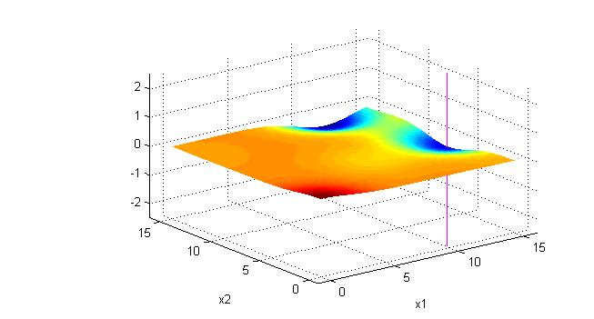
Lookup tables – correlated beliefs
Learning a two-dimensional surface
Notes:
44

Slide 45
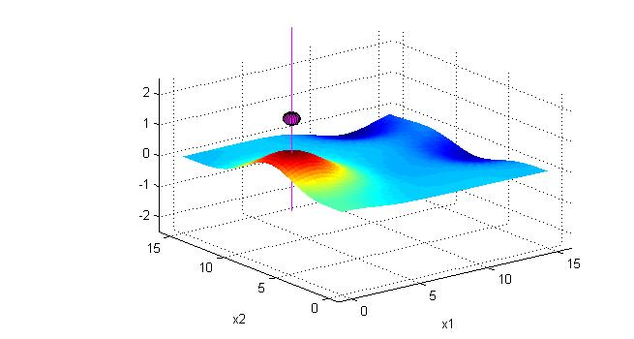
Lookup tables – correlated beliefs
Learning a two-dimensional surface
Notes:
45

Slide 46
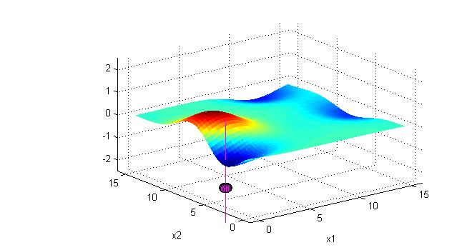
Lookup tables – correlated beliefs
Learning a two-dimensional surface
Notes:
46

Slide 47

Lookup tables – correlated beliefs
Learning a two-dimensional surface
Notes:
47

Slide 48

Lookup tables – correlated beliefs
Learning a two-dimensional surface
Notes:
48

Slide 49
Lookup tables – correlated beliefs
Notes:
  Correlated beliefs is a powerful way of estimating continuous surfaces with a relatively small number of observations.
  These updates require the use of a “distance function” that measures the distance between two points on the surface. Care needs to be used if you have more than about 5 dimensions.
  This logic can be used for categorical data:
    Consumer choices based on age, location, gender, …
    Performance of different materials that share characteristics.
    Behavior of a drug as a function of patient characteristics.
Slide 49

Slide 50
Parametric models
Linear models

Slide 51


Learning in stochastic optimization
Recursive least squares
  Let ${\hat{F}}^{n+1}$ be the observation and let our model be
  We update our estimate ${\overline{θ}}^{n}$ using our recursive least squares equations:
Belief state $S^{n}$
Slide 51

Slide 52
Parametric models
Nonlinear models

Slide 53


Sampled belief models
Notes:
  We often have to take expectations of nonlinear functions imbedded in maximization problems, such as
  $$𝔼_{θ}\max_{x}{f(x|θ)}$$
  If $θ$ is a vector, this can be complicated.
  We can overcome this using a sampled belief model where we replace the probability distribution for the unknown (random) parameter $θ$ with a sample
  $$(θ_{1},θ_{2},…,θ_{K})$$
  Now let $p_{k}^{n}=Prob[θ=θ_{k}|S^{n}]$. Now the expectation is simply
  $𝔼_{θ}\left\{\max_{x}{f(x|θ)}|S^{n}\right\}=\sum_{k=1}^{K}{\max_{x}{f\left(x | θ_{k}\right)p_{k}^{n}}}$
Belief state $S^{n}$
Slide 53

Slide 54

Sampled belief models
A sampled belief model
Response
Concentration/temperature
Slide 54

Slide 55
Sampled belief models
Possible experimental outcomes
Response
Possible
responses
Concentration/temperature
Slide 55

Slide 56
Sampled belief models
Running an experiment – here we see the actual realization
Response
Actual response
Concentration/temperature
Slide 56

Slide 57

Sampled belief models
Updated posterior reflects proximity to each curve
Response
Concentration/temperature
Slide 57

Slide 58

Nonlinear parametric models
The sampled belief model
  The sampled belief model represents the belief about the parameter $θ$ in $f(y|θ)$ is given by a finite sample $(θ_{1},…, θ_{K})$ with probability vector $(p_{1}^{n},…,p_{K}^{n})$.
  Belief state is now $S^{n}={\left(θ_{k},p_{k}^{n}\right)}_{k=1}^{K}.$
  We approximate the $𝔼_{θ}\{f(y|θ)|S^{n}\}$using
  $$𝔼_{θ}\left\{f\left(y | θ\right) | S^{n}\right\}={\overline{f}}^{n}(y)=\sum_{k=1}^{K}{f\left(y | θ_{k}\right)p_{k}^{n}}$$
  At time $n+1,$ we have observed $W^{n+1}=w.$ The expectation $𝔼_{θ}\{f(y|θ)|{x^{n}=x,S}^{n+1}\}$ is given by
  $$𝔼_{θ}\left\{f\left(y | θ\right) | x^{n}=x,W^{n+1}=w,S^{n+1}\right\}=\sum_{k=1}^{K}{f\left(y | θ_{k}\right)p_{k}^{n+1}(x,w)}$$

Slide 59

Nonlinear parametric models
The sampled belief model (cont’d)
  Let
  $$P^{W}\left(w | x,θ\right)=Prob[W^{n+1}=w|x,θ]$$
  be the probability distribution of $W^{n+1}$ given that we choose to observe $f(x|θ)$ for $x^{n}=x$ and $θ.$
  We update the probabilities $p_{k}^{n}=Prob[θ=θ_{k}|H^{n}]$ using Bayes theorem:
  $$p_{k}^{n+1}(x,w)=\frac{P^{W}\left(w | x,θ=θ_{k}\right)p_{k}^{n}}{\sum_{k=1}^{K}{P^{W}\left(w | x,θ=θ_{k}\right)p_{k}^{n}}}$$
  The challenge with using Bayes theorem tends to be in the denominator. The sampled belief model makes this quite easy.

Slide 60

Sampled belief models
Notes:
  Working with a sampled belief model can be exceptionally easy and flexible.
  We can apply rules to make sure we are creating valid sampled estimates.
    E.g. we might want to ensure that some coefficients are positive.
  The challenge is that if $θ$ is high-dimensional, a small sample (e.g. 100) may not contain any samples that are close to the true optimal solution.
  There are strategies that involve periodically re-generating new samples that can overcome this.
Slide 60

Slide 61
Nonparametric models

Slide 62
Nonparametric methods
Parametric vs. nonparametric
  Working definition of nonparametric:
    Given an infinitely large dataset, a nonparametric model can provide a perfect fit.
  “Parametric” models are inherently low dimensional.
    Might have hundreds of parameters, perhaps more.
    Includes “small” neural networks.
  “Nonparametric” models are inherently high dimensional.
    Deep neural networks may have tens of thousands of parameters. In principle can fit anything given a large enough dataset.
Slide 62

Slide 63

Nonparametric methods
Nonparametric methods
  A nonparametric model has the property that as the amount of data goes to infinity, modeling errors go to zero.
  Kernel regression – Locally weighted smoothing.
  Locally linear
Slide 63

Slide 64

Nonparametric methods
Parametric vs. nonparametric
  Robust CFAs are parametric
  Scenario trees are nonparametric
Observations
Nonparametric fit
Total revenue
Parametric fit
True function
Price of product
Slide 64

Slide 65

Nonparametric methods
Slide 65

Slide 66
Approximating strategies
Parametric vs. sampled distributions
  A sampled representation of a distribution is a form of nonparametric model
Parametric distribution (pdf)
Nonparametric distribution (cdf)
Slide 66

Slide 67
Nonparametric methods
Discussion:
  Nonparametric representations require that you keep the entire history, which makes it very hard to “store” a model.
  Local smoothing methods struggle with curse of dimensionality. In high dimensions, no two data points are ever “close.” This limits the use of clustering methods.
Slide 67

Slide 68
Nonparametric methods
More advanced methods
  Support vector machines (classification)
  Support vector regression (continuous)
    We have had surprising but limited success with SVM, but considerably more empirical research is needed.
  Neural networks (covered next)
Slide 68

Slide 69
Neural networks

Slide 70










Neural networks
A single layer neural network
$$X_{t1}$$
$$\frac{1}{1+e^{−θX}}$$
$$X_{t2}$$
$${\hat{y}}_{t+1}$$
$$X_{t3}$$
Inputs
$$f(x|θ)$$
$$ε_{t+1}$$
$$X_{tI}$$
Slide 70

Slide 71
Neural networks
Multilayer neural networks
  You can get richer behaviors by adding “hidden layers” and manipulating the number of nodes per layer.
Slide 71

Slide 72

Neural networks
Deep neural networks
  By adding layers (and nodes) we can create an architecture that can approximate virtually anything.
  An appeal is that we do not have to know the structure in advance…
  …but the price of this generality is big datasets.
$$…$$
Slide 72

Slide 73


Neural networks
Neural networks: parametric or nonparametric?
  Working definition of a nonparametric model:
  As data $→∞$, modelling error $→0$.
  Shallow neural networks are parametric models (the parameters are the weights on the arcs).
  Deep neural networks are nonparametric. They are very high dimensional (effectively infinite) and can fit anything with enough data.
Slide 73

Slide 74
Neural networks
Notes:
  Neural networks are very high-dimensional architectures
  When used with classical batch learning, they require very large datasets.
  There are settings where we can use iterative learning (e.g. for value functions and policies), but these may require many millions of iterations (as is done with AlphaZero).
  Shallow neural networks have been popular for many years for deterministic engineering control problems.
  Risk of overfitting stochastic problems is high.
Slide 74

Slide 75
Model selection
Notes:
  Lookup tables:
    Best if you have no structure
    Correlated beliefs or hierarchical belief models help
    … but suffers from curse of dimensionality.
  Parametric
    Best if you know the structure of the function.
  Semi/local/non parametric:
    This is a hybrid of lookup table and parametric.
    The concept of “local” introduces the same complexities as lookup table.
Slide 75

Slide 76
The curse of dimensionality

Slide 77
Curse of dimensionality
Bellman’s optimality equation:
These are the “three curses of dimensionality.”
Slide 77

Slide 78

The curse of dimensionality
The curse of dimensionality
  This is often confused with any vector-valued learning problem (esp. in the context of dynamic programming).
  It only arises when using lookup table representations of functions:
1
2
3
Dimensions
Slide 78

Slide 79

The curse of dimensionality
“Solving” the curse of dimensionality is like inventing a perpetual motion machine
  The curse of dimensionality is a true curse. It cannot be “solved” without structure
    Convexity, linearity, monotonicity, …
  Claims to approximate functions without structure should be treated like perpetual motion machines.
Slide 79

Slide 80


The curse of dimensionality
Slide 80

Slide 81
The curse of dimensionality
Please!
  Dynamic programming does not suffer from the curse of dimensionality!
  Lookup tables suffer from the curse of dimensionality!
Slide 81

