Slide 1
A Unified Framework for
Sequential Decision Analytics
Olin Business School
University of Washington, St. Louis
November 5-6, 2019
Warren B. Powell
Princeton University
Department of Operations Research
and Financial Engineering

Slide 2

Modeling

Slide 3

Canonical problems

Slide 4
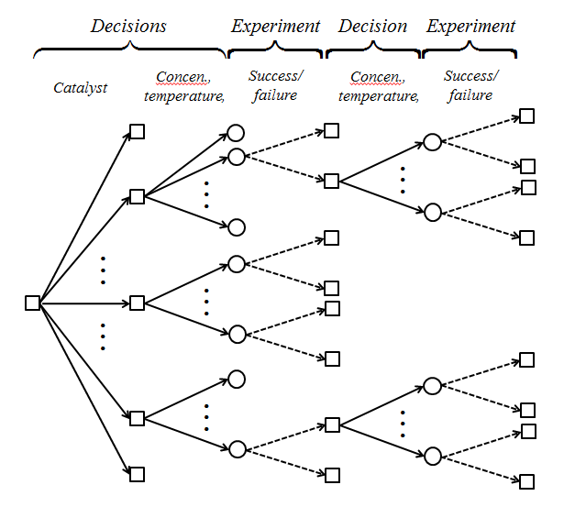
Canonical problems
Decision trees
Slide 4

Slide 5
Canonical problems
Stochastic search (derivative based)
  Basic problem:
  Stochastic gradient
  Asymptotic convergence:
  Finite time performance
Manufacturing network (x=design)
Unit commitment problem (x=day ahead decisions)
Inventory system (x=design, replenishment policy)
Battery system (x=choice of material)
Patient treatment cost (x=drug, treatments)
Trucking company (x=fleet size and mix)
Slide 5

Slide 6
Canonical problems
Ranking and selection (derivative free)
  Basic problem:
  We need to design a policy that finds a design given by
  We refer to this objective as maximizing the final reward.
Slide 6

Slide 7
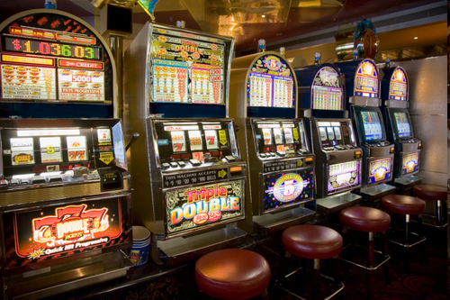
Canonical problems
Multi-armed bandit problems
  We learn the reward from playing each “arm”
  We need to find a policy for playing machine x that maximizes:
  where
What we know about each slot machine
Choose next “arm” to play
New information
We refer to this problem as maximizing cumulative reward.
Slide 7

Slide 8
Canonical problems
(Discrete) Markov decision processes
  Bellman’s optimality equation
  This is also the same as solving
    where the optimal policy has the form
Slide 8

Slide 9
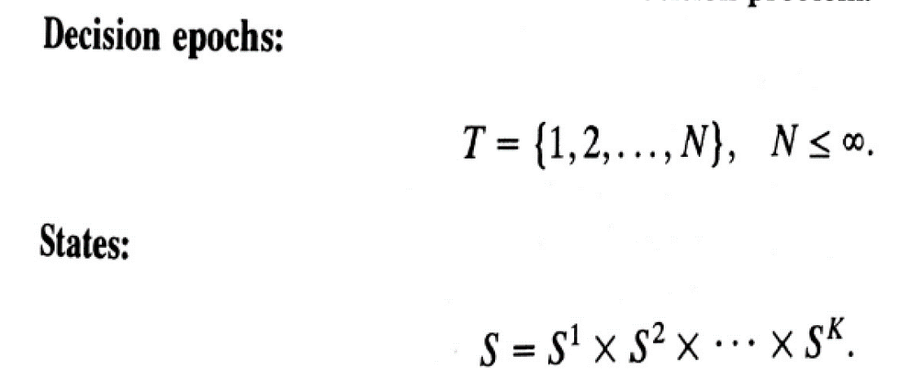
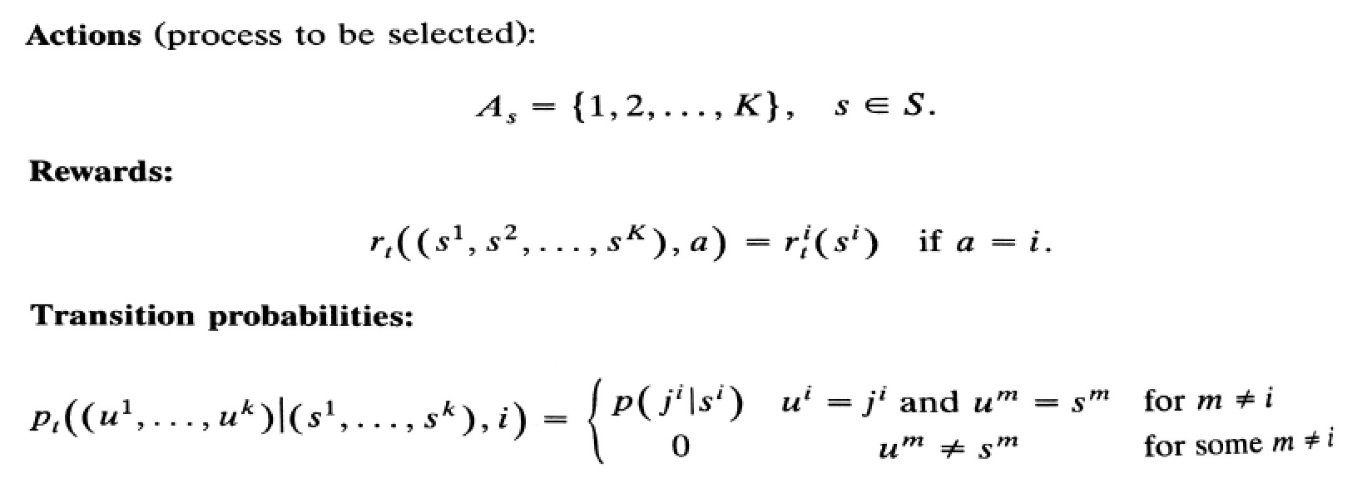
Canonical problems
“Canonical model” from Puterman (Ch. 3)

Slide 10
Value function approximations
Reinforcement learning (computer science)
  Q-learning (for discrete actions)
  The second edition of Reinforcement Learning (Sutton and Barto, forthcoming) includes other solution approaches:
    Policy search (Boltzmann policies)
    Upper confidence bounding
    Monte Carlo tree search
Slide 10

Slide 11
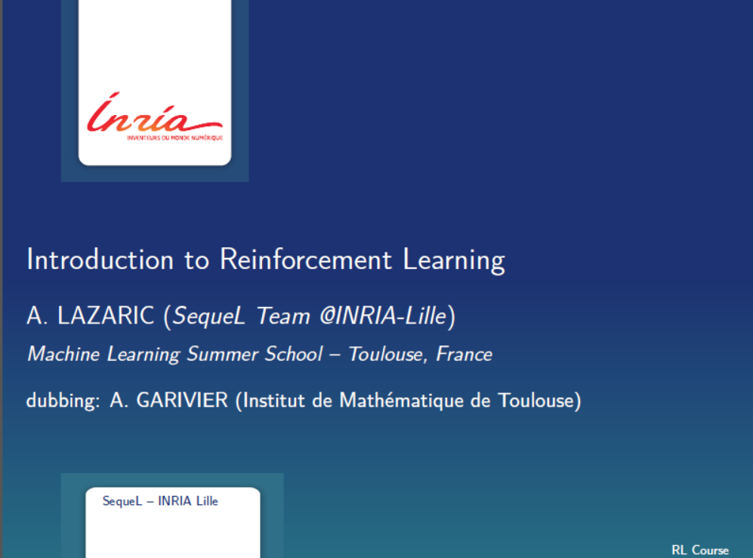

Slide 12
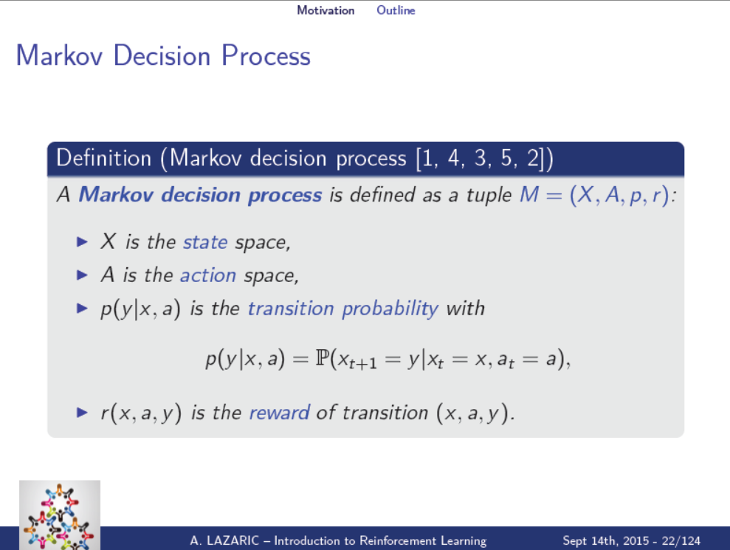
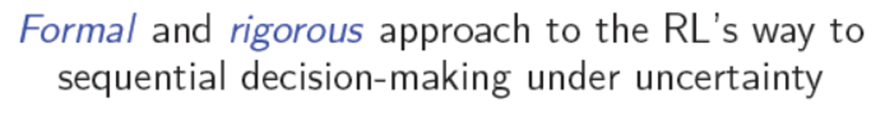


“This modeling framework is virtually useless for practical applications.” Warren Powell

Slide 13
Canonical problems
Optimal stopping I (popular with mathematicians)
  Model:
    Exogenous process:
    Decision:
    Reward:
  Optimization problem:
    where is a “stopping time” (or )
Slide 13

Slide 14
Canonical problems
Optimal stopping II (my style)
  Model:
    Exogenous process:
    State:
    Policy:
  Optimization problem:
Slide 14

Slide 15
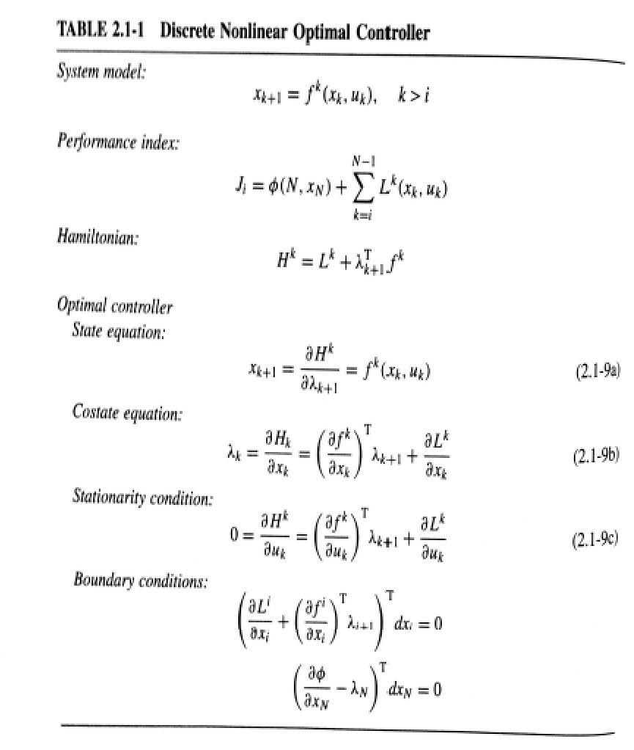
Canonical problems
From “Optimal Control” by Lewis, Vrabie and Syrmos
  Standard model in optimal control is deterministic.
  Bundles objective function with optimality criteria comparable to Bellman equations.

Slide 16
Canonical problems
Linear quadratic regulation (LQR) - Deterministic
  A popular optimal control problem in engineering involves solving:
  where:
  Possible to show that the optimal policy looks like:
  where is a complicated function of Q and R.
Slide 16

Slide 17
Canonical problems
Linear quadratic regulation (LQR) – Stochastic
  A popular optimal control problem in engineering involves solving:
  where:
  … better is to optimize over policies:
  where:
Slide 17

Slide 18
Canonical problems
Stochastic programming
  A (two-stage) stochastic programming problem
  where
  This is the canonical form of stochastic programming, which might also be written over multiple periods:
Slide 18

Slide 19
Canonical problems
Stochastic programming
  A (two-stage) stochastic programming policy
  where
  This is the canonical form of stochastic programming, which might also be written over multiple periods:
Slide 19

Slide 20
Canonical problems
A robust optimization problem would be written
  This means finding the best design x for the worst outcome w in an “uncertainty set”
  This has been adapted to multiperiod problems
Slide 20

Slide 21
Canonical problems
A robust optimization problem would be written
  This means finding the best design x for the worst outcome w in an “uncertainty set”
  … but it is often used as a policy
Slide 21

Slide 22
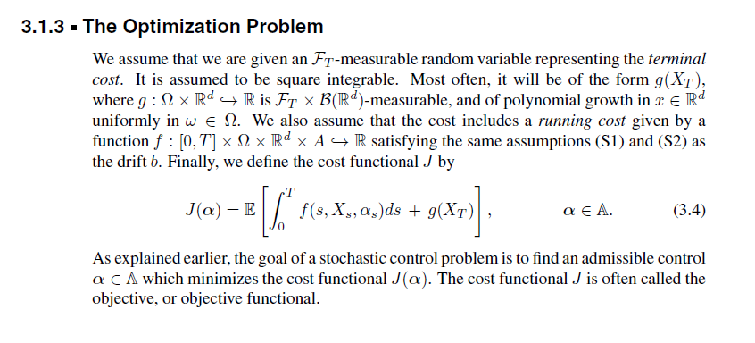
Canonical problems
Stochastic control (from text by Rene Carmona)
  This is mathematically correct, but does not suggest a path to computation, or even how to model a real problem.
Slide 22

Slide 23
Canonical problems
Why do we need a unified framework?
  The classical frameworks and algorithms are fragile.
  Small changes to problems invalidate optimality conditions, or make algorithmic approaches intractable.
  Practitioners need robust approaches that will provide high quality solutions for all problems.

Slide 24
Elements of a dynamic model

Slide 25
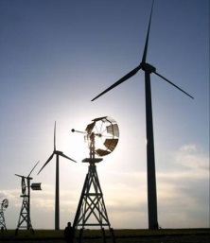
Elements of a dynamic model
Before we can solve complex problems, we have to know how to think about them.
The biggest challenge when making decisions under uncertainty is modeling.
Min E {Σ cx}
Ax = b
x > 0
Organize class
libraries, and set up
communications and
databases
Mathematician
Software
Slide 25

Slide 26
Elements of a dynamic model
For deterministic problems, we speak the language of mathematical programming
  Linear programming:
  For time-staged problems
Arguably Dantzig’s biggest contribution, more so than the simplex algorithm, was his articulation of optimization problems in a standard format, which has given algorithmic researchers a common language.
Slide 26

Slide 27

Stochastic
programming
Approximate
dynamic
programming
Robust
optimization
Decision
analysis
Simulation
optimization
Optimal
learning
Bandit
problems
Dynamic
Programming
and
control
Model
predictive
control
Stochastic
search
Optimal
control
Active
learning
Reinforcement
learning
Online
computation
Markov
decision
processes
Stochastic
control
Simulation
optimization
© Warren Powell 2019
Notes:
Clearing the Jungle of Stochastic optimization – Professor Warren Powell in the Department of Operations Research and Financial Engineering has developed a unified framework for modeling virtually every problem involving optimization under uncertainty. More than just a purely theoretical characterization, he has identified four (meta)classes of policies which provide a clear path to computation (although there is still a lot of work to do for most problems). The framework has identified new problem classes, as well as novel computational strategies. For example, modeling and algorithmic strategies that have long been viewed as competitive (for example, dynamic programming versus stochastic programming) are actually complementary. By building on this integrated framework, we can spend less time focusing on optimizing (making decisions), and more time on an overlooked dimension of stochastic optimization, which is modeling uncertainty.

Slide 28
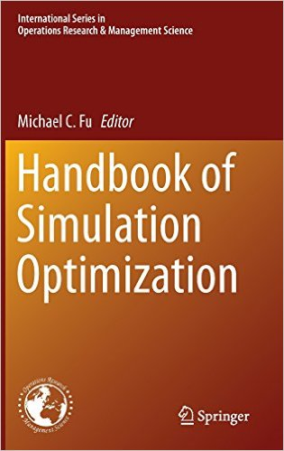
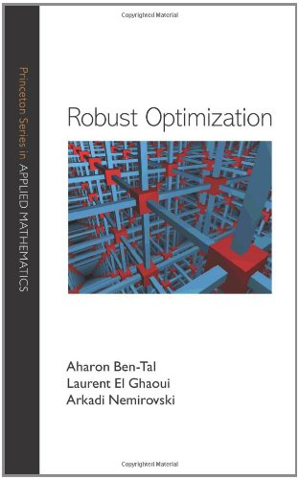
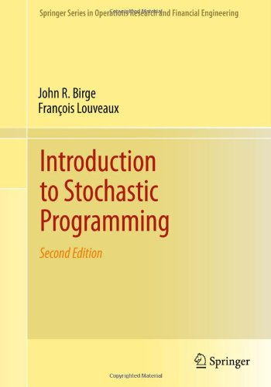

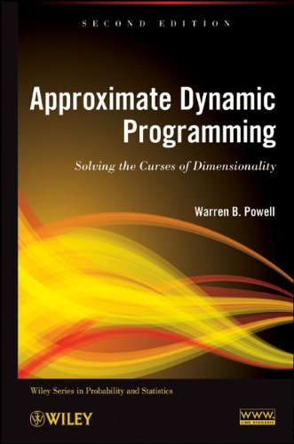
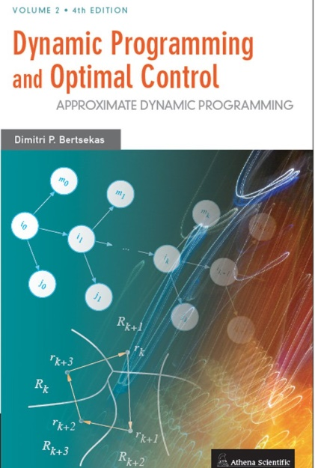

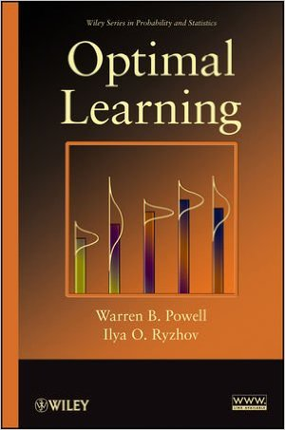
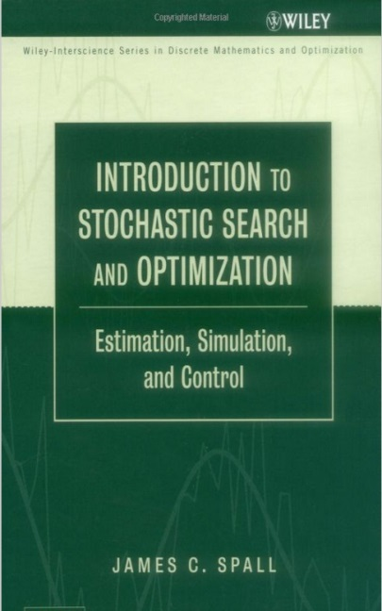
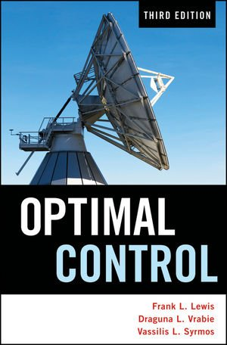
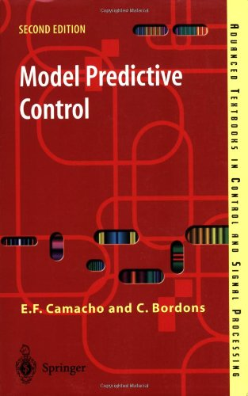
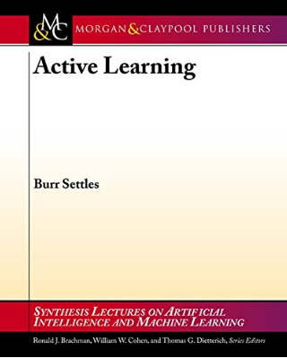
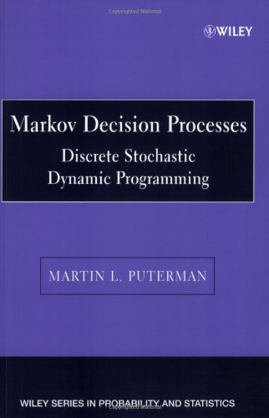
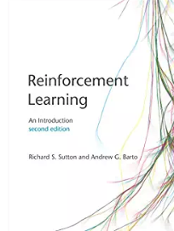

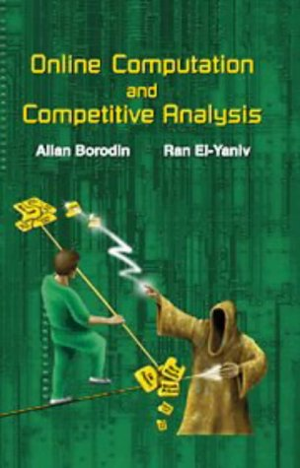
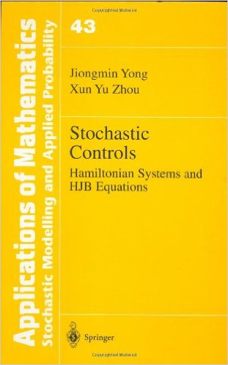
Stochastic
programming
Approximate
dynamic
programming
Robust
optimization
Decision
analysis
Simulation
optimization
Optimal
learning
Bandit
problems
Dynamic
Programming
and
control
Model
predictive
control
Stochastic
search
Optimal
control
Active
learning
Reinforcement
learning
Online
computation
Markov
decision
processes
Stochastic
control
Simulation
optimization
© Warren Powell 2019
Notes:
Clearing the Jungle of Stochastic optimization – Professor Warren Powell in the Department of Operations Research and Financial Engineering has developed a unified framework for modeling virtually every problem involving optimization under uncertainty. More than just a purely theoretical characterization, he has identified four (meta)classes of policies which provide a clear path to computation (although there is still a lot of work to do for most problems). The framework has identified new problem classes, as well as novel computational strategies. For example, modeling and algorithmic strategies that have long been viewed as competitive (for example, dynamic programming versus stochastic programming) are actually complementary. By building on this integrated framework, we can spend less time focusing on optimizing (making decisions), and more time on an overlooked dimension of stochastic optimization, which is modeling uncertainty.

Slide 29
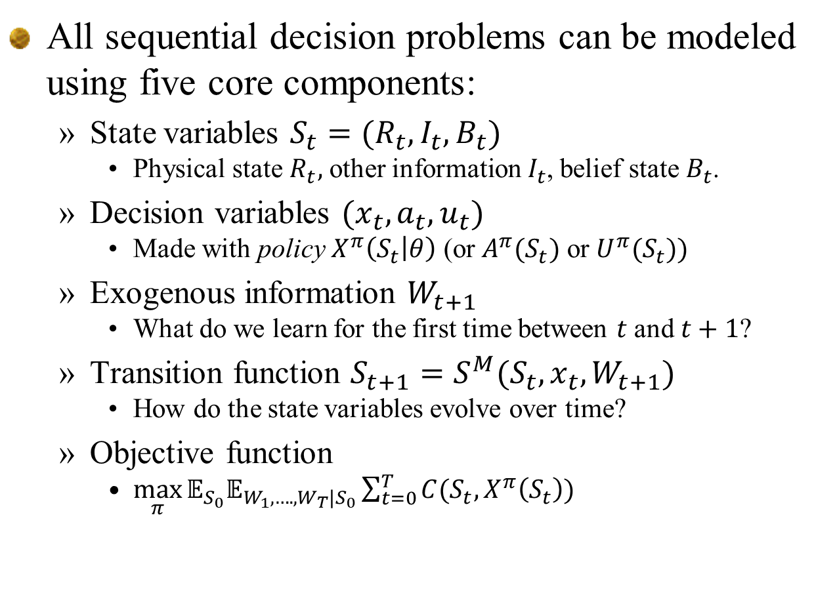
Elements of a dynamic model
All sequential decision problems can be modeled using five core components:
  State variables $S_{t}=(R_{t},I_{t},B_{t})$
    Physical state $R_{t},$ other information $I_{t}$, belief state $B_{t}$.
  Decision variables $(x_{t},a_{t},u_{t})$
    Made with policy $X^{π}\left(S_{t} | θ\right)$ (or $A^{π}(S_{t})$ or $U^{π}(S_{t}))$
  Exogenous information $W_{t+1}$
    What do we learn for the first time between $t$ and $t+1$?
  Transition function $S_{t+1}=S^{M}(S_{t},x_{t},W_{t+1})$
    How do the state variables evolve over time?
  Objective function
    $\max_{π}{𝔼_{S_{0}}𝔼_{W_{1},….,W_{T}|S_{0}}\sum_{t=0}^{T}{C(S_{t},X^{π}\left(S_{t}\right))}}$
Slide 29

Slide 30
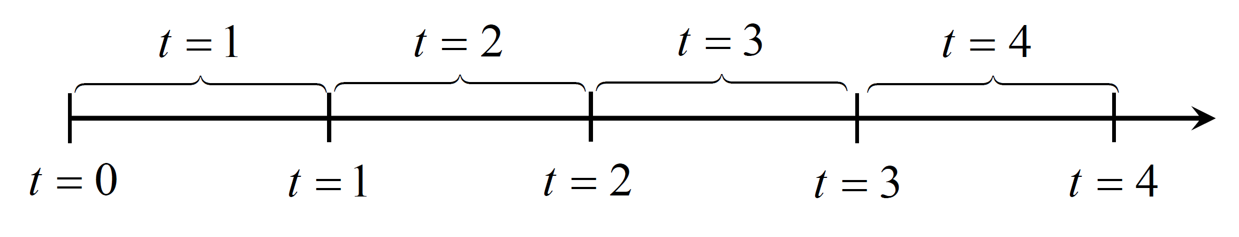






Elements of a dynamic model
Modeling time
  It is important to understand the relationship between discrete time and continuous time when modeling the flow of information (“stochastic systems”)
  Any variable indexed by $t$ is known at time $t$.
  Use same principles when indexing by a counter $n$.
$$W_{t+1}$$
$$S_{t}$$
$$x_{t}$$
$$S_{t+1}$$
$$x_{t+1}$$
Slide 30

Slide 31
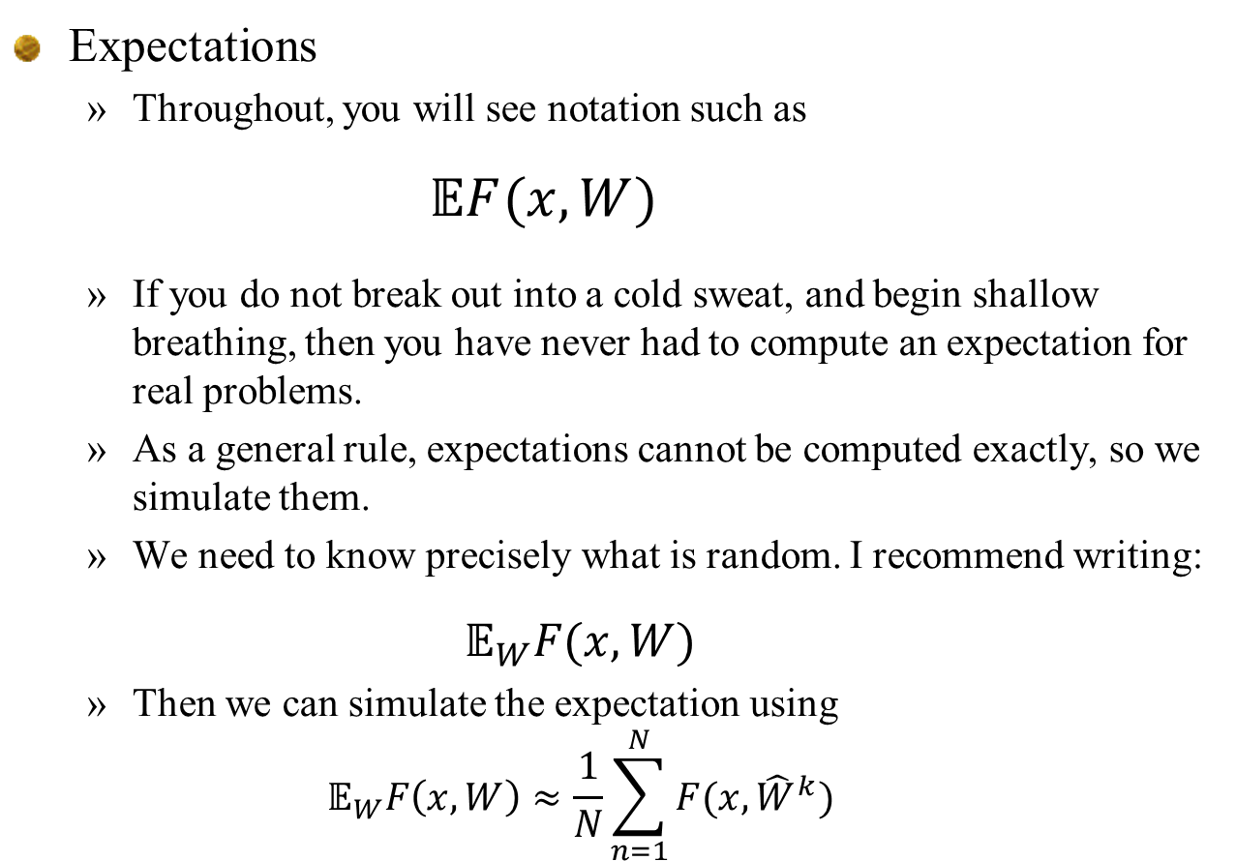
Elements of a dynamic model
Expectations
  Throughout, you will see notation such as
    $$𝔼F(x,W)$$
  If you do not break out into a cold sweat, and begin shallow breathing, then you have never had to compute an expectation for real problems.
  As a general rule, expectations cannot be computed exactly, so we simulate them.
  We need to know precisely what is random. I recommend writing:
  $$𝔼_{W}F(x,W)$$
  Then we can simulate the expectation using
  $$𝔼_{W}F\left(x,W\right)≈\frac{1}{N}\sum_{n=1}^{N}{F(x,{\hat{W}}^{k})}$$
Random sample
Slide 31

Slide 32
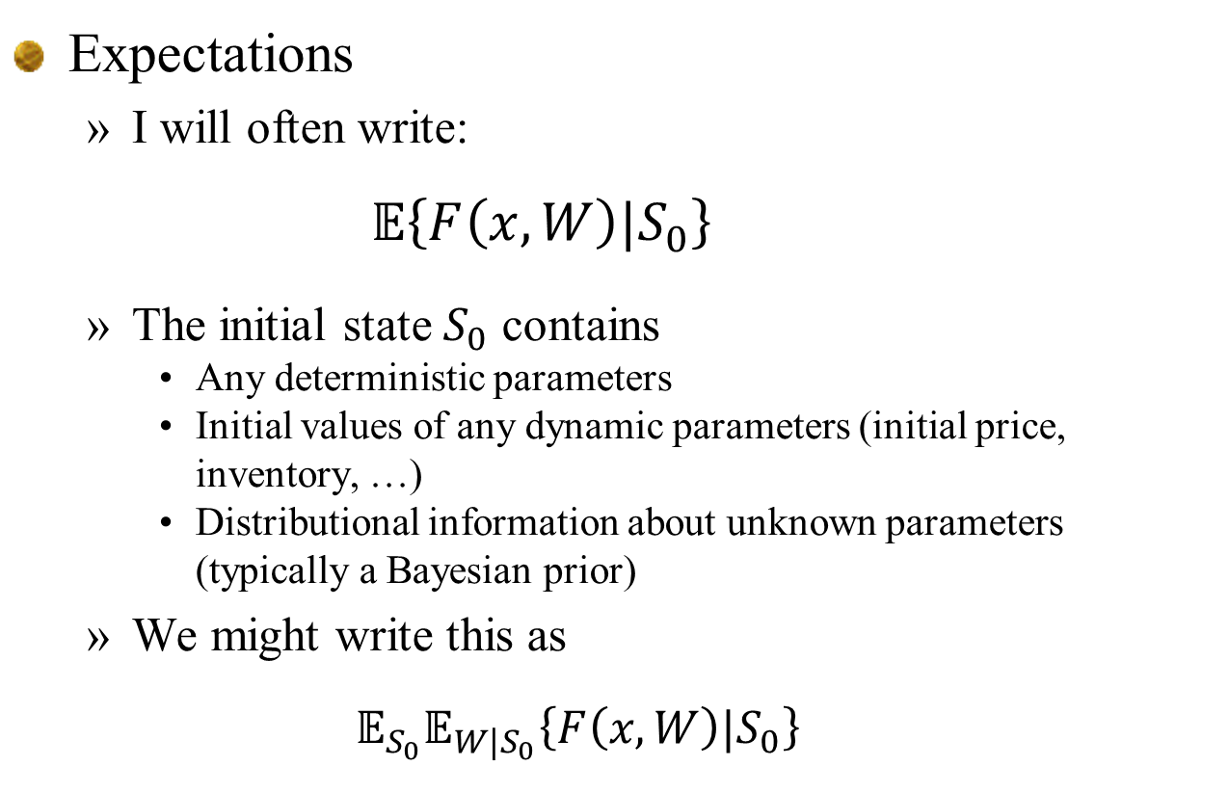
Elements of a dynamic model
Expectations
  I will often write:
    $$𝔼\left\{F\left(x,W\right)|S_{0}\right\}$$
  The initial state $S_{0}$ contains
    Any deterministic parameters
    Initial values of any dynamic parameters (initial price, inventory, …)
    Distributional information about unknown parameters (typically a Bayesian prior)
  We might write this as
  $$𝔼_{S_{0}}𝔼_{W|S_{0}}\left\{F\left(x,W\right)|S_{0}\right\}$$
Slide 32

Slide 33
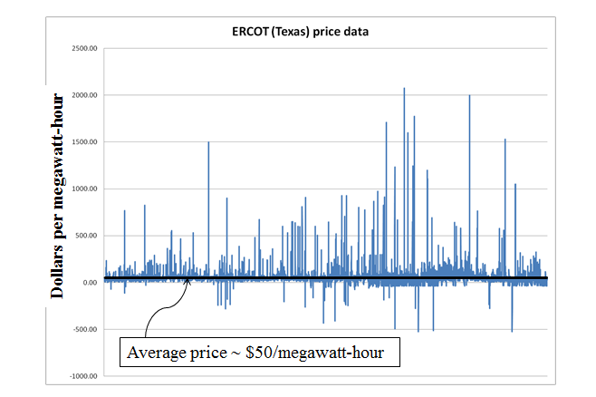
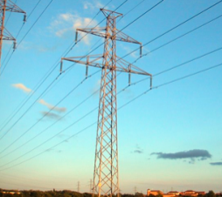
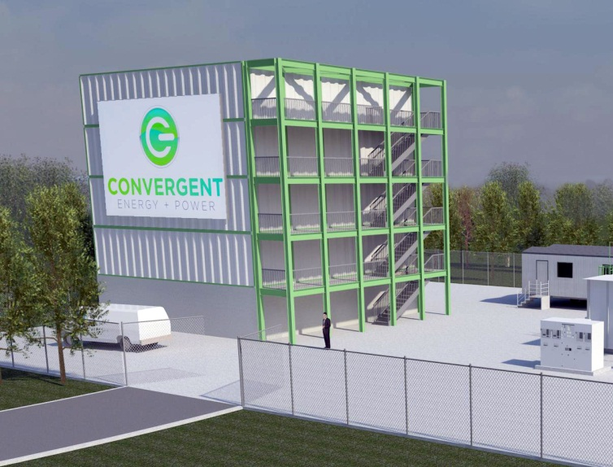
Elements of a dynamic model
Battery arbitrage – When to charge, when to discharge, given stochastic prices

Slide 34
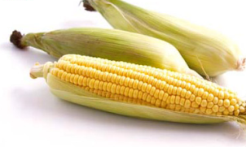
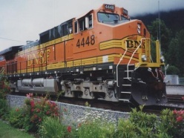
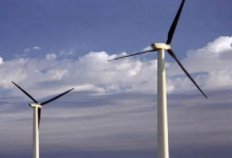
Elements of a dynamic model
The state variable:
Notes:
34

Slide 35
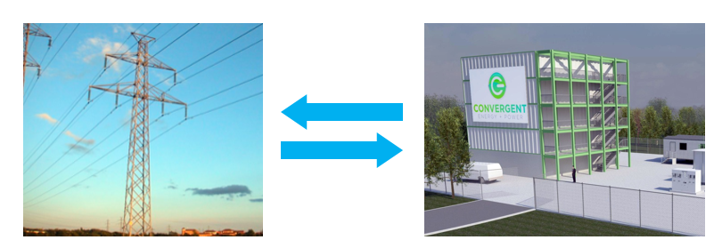

Energy storage example
State variables $S_{t}$
  $R_{t}=$Energy stored in the battery
  $D_{t}=$Current demand
  $p_{t}=$Current grid price
  State variable $S_{t}=(R_{t},{D_{t},p}_{t})$
Slide 35

Slide 36
Elements of a dynamic model
Decisions:
Notes:
36

Slide 37
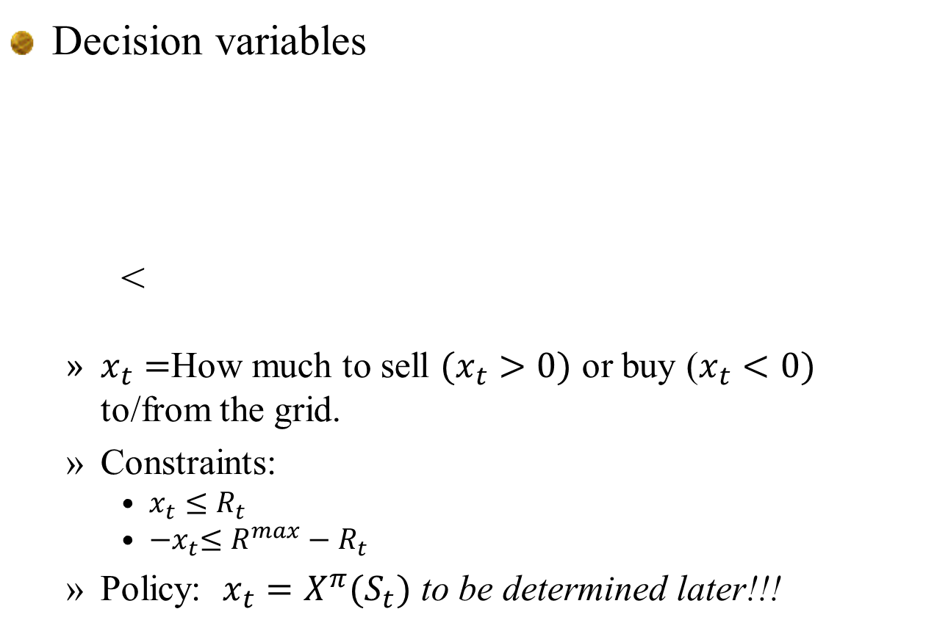
Energy storage example
Decision variables
<
  $x_{t}=$How much to sell $(x_{t}>0)$ or buy ($x_{t}<0)$ to/from the grid.
  Constraints:
    $x_{t}≤R_{t}$
    ${−x}_{t}≤R^{max}−R_{t}$
  Policy: ${x_{t}=X}^{π}(S_{t})$ to be determined later!!!
Slide 37

Slide 38
Elements of a dynamic model
Styles of decisions
  Binary
  Finite
  Continuous scalar
  Continuous vector
  Discrete vector
  Categorical
Slide 38

Slide 39
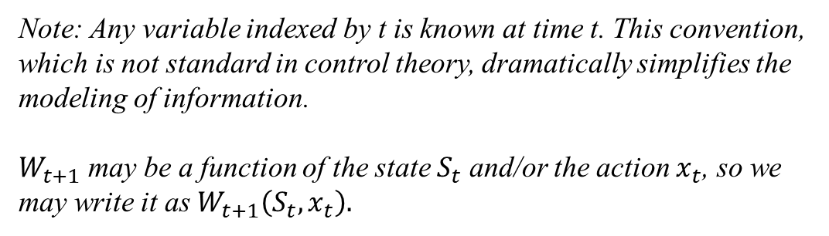
Elements of a dynamic model
Exogenous information:
Note: Any variable indexed by t is known at time t. This convention, which is not standard in control theory, dramatically simplifies the modeling of information.
$W_{t+1}$ may be a function of the state $S_{t}$ and/or the action $x_{t}$, so we may write it as $W_{t+1}\left(S_{t}, x_{t}\right).$
Notes:
39

Slide 40

Energy storage example
Exogenous information
  $W_{t+1}=$
    ${\hat{p}}_{t+1}=$Change in the electricity price $p_{t}$ between $t$ and $t+1$.
    ${\hat{D}}_{t+1}=$Demand for energy between time $t$ and $t+1$
Slide 40

Slide 41
Elements of a dynamic model
The transition function
Also known as the:
“System model”
“State transition model”
“Plant model”
“Plant equation”
“State equation”
“Transfer function”
“Transformation function”
“Law of motion”
“Model”
“transition function”
Notes:
41

Slide 42

Energy storage example
Transition function
  $R_{t+1}=R_{t}+ηx_{t}$
  $p_{t+1}=p_{t}+{\hat{p}}_{t+1}$
  $D_{t+1}={\hat{D}}_{t+1}$
For many problems, the transition function can be very complex (“500 lines of Matlab code”).
Slide 42

Slide 43
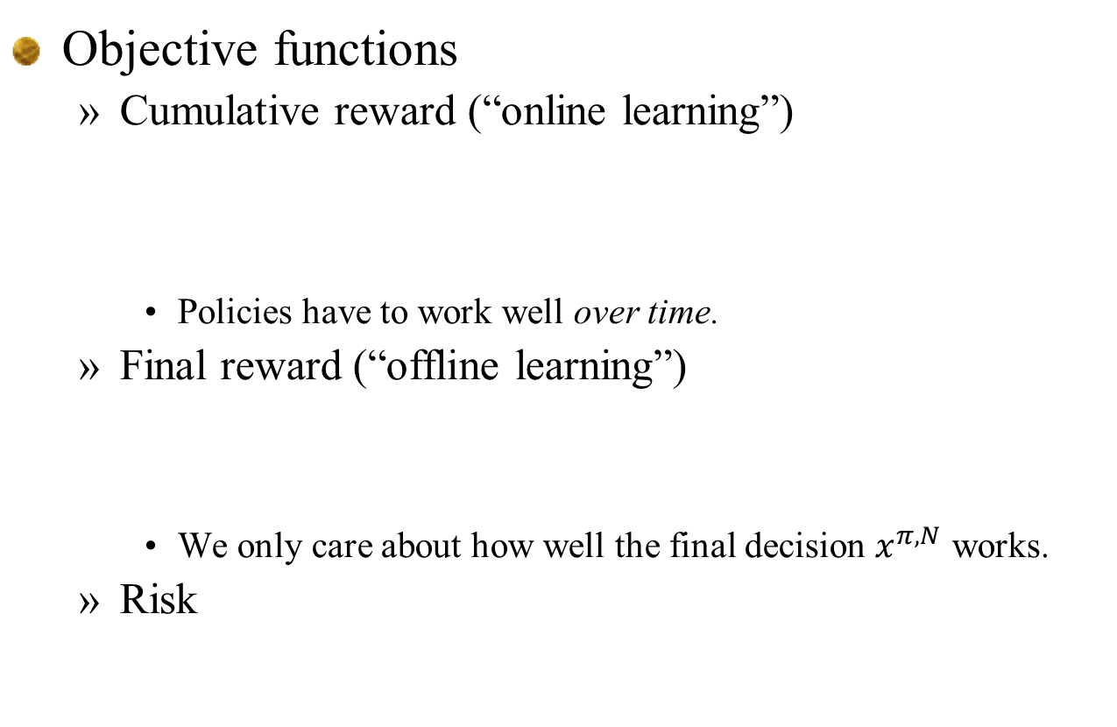
Elements of a dynamic model
Objective functions
  Cumulative reward (“online learning”)
    Policies have to work well over time.
  Final reward (“offline learning”)
    We only care about how well the final decision $x^{π,N}$ works.
  Risk
Slide 43

Slide 44

Energy storage example
Objective function
  $C\left(S_{t},x_{t}\right)=p_{t}x_{t}$
  $\max_{π}{𝔼\left\{\sum_{t=0}^{T}{C(S_{t},X^{π}(S_{t}))}|S_{0}\right\}}$
Slide 44

Slide 45
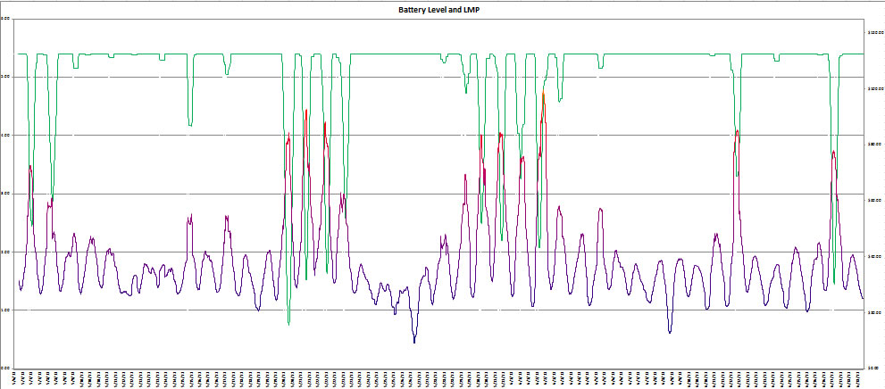
Energy storage example
Our policy function might be the parametric model (this is nonlinear in the parameters):
Energy in storage:
Price of electricity:

Slide 46

Energy storage example
Objective function
  Now the policy search is to find the best parameters $ρ:$
  $$\max_{ρ}{𝔼\left\{\sum_{t=0}^{T}{C(S_{t},X^{π}(S_{t}|ρ))}|S_{0}\right\}}$$
Slide 46

Slide 47
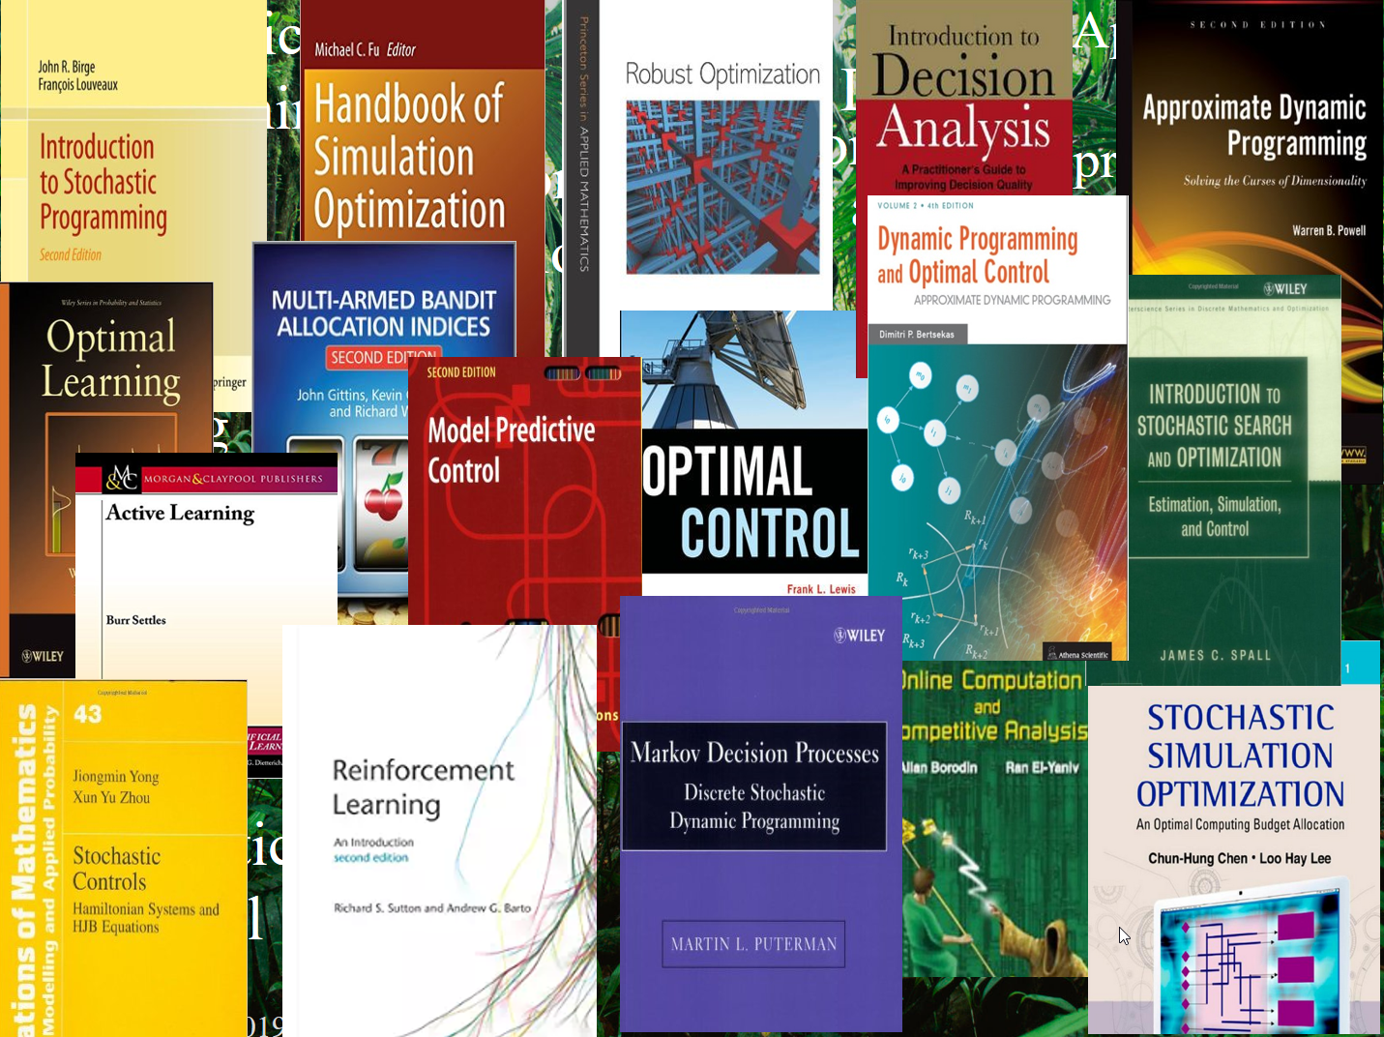
Elements of a dynamic model
The complete model:
  Objective function
    Cumulative reward (“online learning”)
    Final reward (“offline learning”)
    Risk:
  Transition function:
  Exogenous information:
Slide 47

Slide 48
Elements of a dynamic model
The modeling process
  I conduct a conversation with a domain expert to fill in the elements of a problem:
State
variables
Decision
variables
New
information
Transition
function
Objective
function
Performance metrics
How the state variables evolve
What we didn’t know
when we made our decision
What we control
What we need to know
(and only what we need)
Slide 48

Slide 49
Elements of a dynamic model
Deterministic
  Objective function
  Decision variables:
  Constraints:
    At time t
    Over time
Stochastic
  Objective function
  Policy
  Constraints at time t
  Transition function
  Exogenous information

Slide 50
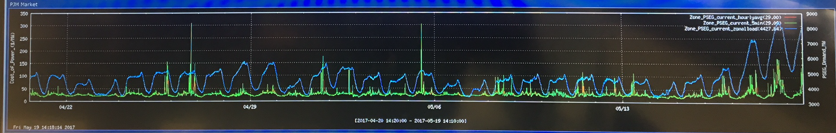

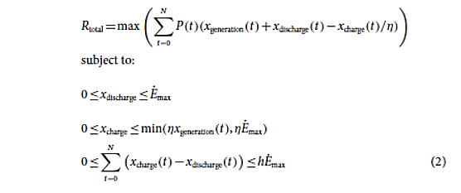
Modeling with uncertainty
Stochastic prices
Charge/discharge decisions

Slide 51
Planning under uncertainty
The models in these papers allow decisions to see into the future:
  Strategy posed by the battery manufacturer: “Buy low, sell high”
Sell
Price
Sell
Sell
Sell
Sell
Sell
Buy
Buy
Buy
Buy
Buy
Buy

Slide 52

Planning under uncertainty
Don’t gamble; take all your savings and buy some good stock and hold it till it goes up, then sell it. If it don’t go up, don’t buy it.
Will Rogers
It is not enough to mix “optimization” (intelligent decision making) and uncertainty. You have to be sure that each decision has access to the information available at the time.

Slide 53
From deterministic to stochastic
Imagine that you would like to solve the time-dependent linear program:
  subject to
We can convert this to a proper stochastic model by replacing with and taking an expectation:
  The policy has to satisfy with transition function:
Slide 53

Slide 54
Elements of a dynamic model
The most common mistake that everyone makes is to start with a policy, and then build a model around the policy.
It is important to remember:
  Model first, then solve.
  We will find a practical, scalable policy.

Slide 55

Elements of a dynamic model
… and don’t worry about finding a policy. Trust me!

Slide 56

Morning break

Slide 57
Four major problem classes

Slide 58
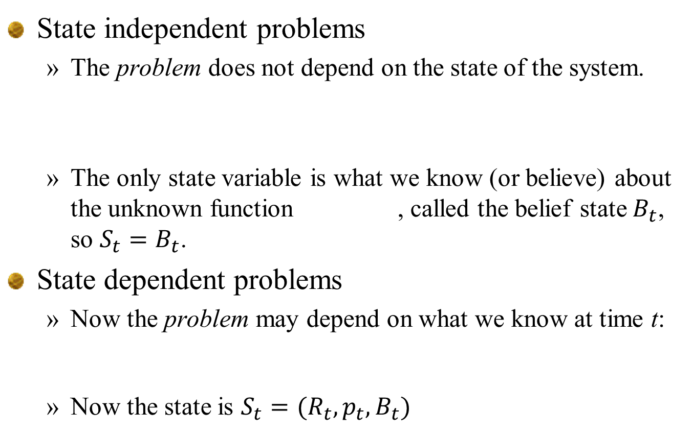
Problem classes
State independent problems
  The problem does not depend on the state of the system.
  The only state variable is what we know (or believe) about the unknown function , called the belief state $B_{t}$, so $S_{t}=B_{t}$.
State dependent problems
  Now the problem may depend on what we know at time t:
  Now the state is $S_{t}=(R_{t},p_{t},B_{t})$

Slide 59
Problem classes
Offline (final reward)
  We can iteratively search for the best solution, but only care about the final answer.
  Asymptotic formulation:
  Finite horizon formulation:
Online (cumulative reward)
  We have to learn as we go
“ranking and selection”
or
“stochastic search”

Slide 60
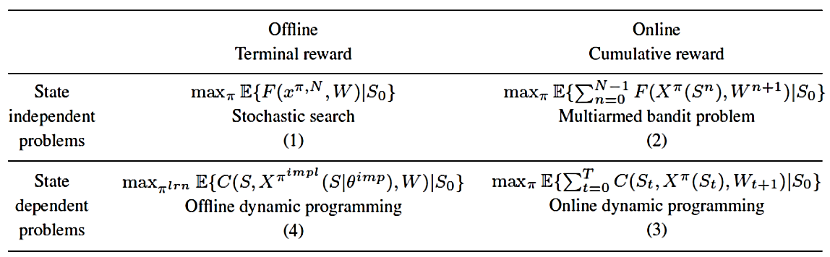

Problem classes
The four classes of problems
  $π$ and $π^{learn}$ under offline learning are typically viewed as algorithms.
  Class (3) is the most common way to write out a formal dynamic program which is usually solved offline, which is class (4).
  This is covered in more depth in chapter 9 of Reinforcement Learning and Stochastic Optimization.

Slide 61
What is a state variable?

Slide 62
The state variables
What is a state variable?
  Bellman’s classic text on dynamic programming (1957) describes the state variable with:
    “… we have a physical system characterized at any stage by a small set of parameters, the state variables.”
  The most popular book on dynamic programming (Puterman, 2005, p.18) “defines” a state variable with the following sentence:
    “At each decision epoch, the system occupies a state.”
  Wikipedia:
    “State commonly refers to either the present condition of a system or entity” or….
    A state variable is one of the set of variables that are used to describe the mathematical ‘state’ of a dynamical system

Slide 63
The state variables
What is a state variable?
  Kirk (2004), an introduction to control theory, offers the definition:
    A state variable is a set of quantities which if known at time are determined for by specifying the inputs for the system for .
    … or “all the information you need to model the system from time t onward.” True, but vague (and only for deterministic problems).
  Cassandras and Lafortune (2008):
    The state of a system at time is the information required at such that the output [cost] y(t) for all is uniquely determined from this information and from .
    Again, consistent with the statement “all the information you need to model the system from time onward,” but then why do they later talk about “Markovian” and “non-Markovian” queueing systems?

Slide 64

The state variables
From Probability and Stochastics by Erhan Cinlar (2011):
  Question: Why would you ever model a stochastic process where you intentionally left needed information out of the state variable?

Slide 65
The state variables
There appear to be two ways of approaching a state variable:
  The mathematician’s view – The state variable is a given, at which point the mathematician will characterize its properties (“Markovian,” “history-dependent,” …)
  The modeler’s view – The state variable needs to be constructed from a raw description of the problem. Information should not be excluded due to computational tractability until after a solution strategy has been designed.

Slide 66
The state variable
Illustrating state variables
  A deterministic graph

Slide 67


The state variable
Illustrating state variables
  A stochastic graph

Slide 68
The state variable
Illustrating state variables
  A stochastic graph

Slide 69
The state variable
Illustrating state variables
  A stochastic graph with left turn penalties

Slide 70
The state variable
Variant of problem in Puterman (2005):
  Find best path from 1 to 11 that minimizes the second highest arc cost along the path:
  If the traveler is at node 9, what is her state?
2
14
5
4
8
12
8
1
8
12
12
8
15
14
1
3
15
6
9
11
8
3
11
8
5
7
10
4
7
10

Slide 71

The state variable
Other information states $I_{t}$
  The “information state” variable captures the state of any other parameter that we can observe perfectly.
  Examples:
    Weather (e..g temperature, humidity)
    Prices
    Economy
    Traffic conditions
    Forecasts
  The “information state” is simply any information about perfectly observable parameters that we do not model as a resource state.

Slide 72












Parametric cost function approximation
Rolling forecasts
Rolling forecasts, updated each hour.
Forecast made at midnight:
Actual

Slide 73

The state variable
Other information states $I_{t}$
  Exogenous forecasts – Provided by an external source
    Exogenous forecasts are complete forecasts provided by an external source.
    A forecast is the expected value of a future quantity (e.g. demand $D_{t′})$ given what we know at time $t$ (what we know is captured by the state $S_{t}$).
    Actual demand is the forecast the previous period plus an error:
    Forecasts are updated on a rolling basis:
    Forecast state variables are then:

Slide 74

The state variables
Other information states $I_{t}$
  Endogenous forecasts – From a statistical model

Slide 75





The state variable
Belief states
  Lookup table belief models
  State variable (belief state)
    $$S^{n}={\left({\overline{μ}}_{x}^{n},β_{x}^{n}\right)}_{x∈X}$$
  Belief states may be frequentist or Bayesian
$${\overline{σ}}_{5}^{n}$$
$$β_{5}^{n}=\frac{1}{{\overline{σ}}_{5}^{2,n} }$$
$${\overline{μ}}_{5}^{n}$$

Slide 76




The state variable
Belief states:
  Look up tables, Bayesian belief, independent beliefs:
  $$B^{n}={\left({\overline{μ}}_{x}^{n},β_{x}^{n}\right)}_{x∈X}$$
  Correlated beliefs
  $B^{n}=\left({\overline{μ}}_{}^{n}, Σ^{n}\right)$
  Sampled beliefs, nonlinear model $f\left(x | θ_{k}\right):$
  $B^{n}={\left(p_{k}^{n}\right)}_{k=1}^{K}, p_{k}^{n}=Prob[θ=θ_{k}]$

Slide 77
The state variable
Illustrating state variables
  A stochastic graph with generalized learning

Slide 78


The state variable
Illustrating state variables
  A stochastic graph with generalized learning

Slide 79
The state variable
Classes of state variables
Resource/physical state
Belief state
Information state

Slide 80

The state variable
Notes:
  The distinction between $R_{t}$, $I_{t}$, and $B_{t}$ is imprecise. After all, they are three types of information.
  There are communities (e.g. operations research) that have a tendency to interpret “physical state” as “the state” (the graph example is a good illustration).
  So, we can think of $R_{t}$ as just a special case of $I_{t}$.
  The belief $B_{t}$ is the parameters of a probability distribution about parameters we do not know perfectly. But we can think of $I_{t}$ (and therefore $R_{t}$) as simply point estimates of parameters we know perfectly.

Slide 81

The state variable
My definition of a state variable:
  The first depends on a policy. The second depends only on the problem (and includes the constraints).
  Using either definition, all properly modeled problems are Markovian!

Slide 82

The state variable
Pre- and post-decision states
  The “pre-decision” state variable:
    Same as a “decision node” in a decision tree.
  The “post-decision” state variable:
    Same as an “outcome node” in a decision tree. Also known as “end of period state” or “after state”.
  The information and decision sequence
    $(S_{0},x_{0},S_{0}^{x},W_{1},S_{1},x_{1},S_{1}^{x},W_{2},S_{2},…S_{t},x_{t},{S_{t}^{x},W}_{t+1},…)$

Slide 83
The state variable
Representations of the post-decision state:
  Decision trees:
  Q-learning:
  Transition function with expectation:

Slide 84
The state variable
Post-decision belief states
  The post-decision belief state does not have any more information than the pre-decision belief state.
  In active learning problems, the post-decision state may have to include what decision we made, because it may be the decision of what to observe:
    What experiment?
    What drug to try?

Slide 85
Multiagent systems

Slide 86

Multiagent systems
Types of agents
  Passive – Does not make decisions or perform learning, but captures dynamic processes and may perform passive learning.
  Active – Makes decisions that come in three flavors:
    Decisions that act on the physical environment
    Decisions to observe the environment
    Decisions to communicate information to other agents
  The “ground truth” agent
    This is a passive agent that captures the true values of system parameters. The ground truth may evolve over time, and may be influenced by controlling agents.
  Controlling agents
    Let $𝒬$=Set of agents that are able to make decisions, with element $q∈𝒬$.
    A controlling agent is a system that we model using the universal framework, with all variables indexed by $q$.
  Learning agents
    These learn, but do not make decisions. They are only relevant if they then communicate what they learn to controlling agent(s).

Slide 87

Multiagent systems
State variables
  $S_{t}^{G}=$ State of “ground truth” parameters (which may evolve over time).
  $S_{t}=$ State known to single controlling agent.
  $S_{tq}=$ Information known to agent $q∈𝒬$ if multiple agents. May include beliefs about parameters for ground truth agent (or other controlling agents)
  Controlling agents may observe ground truth, or states of other agents, with noise (mechanism has to be defined).
  The ground truth may be influenced by decisions of controlling agents.

Slide 88

Multiagent systems
Examples
  Static truth
    Let $μ_{x}=𝔼_{W}F(x,W)$=(unknown) true value of a function (the ground truth). We would write $S_{t}^{G}={\left(μ_{x}\right)}_{x∈𝒳}.$
    Let ${\overline{μ}}_{t}=$Estimate of $μ_{x}$ at time t.
    $W_{t+1,x}=μ_{x}+ε_{t+1}$=noisy observation of the ground truth $μ_{x}$
    ${\overline{μ}}_{t+1,x}=(β_{t}{\overline{μ}}_{tx}+β^{Q}W_{t+1,x})/(β_{t}+β^{W})$
  Dynamic truth (“restless bandits”)
    Assume $μ_{t+1,x}=μ_{tx}+ε_{t+1}^{μ}$=evolving truth.
    $W_{t+1,x}=μ_{t+1, x}+ε_{t+1}$=noisy observation of the ground truth $μ_{t+1,x}$
  Controllable truth
    $μ_{t+1,x_{t}}=μ_{t,x_{t}}+θx_{t}+ε_{t+1}^{μ}$.
    Challenge is to estimate both $μ_{t}$ and $θ$.

Slide 89
Multiagent systems
Notes:
  This notation allows us to cover the full range of active learning problems (static truth, dynamic truth, controllable truth).
  It also allows us to model any form of partially observable Markov decision process (POMDP) by recognizing two distinct systems (each with its own state variables):
    The ground truth.
    One or more controlling agents that may influence the ground truth.
  The POMDP literature refers to the “state” as the ground truth, and then there is a belief about the “state.” In this framework, we have two sets of state variables:
    The ground truth state.
    The beliefs of the controlling agent(s) about the ground truth.

