Slide 1
A Unified Framework for
Sequential Decision Analytics
Olin Business School
University of Washington, St. Louis
November 5-6, 2019
Warren B. Powell
Princeton University
Department of Operations Research
and Financial Engineering

Slide 2

Reading materials

Slide 3

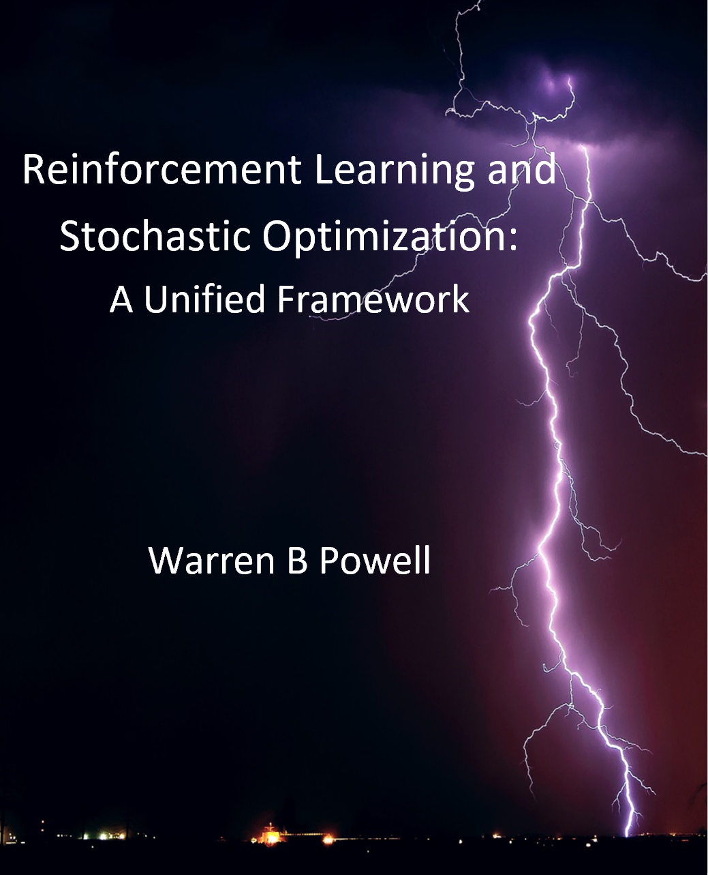

Slide 4
Reading materials
Notes on RLSO
  Math level requires undergraduate course in probability and statistics, but using a methods-oriented presentation.
  Organized around major problem classes:
    State-independent
      Derivative-based stochastic optimization
      Derivative-free stochastic optimization – Introduces four classes of policies for learning problems
    State-dependent
      In-depth presentation of modeling framework (Ch. 9)
      Discussion of uncertainty (Ch. 10) and policies (Ch. 11)
      Remainder of book organized around the four classes of policies
  Fully integrated presentation of stochastic optimization spanning all fields (the unified framework)
Slide 4

Slide 5
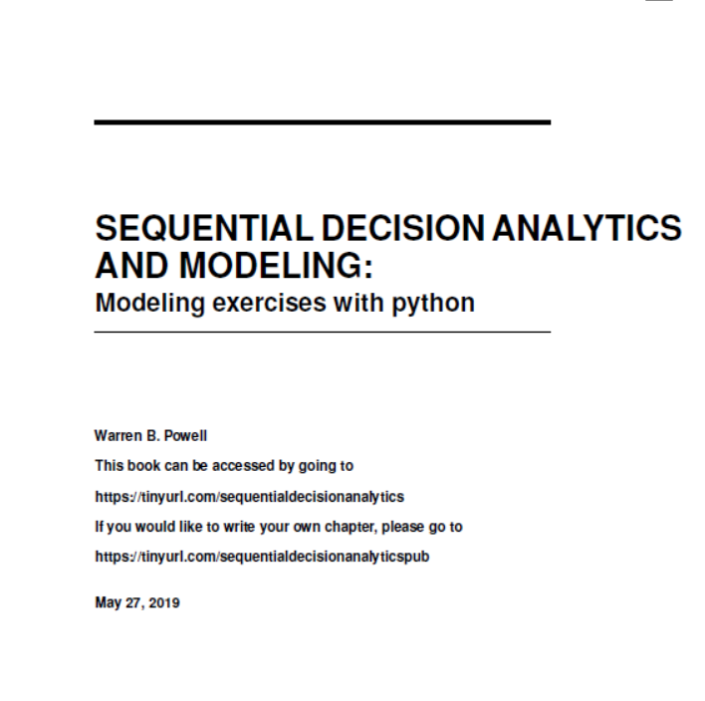
Can be accessed at jungle.princeton.edu
Also available at
http://tinyurl.com/sequentialdecisionanalytics
Slide 5

Slide 6
Reading materials
Notes on Sequential Decision Analytics
  Math level requires undergraduate course in probability and statistics.
  Uses a teach-by-example presentation style.
  Chapter 1 presents the unified framework (briefly)
  Chapters 2-6 present a series of applications, chosen to illustrate each of the different classes of policies.
  Chapter 7 is a brief intro to recursive learning (taken from chapter 3 of the RLSO book).
  Chapter 8 introduces the four classes of policies, using chapters 2-6 to illustrate.
  Chapters 9 onward are more advanced problems.
Slide 6

Slide 7
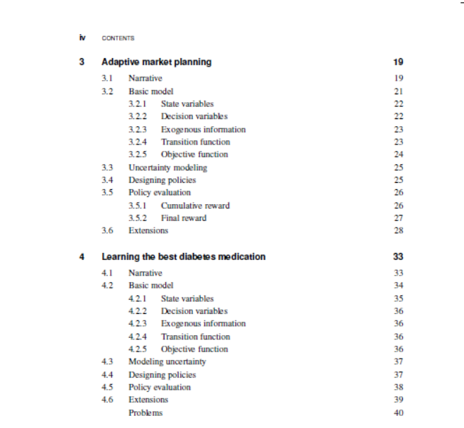
Slide 7

Slide 8

Can be accessed at jungle.princeton.edu
Publicly editable – write your own chapters!
http://tinyurl.com/sequentialdecisionanalyticspub
Slide 8

Slide 9
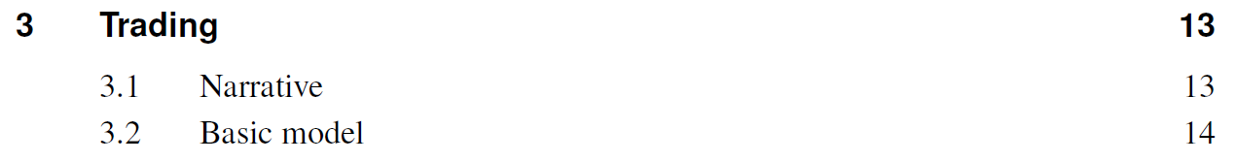
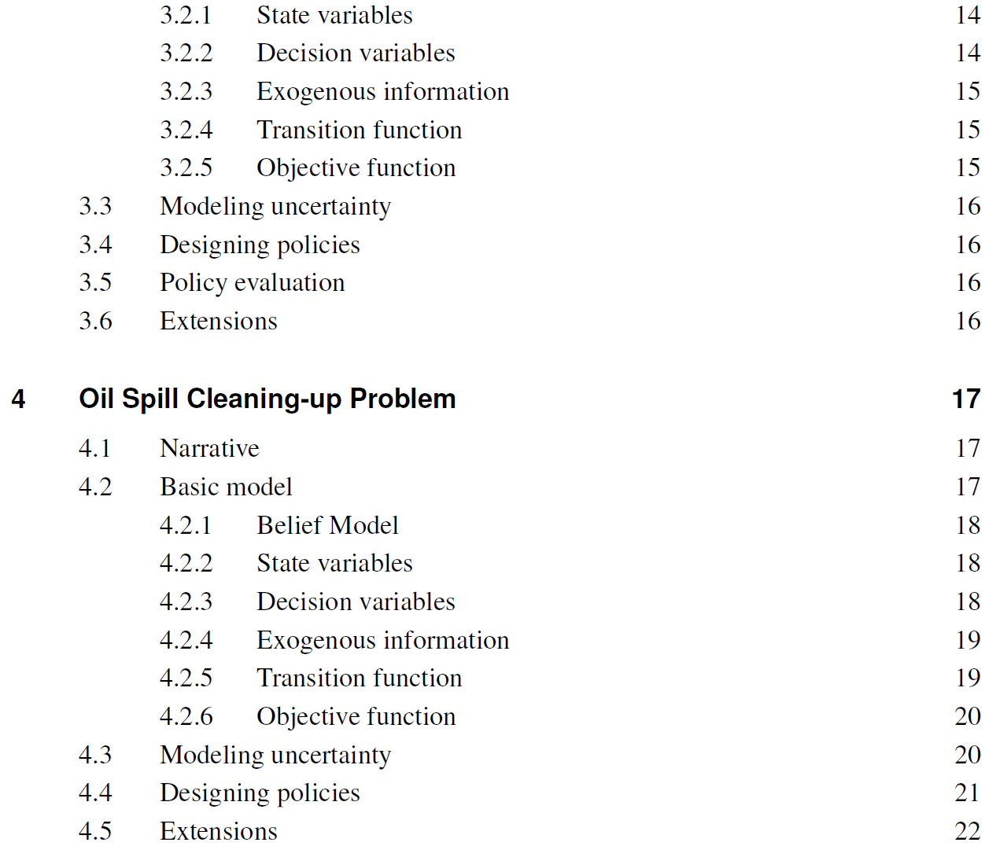
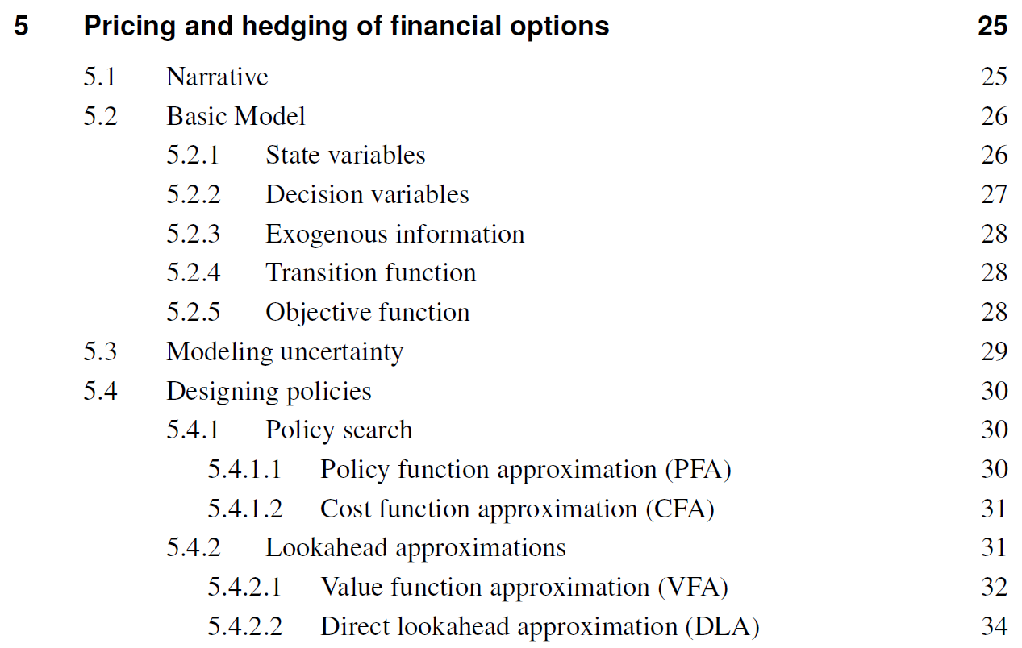
Slide 9

Slide 10
Educational materials
Please provide feedback!
  I have provided an online evaluation form – I would appreciate any feedback you can provide (link is on the syllabus):
  https://tinyurl.com/unifiedtutorialcomments
Slide 10

Slide 11
Course evaluation
Please contribute!
  Chapters should be around 3-6 pages.
  Think of submitting a streamlined model of a problem you are working on.
  Please follow the outline of the other chapters. You are welcome to use my Latex macros or your own (just be sure to insert them).
Slide 11

Slide 12

Thank you!
More material is available at: jungle.princeton.edu
Please be sure you are on the signup list so I can send you followup information (link is at the top of jungle.Princeton.edu).
Look undzer “Educational materials“
This presentation will be posted at jungle.Princeton.edu soon.

