Slide 1
A Unified Framework for
Sequential Decision Analytics
Olin Business School
University of Washington, St. Louis
November 5-6, 2019
Warren B. Powell
Princeton University
Department of Operations Research
and Financial Engineering

Slide 2

Guidelines for choosing policies
From the real-world to the model

Slide 3
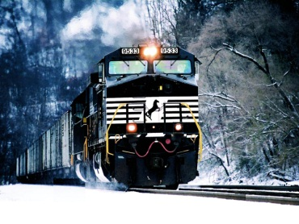
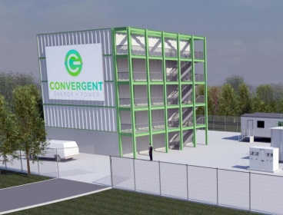
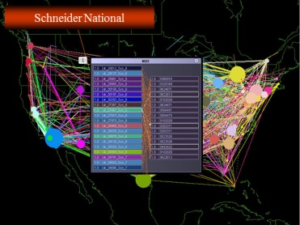
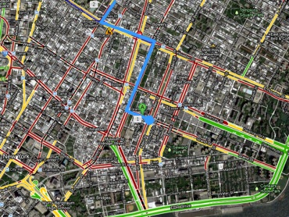
Choosing a policy
Robust cost function approximation
Lookahead policy
Policy function approximation
Policy based on value function approximation
Slide 3

Slide 4
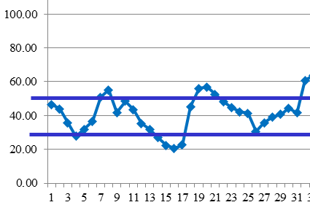
Choosing a policy
Policy function approximations
  PFAs are best for low-dimensional problems where the structure of the policy is apparent from the problem.
  Potential architectures:
    Lookup table rules (this was AI in the 1970’s)
    Linear models?
    Nonlinear models?
    Neural networks?
Slide 4

Slide 5
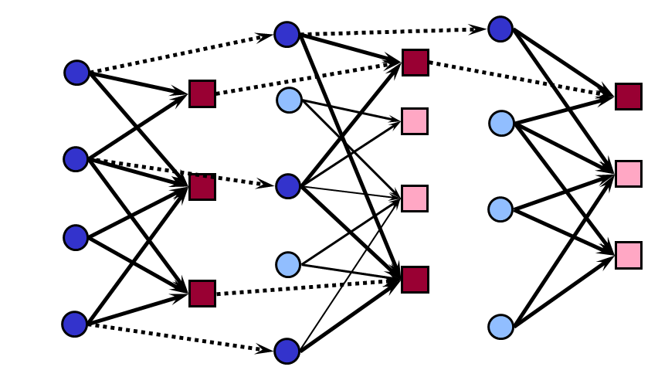
Choosing a policy
Cost function approximations
  CFAs work for both low-and high-dimensional problems, where we again have strong intuition of how uncertainty would affect the solution.
  Parameterizations:
    Schedule slack?
    Buffer stock?
    Parameterized forecasts?
Slide 5

Slide 6
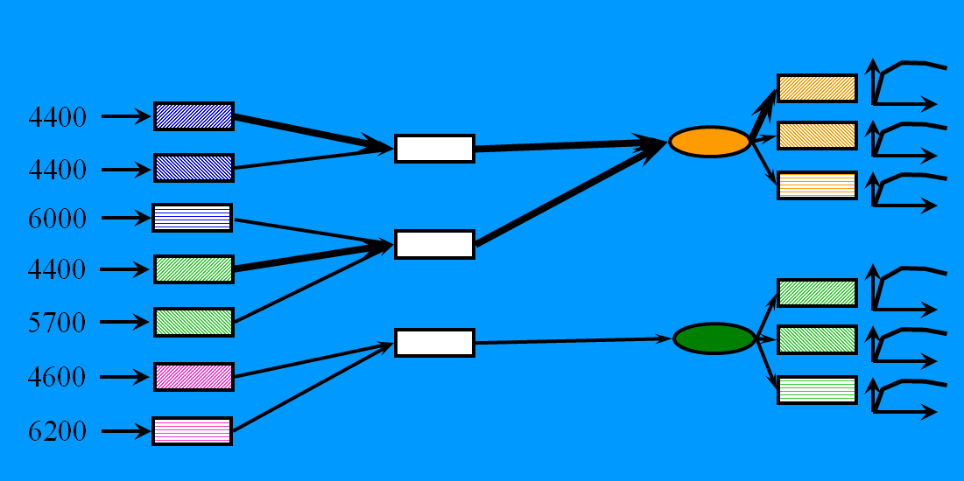

Choosing a policy
Value function approximations
  VFAs work best when the lookahead model is easy to approximate
  The issue is not dimensionality – it is structure.
Can you approximate this as a function???
$${\overline{V}}_{t}^{x}(S_{t}^{x})$$
Slide 6

Slide 7
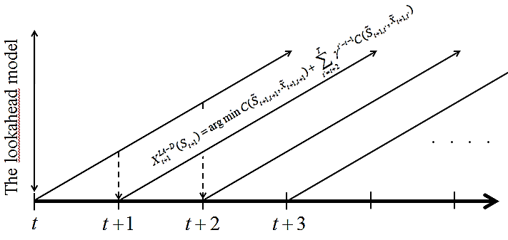
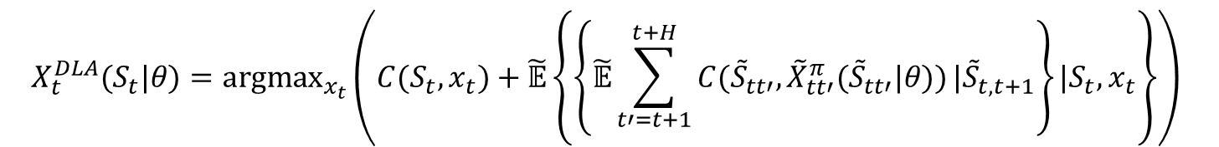
Choosing a policy
Direct lookahead approximations
  Direct lookahead models should be used only when all else fails (which is often). DLAs are important when decisions now depend on future plans and forecasts.
  Question: How are you going to compute downstream costs?
    Deterministic? Scenario trees?
    Simulating a parametric policy?
    MCTS?
$$X_{t}^{DLA}(S_{t}|θ)={argmax}_{x_{t}}\left(C(S_{t},x_{t})+\tilde{𝔼}\left\{\left\{\tilde{𝔼}\sum_{t′=t+1}^{t+H}{C({\tilde{S}}_{tt′},{\tilde{X}}_{tt′}^{π}({\tilde{S}}_{tt′}|θ))}|{\tilde{S}}_{t,t+1}\right\}|S_{t},x_{t}\right\}\right)$$
Slide 7

Slide 8
Choosing a policy
Don’t forget about hybrids:
  Parameterized policies
    Parameterized myopic policies
    Parameterized lookaheads
  Lookahead plus VFA
    May help to shorten the horizon
  Hybrid PFA with anything
    PFAs allow you to specify the decision you want, but the logic may not be very sophisticated.
    CFAs, VFAs and lookaheads introduced more sophisticated behaviors.
  VFA plus tuning
    Fit the VFA, then tune the VFA so it works better.

Slide 9
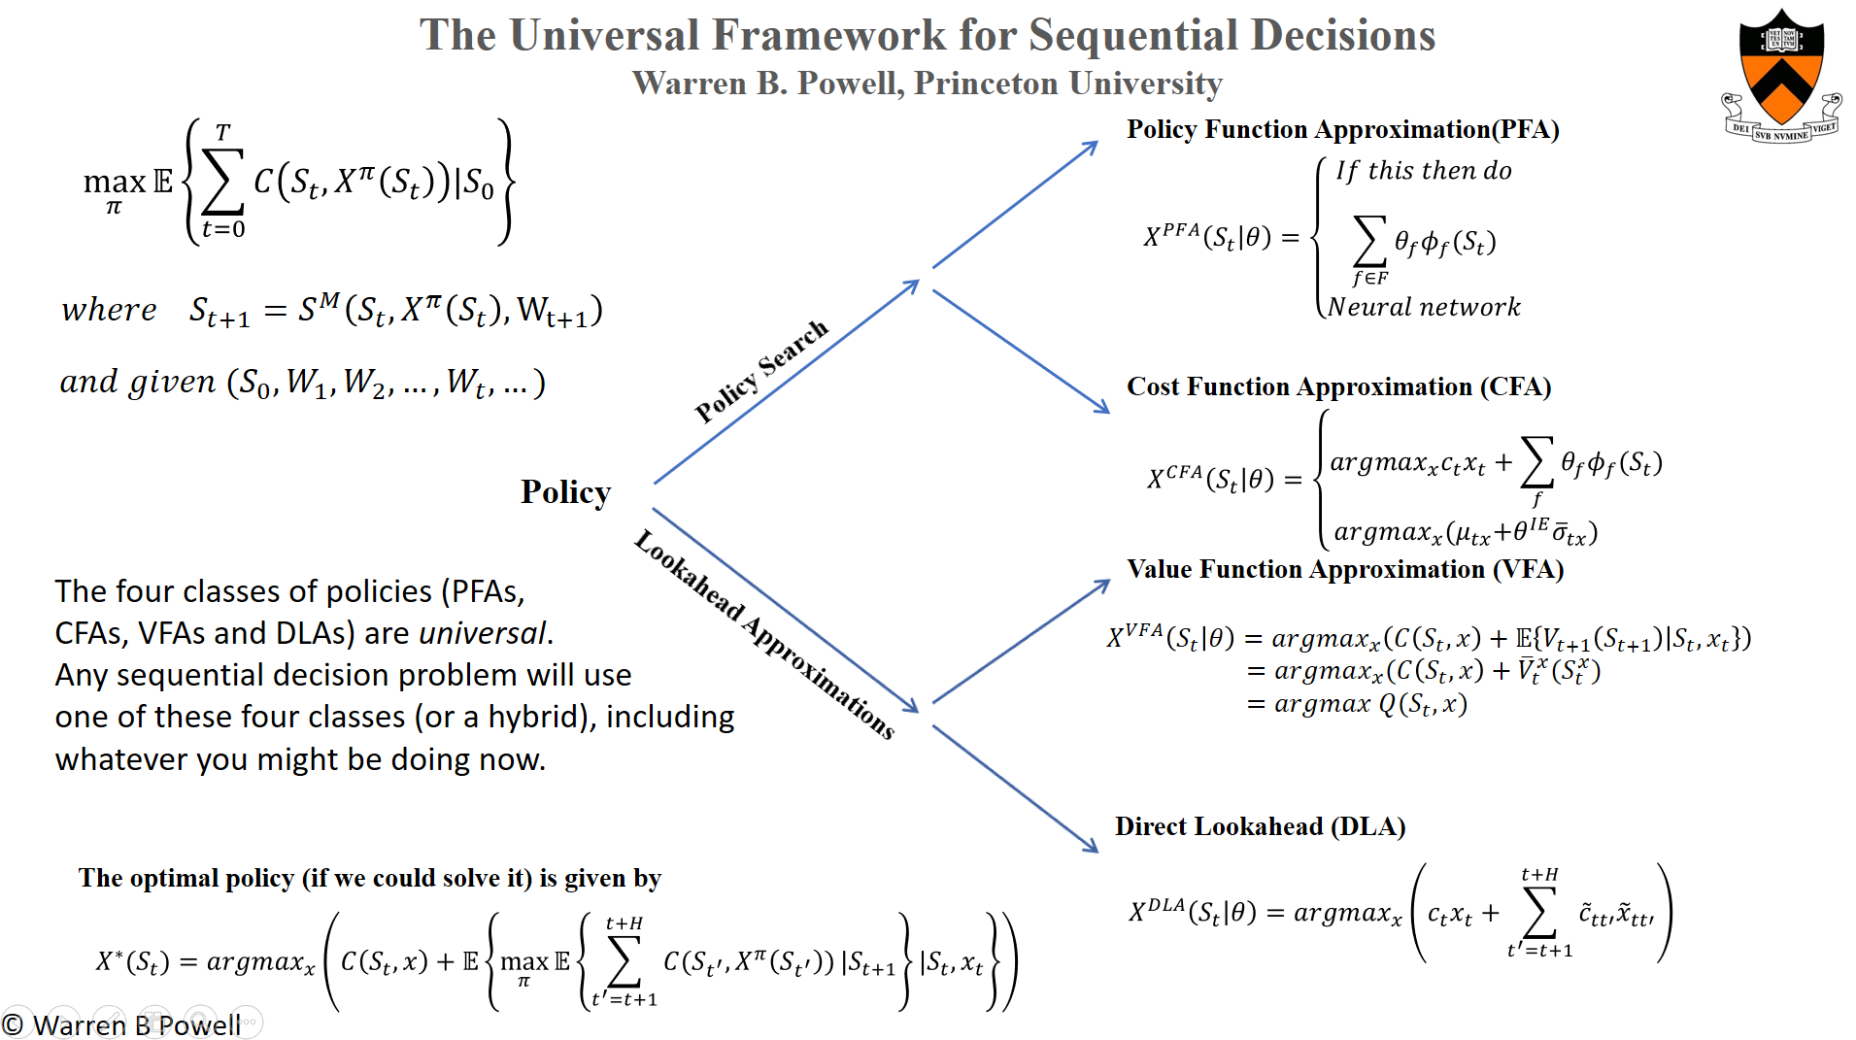
Available at jungle.princeton.edu

Slide 10
Choosing a policy
My notes:
  Model first, then design policies.
  Think seriously about at least one policy from the policy search class, and one from the lookahead class.
  The research community tends to prefer the lookahead class.
  Practitioners prefer the policy search class – they are simpler and make it easier to exploit domain knowledge. Don’t ignore domain knowledge! The more “sophisticated policies” may underperform these simpler methods.
  But remember…
  The price of simplicity is tunable parameters!

Slide 11
Modeling sequential decision problems
First build your model
  Objective function
  Policy
  Constraints at time t
  Transition function
  Exogenous information
Then design your policies:
  PFA? Exploit obvious problem structure.
  CFA? Can you tune a deterministic approximation to make it work better?
  VFA? Can you approximate the value of being in a downstream state?
  Lookahead? Do you have a forecast? What is the nature of the uncertainty?
  Hybrid?
Slide 11

