Slide 1
A Unified Framework for
Sequential Decision Analytics
Olin Business School
University of Washington, St. Louis
November 5-6, 2019
Warren B. Powell
Princeton University
Department of Operations Research
and Financial Engineering

Slide 2

Supply chain management

Slide 3

Examples

Slide 4
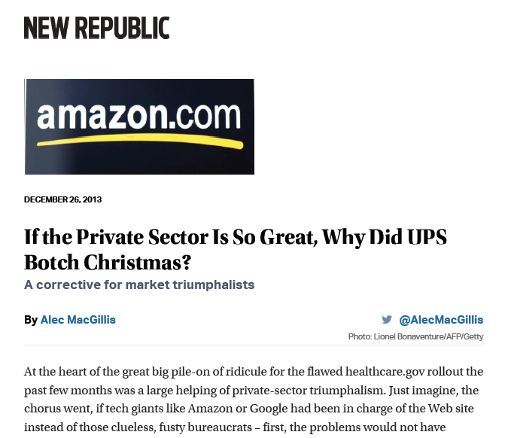
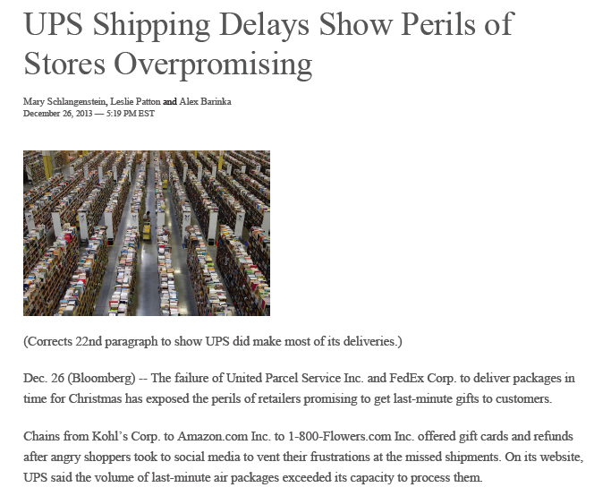
Supply chain management
Amazon-UPS meltdown, Christmas, 2013
  Amazon promised 2-day service (based on UPS service guarantees). UPS was overwhelmed.
Slide 4

Slide 5
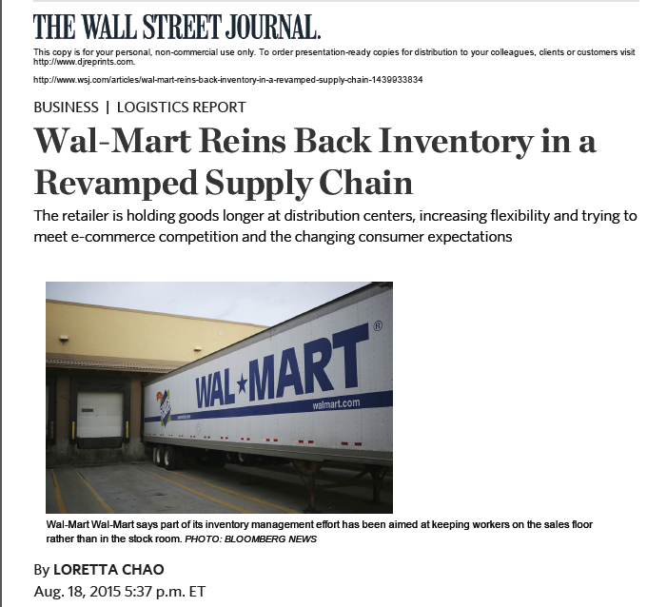
Supply chain management
Why?
Slide 5

Slide 6
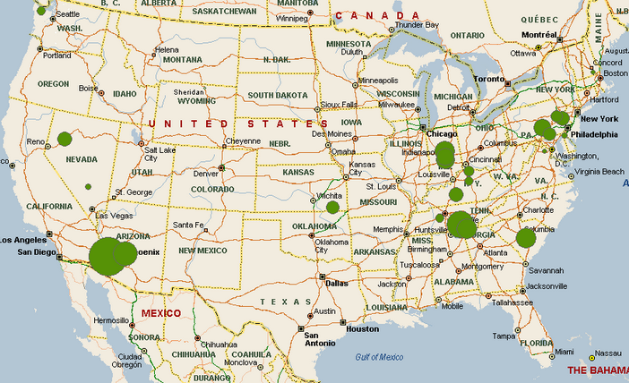
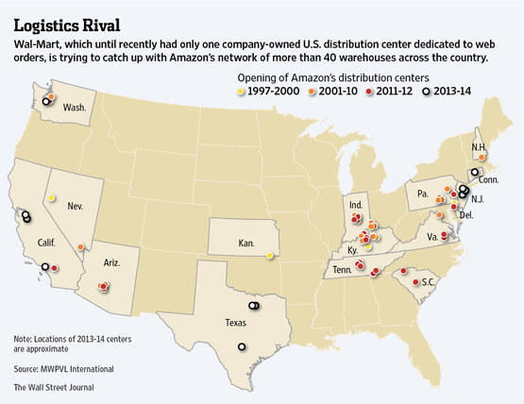
Amazon distribution network
  Small number of DC’s
  Uses UPS, FedEx, for final distribution
Walmart distribution network
  Extensive retail network
  Limited need for distribution centers
  Increasing role of internet sales
Slide 6

Slide 7
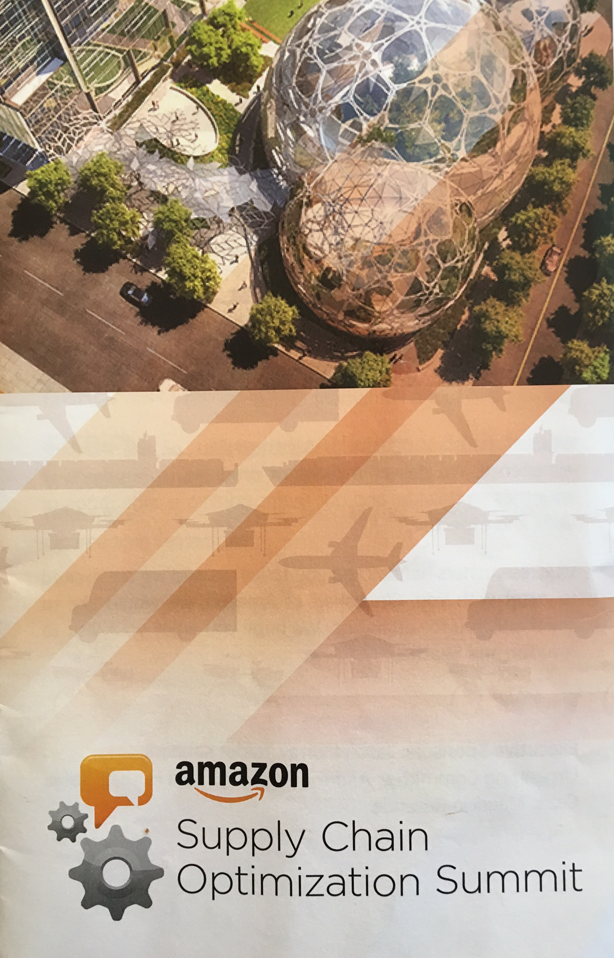
Amazon
First supply chain logistics conference in 2015
Still running off of spreadsheets developed by Jeff Bezos
Numerous instances where uncertainty is an important element.
Exclusively using deterministic optimization tools at that time.
Slide 7

Slide 8
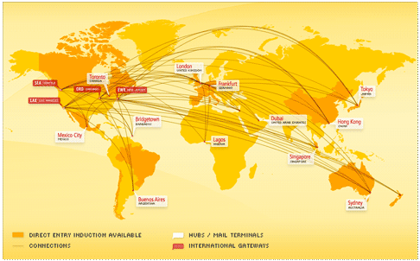
Global logistics
Apple, Inc.
Slide 8
Notes:
Who is Tim Cook – CEO of Apple
What was his job before taking over from Steve Jobs? Head of global logistics
Apple has gained a significant advantage over its competitors through logistics, largely in the form of contracts that lock up supplies of materials and components, blocking out competitors.

Slide 9
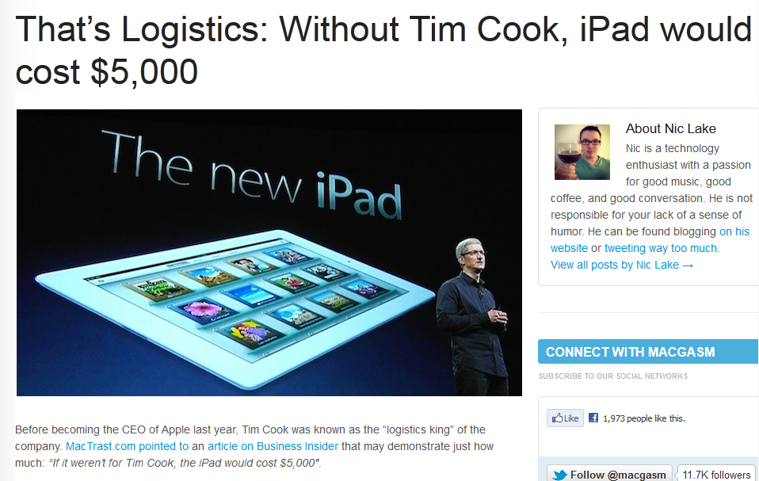

Slide 9
Notes:
http://www.macgasm.net/2012/03/24/logistics-tim-cook/

Slide 10
Supply chain management for Pratt & Whitney

Slide 11
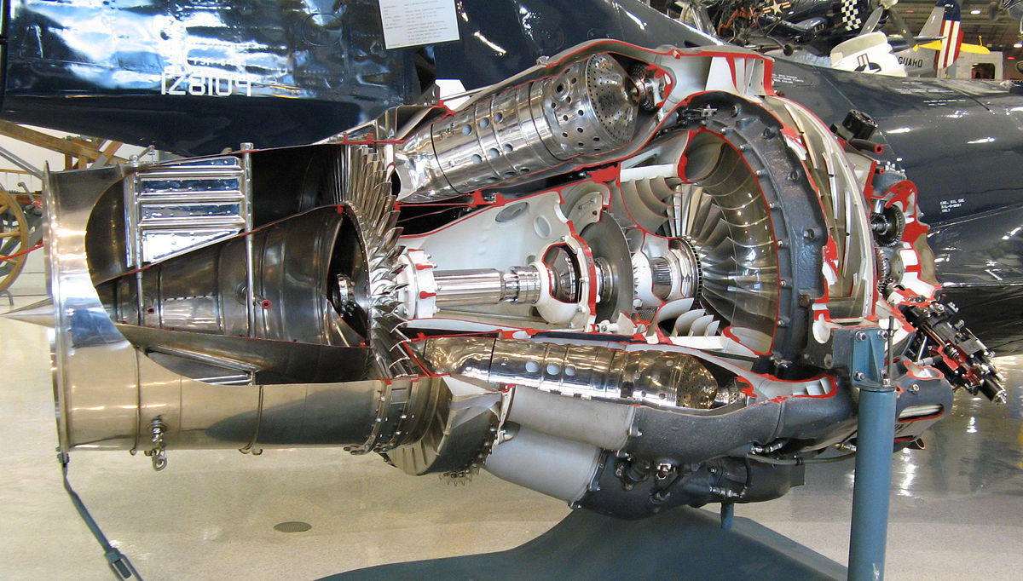
Supply chain mgmt. for Pratt & Whitney
Pratt&Whitney jet engines
Slide 11

Slide 12
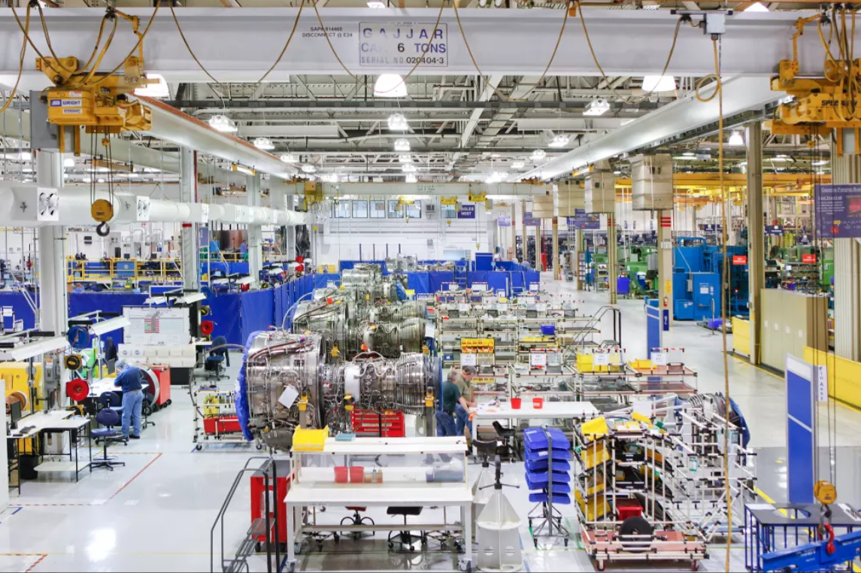
Supply chain mgmt. for Pratt & Whitney
Pratt&Whitney jet engines

Slide 13

Supply chain mgmt. for Pratt & Whitney
Pratt&Whitney jet engines
Slide 13

Slide 14
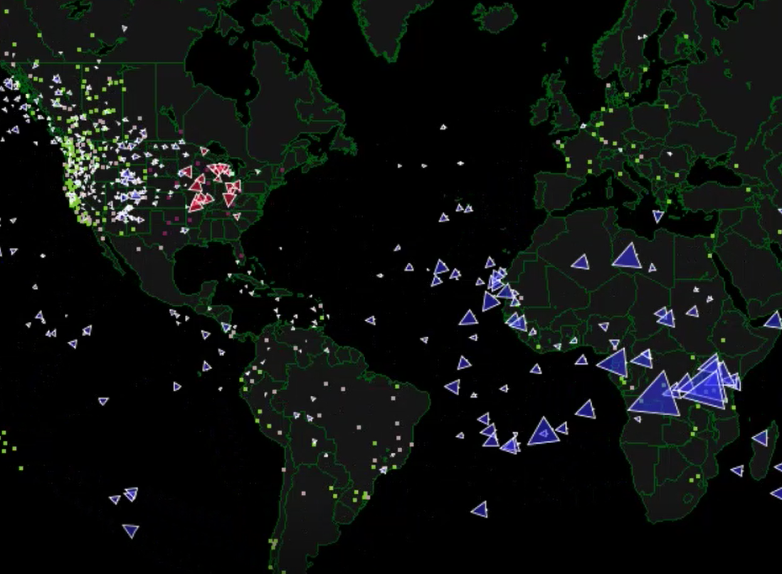
Pratt & Whitney supply chain
Notes:
This slide illustrates the decentralization of decision making across the UPS network.

Slide 15
Pratt & Whitney supply chain
Notes:
This slide illustrates the decentralization of decision making across the UPS network.

Slide 16
Pratt & Whitney supply chain
Notes:
This slide illustrates the decentralization of decision making across the UPS network.

Slide 17
Supply chain mgmt. for Pratt & Whitney
Notes from Pratt & Whitney project
  We modelled each supplier as an independent decision maker.
  Then, model the decision problem of each supplier using the framework we have presented here. This is now a multiagent system, which means we are now getting information from and sending information to other agents.
Slide 17

Slide 18
Policies

Slide 19
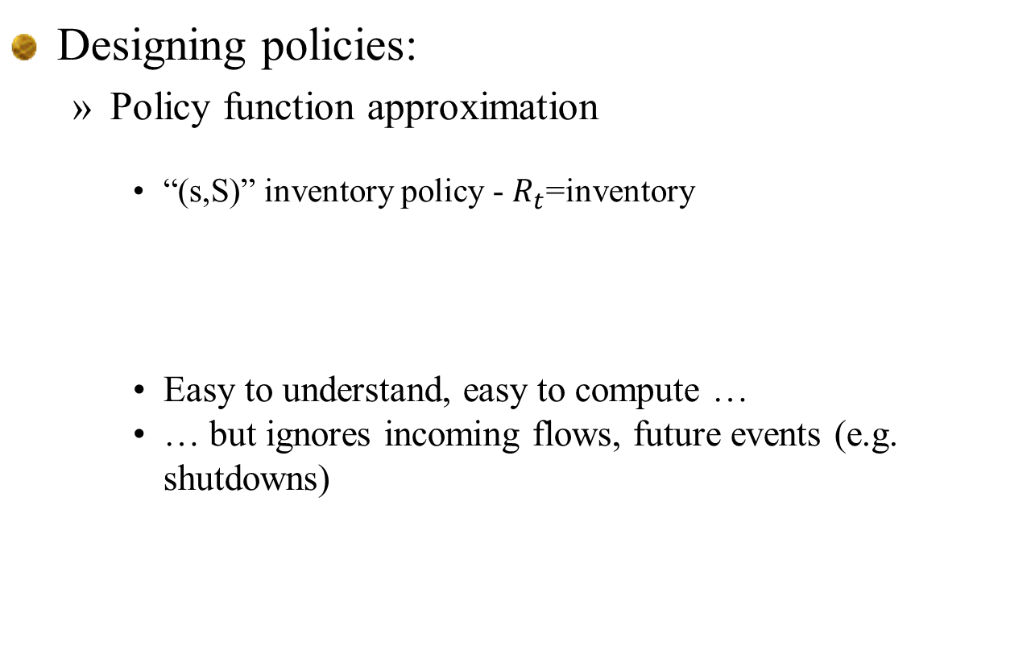
Supply chain mgmt. for Pratt & Whitney
Designing policies:
  Policy function approximation
    “(s,S)” inventory policy - $R_{t}$=inventory
    Easy to understand, easy to compute …
    … but ignores incoming flows, future events (e.g. shutdowns)
Slide 19

Slide 20
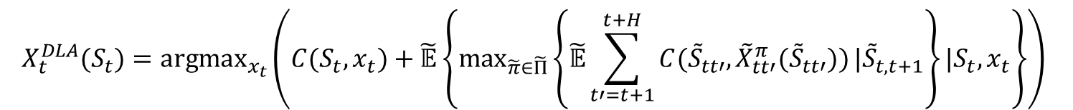
Supply chain mgmt. for Pratt & Whitney
The stochastic lookahead
  The optimal policy
  We replace the full lookahead with an approximation
  We can replace the expectations with Monte Carlo samples
  Real challenge is designing the “policy within a policy”
$$X_{t}^{DLA}(S_{t})={argmax}_{x_{t}}\left(C(S_{t},x_{t})+\tilde{𝔼}\left\{\max_{\tilde{π}∈\tilde{Π}}\left\{\tilde{𝔼}\sum_{t′=t+1}^{t+H}{C({\tilde{S}}_{tt′},{\tilde{X}}_{tt′}^{π}({\tilde{S}}_{tt′}))}|{\tilde{S}}_{t,t+1}\right\}|S_{t},x_{t}\right\}\right)$$
Slide 20

Slide 21
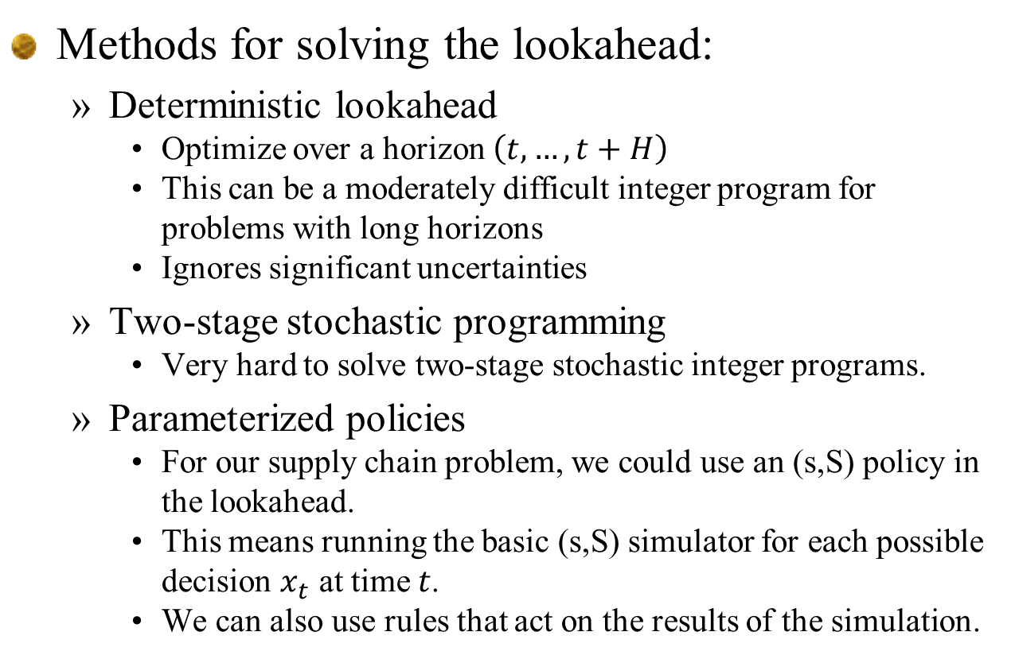
Supply chain mgmt. for Pratt & Whitney
Methods for solving the lookahead:
  Deterministic lookahead
    Optimize over a horizon $\left(t,…,t+H\right)$
    This can be a moderately difficult integer program for problems with long horizons
    Ignores significant uncertainties
  Two-stage stochastic programming
    Very hard to solve two-stage stochastic integer programs.
  Parameterized policies
    For our supply chain problem, we could use an (s,S) policy in the lookahead.
    This means running the basic (s,S) simulator for each possible decision $x_{t}$ at time $t$.
    We can also use rules that act on the results of the simulation.
Slide 21

Slide 22
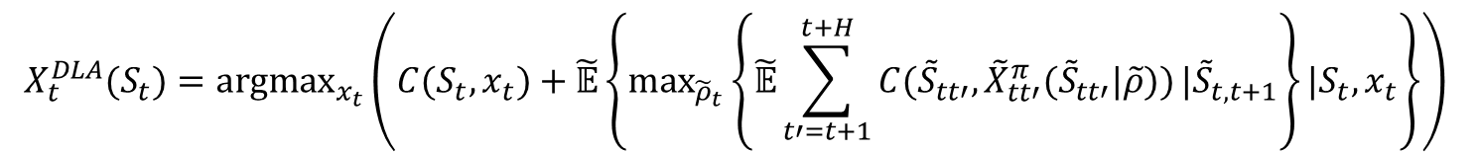
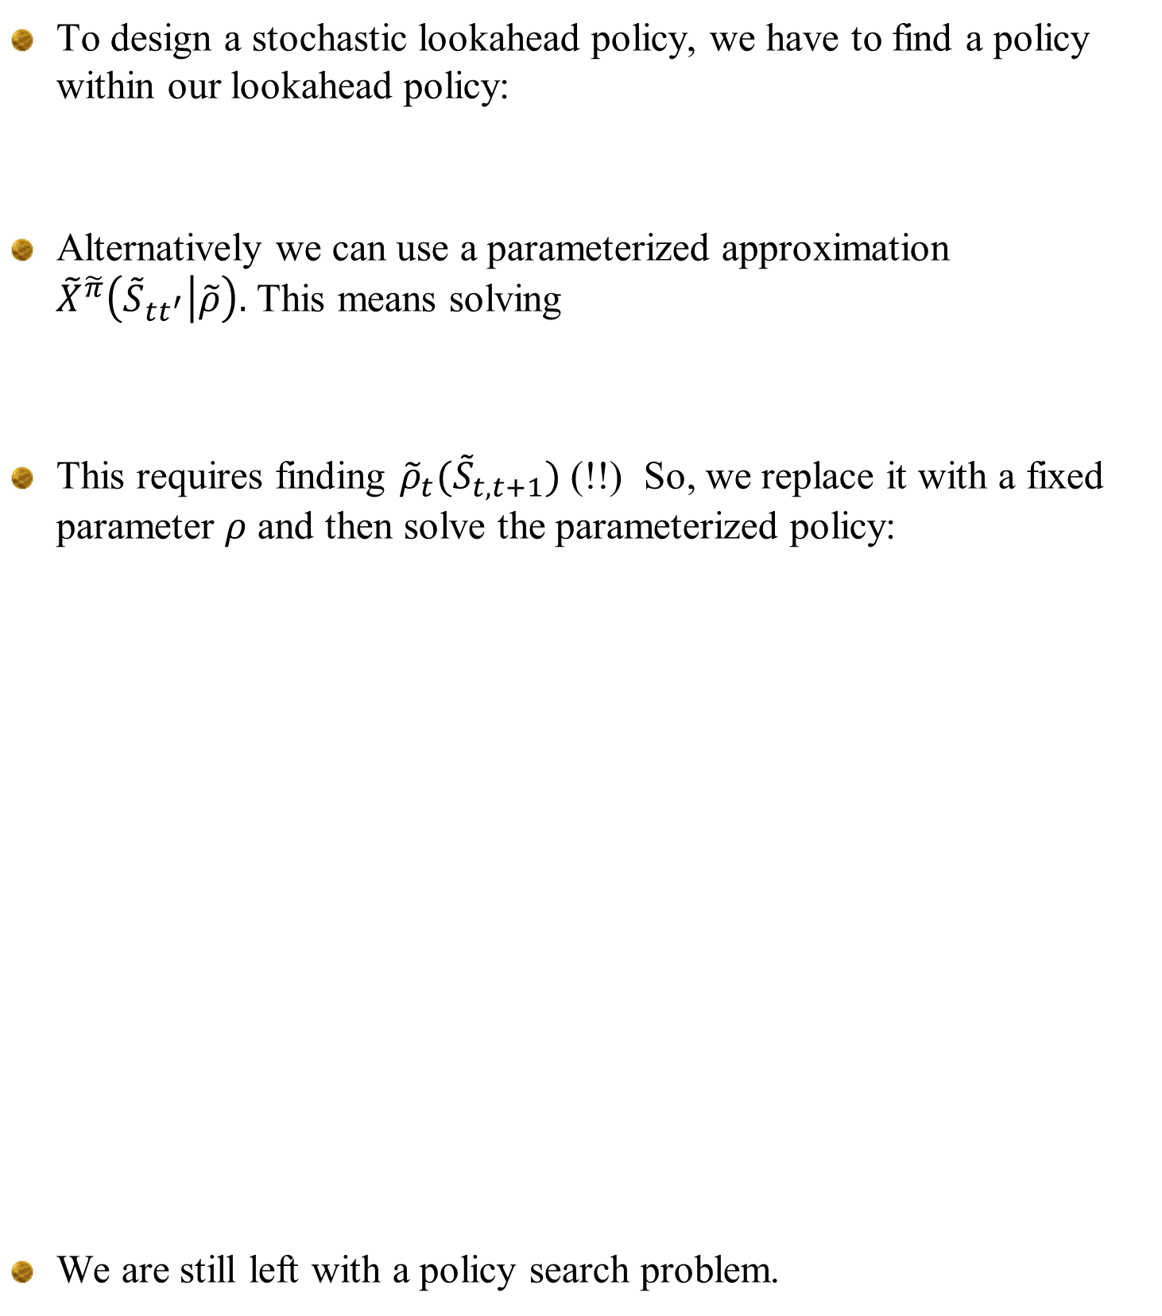
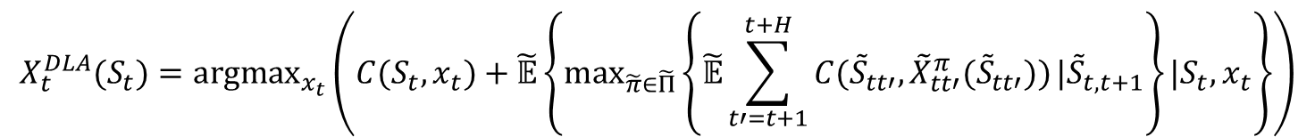
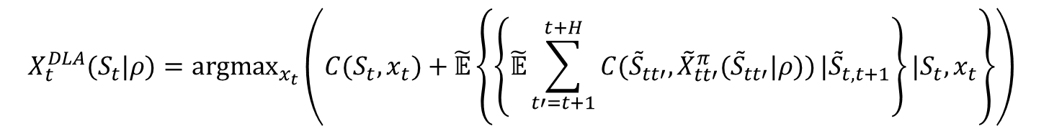
Supply chain mgmt. for Pratt & Whitney
To design a stochastic lookahead policy, we have to find a policy within our lookahead policy:
Alternatively we can use a parameterized approximation ${\tilde{X}}^{\tilde{π}}\left({\tilde{S}}_{tt^{′}} | \tilde{ρ}\right).$ This means solving
This requires finding ${\tilde{ρ}}_{t}({\tilde{S}}_{t,t+1})$ (!!) So, we replace it with a fixed parameter $ρ$ and then solve the parameterized policy:
We are still left with a policy search problem.
$$X_{t}^{DLA}(S_{t})={argmax}_{x_{t}}\left(C(S_{t},x_{t})+\tilde{𝔼}\left\{\max_{\tilde{π}∈\tilde{Π}}\left\{\tilde{𝔼}\sum_{t′=t+1}^{t+H}{C({\tilde{S}}_{tt′},{\tilde{X}}_{tt′}^{π}({\tilde{S}}_{tt′}))}|{\tilde{S}}_{t,t+1}\right\}|S_{t},x_{t}\right\}\right)$$
$$X_{t}^{DLA}(S_{t})={argmax}_{x_{t}}\left(C(S_{t},x_{t})+\tilde{𝔼}\left\{\max_{{\tilde{ρ}}_{t}}\left\{\tilde{𝔼}\sum_{t′=t+1}^{t+H}{C({\tilde{S}}_{tt′},{\tilde{X}}_{tt′}^{π}({\tilde{S}}_{tt′}|\tilde{ρ}))}|{\tilde{S}}_{t,t+1}\right\}|S_{t},x_{t}\right\}\right)$$
$$X_{t}^{DLA}(S_{t}|ρ)={argmax}_{x_{t}}\left(C(S_{t},x_{t})+\tilde{𝔼}\left\{\left\{\tilde{𝔼}\sum_{t′=t+1}^{t+H}{C({\tilde{S}}_{tt′},{\tilde{X}}_{tt′}^{π}({\tilde{S}}_{tt′}|ρ))}|{\tilde{S}}_{t,t+1}\right\}|S_{t},x_{t}\right\}\right)$$
Slide 22

Slide 23

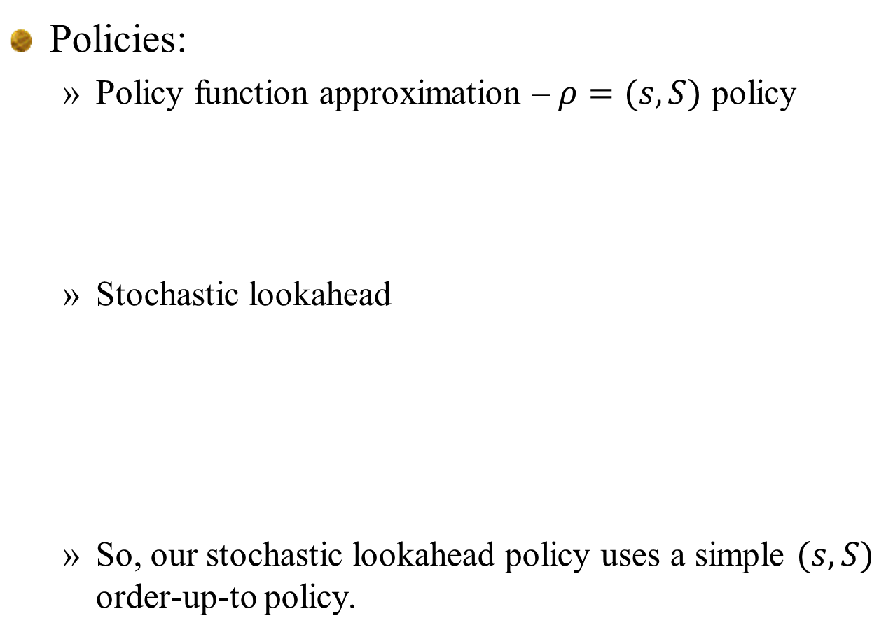

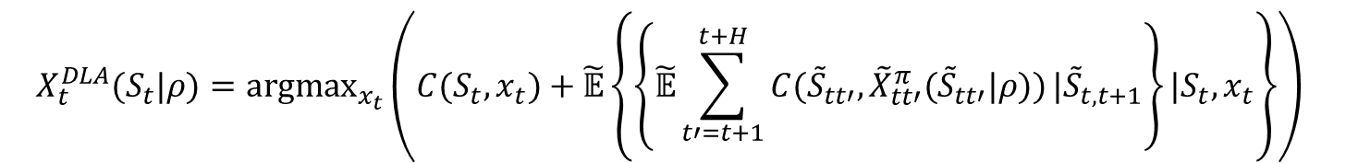
Supply chain mgmt. for Pratt & Whitney
Policies:
  Policy function approximation – $ρ=(s,S)$ policy
  Stochastic lookahead
  So, our stochastic lookahead policy uses a simple $(s,S)$ order-up-to policy.
$$ρ=(s,S)$$
$$X_{t}^{DLA}(S_{t}|ρ)={argmax}_{x_{t}}\left(C(S_{t},x_{t})+\tilde{𝔼}\left\{\left\{\tilde{𝔼}\sum_{t′=t+1}^{t+H}{C({\tilde{S}}_{tt′},{\tilde{X}}_{tt′}^{π}({\tilde{S}}_{tt′}|ρ))}|{\tilde{S}}_{t,t+1}\right\}|S_{t},x_{t}\right\}\right)$$
$ρ$ $=(s,S)$
No max operator!
Slide 23

Slide 24

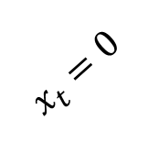
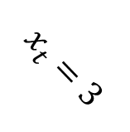

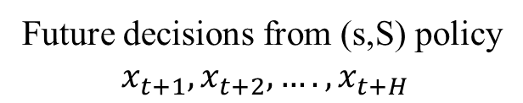
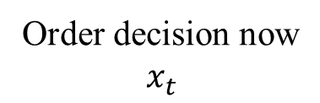
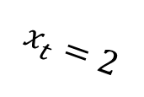




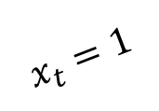


Supply chain mgmt. for Pratt & Whitney
Two stage lookahead approximation
Order decision now
$$x_{t}$$
Future decisions from (s,S) policy
$$x_{t+1},x_{t+2},….,x_{t+H}$$
$$S$$
$$s$$
$$x_{t}=0$$
$$S$$
$$s$$
$$x_{t}=1$$
$$S$$
$$x_{t}=2$$
$$s$$
$$x_{t}=3$$
$$S$$
$$s$$
Pick the $x_{t}$ that performs the best (using one or more forward simulations)
Slide 24

Slide 25


Supply chain mgmt. for Pratt & Whitney
We simulate our (s,S) policy for each decision now.
$$S$$
The lookahead model
$$s$$
. . . .
The base model
Slide 25

Slide 26


Supply chain mgmt. for Pratt & Whitney
We simulate our (s,S) policy for each decision now.
$$S$$
The lookahead model
$$s$$
. . . .
The base model
Slide 26

Slide 27
Supply chain mgmt. for Pratt & Whitney
We simulate our (s,S) policy for each decision now.
$$S$$
The lookahead model
$$s$$
. . . .
The base model
Slide 27

Slide 28


Supply chain mgmt. for Pratt & Whitney
We simulate our (s,S) policy for each decision now.
$$S$$
The lookahead model
$$s$$
. . . .
The base model
Slide 28

Slide 29


Supply chain mgmt. for Pratt & Whitney
We simulate our (s,S) policy for each decision now.
$$S$$
The lookahead model
$$s$$
. . . .
The base model
Slide 29

Slide 30
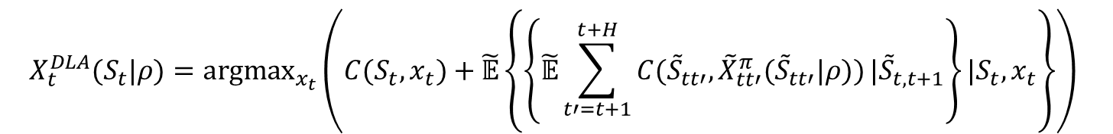
Supply chain mgmt. for Pratt & Whitney
Comparing policies
  (s,S) policy as the base model
  Stochastic lookahead (with (s,S) as the lookahead policy)
  Now, we simulate each of these policies in our simulator:
  The stochastic lookahead is a simulator within a simulator.
$$X_{t}^{DLA}(S_{t}|ρ)={argmax}_{x_{t}}\left(C(S_{t},x_{t})+\tilde{𝔼}\left\{\left\{\tilde{𝔼}\sum_{t′=t+1}^{t+H}{C({\tilde{S}}_{tt′},{\tilde{X}}_{tt′}^{π}({\tilde{S}}_{tt′}|ρ))}|{\tilde{S}}_{t,t+1}\right\}|S_{t},x_{t}\right\}\right)$$
Slide 30

