Slide 1
A Unified Framework for
Sequential Decision Analytics
Olin Business School
University of Washington, St. Louis
November 5-6, 2019
Warren B. Powell
Princeton University
Department of Operations Research
and Financial Engineering

Slide 2

Stochastic lookahead policies

Slide 3
Designing policies
The ultimate lookahead policy is optimal
  In practice, we solve an approximate lookahead model:
  A direct lookahead policy (DLA) works by solving the lookahead model:
Slide 3

Slide 4
Designing policies
Strategies:
  Deterministic lookahead (classical “model predictive control”)
  Two-stage stochastic programming
  Approximate dynamic programming for the lookahead model
  Parameterized policies
Slide 4

Slide 5

Scenario trees

Slide 6
Stochastic lookahead policies
Variations of lookahead policies
  Deterministic lookahead – We replace uncertain future events using a deterministic approximation
  Stochastic lookahead
    We can create a lookahead model where uncertainties are captured using a sampled scenario tree:
Slide 6

Slide 7
Stochastic lookahead policies
Probabilistic lookahead
  Here, we approximate the information model by using a Monte Carlo sample to create a scenario tree:
  We can try to solve this as a single “deterministic” optimization problem. This is a direct lookahead policy.

Slide 8
Stochastic lookahead policies
We can then simulate this lookahead policy over time:
The lookahead model
. . . .
The base model
Slide 8

Slide 9
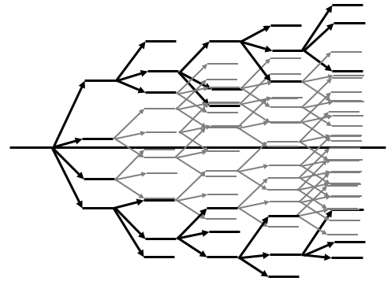
Stochastic lookahead policies
We can then simulate this lookahead policy over time:
The lookahead model
. . . .
The base model
Slide 9

Slide 10
Stochastic lookahead policies
We can then simulate this lookahead policy over time:
The lookahead model
. . . .
The base model
Slide 10

Slide 11
Stochastic lookahead policies
We can then simulate this lookahead policy over time:
The lookahead model
. . . .
The base model
Slide 11

Slide 12
Two-stage approximation

Slide 13
Stochastic lookahead policies
Stochastic lookahead
  Here, we approximate the information model by using a Monte Carlo sample to create a scenario tree:
1am 2am 3am 4am 5am …..
Change in wind speed
Change in wind speed
Change in wind speed
Slide 13

Slide 14
Stochastic lookahead policies
Two stage lookahead approximation
3) Schedule turbines
2) See wind:
Slide 14

Slide 15
Stochastic unit commitment
We have to construct scenarios of what might happen.
  “Scenarios” are possible stochastic outcomes in a lookahead model (not to be confused with “sample paths” that represent realizations in a base model)
  For our problem, assume the only uncertainty is the energy generated by wind.
  We developed a mathematical model that models the errors in forecast. We then sample errors from this model, and add it to the forecast to get a realization of the energy that might be generated from wind over the day.
  Below we show five scenarios.
Slide 15

Slide 16
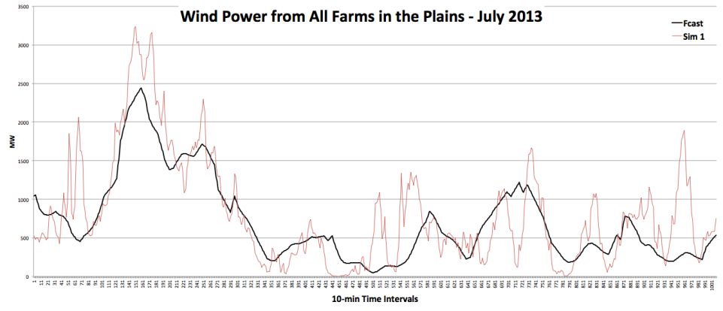
Stochastic lookahead policies
Creating wind scenarios (Scenario #1)
Slide 16

Slide 17
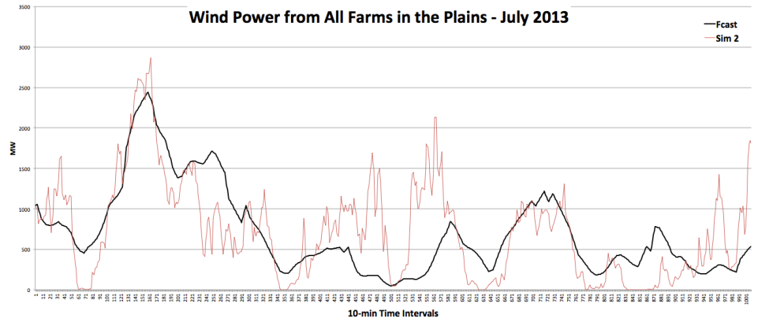
Stochastic lookahead policies
Creating wind scenarios (Scenario #2)
Slide 17

Slide 18
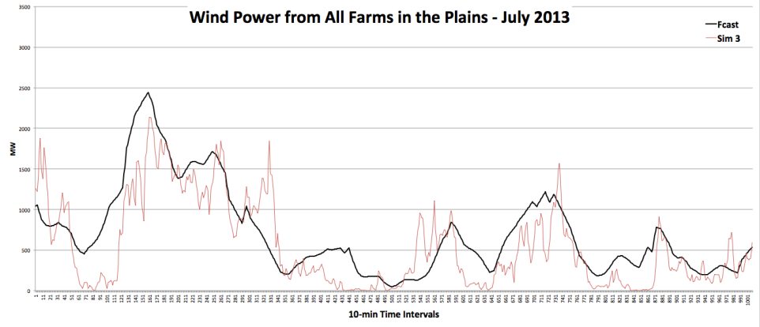
Stochastic lookahead policies
Creating wind scenarios (Scenario #3)
Slide 18

Slide 19
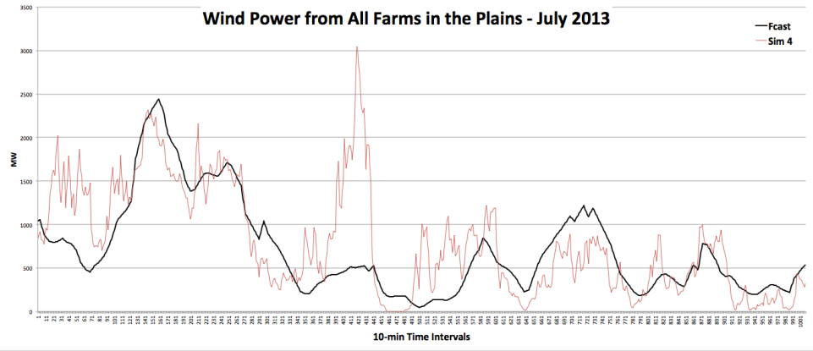
Stochastic lookahead policies
Creating wind scenarios (Scenario #4)
Slide 19

Slide 20
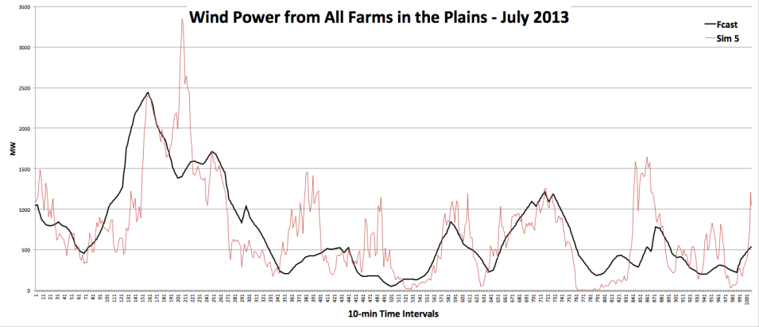
Stochastic lookahead policies
Creating wind scenarios (Scenario #5)
Slide 20

Slide 21
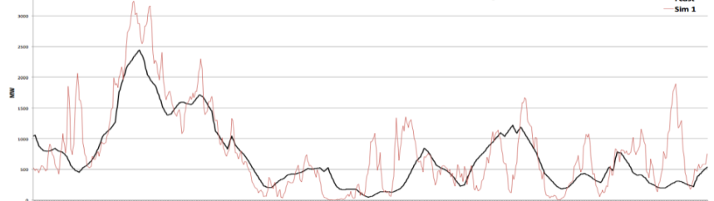
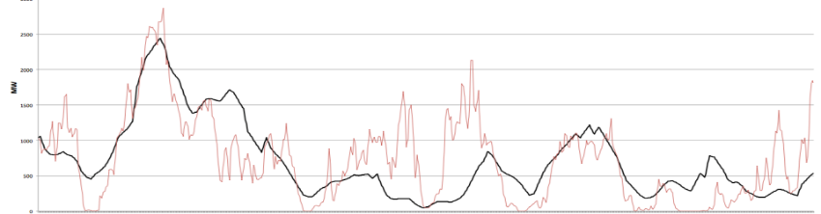
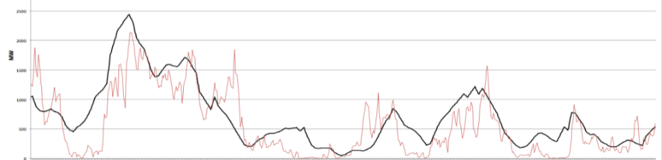
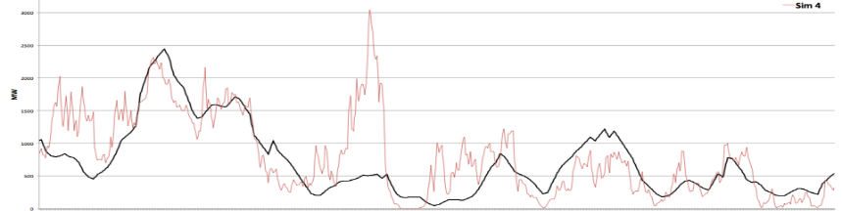
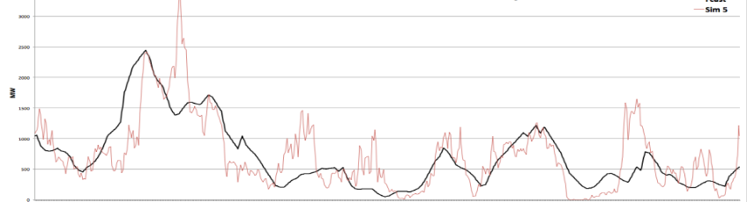
Stochastic lookahead policies
The two-stage approximation
2) See wind:
3) Schedule turbines
Slide 21

Slide 22
Stochastic lookahead policies
We can then simulate this lookahead policy over time:
The lookahead model
. . . .
The base model
Slide 22

Slide 23
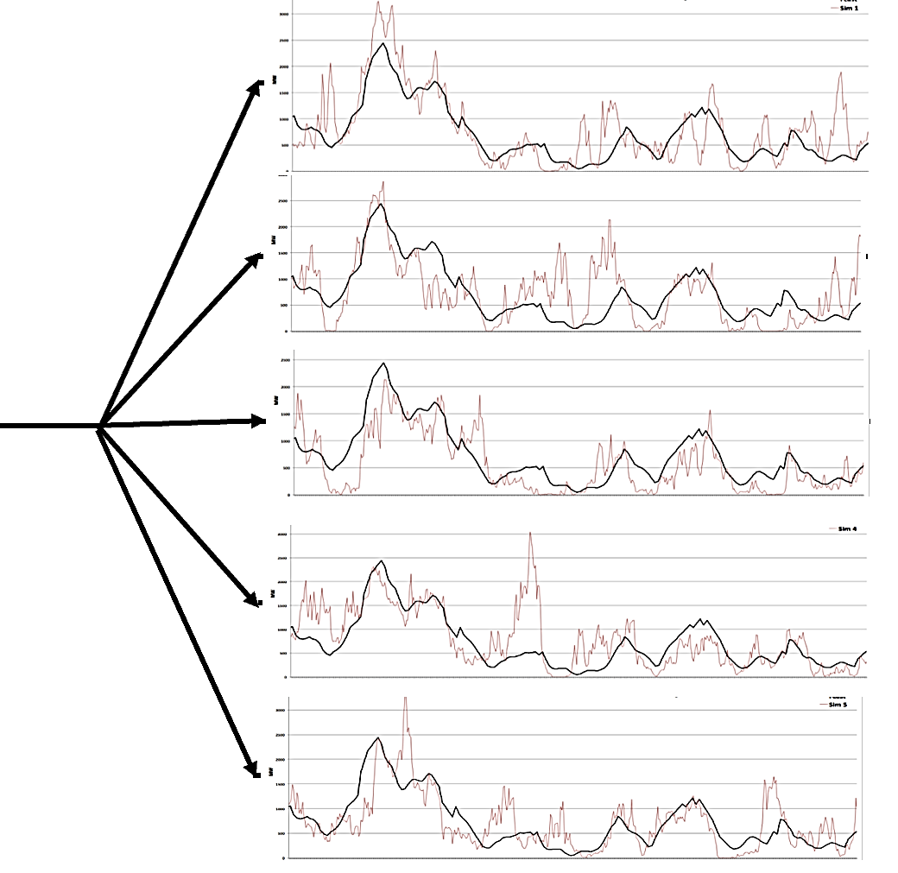
Stochastic lookahead policies
We can then simulate this lookahead policy over time:
The lookahead model
. . . .
The base model
Slide 23

Slide 24
Stochastic lookahead policies
We can then simulate this lookahead policy over time:
The lookahead model
. . . .
The base model
Slide 24

Slide 25
Stochastic lookahead policies
We can then simulate this lookahead policy over time:
The lookahead model
. . . .
The base model
Slide 25

Slide 26
Stochastic lookahead
Notes:
  Virtually all stochastic programming models use a two-stage approximation.
  It is often the case that these two-stage approximations are hard to solve (research groups have spent years developing efficient algorithms).
  However, an optimal solution to a stochastic program is not an optimal policy!
  The errors introduced by the two-stage approximation are problem dependent, but largely ignored.
  Myth: to solve a stochastic optimization problem, you have to use a stochastic lookahead model.
Slide 26

Slide 27
Using approximate dynamic programming

Slide 28
Stochastic lookahead policies
Probabilistic lookahead
  We can also solve the lookahead model using convex value function approximations (“dynamic programming”)
  We can try to solve this as a single “deterministic” optimization problem. This is a direct lookahead policy.

Slide 29
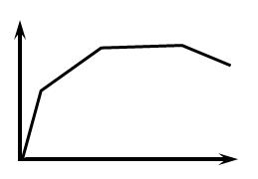
Stochastic lookahead policies
Probabilistic lookahead
  We can also solve the lookahead model using convex value function approximations (“dynamic programming”)
Slide 29

Slide 30
Stochastic lookahead policies
Probabilistic lookahead
  We can also solve the lookahead model using convex value function approximations (“dynamic programming”)
Slide 30

Slide 31
Stochastic lookahead policies
Probabilistic lookahead
  We can also solve the lookahead model using convex value function approximations (“dynamic programming”)
Slide 31

Slide 32
Stochastic lookahead policies
Probabilistic lookahead
  We can also solve the lookahead model using convex value function approximations (“dynamic programming”)
Slide 32

Slide 33
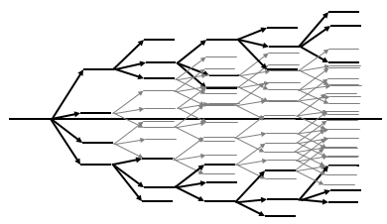
Stochastic lookahead policies
We can then simulate this lookahead policy over time:
The lookahead model
. . . .
The real process
Slide 33

Slide 34
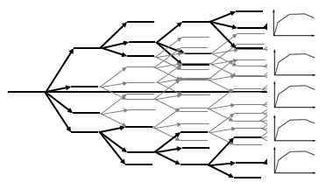
Stochastic lookahead policies
We can then simulate this lookahead policy over time:
The lookahead model
. . . .
The real process
Slide 34

Slide 35
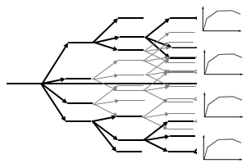
Stochastic lookahead policies
We can then simulate this lookahead policy over time:
The lookahead model
. . . .
The real process
Slide 35

Slide 36
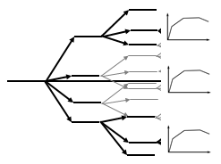
Stochastic lookahead policies
We can then simulate this lookahead policy over time:
The lookahead model
. . . .
The real process
Slide 36

Slide 37
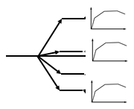
Stochastic lookahead policies
We can then simulate this lookahead policy over time:
The lookahead model
. . . .
The real process
Slide 37

Slide 38
Stochastic lookahead policies
We can then simulate this lookahead policy over time:
The lookahead model
. . . .
The real process
Slide 38

Slide 39
Stochastic lookahead policies
We can then simulate this lookahead policy over time:
The lookahead model
. . . .
The real process
Slide 39

Slide 40
Stochastic lookahead policies
We can then simulate this lookahead policy over time:
The lookahead model
. . . .
The real process
Slide 40

Slide 41
Stochastic lookahead policies
We can then simulate this lookahead policy over time:
The lookahead model
. . . .
The real process
Slide 41

Slide 42
Stochastic lookahead policies
We can then simulate this lookahead policy over time:
The lookahead model
. . . .
The real process
Slide 42

Slide 43
Stochastic lookahead policies
We can then simulate this lookahead policy over time:
The lookahead model
. . . .
The real process
Slide 43

Slide 44
Stochastic lookahead policies
We can then simulate this lookahead policy over time:
The lookahead model
. . . .
The real process
Slide 44

Slide 45
Stochastic lookahead policies
We can then simulate this lookahead policy over time:
The lookahead model
. . . .
The real process
Slide 45

Slide 46
Stochastic lookahead policies
We can then simulate this lookahead policy over time:
The lookahead model
. . . .
The real process
Slide 46

Slide 47
Stochastic lookahead policies
We can then simulate this lookahead policy over time:
The lookahead model
. . . .
The real process
Slide 47

Slide 48
Stochastic lookahead policies
Notes:
  There are many people who equate “stochastic optimization” with a “stochastic lookahead model.”
  Later, we will show how to use a parameterized version of a deterministic lookahead to produce robust solutions in a stochastic environment.
Slide 48

Slide 49
Stochastic lookahead policies
Lookahead models vs base models
  There are many papers on stochastic optimization problems where it is not clear if the paper is solving a base model or a lookahead model.
  Hints that you are solving a base model:
    The model is used as a simulator to answer strategic questions (e.g. fleet size, pricing policies, capacity investments in reservoirs).
  Hints that you are solving a lookahead model
    You are solving a problem over a horizon, but you are only interested in the first-period solution.
    You have an imbedded forecast which is not updated on a rolling basis over the course of the planning horizon (forecasts are treated as a latent variable).
    There are other variables that would change over time, but which are being held constant.

Slide 50
Stochastic lookahead policies
Lookahead models vs base models
  Some models can only be lookahead models:
    Stochastic programs which represent the future using scenario trees.
    Deterministic models that are clearly being solved in the context of a stochastic problem.
    Robust optimization in the context of a sequential decision problem.

