Slide 1
.
ORF 544
Stochastic Optimization and Learning
Spring, 2019
Warren Powell
Princeton University
http://www.castlelab.princeton.edu

Slide 2

Week 10
Backward approximate dynamic programming

Slide 3

Backward MDP and the curse of dimensionality

Slide 4
Curse of dimensionality
The ultimate policy is to optimize from now on:
Ideally, we would like to replace the future contributions with a single value function:
Sometimes we can compute this function exactly!

Slide 5
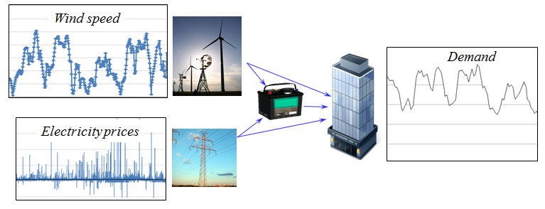
Curse of dimensionality
Energy storage with stochastic prices, supplies and demands.

Slide 6
Curse of dimensionality
Bellman’s optimality equation
These are the “three curses of dimensionality.”

Slide 7
Curse of dimensionality
Backward dynamic programming in one dimension

Slide 8
Curse of dimensionality
Dynamic programming in multiple dimensions

Slide 9
Curse of dimensionality
Notes:
  There are potentially three “curses of dimensionality” when using backward dynamic programming:
    The state variable – We need to enumerate all states. If the state variable is a vector with more than two dimensions, the state space gets very big, very quickly.
    The random information – We have to sum over all possible realizations of the random variable. If this has more than two dimensions, this gets very big, very quickly.
    The decisions – Again, decisions may be vectors (our energy example has five dimensions). Same problem as the other two.
  Some problems fit this framework, but not very. However, when we can use this framework, we obtain something quite rare: an optimal policy.

Slide 10
Curse of dimensionality
Strategies for approximating value functions:
  Backward dynamic programming
    Exact using lookup tables
    Backward approximate dynamic programming:
      Linear regression
      Low rank approximations
  Forward approximate dynamic programming
    Approximation architectures
      Lookup tables
        Correlated beliefs
        Hierarchical
      Linear models
      Convex/concave
    Updating schemes
      Pure forward pass TD(0)
      Double pass TD(1)

Slide 11
Backward ADP-Chapter 16

Slide 12
Backward ADP
Classical backward dynamic programming
  Uses lookup table representations of value functions
  Assumes the one-step transition matrix can be computed (which is also lookup table).
  “Dynamic programming” does not suffer from the curse of dimensionality (as we show below), but lookup tables do.
  There are three curses of dimensionality, but often it is the state variable that causes the most problems.
  Backward ADP uses a sample of states rather than all the states, and a statistical model for the value of being in a state. At a minimum this fixes two of the three curses of dimensionality.

Slide 13
Backward ADP
Backward approximate dynamic programming
  Basic idea is to step backward in time, just as we do with classical backward dynamic programming.
  Instead of looping over all the states, loop over a random sample.
  Now, use the sample of values and states to produce an approximate value function:
    Any statistical model
    Low-rank approximations (works well when value functions are smooth).
  You still need to take full expectation (although this might be approximated) and search over all actions.

Slide 14
Backward ADP
Backward ADP

Slide 15
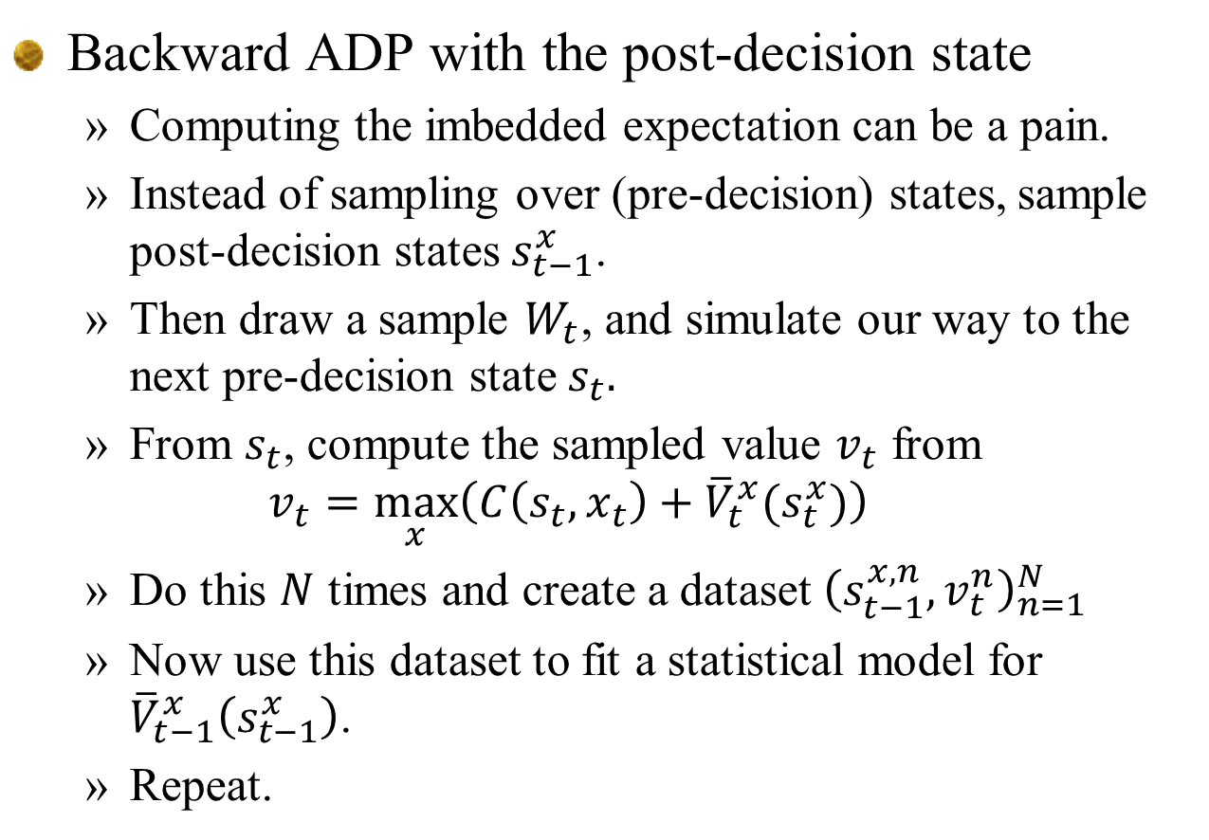
Backward ADP
Backward ADP with the post-decision state
  Computing the imbedded expectation can be a pain.
  Instead of sampling over (pre-decision) states, sample post-decision states $s_{t−1}^{x}$.
  Then draw a sample $W_{t}$, and simulate our way to the next pre-decision state $s_{t}.$
  From $s_{t}$, compute the sampled value $v_{t}$ from
  $$v_{t}=\max_{x}\left(C\left(s_{t},x_{t}\right)+{\overline{V}}_{t}^{x}(s_{t}^{x})\right)$$
  Do this $N$ times and create a dataset ${\left(s_{t−1}^{x,n},v_{t}^{n}\right)}_{n=1}^{N}$
  Now use this dataset to fit a statistical model for ${\overline{V}}_{t−1}^{x}\left(s_{t−1}^{x}\right)$.
  Repeat.

Slide 16
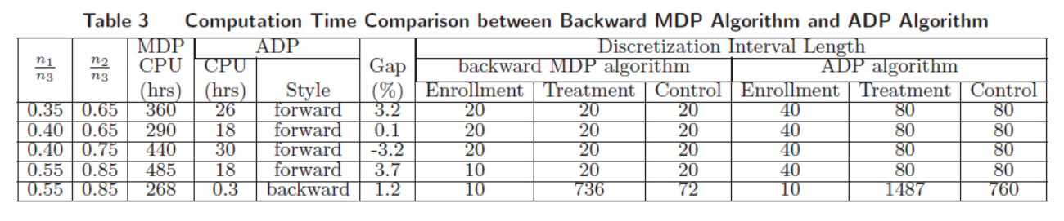
Backward ADP
Backward ADP for a clinical trial problem
  Problem is to learn the value of a new drug within a budget of patients to be tested.
  Backward MDP required 268-485 hours.
  Forward ADP exploiting monotonicity (we will cover thiss later) required 18-30 hours.
  Backward ADP required 20 minutes, with a solution that was 1.2 percent within optimal.

Slide 17
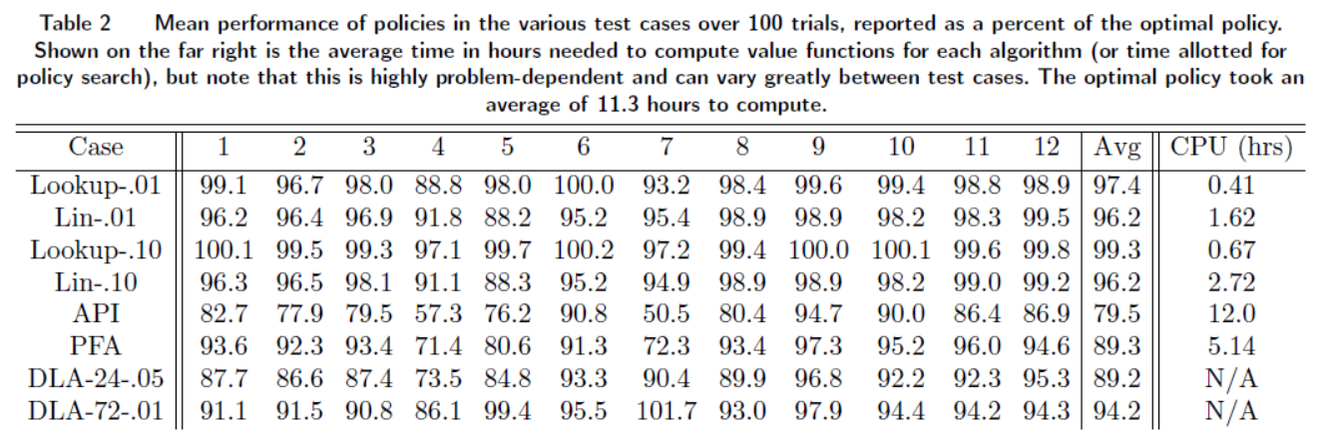
Backward ADP
Energy storage problem
  Lookup table – 99.3 percent of optimal, .67 hours.
  Backward MDP 11.3 hours.

Slide 18
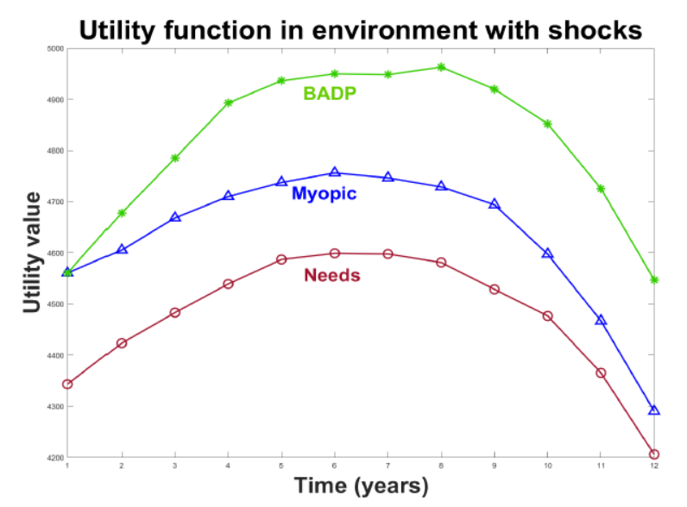
Backward ADP
Resource allocation in Africa
  Extended widely cited myopic policy to a dynamic setting.

Slide 19
Backward ADP
Notes
  By now I have applied backward ADP to approximate four projects, three with rigorous benchmarks, and one (the resource allocation problem) with a high quality benchmark (the myopic policy).
  Each time it seems to have worked very well.

Slide 20
Histories of approximate dynamic programming and reinforcement learning

Slide 21
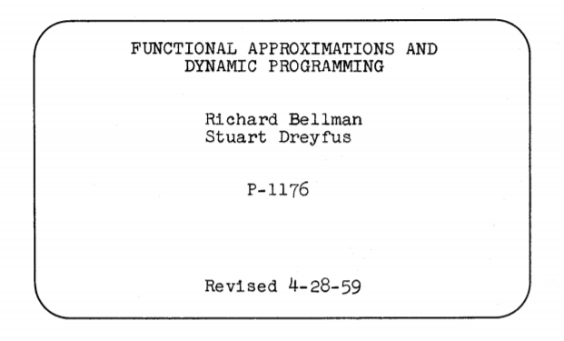
Histories of ADP/reinforcement learning
1959 – Operations research
  Bellman recognizes the limitations of classical backward dynamic programming.
  Introduces the idea of statistically approximating value functions.
  This line of research quickly died out in the operations research community.

Slide 22
The fields of stochastic optimization
Approximate dynamic programming/reinforcement learning
  1959 paper by Bellman – first attempt at ADP
  ADP in control theory – 1974 dissertation of Paul Werbos
  Reinforcement learning in computer science – 1980 research of Rich Sutton and Andy Barto
    1998 book Reinforcement Learning establishes the field
  1996 book Neuro-Dynamic programming – First to bridge the theory of stochastic approximation methods (Robbins and Monro) with reinforcement learning
  Late 1990’s – ADP returns to operations research
    1994 dissertation of Ben van Roy
    Late 1990’s onward – Value function approximations for MDPs (discrete actions)
    1998 onward – use of ADP for vector-valued actions (Powell and students)
  2007 ADP book by Powell; second edition in 2011.
    Three curses of dimensionality; high dimensional decision vectors (action spaces)

Slide 23
Histories of ADP/reinforcement learning
1974 – Controls community
  Paul Werbos introduces “backpropagation” for approximating the “cost to go” function for continuous controls problems.
  Engineering controls community continues to develop these ideas, with special emphasis on the use of neural networks in two ways:
    Actor nets – A neural network for the policy (which chooses the action given a state).
    Critic nets – A neural network for approximating the value function (cost to go function in the language of control theory)
  Paul Werbos becomes an NSF program officer and continues to promote “approximate dynamic programming.” Funded workshops on ADP in 2002 and 2006.
  1994 – Beginning with 1994 paper of John Tsitsiklis, bridging of the heuristic techniques of Q-learning and the mathematics of stochastic approximation methods (Robbins-Monro).
  1996 book “Neuro-Dynamic Programming” by Bertsekas and Tsitsiklis formally bridges Q-learning and stochastic approx. methods

Slide 24

Histories of ADP/reinforcement learning
Werbos, P. J. (1974). Beyond regression: new tools for prediction and analysis in the behavioral sciences. Ph.D. dissertation Harvard University.

Slide 25
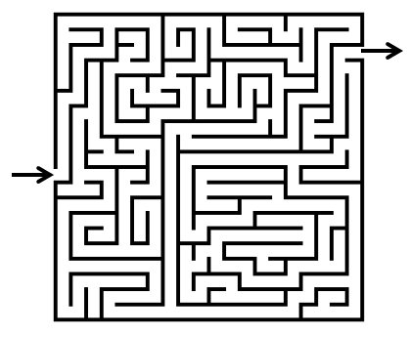
Histories of ADP/reinforcement learning
History of Q-learning
  Began ~1980 with Andy Barto (supervisor) and Rich Sutton (student) studying behavior of mice in mazes.
  Heuristically developed basic feedback mechanism:
  Late 1980’s the link to Markov decision processes was made, and the community adopted the basic notation of Markov decision processes.
  Bizarrely, the RL community adopted popular test problems from the controls community, which are primarily deterministic:
    Inverted pendulum problem.
    Hill-climbing
    Truck backer-upper
    Robotics applications.

Slide 26

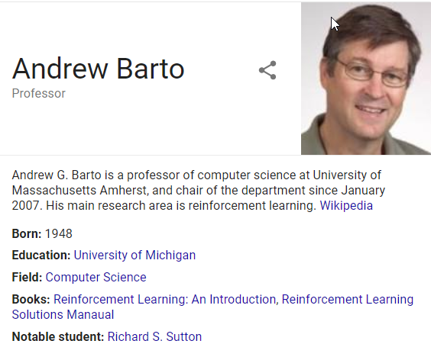
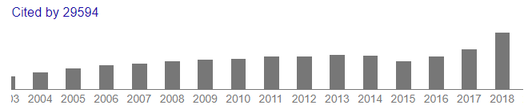
Histories of ADP/reinforcement learning
Reinforcement Learning

Slide 27
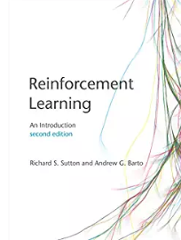
Histories of ADP/reinforcement learning
Second edition of Reinforcement Learning

Slide 28
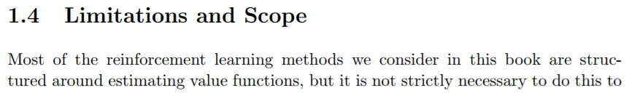
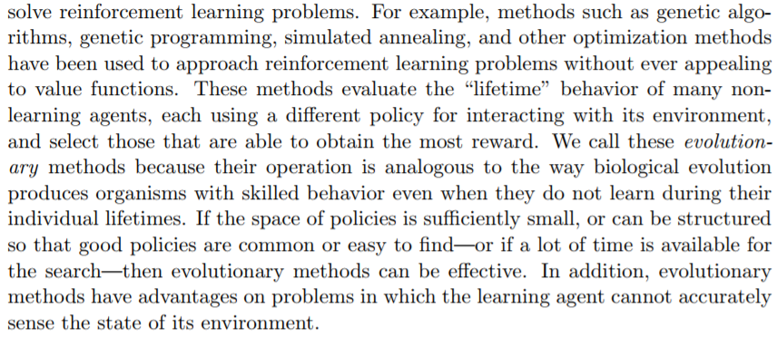
Histories of ADP/reinforcement learning
From Q-learning to other policies
  From the second edition:
  This hints at policy search, but still ignores lookahead policies (Monte Carlo tree search)

Slide 29
Histories of ADP/reinforcement learning
1990’s – Operations research
  Ben van Roy (student of John Tsitsklis) developed the ideas of using regression models for solving the “curse of dimensionality problem” of dynamic programming.
  1991 – Pereira and Pinto introduce the idea of Benders cuts for “solving the curse of dimensionality” for stochastic linear programs. Method called “stochastic dual decomposition procedure” (SDDP)
  ~2000 – Work of WBP on “adaptive dynamic programming” for high-dimensional problems in logistics.
  With Ben van Roy (who first introduced the term), WBP developed the idea of the post-decision state which opened the door for solving high-dimensional convex DPs.
  WBP switches to “approximate dynamic programming” after attending Werbos’ 2002 conference on “Approximate dynamic programming and reinforcement learning”

Slide 30
Histories of ADP/reinforcement learning
Today:
  Controls community now uses the term “adaptive dynamic programming”
    Balanced using of “control laws” (PFAs), Hamilton/Jacobi/Bellman equations (VFAs) and “model predictive control” (DLAs)
  “Reinforcement learning” has spread from Q-learning to include “policy search” and Monte Carlo tree search (a form of direct lookahead – we will get to this later).
  2014-2016 Two tutorials by WBP establish the “four classes of policies”
  “Optimization under Uncertainty” book (being written for this class) is the first to truly unify all of the different subcommunities of stochastic optimization.

Slide 31
Next steps
What we are going to cover:
  Forward approximate dynamic programming
    Estimating the value of a fixed policy
    Optimizing while learning

Slide 32
Learning the value of a policy
TD-learning

Slide 33
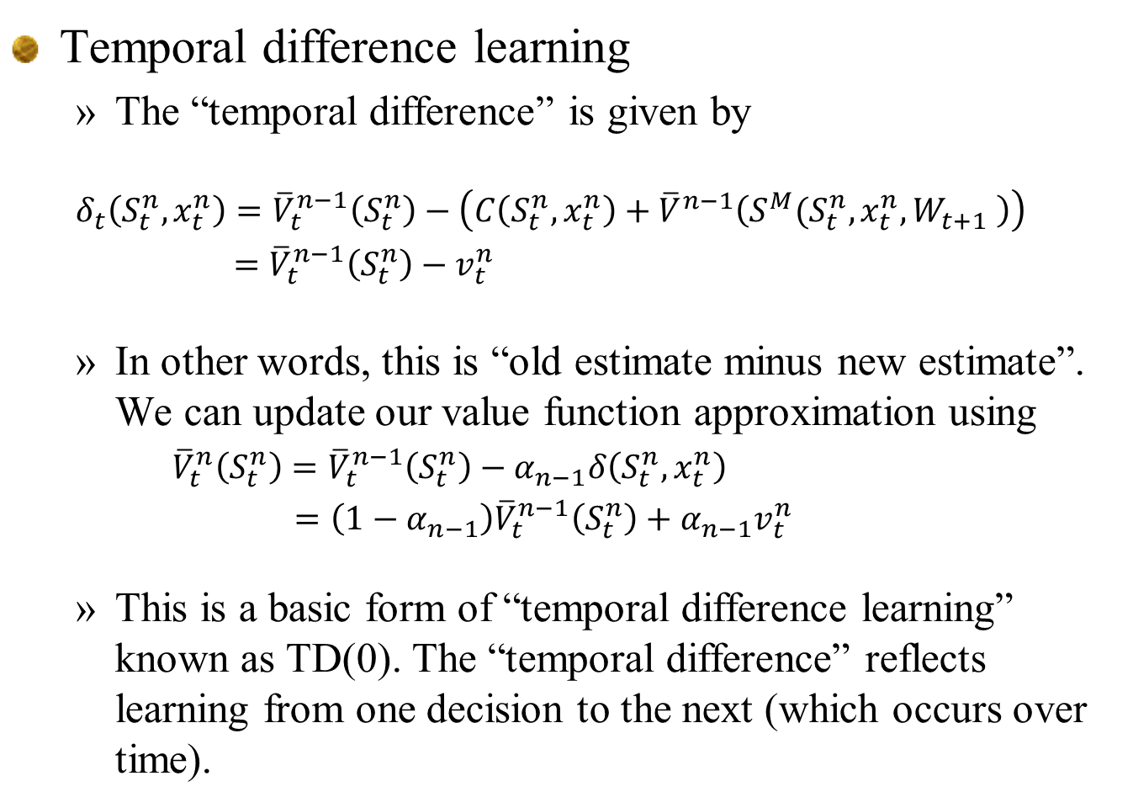
TD-learning
Temporal difference learning
  The “temporal difference” is given by
  $$δ_{t}\left(S_{t}^{n},x_{t}^{n}\right)={\overline{V}}_{t}^{n−1}\left(S_{t}^{n}\right)−\left(C\left(S_{t}^{n},x_{t}^{n}\right)+{\overline{V}}^{n−1}\left(S^{M}(S_{t}^{n},x_{t}^{n},W_{t+1} \right)\right)$$
  $={\overline{V}}_{t}^{n−1}\left(S_{t}^{n}\right)−v_{t}^{n}$
  In other words, this is “old estimate minus new estimate”. We can update our value function approximation using
  ${\overline{V}}_{t}^{n}\left(S_{t}^{n}\right)={\overline{V}}_{t}^{n−1}\left(S_{t}^{n}\right)−α_{n−1}δ\left(S_{t}^{n},x_{t}^{n}\right)$
  $=\left(1−α_{n−1}\right){\overline{V}}_{t}^{n−1}\left(S_{t}^{n}\right)+α_{n−1}v_{t}^{n}$
  This is a basic form of “temporal difference learning” known as TD(0). The “temporal difference” reflects learning from one decision to the next (which occurs over time).

Slide 34
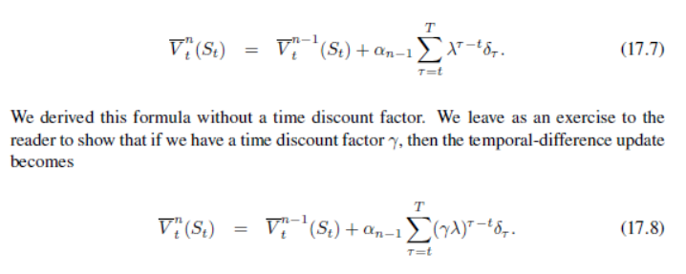
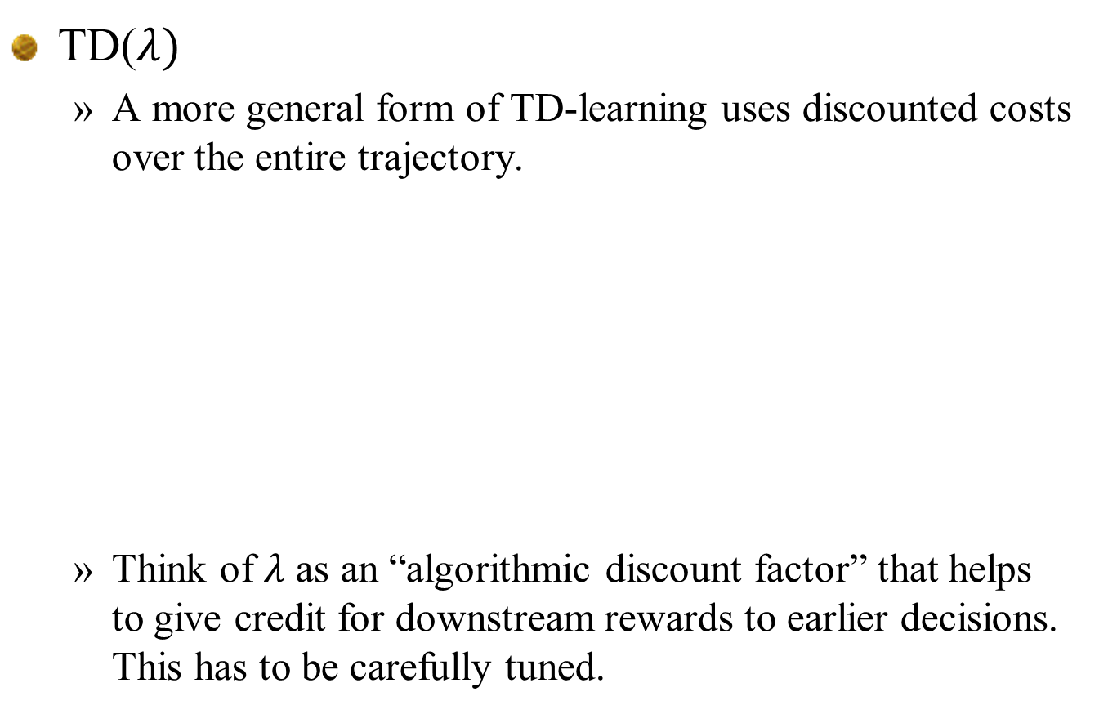
TD-learning
TD($λ)$
  A more general form of TD-learning uses discounted costs over the entire trajectory.
  Think of $λ$ as an “algorithmic discount factor” that helps to give credit for downstream rewards to earlier decisions. This has to be carefully tuned.

Slide 35
TD-learning
Approximating the value function
  Temporal difference updates can be used in any recursive estimation algorithm:
    Lookup tables
      Independent beliefs
      Correlated beliefs
    Parametric models
      Linear
      Nonlinear
      Shallow neural networks
    Nonparametric
      Kernel regression
      Locally linear
      Deep neural networks

Slide 36
Q-learning
“Reinforcement learning”

Slide 37
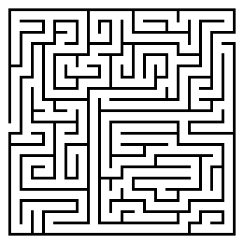
Q-learning
Mouse in a maze problem
Receive reward = 1

Slide 38
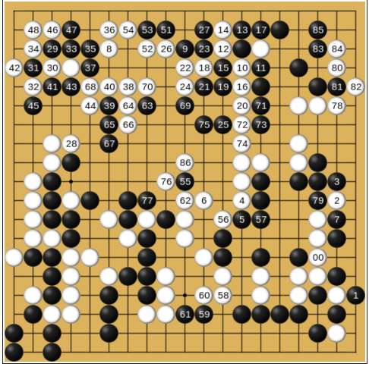
Q-learning
AlphaGo
  Much more complex state space.
  Uses hybrid of policies:
    PFA
    VFA
    Lookahead (DLA)

Slide 39
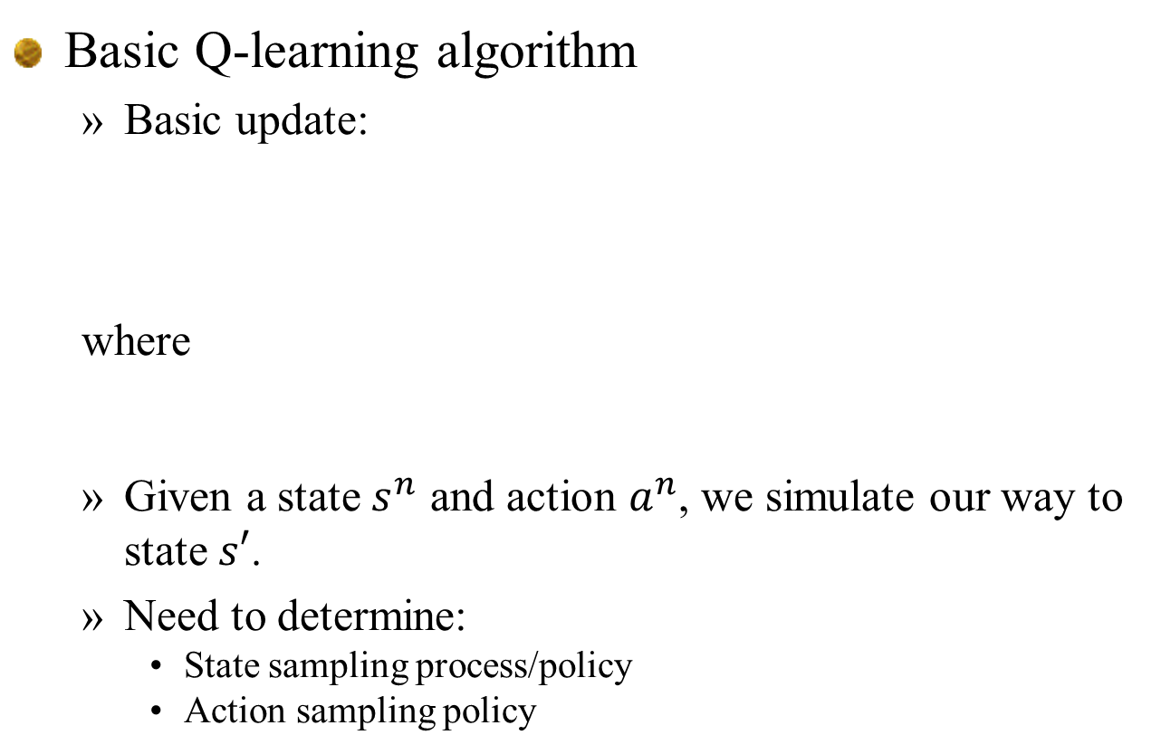
Q-learning
Basic Q-learning algorithm
  Basic update:
  where
  Given a state $s^{n}$ and action $a^{n}$, we simulate our way to state $s′$.
  Need to determine:
    State sampling process/policy
    Action sampling policy

Slide 40
Q-learning
Some terms from reinforcement learning:
  “Behavior policy” is the policy used to choose actions
    E.g. these are actions observed by a real system
  “Target policy” is the policy that we are trying to learn, which is to say the policy we want to implement.
  When the target policy is different from the behavior policy, then this is termed “off policy learning”
In this course
  The “learning policy” is the policy (often called an algorithm) that learns the value functions (or Q-factors)
  The “implementation policy” is the policy determined by the value functions (or Q-factors).

Slide 41
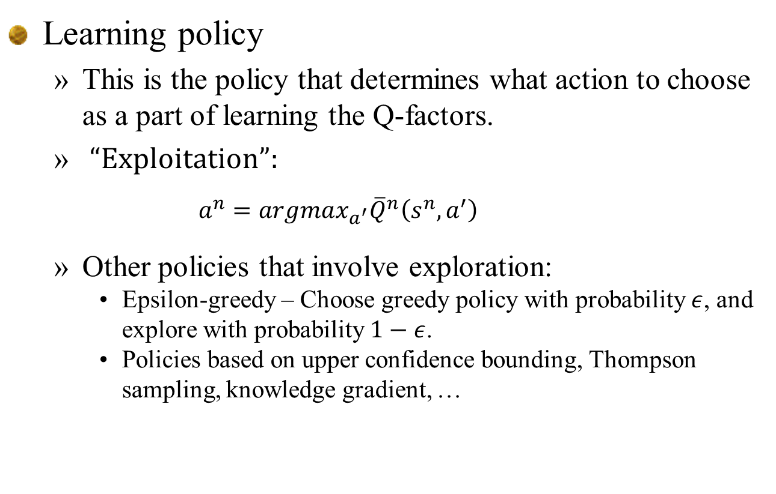
Q-learning
Learning policy
  This is the policy that determines what action to choose as a part of learning the Q-factors.
  “Exploitation”:
    $$a^{n}=argmax_{a^{′}}{\overline{Q}}^{n}\left(s^{n},a^{′}\right)$$
  Other policies that involve exploration:
    Epsilon-greedy – Choose greedy policy with probability $ε$, and explore with probability $1−ε$.
    Policies based on upper confidence bounding, Thompson sampling, knowledge gradient, …

Slide 42
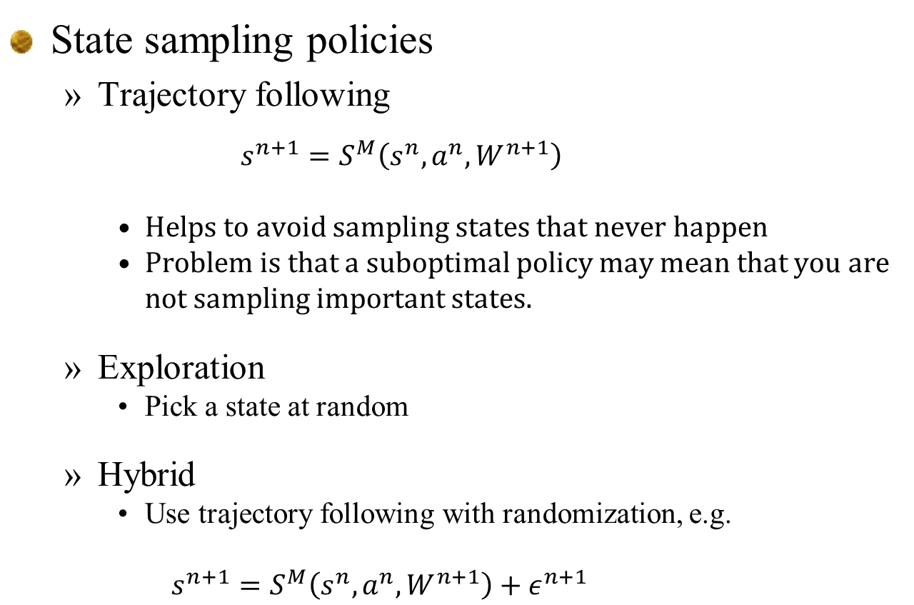
Q-learning
State sampling policies
  Trajectory following
    $$s^{n+1}=S^{M}\left(s^{n},a^{n},W^{n+1}\right)$$
    Helps to avoid sampling states that never happen
    Problem is that a suboptimal policy may mean that you are not sampling important states.
  Exploration
    Pick a state at random
  Hybrid
    Use trajectory following with randomization, e.g.
      $$s^{n+1}=S^{M}\left(s^{n},a^{n},W^{n+1}\right)+ε^{n+1}$$

Slide 43
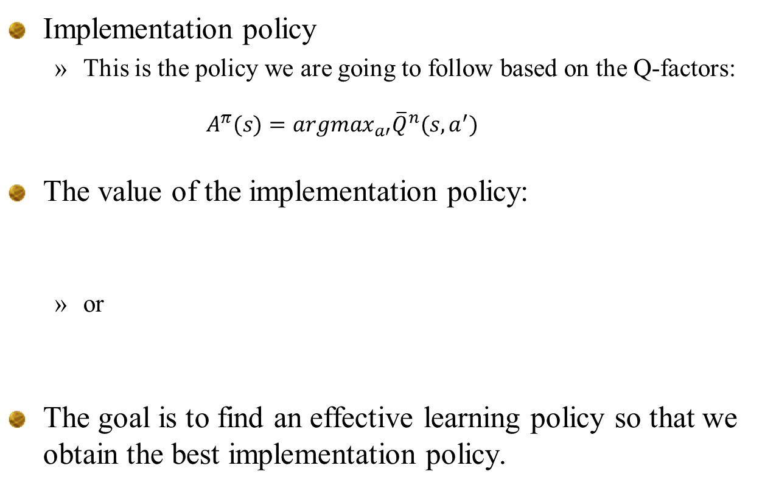
Q-learning
Implementation policy
  This is the policy we are going to follow based on the Q-factors:
    $$A^{π}(s)=argmax_{a′}{\overline{Q}}^{n}(s,a^{′})$$
The value of the implementation policy:
  or
The goal is to find an effective learning policy so that we obtain the best implementation policy.

Slide 44
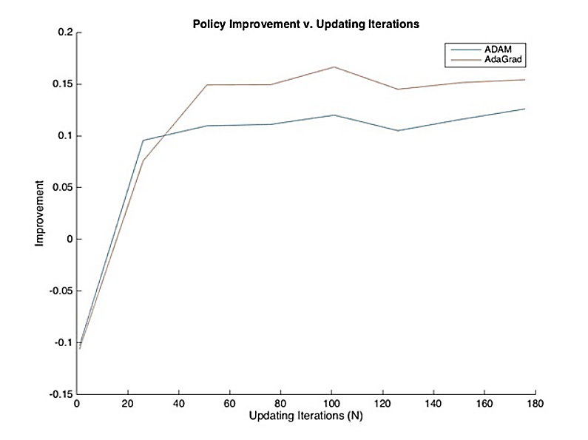
Q-learning
Convergence rates:

Slide 45
Q-learning
On vs off-policy learning:
  On-policy learning – Learning the value of a fixed policy:
  Off-policy learning:
    Sample actions according to a learning policy (called “behavior policy” in the RL literature). This is the policy used for learning the implementation policy (called the “target policy” in the RL literature).
    Needs to be combined with a state sampling policy.

Slide 46
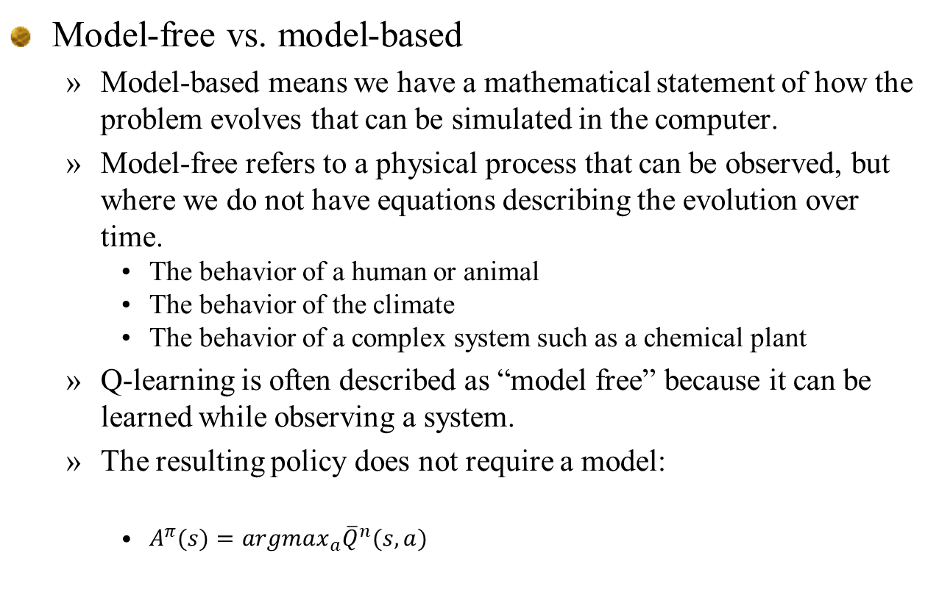
Q-learning
Model-free vs. model-based
  Model-based means we have a mathematical statement of how the problem evolves that can be simulated in the computer.
  Model-free refers to a physical process that can be observed, but where we do not have equations describing the evolution over time.
    The behavior of a human or animal
    The behavior of the climate
    The behavior of a complex system such as a chemical plant
  Q-learning is often described as “model free” because it can be learned while observing a system.
  The resulting policy does not require a model:
    $A^{π}(s)=argmax_{a}{\overline{Q}}^{n}(s,a)$

Slide 47
Q-learning
Notes
  Lookup table belief models are most popular, but do not scale (limit of 3 dimensions).
  Various smoothing strategies have been suggested (basically nonparametric statistics), but still limited to 3 dimensions.
  Need to be very careful with stepsizes. Q-learning is a form of approximate value iteration where the backward learning is slowed by the use of stepsizes.

Slide 48
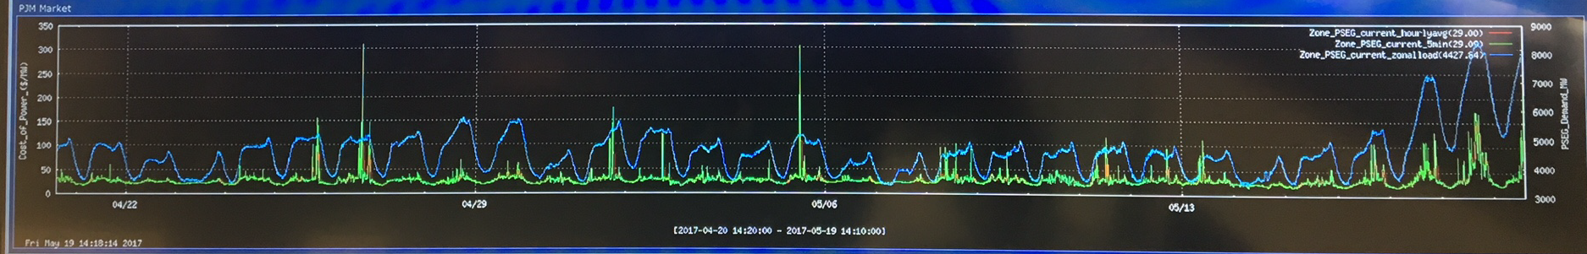

Q-learning
Max operator bias:
  Second issue arises when there is randomness in the reward.
  Imagine that we are purchasing energy at a price $p_{t}$ which evolves randomly from one time period to the next.
  Imagine buying and selling energy using real time prices:

Slide 49
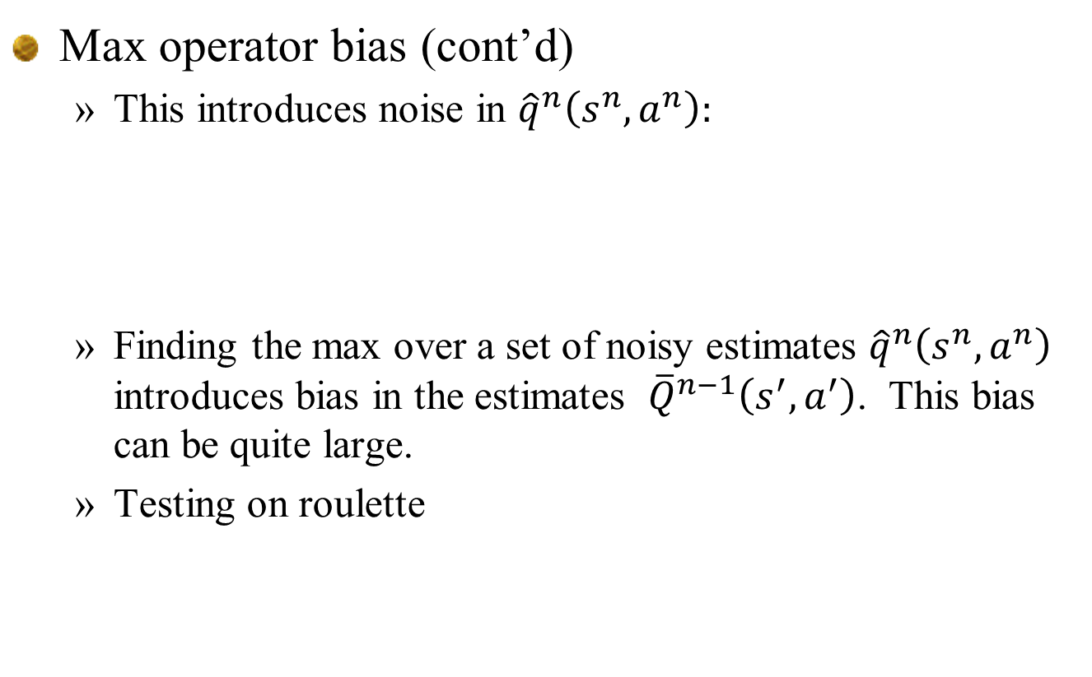
Q-learning
Max operator bias (cont’d)
  This introduces noise in ${\hat{q}}^{n}\left(s^{n},a^{n}\right):$
  Finding the max over a set of noisy estimates ${\hat{q}}^{n}\left(s^{n},a^{n}\right)$ introduces bias in the estimates ${\overline{Q}}^{n−1}\left(s^{′},a^{′}\right)$. This bias can be quite large.
  Testing on roulette

Slide 50
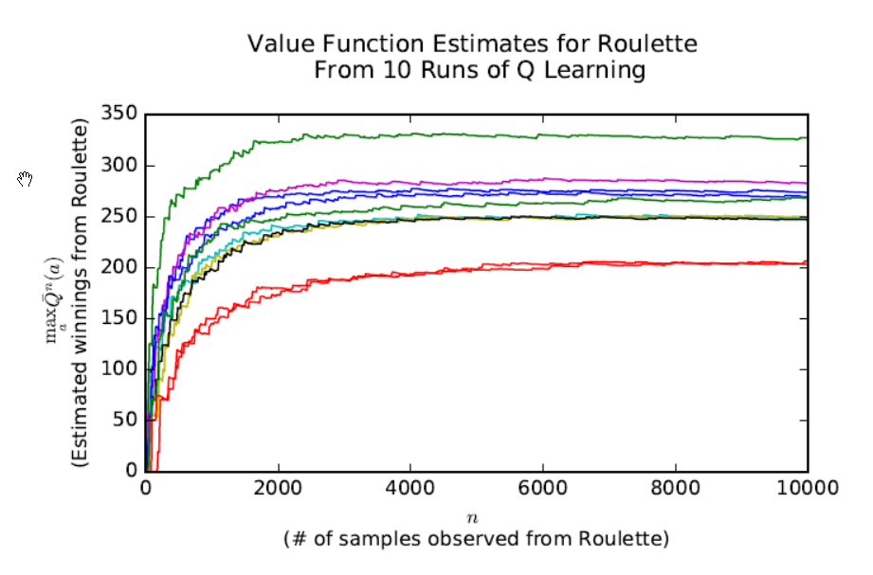
Q-learning
Roulette
  Optimal solution is not to play – optimal value of game is zero
  Q-learning over 10,000 iterations
Hint: Optimal Q = 0!

Slide 51
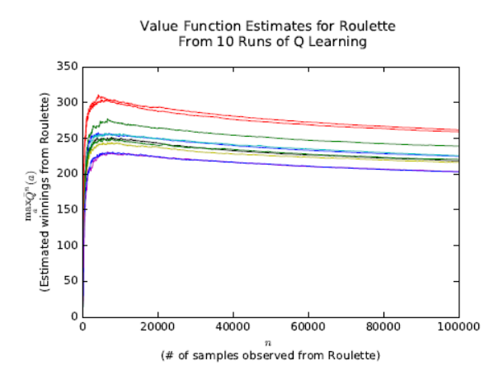
Q-learning
Roulette
  Optimal solution is not to play – optimal value of game is zero
  Q-learning over 10,000 iterations

Slide 52
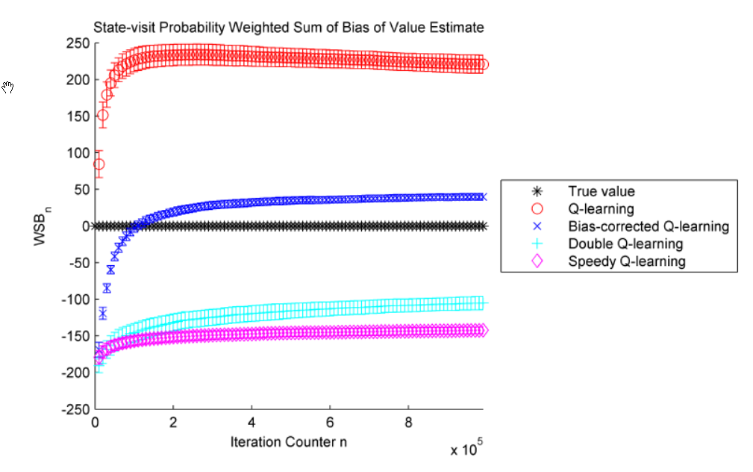
Q-learning
Roulette
  Optimal solution is not to play – optimal value of game is zero

Slide 53
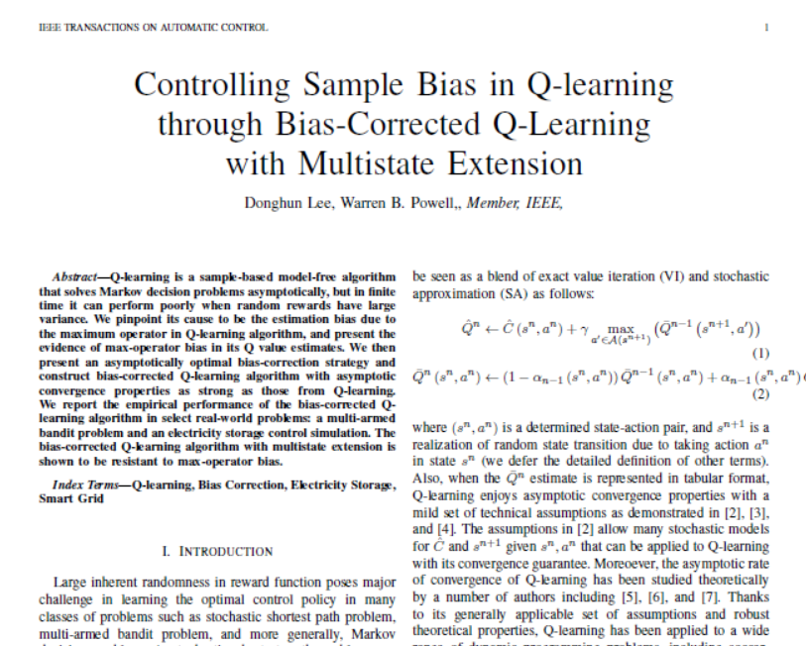
… ongoing research.

Slide 54
Approximate dynamic programming
Algorithms

Slide 55
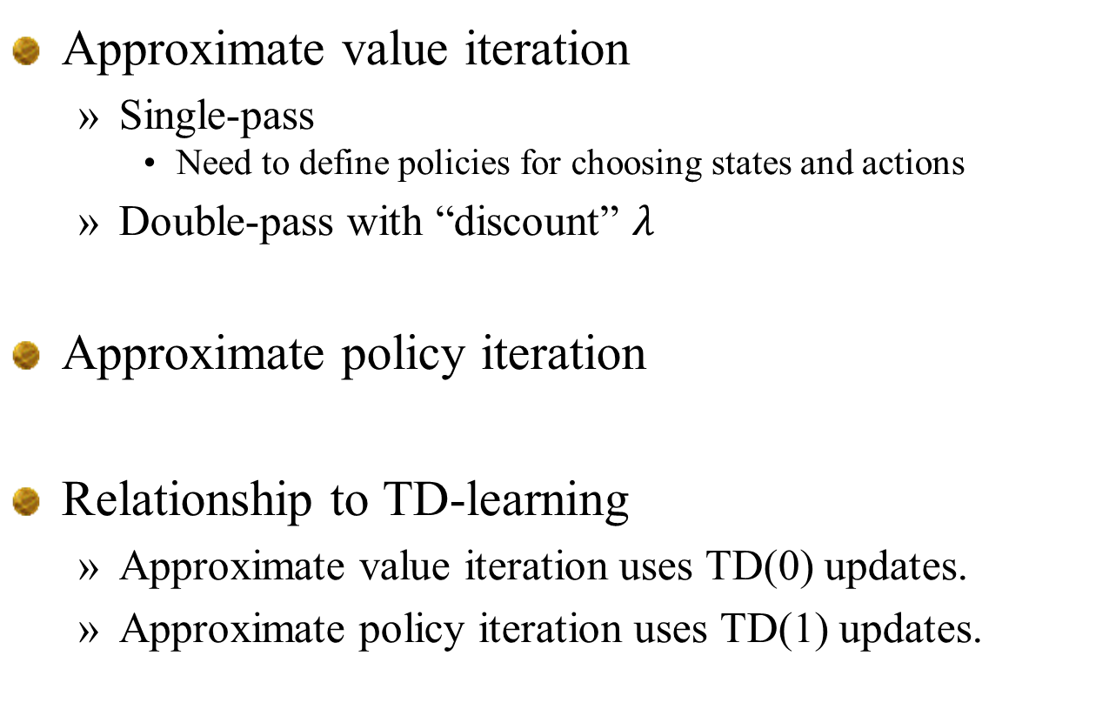
Algorithms
Approximate value iteration
  Single-pass
    Need to define policies for choosing states and actions
  Double-pass with “discount” $λ$
Approximate policy iteration
Relationship to TD-learning
  Approximate value iteration uses TD(0) updates.
  Approximate policy iteration uses TD(1) updates.

Slide 56
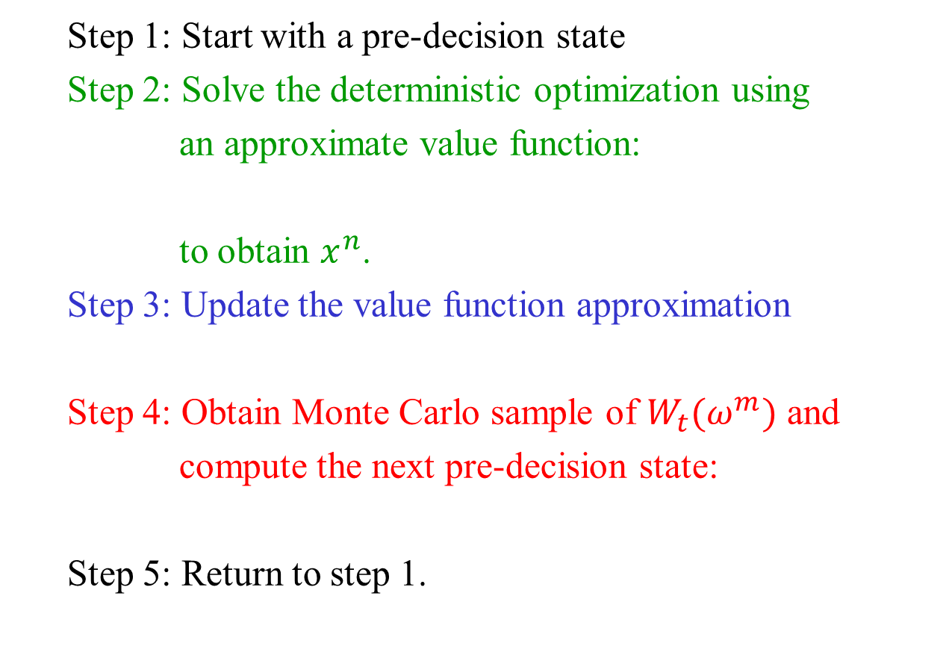
Approximate value iteration
  Step 1: Start with a pre-decision state
  Step 2: Solve the deterministic optimization using
  an approximate value function:
  to obtain $x^{n}$.
  Step 3: Update the value function approximation
  Step 4: Obtain Monte Carlo sample of $W_{t}(ω^{m})$ and
  compute the next pre-decision state:
  Step 5: Return to step 1.
Deterministic
optimization
Recursive
statistics
Simulation
Notes:
56

Slide 57
Approximate value iteration
  Step 1: Start with a pre-decision state
  Step 2: Solve the deterministic optimization using
  an approximate value function:
  to obtain $x^{n}$.
  Step 3: Update the value function approximation
  Step 4: Obtain Monte Carlo sample of $W_{t}(ω^{m})$ and
  compute the next pre-decision state:
  Step 5: Return to step 1.
Deterministic
optimization
Linear model for post-decision state
Recursive
statistics
Simulation
“Trajectory following”
Notes:
57

Slide 58
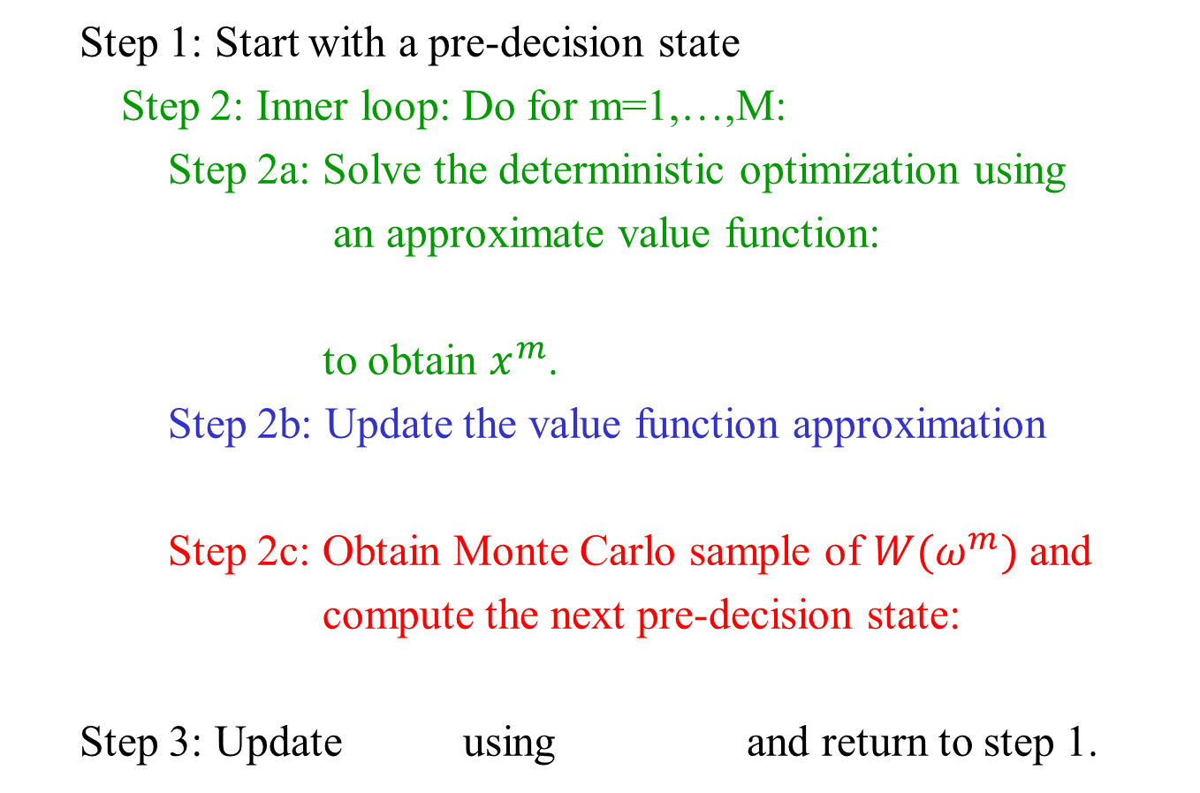
Approximate policy iteration
  Step 1: Start with a pre-decision state
  Step 2: Inner loop: Do for m=1,…,M:
  Step 2a: Solve the deterministic optimization using
  an approximate value function:
  to obtain $x^{m}$.
  Step 2b: Update the value function approximation
  Step 2c: Obtain Monte Carlo sample of $W(ω^{m})$ and
  compute the next pre-decision state:
  Step 3: Update using and return to step 1.
Notes:
58

Slide 59
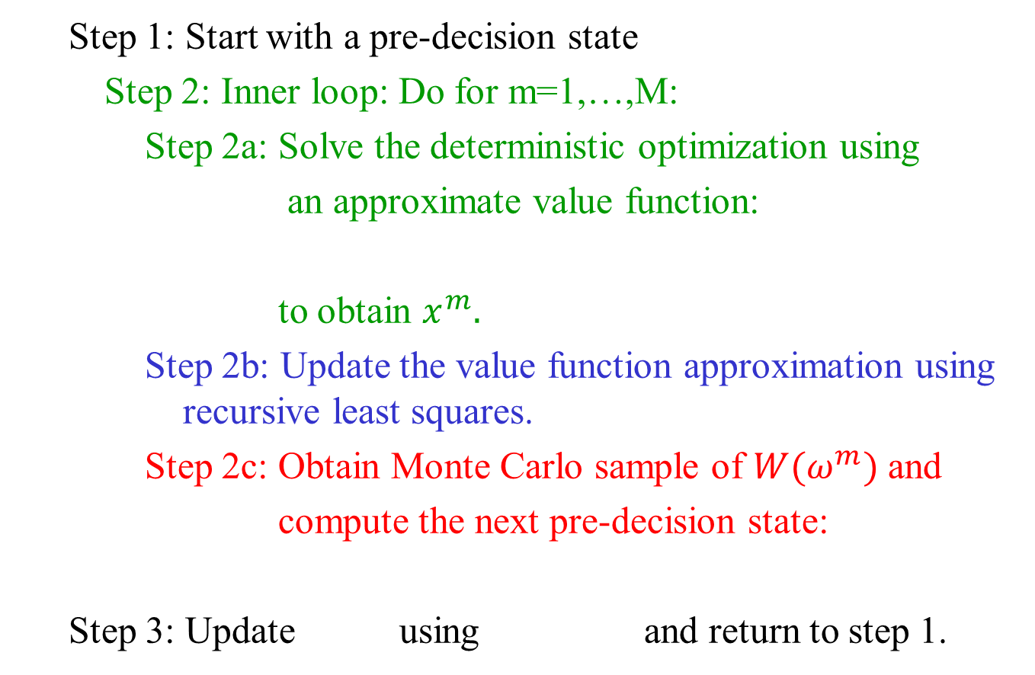
Approximate policy iteration
  Step 1: Start with a pre-decision state
  Step 2: Inner loop: Do for m=1,…,M:
  Step 2a: Solve the deterministic optimization using
  an approximate value function:
  to obtain $x^{m}.$
  Step 2b: Update the value function approximation using recursive least squares.
  Step 2c: Obtain Monte Carlo sample of $W(ω^{m})$ and
  compute the next pre-decision state:
  Step 3: Update using and return to step 1.
Notes:
59

Slide 60
Approximate dynamic programming
Nomadic trucker problem
Approximate value iteration

Slide 61
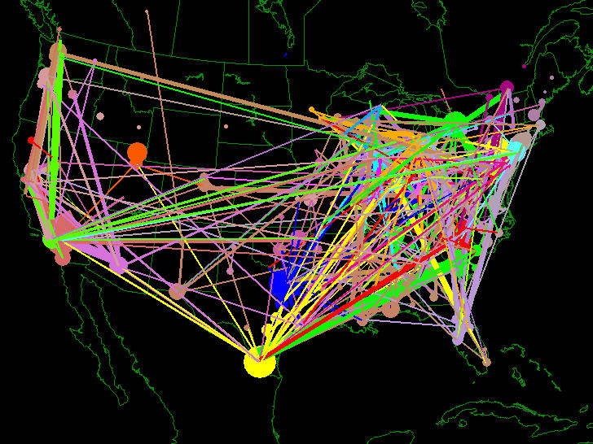
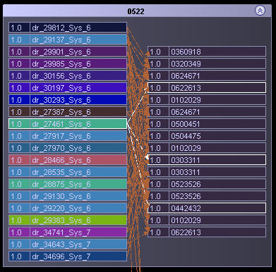
Fleet management
Fleet management problem
  Optimize the assignment of drivers to loads over time.
  Tremendous uncertainty in loads being called in

Slide 62
Approximate dynamic programming
Pre-decision state: we see the demands
$350
$150
$450
$300

Slide 63
Approximate dynamic programming
We use initial value function approximations…
$350
$150
$450
$300

Slide 64
Approximate dynamic programming
… and make our first choice:
$350
$150
$450
$300

Slide 65
Approximate dynamic programming
Update the value of being in Texas.
$350
$150
$450
$300

Slide 66
Approximate dynamic programming
Now move to the next state, sample new demands and make a new decision
$180
$400
$600
$125

Slide 67
Approximate dynamic programming
Update value of being in NY
$180
$400
$600
$125

Slide 68
Approximate dynamic programming
Move to California.
$400
$200
$150
$350

Slide 69
Approximate dynamic programming
Make decision to return to TX and update value of being in CA
$400
$200
$150
$350

Slide 70
Approximate dynamic programming
An updated value of being in TX
$385
$800
$125
$275

Slide 71
Approximate dynamic programming
Updating the value function:

Slide 72
Approximate dynamic programming
An updated value of being in TX
$385
$800
$125
$275

Slide 73
Approximate dynamic programming
Hierarchical learning

Slide 74
Hierarchical learning
decision d

Slide 75
Hierarchical learning
decision d’

Slide 76
Hierarchical learning

Slide 77
Hierarchical learning

Slide 78
Hierarchical learning
Our optimization problem at time t looks like:
  We had to develop novel machine learning strategies to estimate this function, since the attribute space was very large.
There are a lot of these attributes!
Notes:
Again the size of A is due to the 15-attribute dimension of a

Slide 79
Hierarchical learning
Different levels of aggregation:
3,293,136
33,264
5,544
672
Notes:
Even after we aggregate the 15 attributes into, say, only 4, we still get a significantly large state space.
Further aggregation does reduce the state space, but loses accuracy.

Slide 80
Hierarchical learning
Estimating value functions
  Most aggregate level

Slide 81
Hierarchical learning
Estimating value functions
  Middle level of aggregation

Slide 82
Hierarchical learning
Estimating value functions
  Most disaggregate level

Slide 83
Hierarchical learning
Adaptive hierarchical estimation procedure developed as part of this project (George, Powell and Kulkarni, 2008)
  Use weighted sum across different levels of aggregation.
Estimate of variance -
Estimate of bias
Both can be computed using simple recursive formulas.
George, A., W.B. Powell and S. Kulkarni, “Value Function Approximation Using Hierarchical Aggregation for Multiattribute Resource Management,” Journal of Machine Learning Research, Vol. 9, pp. 2079-2111 (2008).
Notes:
Emphasize that the weights vary for each attribute vector of each aggregation level: if we have lots of observations for a given a (say, drivers in Ohio), the weight will be larger, whereas if we have few observations (say, drivers in Montana), the weight will be smaller, for the SAME level of aggregation

Slide 84
Hierarchical learning
Hierarchical aggregation
Original function
v(a)
Aggregated function
Approximating a nonlinear function using two-levels of aggregation.
a = attribute selected

Slide 85
Hierarchical learning
Hierarchical aggregation
f(x)
High bias
Moderate bias
Zero bias
x

Slide 86
Hierarchical learning

Slide 87
Hierarchical learning
NE region
PA
TX

Slide 88
Hierarchical learning
Hierarchical aggregation
Aggregation level
Average weight on most disaggregate level
1
3
2
4
5
Weights
Average weight on most aggregate levels
67
Iterations
Notes:
Just highlight that as iterations progress, the AVERAGE weight on the most aggregate levels progressively decreases, while the AVERAGE weight on the most disaggregate levels increases; but still the actual weights vary for each attribute vector in each level of aggregation.

Slide 89
Hierarchical learning
Notes:
  In the early iterations, we do not have enough data to provide estimates at the detail level.
  So, we put more weight on the most aggregate estimates.
  As the algorithm progresses and we gain more information, we can put more weight on the more disaggregate estimates.
  But the weights depend on how much data we have in different regions.
  This type of adaptive learning, from coarse-grained to fine-grained, is common across all learning problems in stochastic optimization.

Slide 90
Hierarchical learning
Hierarchical aggregation
Aggregate
Aggregate approximation shows faster initial convergence; disaggregate shows better asymptotic performance.
Disaggregate

Slide 91
Hierarchical learning
Hierarchical aggregation
Weighted Combination
Aggregate
But adaptive weighting outperforms both. This hints at a strategy for adaptive learning.
Disaggregate

Slide 92
The exploration-exploitation problem

Slide 93
Exploration vs. exploitation

Slide 94
Exploration vs. exploitation
What decision do we make?
  The one we think is best?
    Exploitation
  Or do we make a decision just to try something and learn more about the result?
    Exploration
  This is the reason that the “exploration vs. exploitation” problem is so well known in ADP/RL.

Slide 95
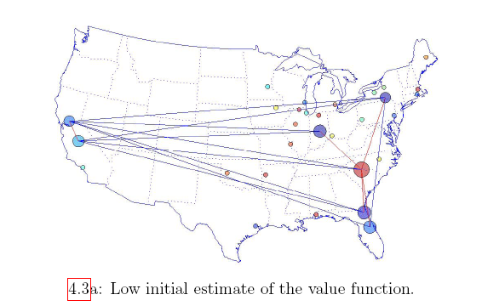
Exploration vs. exploitation
Pure exploitation

Slide 96
Exploration vs. exploitation

Slide 97
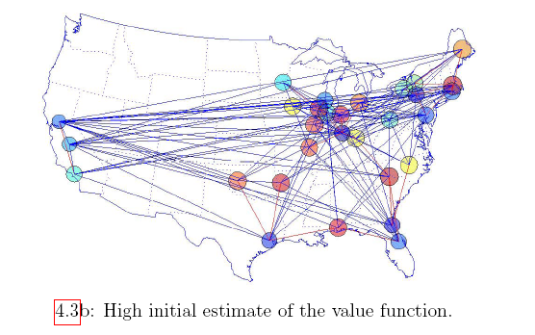
Exploration vs. exploitation
Pure exploitation with generalized learning.

Slide 98
Exploration vs. exploitation
Notes
  This is a learning problem in the presence of a physical state (the location)
  Above, we are using a pure exploitation strategy, but with generalized learning (visiting one location teaches us about another location).
  An active area of research, with painfully little progress, is how to do active learning for state-dependent problems (in general) and more specifically, problems with a physical state.
  Note that we have avoided modeling the uncertainty in the value functions as part of the state variable. This is a historical oversight.

Slide 99
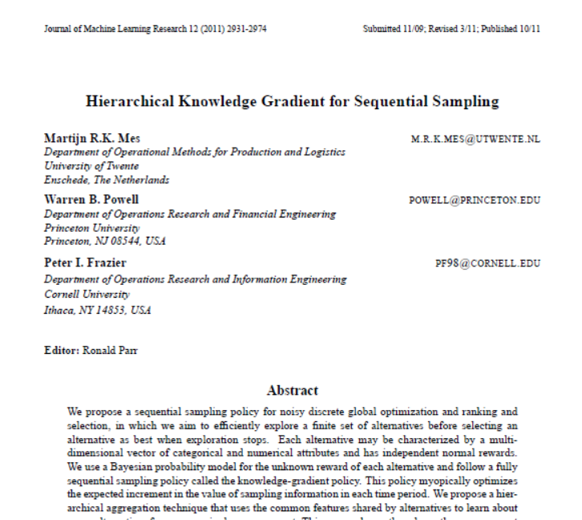
Optimal learning with a single physical state and hierarchical learning.

Slide 100
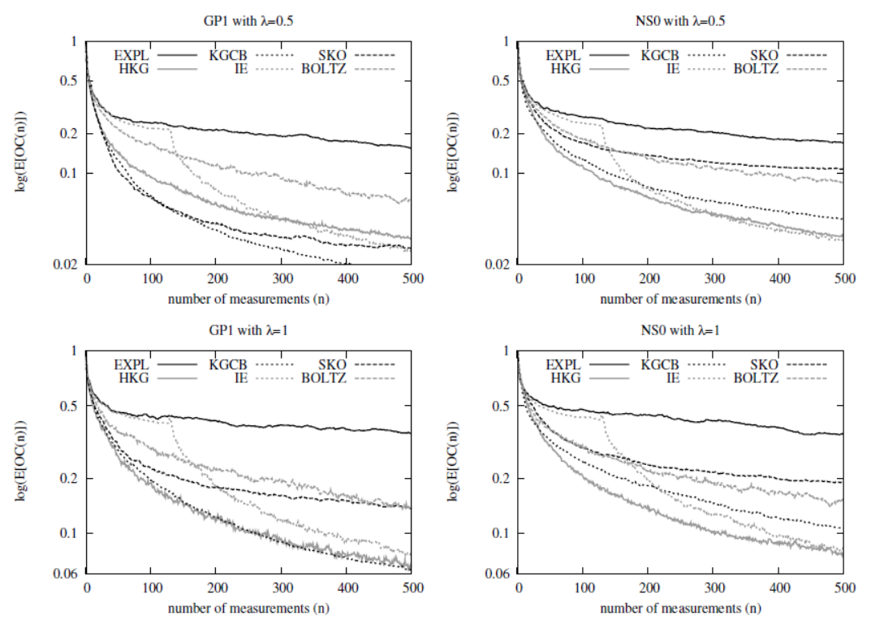
Exploration vs. exploitation
Comparison of policies for pure learning problems

Slide 101
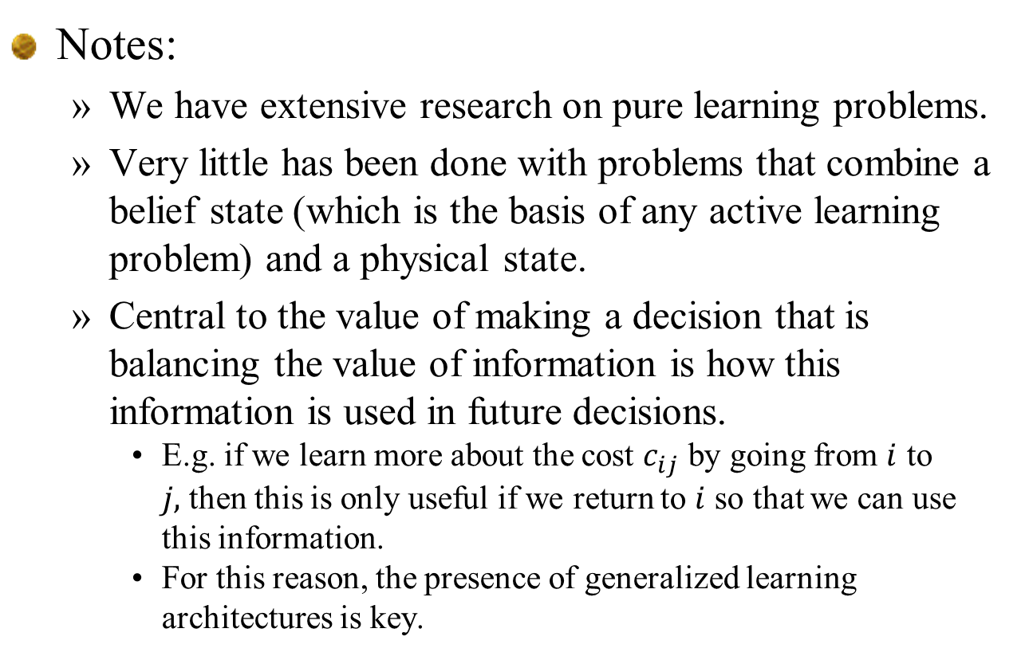
Exploration vs. exploitation
Notes:
  We have extensive research on pure learning problems.
  Very little has been done with problems that combine a belief state (which is the basis of any active learning problem) and a physical state.
  Central to the value of making a decision that is balancing the value of information is how this information is used in future decisions.
    E.g. if we learn more about the cost $c_{ij}$ by going from $i$ to $j,$then this is only useful if we return to $i$ so that we can use this information.
    For this reason, the presence of generalized learning architectures is key.

Slide 102
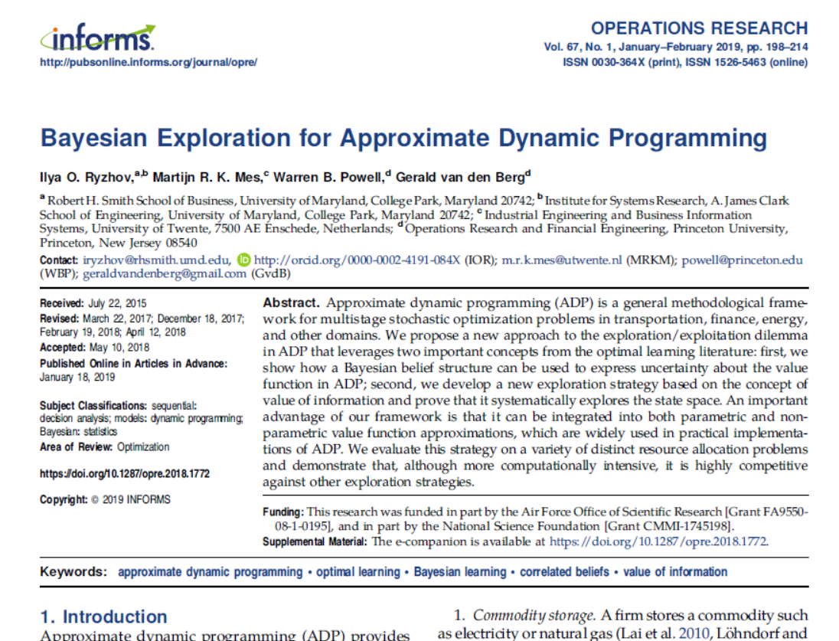
Exploration vs. exploitation
What about learning?
  “Active learning” with general dynamic programs is a very young field.
  Typically “exploration vs. exploitation” issues are solved with CFAs using approximate value functions as part of the estimate of the value of a decision.
Jan, 2019

Slide 103
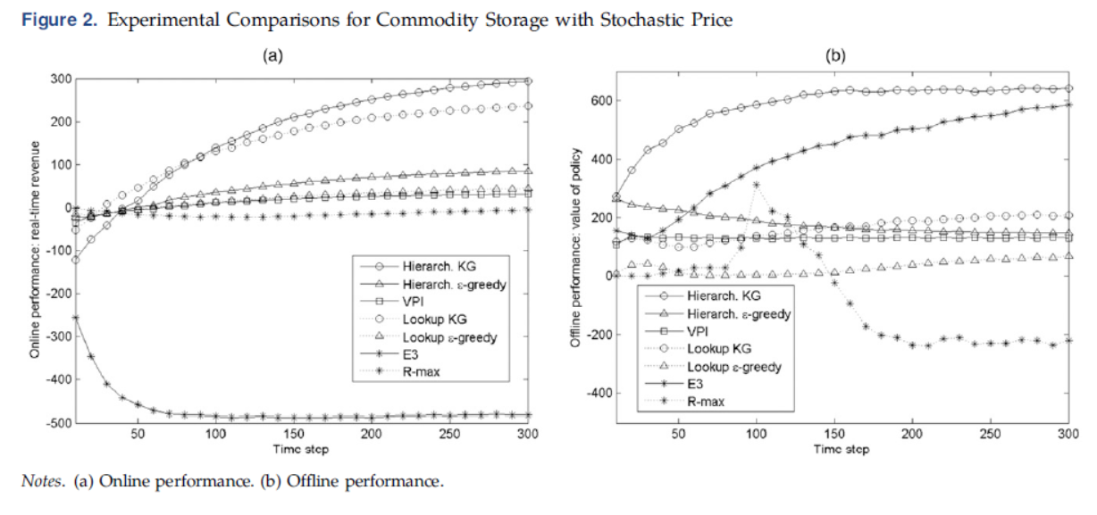
Exploration vs. exploitation
Some numerical experiments from Ryzhov et al. paper.

Slide 104
Exploration vs. exploitation
Notes:
  The exploration vs. exploitation problem is well known in approximate dynamic programming, but lacks the elegant solution of pure learning problems.
  Most algorithms use fairly simple heuristics to balance exploration and exploitation.
  We have been pursuing research in optimal learning:
    First paper: optimally sampling a function represented by a hierarchical belief model.
    Second paper (in preparation): optimal learning with a physical state (the truck)
  Our research in optimal learning with a physical state is modest. The challenge is our ability to learn from one physical state, and generalize to others.
  Open question right now: how much does active learning contribute when there is a physical state? This is likely to be very problem-dependent.

Slide 105
From one truck to many

Slide 106
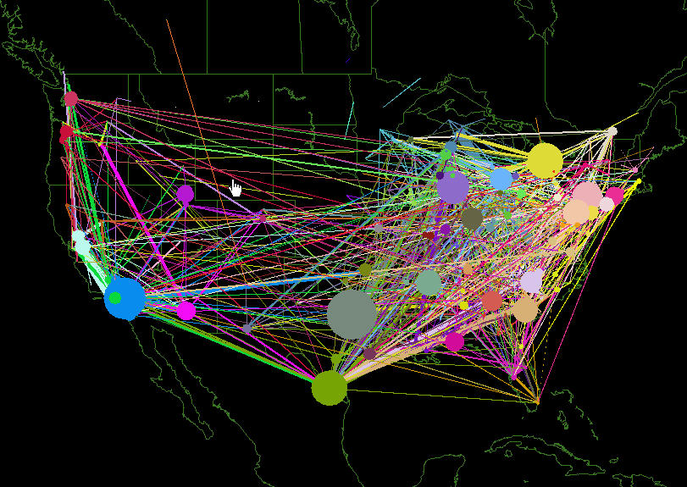
Schneider National
© 2008 Warren B. Powell
Slide 106
Notes:
106

Slide 107

© 2008 Warren B. Powell
Slide 107
Notes:
107
This is the dispatch room for Schneider National, one of the largest truckload motor carriers in the U.S.

Slide 108
Optimizing fleets
From one truck to many trucks
  If there is one truck and N “states” (locations), then our dynamic program (post-decision state) has N states.
  But what if there is more than one truck? Then we have to capture the state of the fleet.

Slide 109
The state of the fleet

Slide 110
The state of the fleet

Slide 111
The state of the fleet

Slide 112
The state of the fleet

Slide 113
The state of the fleet

Slide 114
The state of the fleet

Slide 115
The state of the fleet

Slide 116
The state of the fleet

Slide 117
The state of the fleet

Slide 118
Optimizing fleets
What if we have N > 1 trucks?
Real problems: 500 to 5,000 trucks, attribute space 50,000 up to ${10}^{20}$attributes.

Slide 119
Optimizing fleets
Drivers
Loads
Slide 119
The pre-decision state: drivers and loads
Notes:
119
A transportation example of a pre-decision state (the drivers and loads)

Slide 120
Optimizing fleets
The post-decision state - drivers and loads after a decision is made:
Slide 120
Notes:
120
Post-decisoin state (the state immediately after we make a decision)

Slide 121
Optimizing fleets
The transition: Adding new information
Slide 121
Notes:
121
New information

Slide 122
Optimizing fleets
The next pre-decision state
Slide 122
Notes:
122
New pre-decision state

Slide 123
Optimizing fleets
Assignment network
  Capture the value of downstream driver.
  Add this value to the assignment arc.
Loads
Future attributes
Drivers

Slide 124
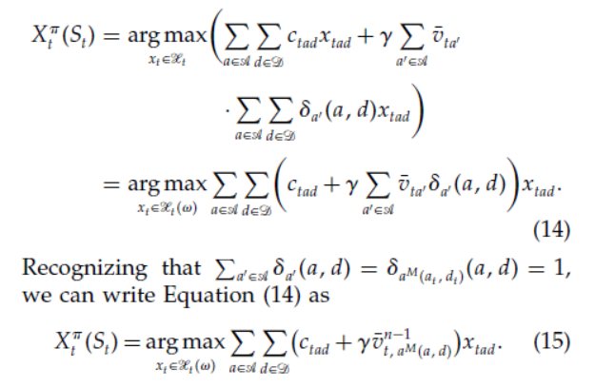

Optimizing fleets
The assignment problem
  We now have a basic assignment problem, but where we have to capture the downstream value of a truck:

Slide 125
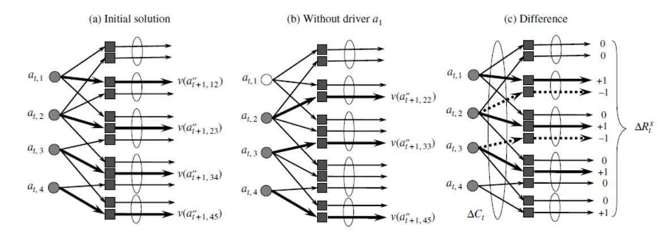
Optimizing fleets
Finding the marginal value of a driver:
  Dual variables
    Can provide unreliable estimates.
    Need to get the marginal value of drivers who are not actually there.
  Numerical derivatives:

Slide 126
Optimizing fleets
  Step 1: Start with a pre-decision state
  Step 2: Solve the deterministic optimization using
  an approximate value function:
  to obtain .
  Step 3: Update the value function approximation
  Step 4: Obtain Monte Carlo sample of and
  compute the next pre-decision state:
  Step 5: Return to step 1.
Deterministic
optimization
Recursive
statistics
Simulation
“on policy learning”
Notes:
126

Slide 127
Optimizing fleets
t

Slide 128
Optimizing fleets

Slide 129
Optimizing fleets

Slide 130
Approximate dynamic programming
… a typical performance graph.

Slide 131
Approximate dynamic programming
Stepsizes for forward APD

Slide 132
Stepsizes
Updated estimate
Old estimate
New observation
The stepsize
“Learning rate”
“Smoothing factor”
Stepsizes:
  Approximate value iteration requires updates of the form:

Slide 133
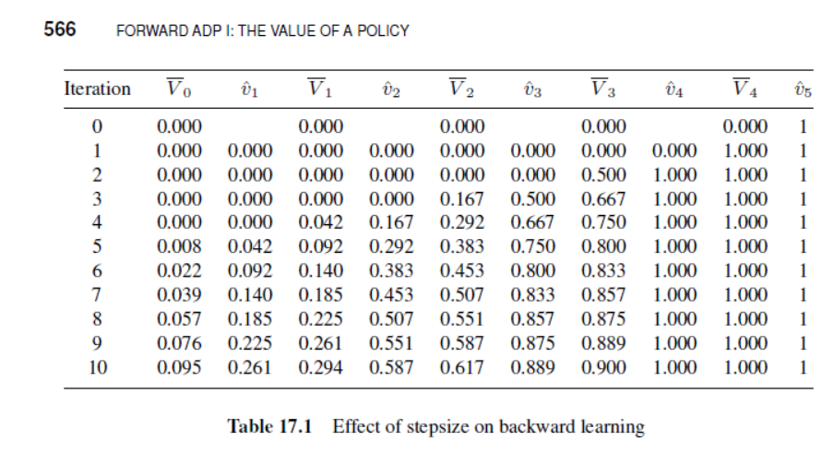
Stepsizes
Single state, single action Markov chain
  Updating – receives reward=1 at last node. All other rewards = 0.
  Same as adding up random rewards with mean of 1. Noise may be zero, or quite high.
0
0
0
0
0
1
0
1
2
3
4
5

Slide 134
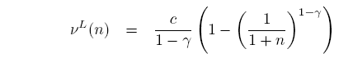
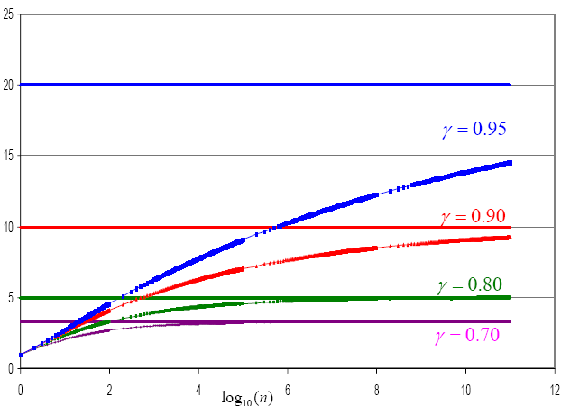
Stepsizes
Single state, single action
Bound on performance using 1/n:

Slide 135
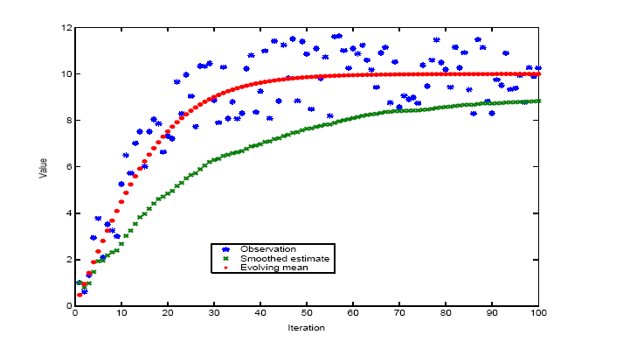
Stepsizes
Estimate of the variance
Noise
Bias
Estimate of the bias
Bias-adjusted Kalman filter (BAKF)

Slide 136
Stepsizes
Observed values
BAKF stepsize rule
1/n stepsize rule
The bias-adjusted Kalman filter

Slide 137
Stepsizes
Observed values
BAKF stepsize rule
The bias-adjusted Kalman filter

Slide 138
Stepsizes
Notes:
  Because and have to be estimated from data, it is a stochastic stepsize policy. The challenge is estimating .
  This stepsize rule is designed for a nonstationary time series. It does not recognize the feedback that arises in approximate value iteration.

Slide 139

Optimizing fleets
The effect of stepsizes

Slide 140
Schneider National case study

Slide 141
Schneider National
Historical min and max
Calibrated model
Utilization
Revenue per WU
We were able to calibrate our ADP model very closely to the behavior of the company, which helped to build confidence.
Notes:
141
With ADP, we were able to closely match their historical performance.

Slide 142
Schneider National
Vanilla simulator
Using approximate dynamic programming
Acceptable region
The adaptive learning of value functions produced results that more accurately matched historical performance.
Notes:
Here we show how we learn to behave just like they do.

Slide 143
ADP for trucking
Notes:
  We can use the value functions to estimate the marginal value of drivers whose home is in a particular region.
  In the next slides, we are going to show two ways to estimate these values:
    In the first, we are going to run a series of (very expensive) simulations where we hire an increasing number of drivers in a region. Each time, we have to reoptimize the entire fleet over many iterations. We would have to repeat this for each possible home location.
    In the second, we are going to estimate the marginal value by using the value function approximations to estimate the value of drivers in each region, from one run of the model.

Slide 144
Case study: truckload trucking
Notes:
Now we want to know the marginal value of addiing drivers whose home is in a particular location (e.g. Texas). Here, we simply ran many simulations as we increased the number of drivers. The blue line shows the average value of more drivers in Texas. This is very expensive to do.

Slide 145
Case study: truckload trucking
Notes:
The red line is directly from the value function. We get the slope of this line for every type of driver just from the base case. We do not have to do all those simulations to get the marginal value of additional drivers.

Slide 146
Case study: truckload trucking
Purple bars: Value of drivers from value function approximations
Error bars: Statistical estimate from rerunning the simulation.
This shows that the value functions provide reasonable approximations of the
Notes:
Here we compared the value function to the brute force for 20 different types of drivers. We show confidence intervals from the brute force simulation. 18 out of 20 times we are within the confidence interval.

Slide 147

Case study: truckload trucking
Where to add drivers:

Slide 148

Case study: truckload trucking
Where to reduce drivers:

