Slide 1
.
ORF 544
Stochastic Optimization and Learning
Spring, 2019
Warren Powell
Princeton University
http://www.castlelab.princeton.edu

Slide 2

Week 9
Cost function approximations

Slide 3
Cost function approximations
A general CFA policy:
  Define our policy:
  subject to
  We tune by optimizing:
Parametrically
modified costs
Parametrically
modified constraints

Slide 4
Cost function approximations
A general CFA policy:
  Define our policy:
  subject to
  We tune by optimizing:

Slide 5
Cost function approximation
Notes
  CFAs can handle high-dimensional decision vectors.
  There is no difference doing policy search for PFAs or CFAs.
  We can apply the same methods we have used before:
    Derivative-free
    Derivative-based
  Parameterized policies are easy to compute than the lookahead versions, but policy search remains challenging.

Slide 6

Cost function approximation
Logistics

Slide 7
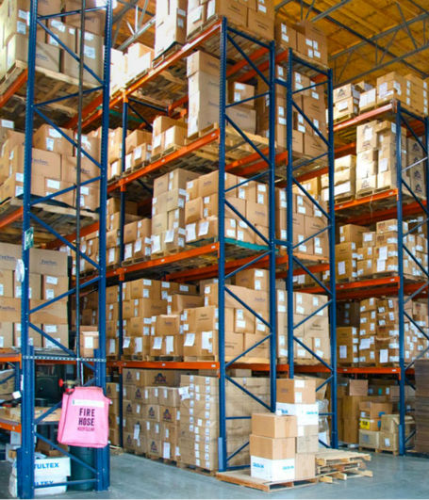
Cost function approximations
Inventory management
  How much product should I order to anticipate future demands?
  Need to accommodate different sources of uncertainty.
    Market behavior
    Transit times
    Supplier uncertainty
    Product quality

Slide 8
Cost function approximations
Imagine that we want to purchase parts from different suppliers. Let be the amount of product we purchase at time t from supplier p to meet forecasted demand . We would solve
  This assumes our demand forecast is accurate.

Slide 9
Cost function approximations
Imagine that we want to purchase parts from different suppliers. Let be the amount of product we purchase at time t from supplier p to meet forecasted demand . We would solve
  This is a “parametric cost function approximation”
Reserve
Buffer stock

Slide 10
Cost function approximation
Driver dispatching for truckload

Slide 11
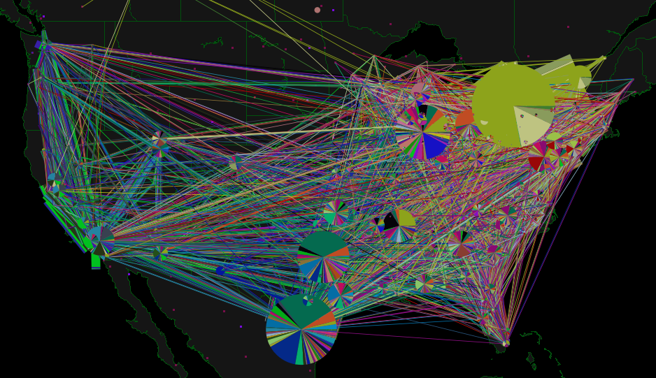
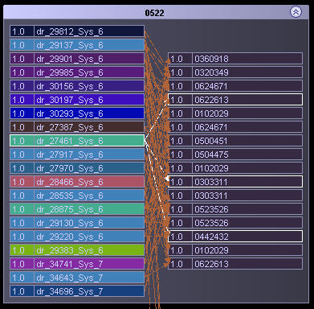
Schneider National

Slide 12

Slide 12
Notes:
12
This is the dispatch room for Schneider National, one of the largest truckload motor carriers in the U.S.

Slide 13
Cost function approximations
Drivers
Demands
Notes:
… to tasks (loads, trains, flights).

Slide 14
Cost function approximations
t
t+1
t+2
The assignment of drivers to loads evolves over time, with new loads being called in, along with updates to the status of a driver.
Notes:
After we make a decision at time t, we then have to do it again at t+1 and t+2

Slide 15
Cost function approximations
A purely myopic policy would solve this problem using
  where
  What if a load it not assigned to any driver, and has been delayed for a while? This model ignores the fact that we eventually have to assign someone to the load.

Slide 16
Cost function approximations
We can minimize delayed loads by solving a modified objective function:
  where
  We refer to our modified objective function as a cost function approximation.

Slide 17
Cost function approximations
We now have to tune our policy, which we define as:
  We can now optimize , another form of policy search, by solving

Slide 18
Cost function approximation
SMART-Invest
One-dimensional parameter search

Slide 19
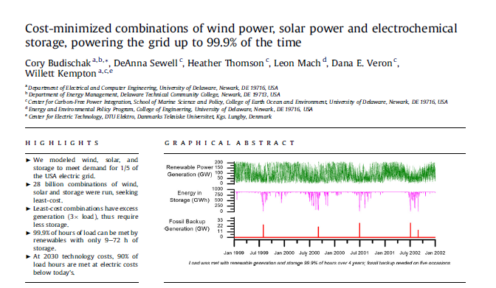
SMART-Invest
Wind &
solar
Battery
storage
750 GWhr battery!
Fossil
backup
20 GW

Slide 20
SMART-Invest
Model used in 99 percent paper:
  If wind+solar > load, store excess in battery (if possible)
  If wind+solar < load, draw from battery (if available)
  If outage, assume we can get what we need from the grid.
  Simulate over 8,760 hours.
Now, optimize
  Enumerate 28 billion combinations of wind, solar and storage.
  Find the least cost combination that meets some level of coverage (e.g. 80 percent, or 99.9 percent)

Slide 21
SMART-Invest
Limitations:
  Ignores the reality that you are going to need a significant portion from slow and fast fossil.
  Ignores the cost of uncertainty when planning fossil generations.
  Ignores the marginal cost of investment.
    Choosing the least cost to get 99 percent ignores the marginal cost of getting to 99 percent.
To fix these problems:
  We created “SMART-Invest” using a Lookahead-CFA to plan a full energy portfolio.

Slide 22
SMART-Invest
Elements of SMART-Invest
  Simulates energy planning process each hour over entire year (8760 hours), planning 36 hours into the future.
  Properly models advance commitment decisions for slow fossil, fast fossil, and real time ramping and storage.
It does not model:
  The grid
  Individual fossil generators

Slide 23
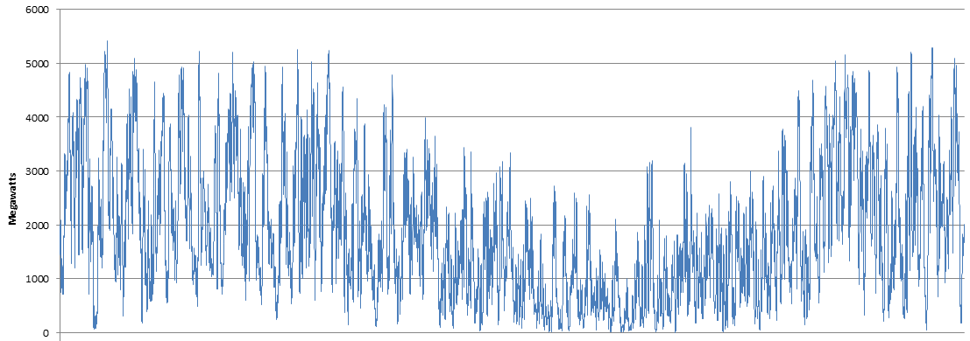
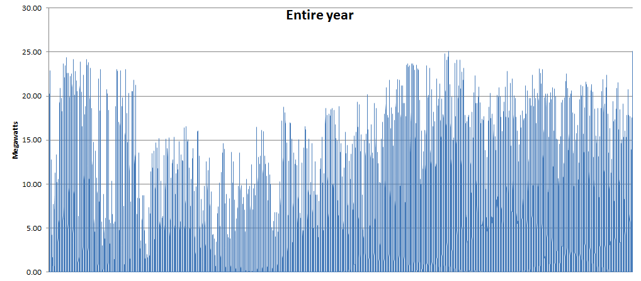
SMART-Invest
The investment problem:
Capital investment cost in
wind, solar and storage
Operating costs of fossil generators,
energy losses from storage, misc.
operating costs of renewables.
Investment cost in wind, solar
and storage.
is the operating policy.
Wind
Solar

Slide 24
SMART-Invest
Operational planning
  Meet demand while minimizing operating costs
  Observe day-ahead notification requirements for generators
  Includes reserve constraints to manage uncertainty
  Meet aggregate ramping constraints (but does not schedule individual generators)
36 hour planning horizon using forecasts of wind and solar
24 hour notification of steam
1 hour notification of gas
Real-time storage and ramping decisions (in hourly increments)

Slide 25
SMART-Invest
Operational planning model
  Model plans using rolling 36 hour horizon
  Steam plants are locked in 24 hours in advance
  Gas turbines are decided 1 hour in advance
Lock in steam generation decisions 24 hours in advance
The tentative plan is discarded
1
24
36
1
Slow fossil running units
24
36
1
Slow fossil running units
24
36
1
Slow fossil running units
24
36
1
Slow fossil running units
24
36
1
Slow fossil running units
24
36
1
Slow fossil running units
24
36
1
Slow fossil running units
24
36
…
Slow fossil running units
1 year
…
…
2
3
8760
1
4
5

Slide 26
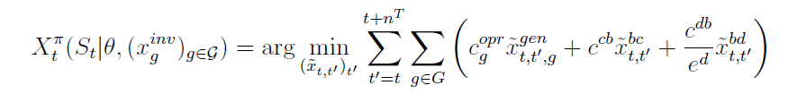
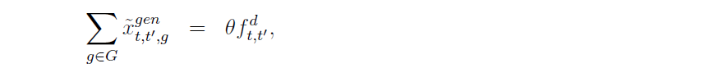
SMART-Invest
Lookahead model:
  Objective function
  Reserve constraint:
  Other constraints:
    Ramping
    Capacity constraints
    Conservation of flow in storage
    ….
Tunable policy parameter

Slide 27
SMART-Invest
The objective function
  Given a system model (transition function)
  And exogenous information process:
  This involves running a simulator.

Slide 28
SMART-Invest
For this project, we used numerical derivatives:
  Objective function is
  Numerical derivative is
  or

Slide 29
SMART-Invest
Optimizing the investment parameters
  The model optimizes investment in:
    Wind
    Solar
    Storage
    Fast and slow fossil (for some times of runs)
  Algorithm
    Stochastic gradient using numerical derivatives
    Custom stepsize formula
  Research opportunity:
    Use adaptive learning model using some sort of parametric or local parametric belief model.

Slide 30
SMART-Invest
Wind Capacity
Solar Capacity
Battery Capacity
Fossil Capacity
Update investments
Stage 1:
Investment
Find search direction
Hour 1
Hour 2
Hour 3
…
Hr 8758
Hr 8759
Hr 8760
Wind
Solar

Slide 31
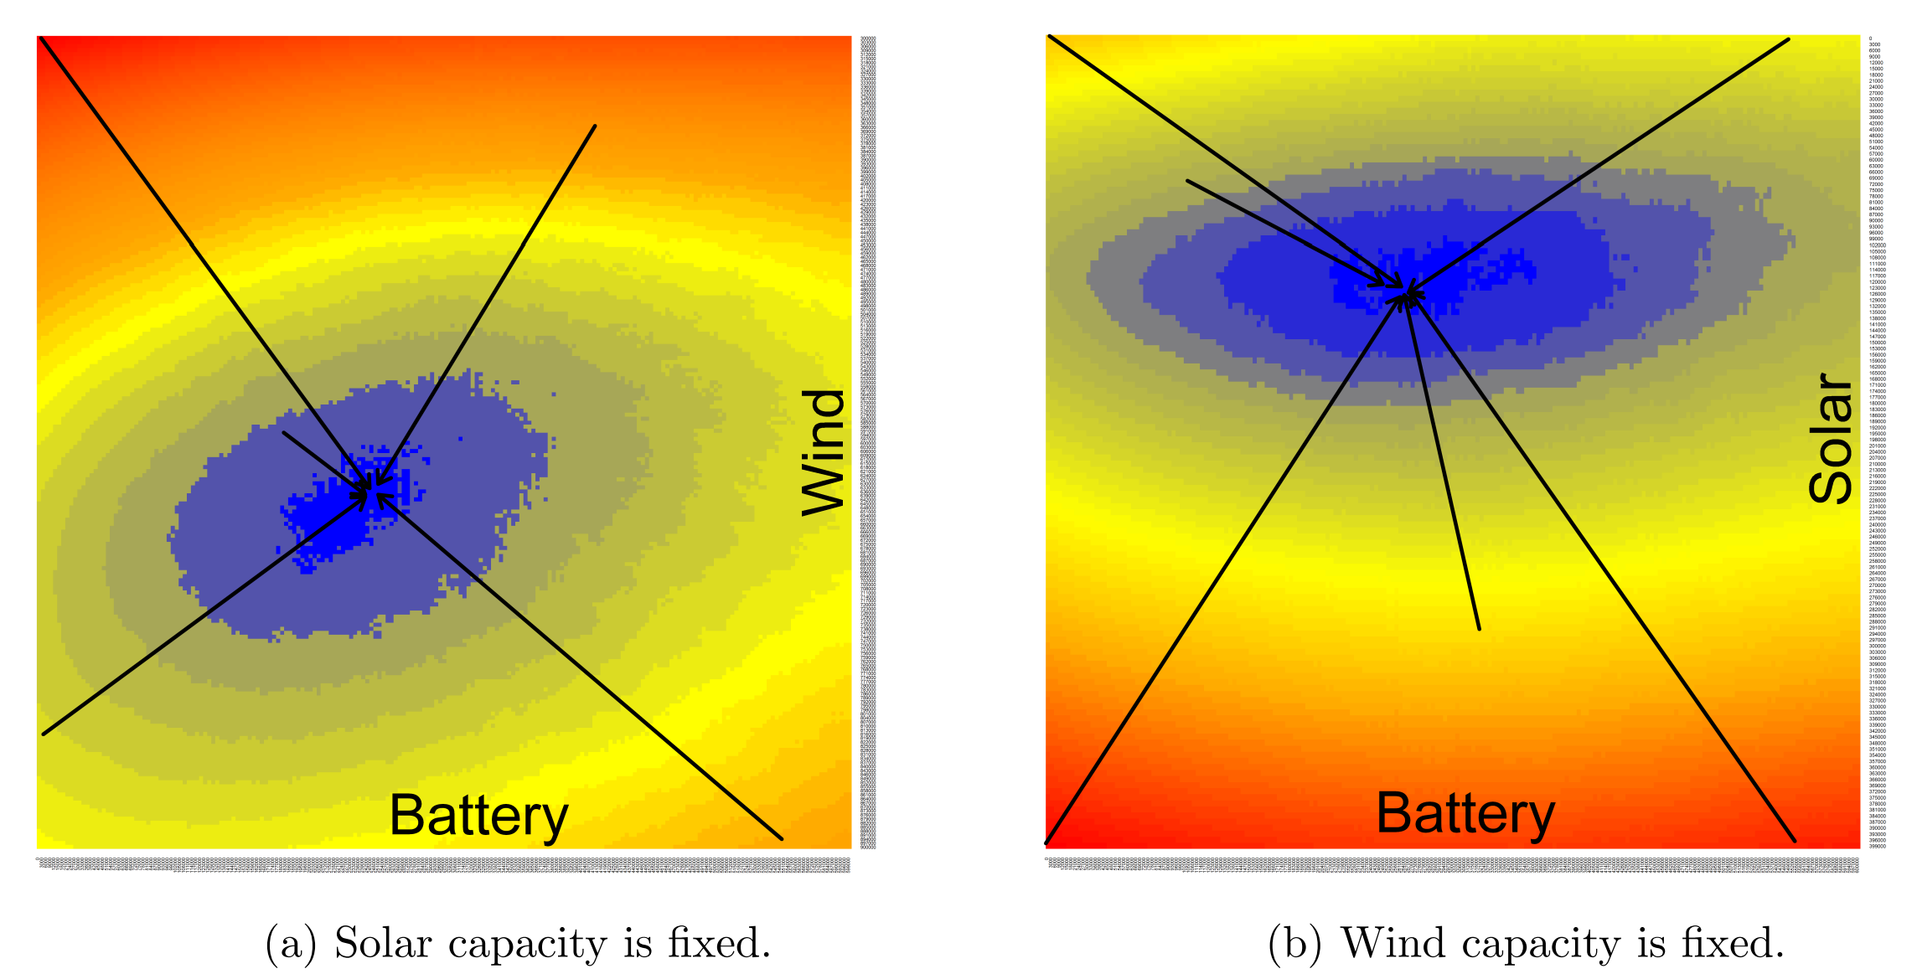
The search algorithm
Results
  The stochastic search algorithm reliably finds the optimum from different starting points.
Different Starting Points

Slide 32
The search algorithm
Empirical performance of algorithm
  Starting the algorithm from different starting points appears to reliably find the optimal (determined using a full grid search).
  Algorithm tended to require < 15 iterations:
    Each iteration required 4-5 simulations to compute the complete gradient
    Required 1-8 evaluations to find the best stepsize
    Worst case number of function evaluations is 15 x (8+5) = 195.
    Budischak paper required “28 billion” for full enumeration (used super computer)
  Run times
    Aggregated supply stack: ~100 minutes
    Full supply stack: ~100 hours

Slide 33
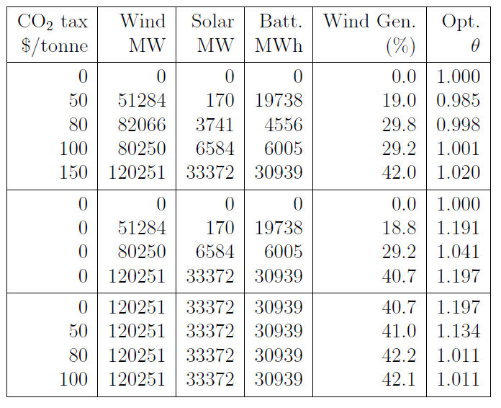
SMART-Invest
Policy search – Optimizing reserve parameter
Low carbon tax, increased usage of slow fossil, requires higher reserve margin ~19 percent
High carbon tax, shift from slow to fast fossil, requires minimal reserve margin ~1 pct

Slide 34
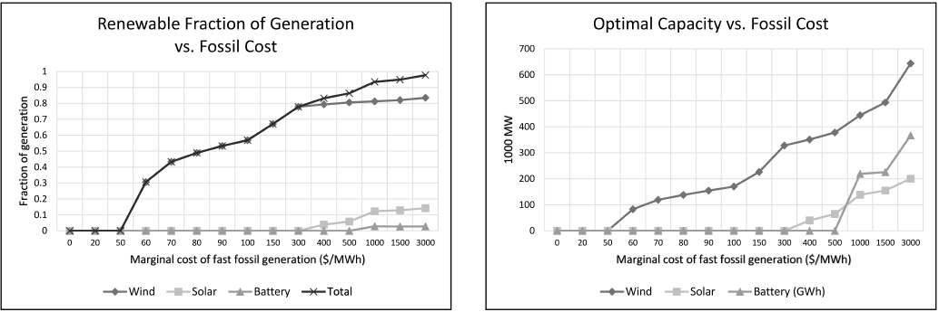
Policy studies
Renewables as a function of cost of fossil fuels
100
80
60
40
20
0
Total renewables
Wind
Percent from renewable
Solar
0 20 50 60 70 80 90 100 150 300 400 500 1000 3000
$/MWhr cost of fossil fuels

Slide 35
Cost function approximation
Energy storage example
Multi-dimensional parameter space

Slide 36
Energy storage optimization
Notes:
  In this set of slides, we are going to illustrate the use of a parametrically modified lookahead policy.
  This is designed to handle a nonstationary problem with rolling forecasts. This is just what you do when you plan your path with google maps.
  The lookahead policy is modified with a set of parameters that factor the forecasts. These parameters have to be tuned using the basic methods of policy search.

Slide 37
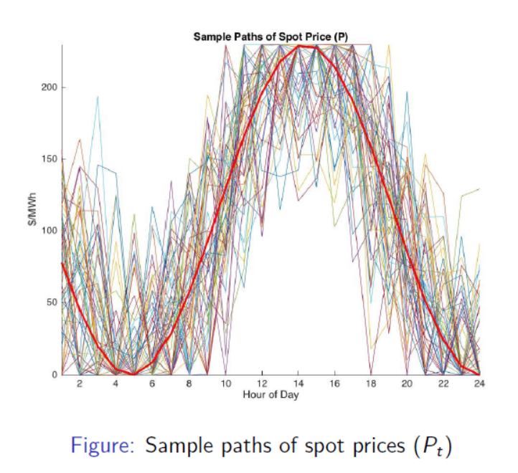
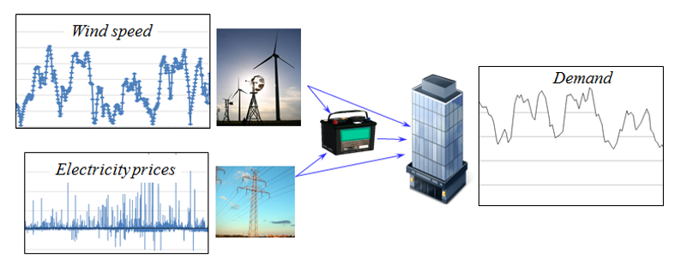
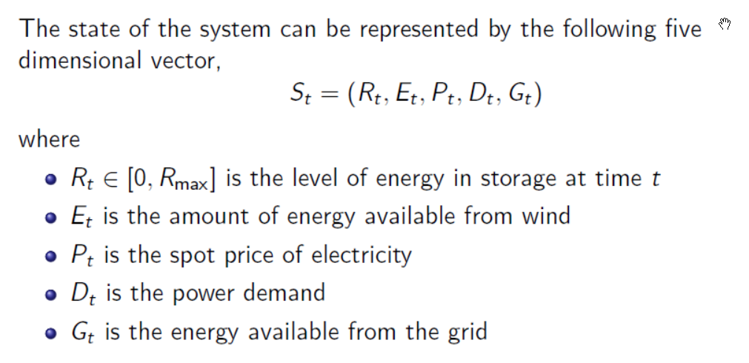
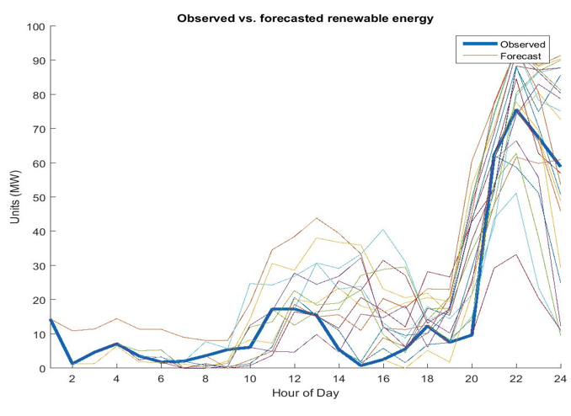
Energy storage optimization
An energy storage problem:

Slide 38
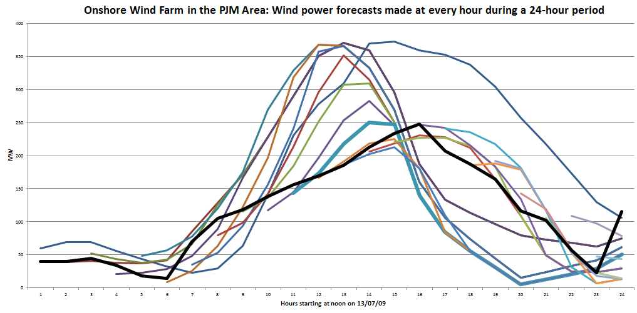
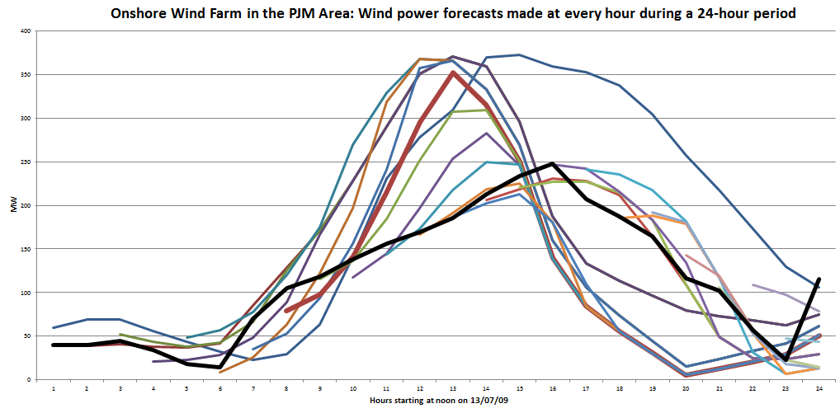
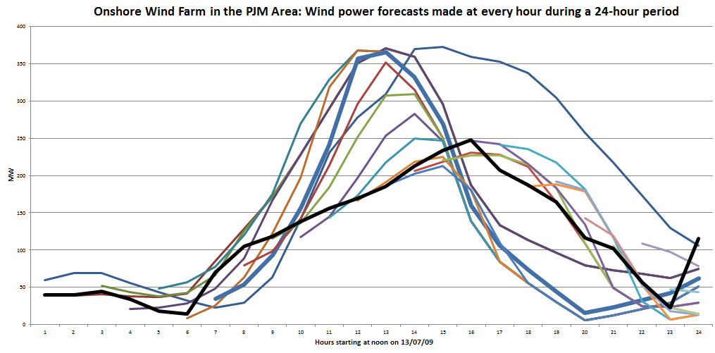
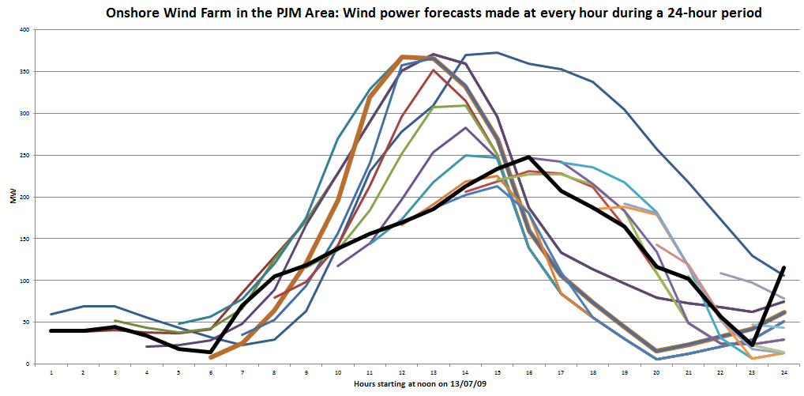
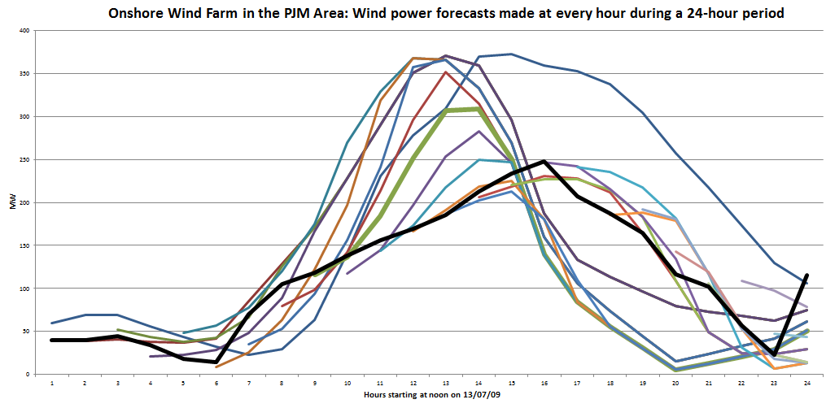
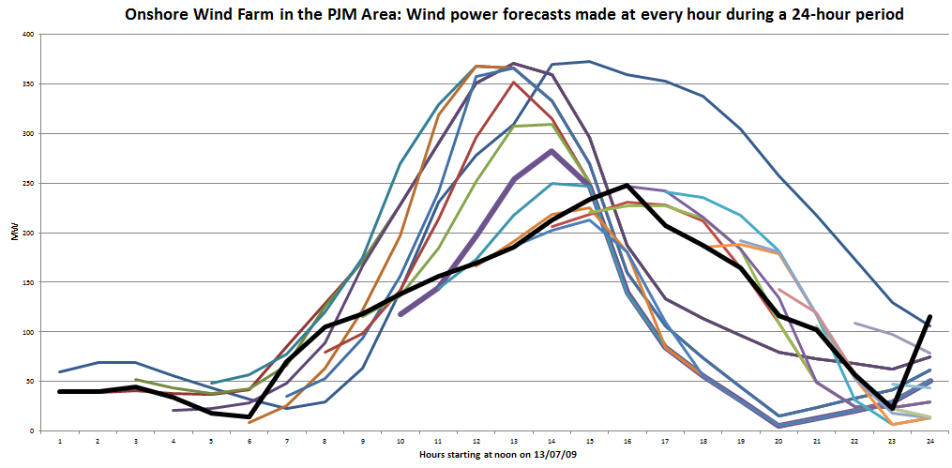
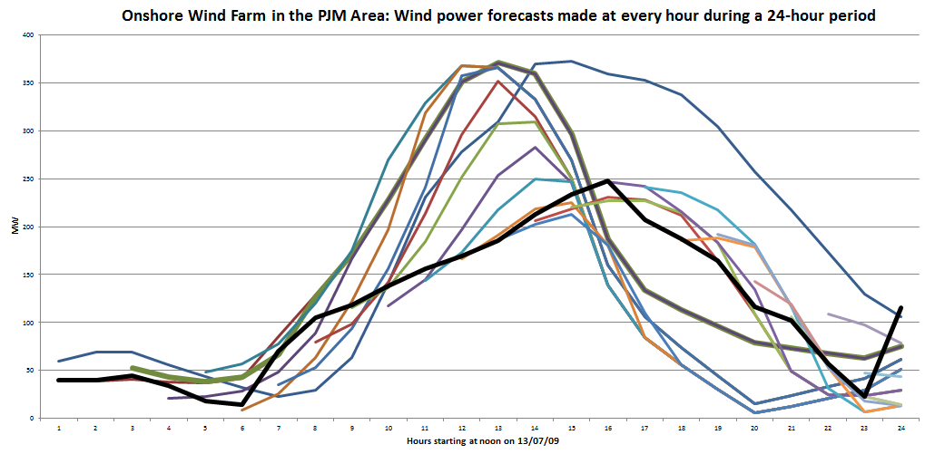
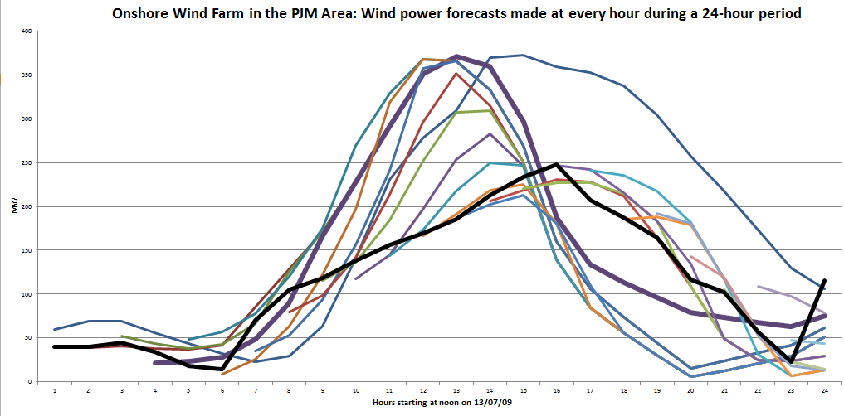
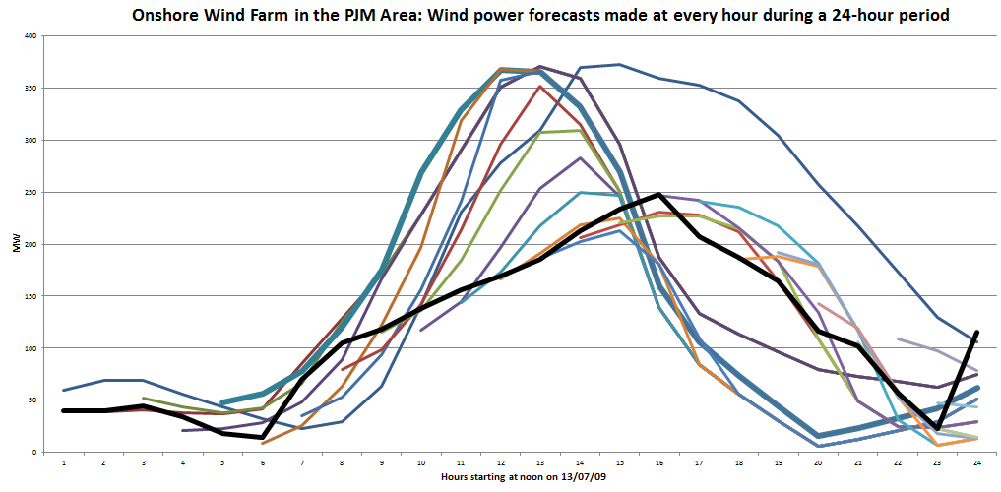
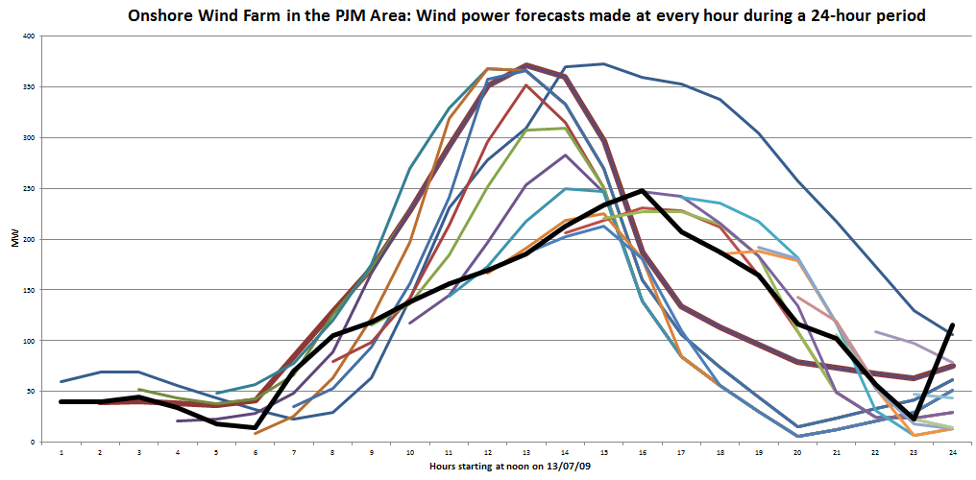
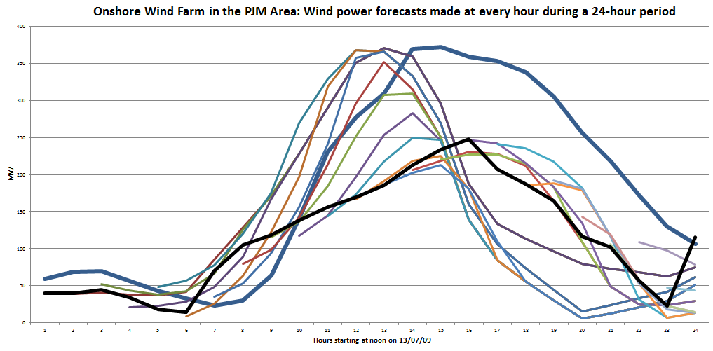
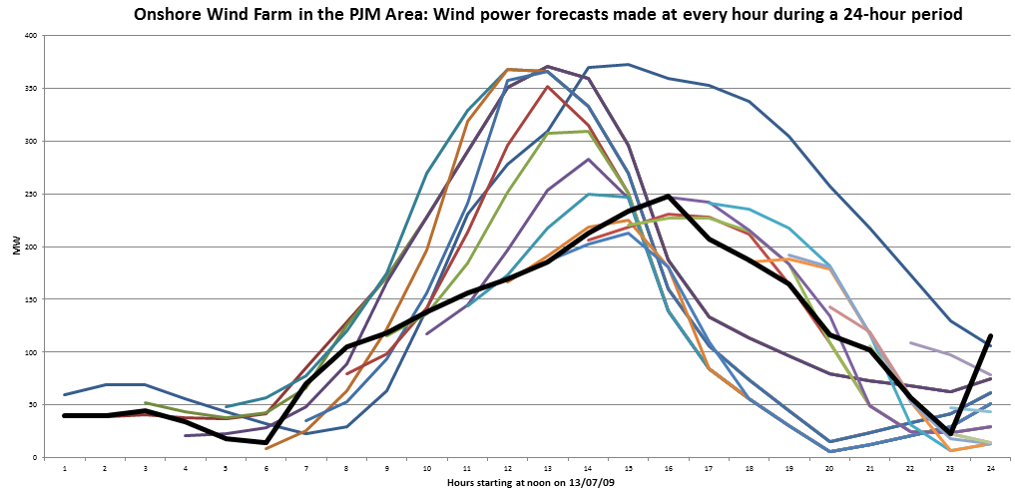
Energy storage optimization
Forecasts evolve over time as new information arrives:
Rolling forecasts, updated each hour.
Forecast made at midnight:
Actual

Slide 39
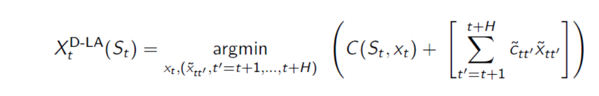
Energy storage optimization
Benchmark policy – Deterministic lookahead

Slide 40
Energy storage optimization
Lookahead policies peek into the future
  Optimize over deterministic lookahead model
The lookahead model
. . . .
The real process

Slide 41

Energy storage optimization
Lookahead policies peek into the future
  Optimize over deterministic lookahead model
The lookahead model
. . . .
The real process

Slide 42

Energy storage optimization
Lookahead policies peek into the future
  Optimize over deterministic lookahead model
The lookahead model
. . . .
The real process

Slide 43

Energy storage optimization
Lookahead policies peek into the future
  Optimize over deterministic lookahead model
The lookahead model
. . . .
The real process

Slide 44
Energy storage optimization
Benchmark policy – Deterministic lookahead

Slide 45
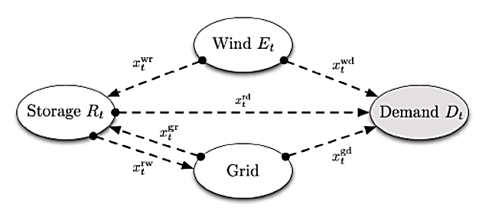

Energy storage optimization
Parametric cost function approximations
  Replace the constraint
with:
  Lookup table modified forecasts (one adjustment term for each time in the future):
  We can simulate the performance of a parameterized policy
  The challenge is to optimize the parameters:

Slide 46
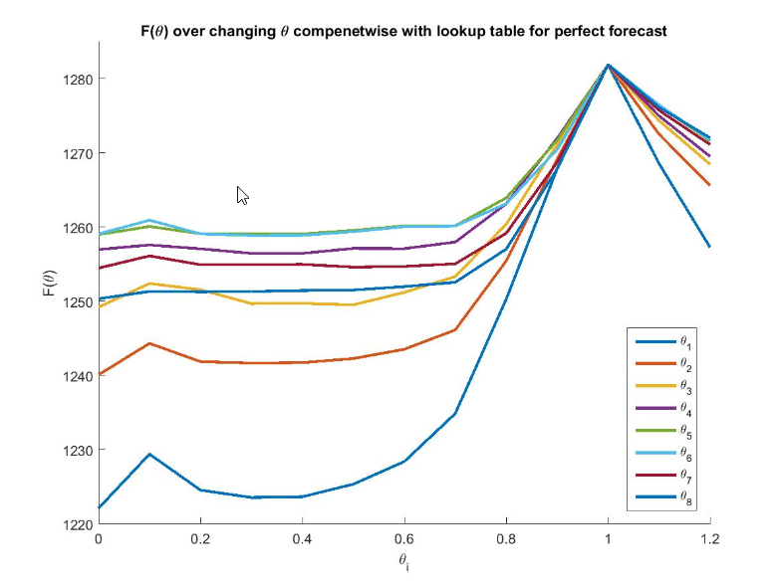

Energy storage optimization
One-dimensional contour plots – perfect forecast
  $θ_{i}$ for i=1,…, 8 hours into the future.
0.0 0.2 0.4 0.6 0.8 1.0 1.2

Slide 47
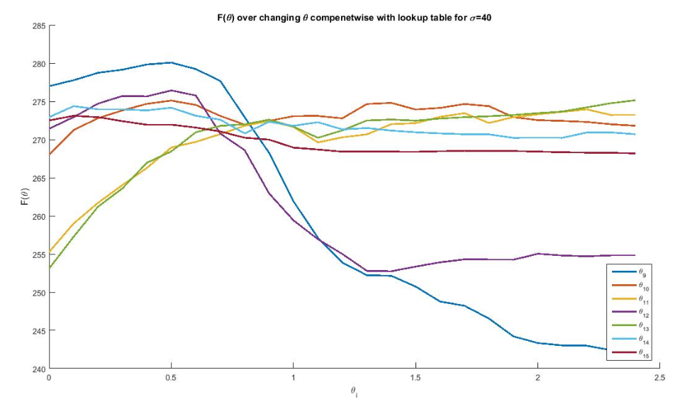

Energy storage optimization
One-dimensional contour plots-uncertain forecast
  $θ_{i}$ for i=9,…, 15 hours into the future
0.0 0.2 0.4 0.6 0.8 1.0 1.2 1.4 1.6 1.8 2.0 2.2 2.4

Slide 48
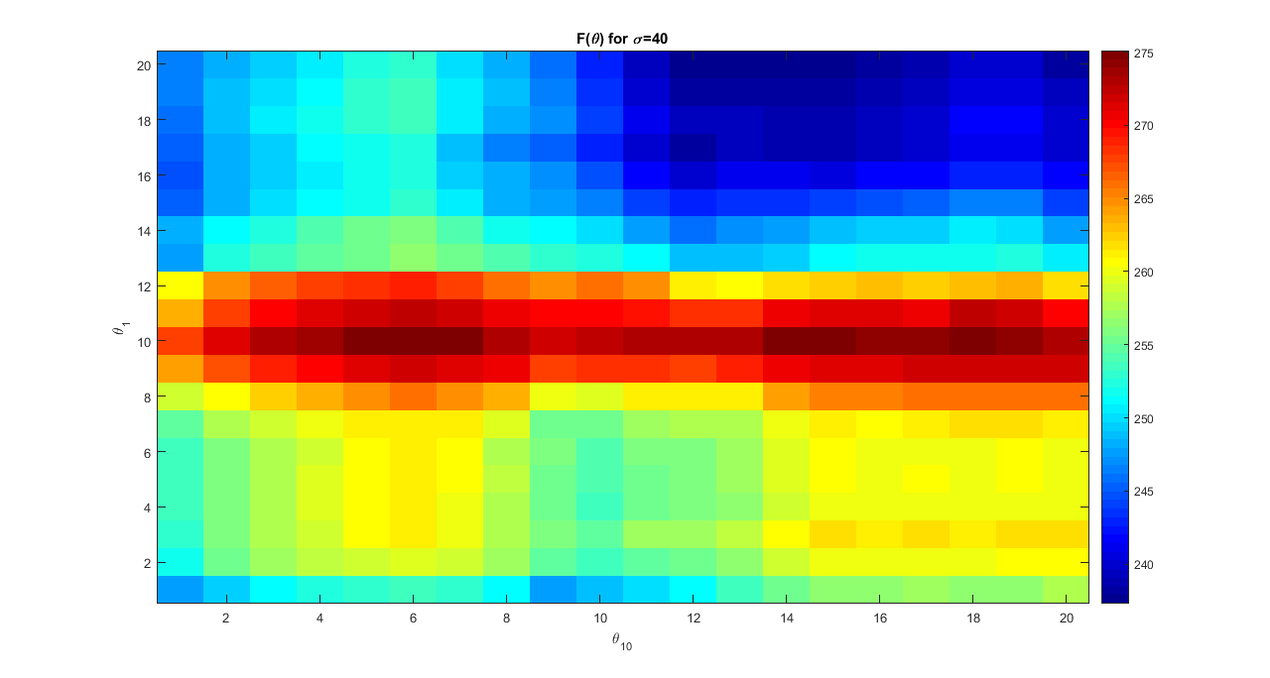
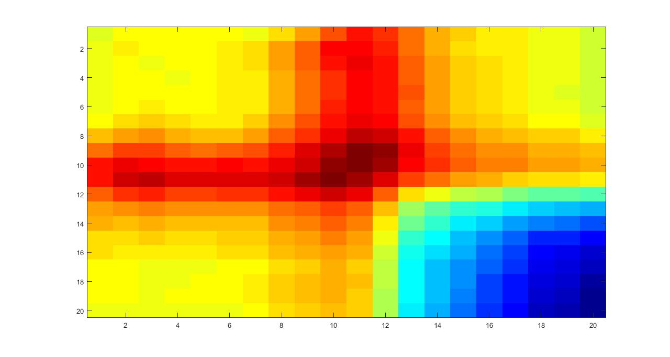
Energy storage optimization
2.0
1.8
1.6
1.4
1.2
1.0
0.8
0.6
0.4
0.2
0.0
0.0 0.2 0.4 0.6 0.8 1.0 1.2 1.4 1.6 1.8 2.0

Slide 49
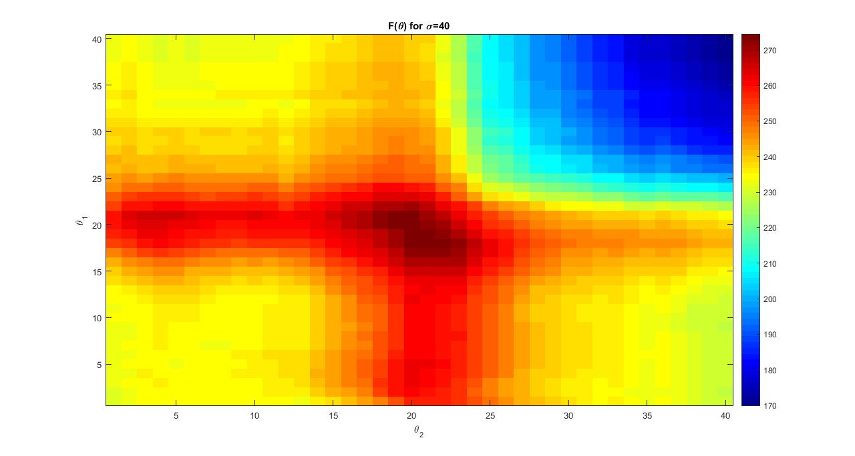
Energy storage optimization
2.0
1.8
1.6
1.4
1.2
1.0
0.8
0.6
0.4
0.2
0.0
0.0 0.2 0.4 0.6 0.8 1.0 1.2 1.4 1.6 1.8 2.0

Slide 50
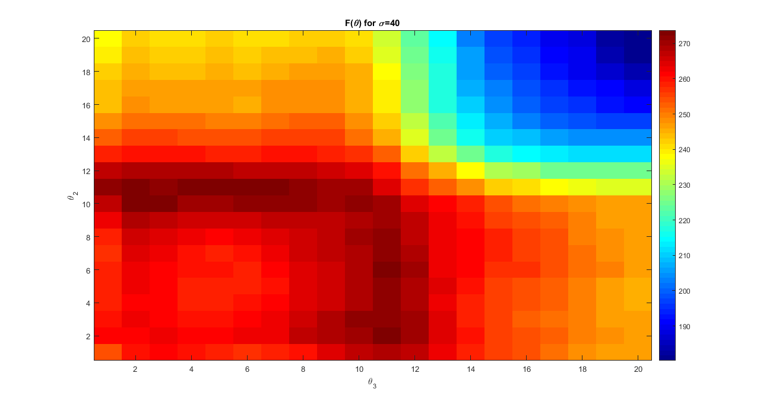
Energy storage optimization
2.0
1.8
1.6
1.4
1.2
1.0
0.8
0.6
0.4
0.2
0.0
0.0 0.2 0.4 0.6 0.8 1.0 1.2 1.4 1.6 1.8 2.0

Slide 51
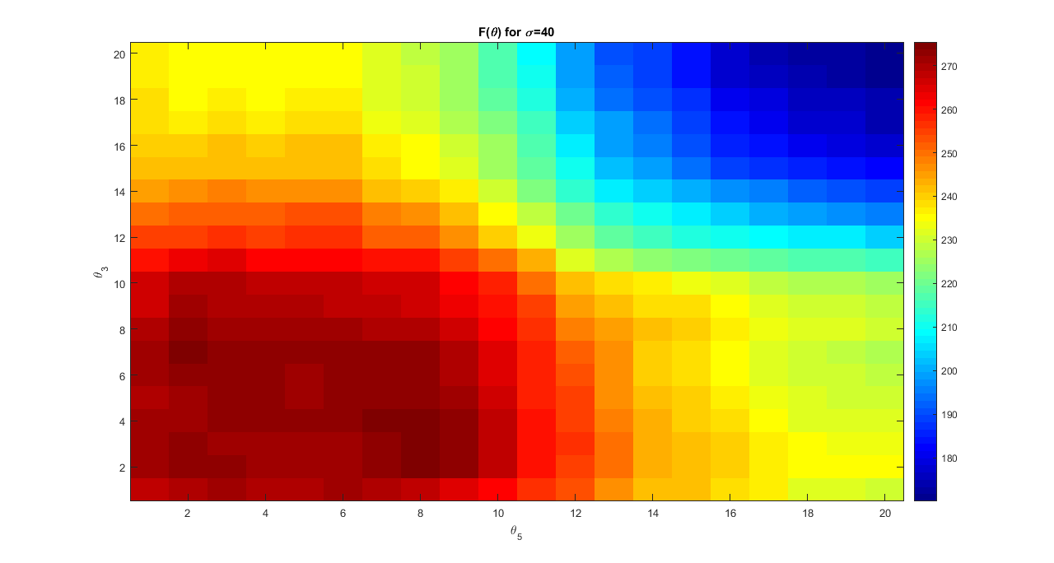
Energy storage optimization
2.0
1.8
1.6
1.4
1.2
1.0
0.8
0.6
0.4
0.2
0.0
0.0 0.2 0.4 0.6 0.8 1.0 1.2 1.4 1.6 1.8 2.0

Slide 52
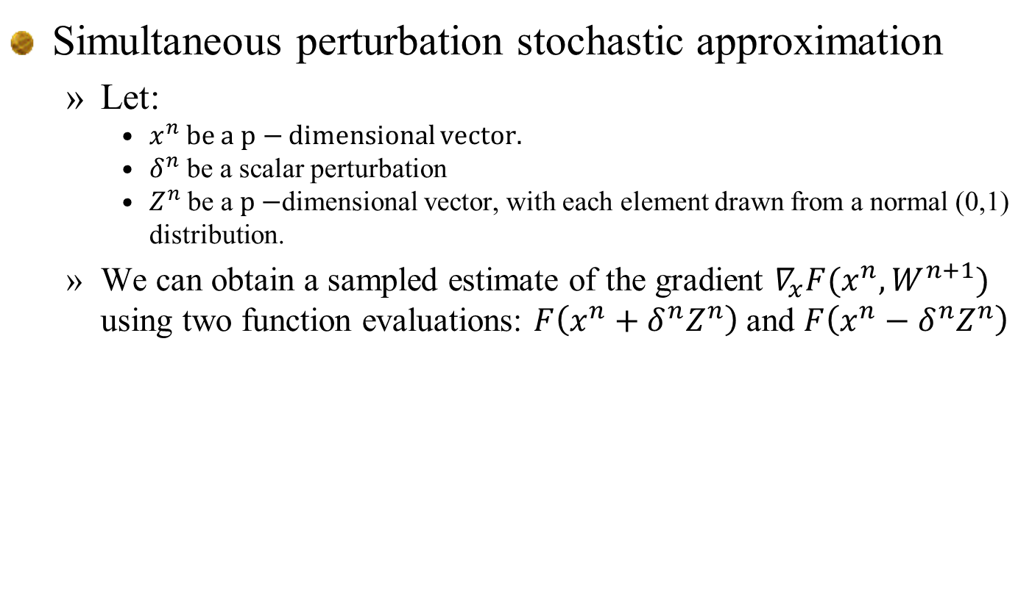
Energy storage optimization
Simultaneous perturbation stochastic approximation
  Let:
    $x^{n}$ be a $p−$ dimensional vector.
    $δ^{n}$ be a scalar perturbation
    $Z^{n}$ be a $p−$dimensional vector, with each element drawn from a normal (0,1) distribution.
  We can obtain a sampled estimate of the gradient $∇_{x}F(x^{n},W^{n+1})$ using two function evaluations: $F\left(x^{n}+δ^{n}Z^{n}\right)$ and $F\left(x^{n}−δ^{n}Z^{n}\right)$

Slide 53
Energy storage optimization
Notes:
  The next three slides represent applications of the SPSA algorithm with different stepsize rules.
  These illustrate the importance of tuning stepsizes (or more generally, stepsize policies).
  In fact, it is necessary to tune the stepsize depending on the starting point (or at least the starting region).
  These were done with RMSProp.

Slide 54
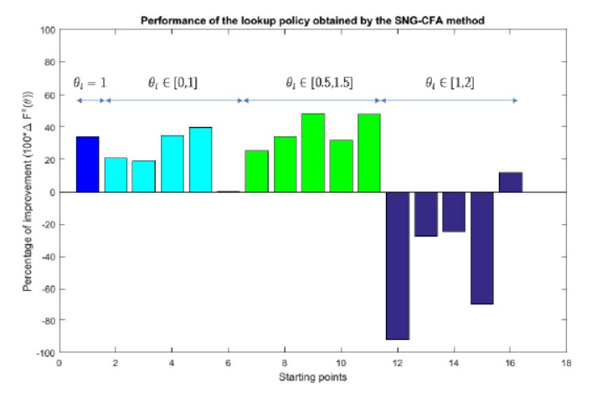

Energy storage optimization
Effect of starting points
  Using a single starting point $θ=1$ is fairly reliable.
Pct. Improvement over benchmark lookahead
Starting point

Slide 55
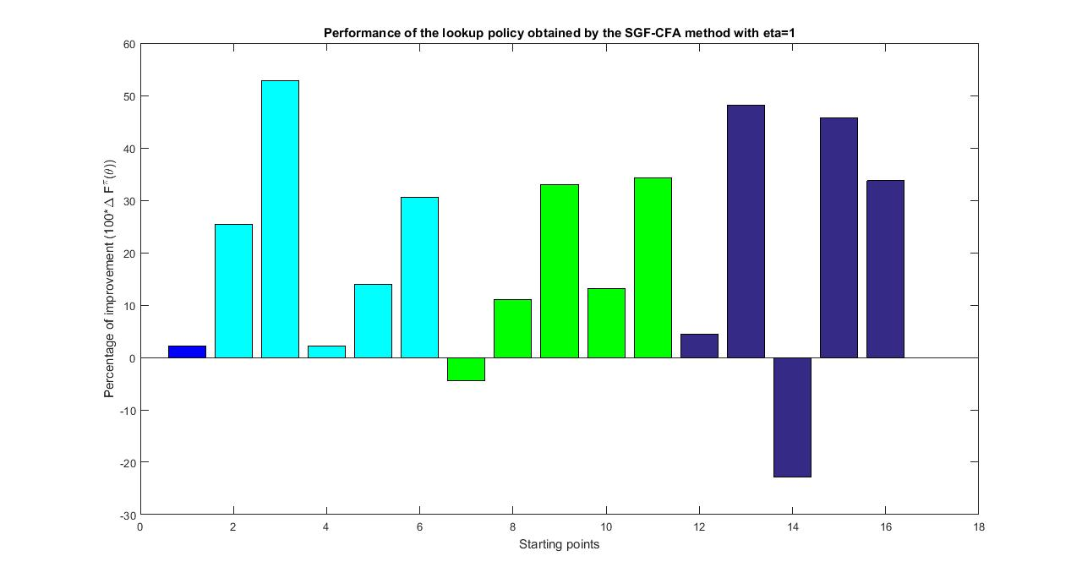



Energy storage optimization
Tuning the parameters
$$θ_{i}=1$$
$$θ_{i}∈[0,1]$$
$$θ_{i}∈[0.5,1.5]$$
$$θ_{i}∈[1,2]$$

Slide 56
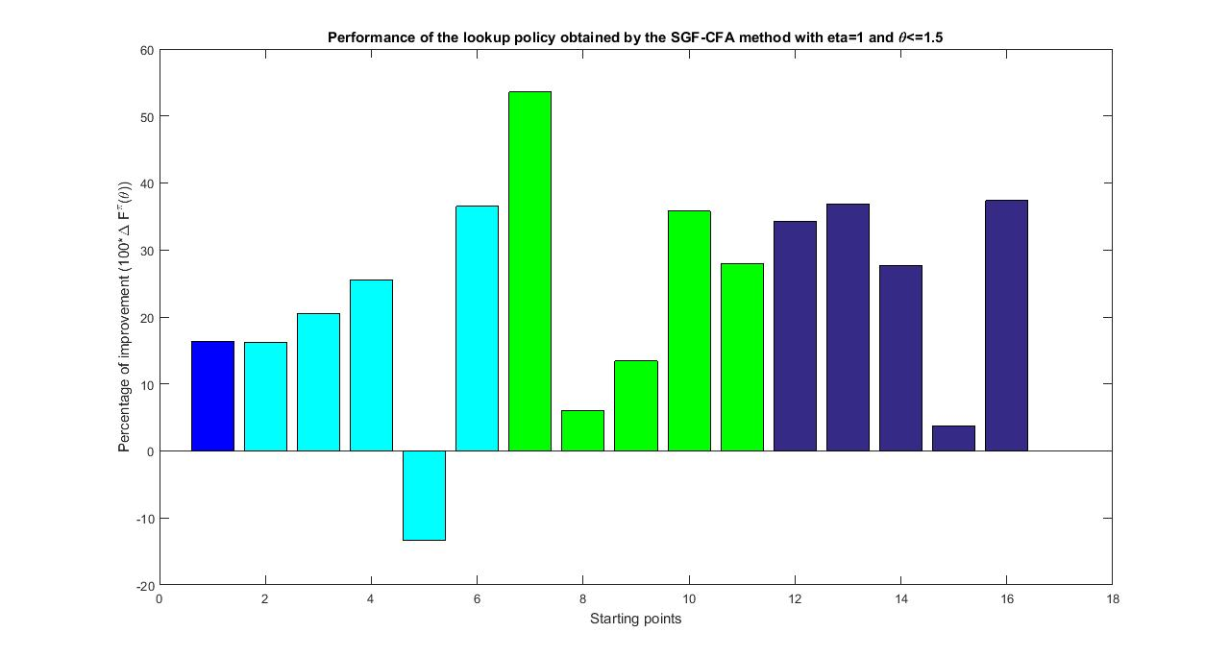
Energy storage optimization
Tuning the parameters
$$θ_{i}=1$$
$$θ_{i}∈[0,1]$$
$$θ_{i}∈[0.5,1.5]$$
$$θ_{i}∈[1,2]$$

Slide 57
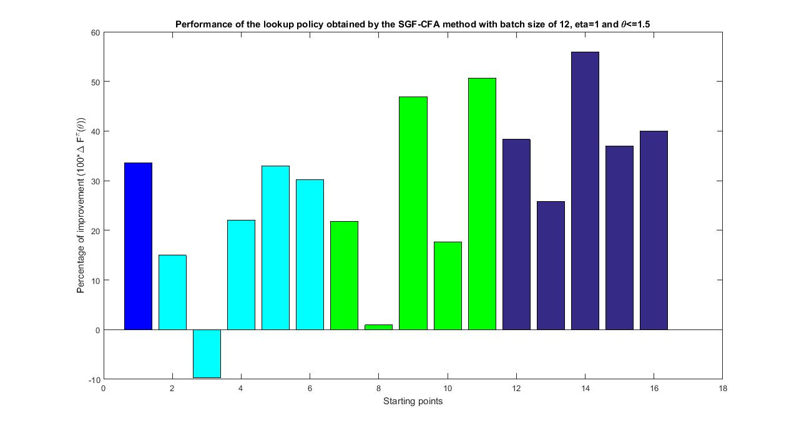
Energy storage optimization
Tuning the parameters
$$θ_{i}=1$$
$$θ_{i}∈[0,1]$$
$$θ_{i}∈[0.5,1.5]$$
$$θ_{i}∈[1,2]$$

Slide 58
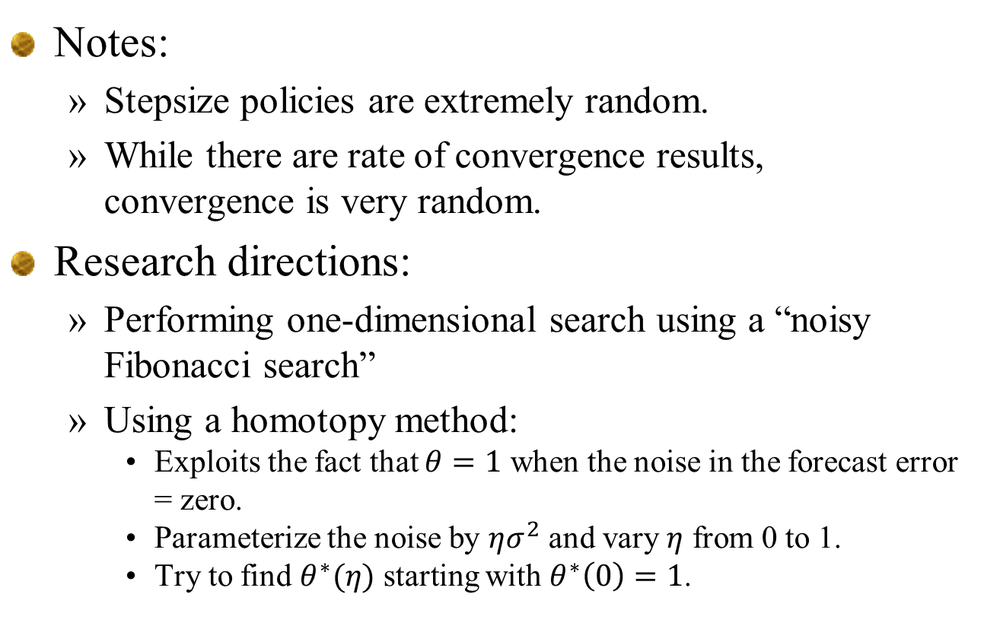
Energy storage optimization
Notes:
  Stepsize policies are extremely random.
  While there are rate of convergence results, convergence is very random.
Research directions:
  Performing one-dimensional search using a “noisy Fibonacci search”
  Using a homotopy method:
    Exploits the fact that $θ=1$ when the noise in the forecast error = zero.
    Parameterize the noise by $ησ^{2}$ and vary $η$ from 0 to 1.
    Try to find $θ^{∗}(η)$ starting with $θ^{∗}\left(0\right)=1$.

Slide 59
Case application – Stochastic unit commitment

Slide 60
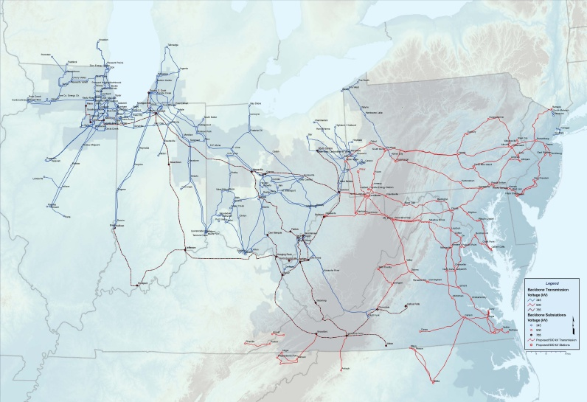
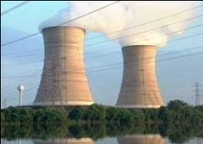

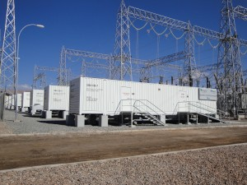
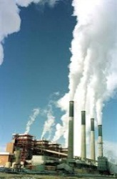
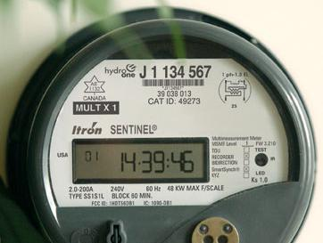

The unit commitment problem

Slide 61
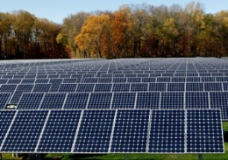








Slide 62

The timing of decisions
Day-ahead planning (slow – predominantly steam)
Intermediate-term planning (fast – gas turbines)
Real-time planning (economic dispatch)
Notes:
SMART-ISO is composed by three nested subsystems: a day-ahead planning model (which schedules primarily the steam generation, or the so-called “slow” generators), an intermediate-term planning model (which schedules primarily the gas turbines, or the “fast” generators), and a real-time simulation model (which corresponds to the economic dispatch).

Slide 63
The timing of decisions
The day-ahead unit commitment problem
Midnight
Midnight
Midnight
Midnight
Noon
Noon
Noon
Noon
Notes:
The day-ahead model runs at, say, noon of every day, aiming to schedule generation for the following day (midnight to midnight).

Slide 64
The timing of decisions
Intermediate-term unit commitment problem
1:00 pm
2:00 pm
3:00 pm
1:15 pm
1:45 pm
2:15 pm
2:30 pm
1:30

Slide 65
The timing of decisions
Intermediate-term unit commitment problem
1:00 pm
2:00 pm
3:00 pm
1:15 pm
1:45 pm
2:15 pm
2:30 pm
1:30

Slide 66
The timing of decisions
Intermediate-term unit commitment problem
2:00 pm
3:00 pm
Commitment
decisions
1:15 pm
1:30
Turbine 2
Ramping, but no on/off decisions.
Turbine 3
Turbine 1
Notification time

Slide 67
The timing of decisions
Real-time economic dispatch problem
1pm
2pm
1:05
1:10
1:15
1:20
1:25
1:30
Notes:
In the real-time problem, we simulate the actual operation of the market. Though we are interested in the economic dispatch only for the next 5 minutes, again we solve the problem for a longer period of time (say 15 minutes), in order to avoid end of horizon biases.

Slide 68
The timing of decisions
Real-time economic dispatch problem
1pm
2pm
1:05
1:10
1:15
1:20
1:25
1:30
Run economic dispatch to perform 5 minute ramping
Run AC power flow model

Slide 69
The timing of decisions
Real-time economic dispatch problem
1pm
2pm
1:05
1:10
1:15
1:20
1:25
1:30
Run economic dispatch to perform 5 minute ramping
Run AC power flow model

Slide 70
The timing of decisions
Real-time economic dispatch problem
1pm
2pm
1:05
1:10
1:15
1:20
1:25
1:30
Run economic dispatch to perform 5 minute ramping
Run AC power flow model

Slide 71
Parallel implementation
Nested decisions are optimized in parallel
  We exploit the gap between when a model is run, and when unit commitment decisions are made, to continue optimizing nested decisions.
Noon
Midnight
Midnight
Noon
Day-ahead
Intermediate
Real-time

Slide 72
The time-staging of decisions
Day-ahead unit commitment
Load curtailment notification
Natural gas generation
Tapping spinning reserve

Slide 73
The nesting of decisions

Slide 74
The nesting of decisions

Slide 75


SMART-ISO: Offshore wind study
Mid-Atlantic Offshore Wind Integration and Transmission Study (U. Delaware & partners, funded by DOE)
29 offshore sub-blocks in 5 build-out scenarios:
  1: 8 GW
  2: 28 GW
  3: 40 GW
  4: 55 GW
  5: 78 GW
Notes:
Now I would like to illustrate how a system like this can be used for strategic analysis.
We have been engaged in a study of high off-shore wind penetration with the University of Delaware, funded by the DOE.
In this study, off-shore wind farms are planned for installation, in different stages or levels of buildout, throughout the Mid-Atlantic coast, from the Jersey shore to the Virginia coast. Note that at its maximum the projected off-shore wind energy could potentially supply well over 50% of the demand in the PJM area.

Slide 76
Generating wind sample paths
Methodology for creating off-shore wind samples
  Use actual forecasts from on-shore wind to develop a stochastic error model
  Generate sample paths of wind by sampling errors from on-shore stochastic error model
  Repeat this for base case and five buildout levels
Our sample paths are based on:
  Four months: January, April, July and October
  WRF forecasts from three weeks each month
  Seven sample paths generated around each forecast, creating a total of 84 sample paths.
  The next four screens show the WRF forecasts for each month, followed by a screen with one forecast, and the seven sample paths generated around that forecast.

Slide 77




WRF simulations for offshore wind
January
April
July
October

Slide 78

Stochastic lookahead policies
Creating wind scenarios (Scenario #1)

Slide 79

Stochastic lookahead policies
Creating wind scenarios (Scenario #2)

Slide 80

Stochastic lookahead policies
Creating wind scenarios (Scenario #3)

Slide 81

Stochastic lookahead policies
Creating wind scenarios (Scenario #4)

Slide 82

Stochastic lookahead policies
Creating wind scenarios (Scenario #5)

Slide 83

Modeling forecast errors
Offshore wind – Buildout level 5 – ARMA error model
Forecasted wind
Sample paths

Slide 84
The robust CFA for unit commitment
The robust cost function approximation
  The ISOs today use simple rules to obtain robust solutions, such as scheduling reserves.
  These strategies are fairly sophisticated:
    Spinning
    Non-spinning
    Distributed spatially across the regions.
  This reserve strategy is a form of robust cost function approximation. They represent a parametric modification of a base cost policy, and have been tuned over the years in an online setting (called the real world).
  The ISOs use what would be a hybrid: the robust CFA concept applied to a deterministic lookahead base model.

Slide 85
Four classes of policies
1) Policy function approximations (PFAs)
  Lookup tables, rules, parametric functions
2) Cost function approximation (CFAs)
3) Policies based on value function approximations (VFAs)
4) Lookahead policies
  Deterministic lookahead:
  Stochastic lookahead (e.g. stochastic trees)

Slide 86
A hybrid lookahead-CFA policy
A deterministic lookahead model
  Optimize over all decisions at the same time
  In a deterministic model, we mix generators with different notification times:
    Steam generation is made day-ahead
    Gas turbines can be planned an hour ahead or less
Steam generation
Gas turbines

Slide 87
A hybrid lookahead-CFA policy
A deterministic lookahead policy
  This is the policy produced by solving a deterministic lookahead model
  No ISO uses a deterministic lookahead model. It would never work, and for this reason they have never used it. They always modify the model to produce a robust solution.
Steam generation
Gas turbines

Slide 88
A hybrid lookahead-CFA policy
A robust CFA policy
  The ISOs introduce reserves:
  This modification is a form of parametric function (a parametric cost function approximation). It has to be tuned to produce a robust policy.

Slide 89
A hybrid lookahead-CFA policy
A robust CFA policy
  The ISOs introduce reserves:
  It is easy to tune this policy when there are only two parameters
  But we might want the parameters to depend on information such as forecasts.

Slide 90
Stochastic unit commitment
Properties of a parametric cost function approximation
  It allows us to use domain expertise to control the structure of the solution
  We can force the model to schedule extra reserve:
    At all points in time (or just during the day)
    Allocated across regions
  This is all accomplished without using a multiscenario model.
  The next slides illustrate the solution before the reserve policy is imposed, and after. Pay attention to the change pattern of gas turbines (in maroon).

Slide 91

Stochastic lookahead policies
Load shedding event:

Slide 92

Stochastic lookahead policies
Load shedding event:

Slide 93

Stochastic lookahead policies
Load shedding event:
Hour
ahead
forecast
Actual wind

Slide 94
Stochastic unit commitment
The outage appears to happen under the following conditions:
  It is July (we are maxed out on gas turbines – we were unable to schedule more gas reserves than we did).
  The day-ahead forecast of energy from wind was low (it is hard to see, but the day-ahead forecast of wind energy was virtually zero).
  The energy from wind was above the forecast, but then dropped suddenly.
  It was the sudden drop, and the lack of sufficient turbine reserves, that created the load shedding event.
  Note that it is very important to capture the actual behavior of wind.

Slide 95
Stochastic unit commitment
What is next:
  We are going to try to fix the outage by allowing the day-ahead model to see the future.
  This will fix the problem, by scheduling additional steam, but it does so by scheduling extra steam at exactly the time that it is needed.
  This is the power of the sophisticated tools that are used by the ISOs (which we are using). If you allow a code such as Cplex (or Gurobi) to optimize across hundreds of generators, you will get almost exactly what you need.

Slide 96
Stochastic lookahead policies
Note the dip in steam just when the outage occurs – This is because we forecasted that wind would cover the load.

Slide 97

Stochastic lookahead policies
When we allow the model to see into the future (the drop in wind), it schedules additional steam the day before. But only when we need it!

Slide 98
SMART-ISO: Offshore wind study
Notes:
Clean run – no outages

Slide 99
SMART-ISO: Offshore wind study
Notice that we get uniformly more gas turbine reserves at all points in time (because we asked for it)
Notes:
Clean run – no outages

Slide 100
Discrete Markov decision processes
Modeling

Slide 101

Discrete Markov decision processes
Dynamic programming
  A “dynamic program” is any sequential decision process which can be written
  The problem is to find an effective policy $X^{π}(S_{t})$, in the presence of the uncertainties $W_{1},W_{2},…$

Slide 102

Discrete Markov decision processes
Our modeling framework consists of:
  States
    Initial state $S_{0}$
    Dynamic states $S_{t}$
  Decisions/actions/controls $x_{t}, a_{t} , u_{t}$
  Exogenous information $W_{t}$
  Transition function:
    $S_{t+1}=S^{M}(S_{t},x_{t},W_{t+1})$
  Objective function

Slide 103


Discrete Markov decision processes
“Canonical model” from Puterman (Ch. 3)

Slide 104

Discrete Markov decision processes
The optimality equation – deterministic problem
  The decision out of node 1 depends on what we are planning on doing out of node 2.

Slide 105

Discrete Markov decision processes
Bellman for deterministic problems
  The best decision out of node $S_{t}$ is given by
  where
  The essential idea is that you can make the best decision now (out of state $S_{t}$) given the contribution of decision $x_{t}$, given by $C(S_{t},x_{t})$, plus the optimal value of the state $S_{t+1}$ that the decision $x_{t}$ takes us to.

Slide 106

Discrete Markov decision processes
The optimality equations for stochastic problems:
  We start with our objective:
  An optimal policy finds the best decision given the optimal value of the state that the decision takes us to:
  We then replace the downstream value of starting in state $S_{t+1}$ with a value function:
  The “optimality equations” are then

Slide 107

Discrete Markov decision processes
Bellman for stochastic problems

Slide 108

Discrete Markov decision processes

Slide 109

Discrete Markov decision processes
Decision tree without learning

Slide 110
Discrete Markov decision processes
Some vocabulary:
  Square nodes are:
    Decision nodes – Links emanating from the squares are decisions
    Also represents the state of our system (it implicitly captures all the information we need to make a decision).
    Also known as the “pre-decision state.”
  Circle nodes are:
    Outcome nodes – Links emanating from circles represent random events.
    Represents the state after a decision is made.
    Also known as the “post-decision state.”
  Nodes in a decision tree always imply the information in the entire path leading up to the node.

Slide 111

Discrete Markov decision processes
Rolling back the tree

Slide 112
Decision Outcome Decision Outcome Decision

Slide 113
Discrete Markov decision processes
Decision trees:
  Discuss the concept of a “state” in a decision tree.
  Implicit in a decision node is the entire history leading up to the decision, which is unique.
  We may not need the entire history, but we do not need to articulate this.
  This is how sequential decisions were approached before Richard Bellman.

Slide 114
Decision Outcome Decision Outcome Decision Outcome
Pre-decision state
Post-decision state

Slide 115
Discrete Markov decision processes
Notes:
  “Dynamic programming” (or more precisely, discrete Markov decision processes) exploits the property that there is (or may be) a compact set of states that all paths return to.
  Capturing this avoids the explosion that happens with decision trees.

Slide 116

Discrete Markov decision processes
Optimality equations in matrix form

Slide 117

Discrete Markov decision processes

Slide 118

Discrete Markov decision processes
Computing the one-step transition matrix
  The MDP community treats the one-step transition matrix as data, but it is usually computationally intractable.

Slide 119

Discrete Markov decision processes
Bellman’s equations using operator notation

Slide 120

Discrete Markov decision processes
Bellman’s equations using operator notation

Slide 121
Discrete Markov decision processes
Backward dynamic programming
Value iteration
Policy iteration
Average reward

Slide 122

Backward dynamic programming
Finite horizon
  Backward MDP
  So, if we can compute the one-step transition matrix, this gives us the optimal solution.

Slide 123
Backward dynamic programming
Backward dynamic programming in one dimension

Slide 124

Backward dynamic programming
Notes:
  If you can compute the one-step transition matrix $p(s^{′}|s,a)$, then backward dynamic programming for a finite horizon is trivial.
  The problem is that the matrix $p(s^{′}|s,a)$ is rarely computable:
    State variables may be vector valued and/or continuous
    Actions may be vector valued and/or continuous
    The exogenous information $W$ (implicit in the one-step transition matrix) may be vector valued and/or continuous.
  The MDP community transitioned to infinite horizon problems that dominate the field.

Slide 125

Backward dynamic programming
Infinite horizon MDP

Slide 126

Backward dynamic programming

Slide 127

Backward dynamic programming

Slide 128

Backward dynamic programming

Slide 129

Backward dynamic programming

Slide 130


Backward dynamic programming

Slide 131

Discrete MDPs

Slide 132

Backward dynamic programming

Slide 133

Backward dynamic programming
Policy iteration

Slide 134

Backward dynamic programming

Slide 135

Discrete MDPs

Slide 136
Backward MDP and the curse of dimensionality

Slide 137
Curse of dimensionality
The ultimate policy is to optimize from now on:
Ideally, we would like to replace the future contributions with a single value function:
Sometimes we can compute this function exactly!

Slide 138

Curse of dimensionality
Energy storage with stochastic prices, supplies and demands.

Slide 139
Curse of dimensionality
Bellman’s optimality equation
These are the “three curses of dimensionality.”

Slide 140
Curse of dimensionality
Backward dynamic programming in one dimension

Slide 141
Curse of dimensionality
Dynamic programming in multiple dimensions

Slide 142
Curse of dimensionality
Notes:
  There are potentially three “curses of dimensionality” when using backward dynamic programming:
    The state variable – We need to enumerate all states. If the state variable is a vector with more than two dimensions, the state space gets very big, very quickly.
    The random information – We have to sum over all possible realizations of the random variable. If this has more than two dimensions, this gets very big, very quickly.
    The decisions – Again, decisions may be vectors (our energy example has five dimensions). Same problem as the other two.
  Some problems fit this framework, but not very. However, when we can use this framework, we obtain something quite rare: an optimal policy.

Slide 143
Curse of dimensionality
Strategies for computing/approximating value functions:
  Backward dynamic programming
    Exact using lookup tables
    Backward approximate dynamic programming:
      Linear regression
      Low rank approximations
  Forward approximate dynamic programming
    To be covered next week

