Slide 1
Computational Stochastic Optimization:
Modeling
October 25, 2012
Warren Powell
CASTLE Laboratory
Princeton University
http://www.castlelab.princeton.edu
© 2012 Warren B. Powell, Princeton University

Slide 2
Outline
Overview and major problem classes
How to model a sequential decision problem
Steps in the modeling process
Examples (underdevelopment)

Slide 3
Problem classes
Where to send a plane:
  Action: Where to send the plane to accomplish a goal.
  Noise: demands on the system, equipment failures.

Slide 4
Problem classes
How to land a plane:
  Control: angle, velocity, acceleration, pitch, yaw…
  Noise: wind, measurement

Slide 5
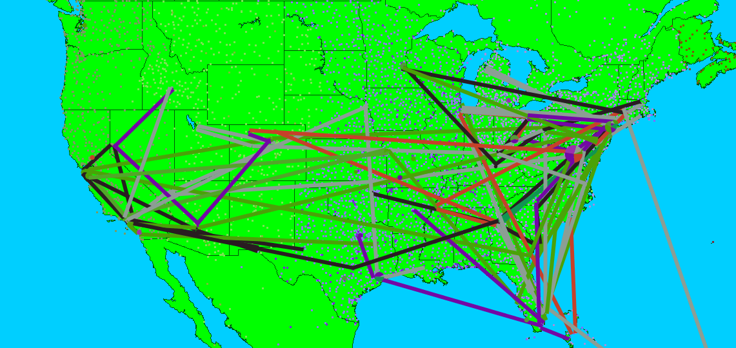
Problem classes
How to manage a fleet of planes
  Decision: Which plane to assign to each customer.
  Noise: demands on the system, equipment failures.

Slide 6
Problem classes
These three problems illustrate three very different applications:
  Managing a single entity, which can be represented with a discrete action, typical of computer science.
  Controlling a piece of machinery, which we model with a multi-dimensional (but low dimensional) control vector.
  Managing large fleets of vehicles with high dimensional vectors (but exploiting convexity).
All three of these can be “modeled” using Bellman’s equation. Mathematically they look the same, but computationally they are very different.

Slide 7
Problem classes
Dimensions of our problem
  Decisions
    Discrete actions
    Multidimensional controls (without convexity)
    High dimensional vectors (with convexity)
  Information stages
    Single, deterministic decisions (or parameters), after which random information is revealed to compute the cost.
    Two-stage with recourse
      Make decision, see information, make one more decision
    Fully sequential (multistage)
      Decision, information, decision, information, decision, …
  The objective function
    Min/max expectation
    Dynamic risk measures
    Robust optimization

Slide 8
Problem classes
Our presentation focuses on sequential (also known as multistage) control problems.
We consider problems which involve sequences of decision, information, decision, information, …
There are important applications in stochastic optimization which belong to the first two classes of problems:
  Decision/information
  Decision/information/decision
We will also focus on problems which use an expectation for the objective function. There are many problems where risk is a major issue. We take the position that the objective function is part of the model.

Slide 9
Deterministic modeling
For deterministic problems, we speak the language of mathematical programming
  For static problems
  For time-staged problems
Arguably Dantzig’s biggest contribution, more so than the simplex algorithm, was his articulation of optimization problems in a standard format, which has given algorithmic researchers a common language.

Slide 10
Modeling as a Markov decision process
For stochastic problems, many people model the problem using Bellman’s equation
  where
  This is the canonical form of a dynamic program building on Bellman’s seminal research. Simple, elegant, widely used but difficult to scale to realistic problems.

Slide 11
Modeling as a stochastic program
A third strategy is to use the vocabulary of “stochastic programming”.
  For “two-stage” stochastic programs (decisions/information, or decisions/information/ decisions), this can be written in the generic form
  or
  where

Slide 12
Modeling as a stochastic program
In this talk, we will focus on multistage, sequential problems. Later in the presentation we show how the stochastic programming community models multistage, stochastic optimization problems.
We are going to show that (for sequential problems), dynamic programming and stochastic programming begin by providing a model of a sequential problem (which we refer to as a dynamic program).
However, we will show that stochastic programming (for sequential problems) is actually modeling what we will call the lookahead model (which is itself a dynamic program). This gives us what we will call a lookahead policy for solving dynamic programs.

Slide 13
Outline
Overview and major problem classes
How to model a sequential decision problem
Steps in the modeling process
Examples (underdevelopment)

Slide 14
Modeling
We lack a standard language for modeling sequential, stochastic decision problems.
  In the slides that follow, we propose to model problems along five fundamental dimensions:
    State variables
    Decision variables
    Exogenous information processes
    Transition function
    Objective function
  This framework is widely followed in the control theory community, and almost completely ignored in operations research and computer science.

Slide 15
Modeling dynamic problems
The state variable is the minimally dimensioned function of history that is necessary and sufficient to calculate the decision function, cost function and transition function.
Slide 15
The system state:
Notes:
15

Slide 16
Modeling dynamic problems
  The state variable is, without question, one of the most controversial concepts in stochastic optimization.
  A number of leading authors will either claim that it cannot be defined, or should not.
  We argue that students need to learn how to model a system properly, and the state variable is central to a proper model.
  Our definition insists that the state variable include all the information we need to make a decision (and only the information needed), now or in the future. We also feel that it should be “minimally dimensioned” which is to say, as simple and compact as possible.
  This means that all (properly modeled) dynamic systems are Markovian, eliminating the need for the concept of “history dependent” processes.
Slide 16
The system state:
Notes:
16

Slide 17
Modeling dynamic problems
Slide 17
Decisions:
Notes:
17

Slide 18
Modeling dynamic problems
Exogenous information:
Note: Any variable indexed by t is known at time t. This convention, which is not standard in control theory, dramatically simplifies the modeling of information.
Slide 18
Notes:
18

Slide 19
Modeling dynamic problems
The transition function
Also known as the:
“System model”
“State transition model”
“Plant model”
“Model”
Slide 19
Notes:
19

Slide 20
Stochastic optimization models
The objective function
  Given a system model (transition function)
  We have to find the best policy, which is a function that maps states to feasible actions, using only the information available when the decision is made.
Expectation over all
random outcomes
Cost function
State variable
Decision function (policy)
Finding the best policy

Slide 21
Objective functions
There are different objectives that we can use:
  Expectations
  Risk measures
  Worst case (“robust optimization”)

Slide 22
Modeling
This framework (very familiar to the control theory community) offers a model for sequential decision problems (minimizing expected costs).
The most difficult hurdles involve:
  Understanding (and properly modeling) the state variable.
  Understanding what is meant (computationally) by the state transition function. While very familiar to the control theory community, this is not a term used in operations research or computer science.
  Understanding what in the world is meant by “minimizing over policies.”
Finding computationally meaningful solution approaches involves entering what I have come to call the jungle of stochastic optimization.

Slide 23
Outline
Overview and major problem classes
How to model a sequential decision problem
Steps in the modeling process
Examples (underdevelopment)

Slide 24
Modeling stochastic optimization
In these slides, I am going to try to present a four-step process for modeling a sequential, stochastic system.
The approach begins by developing the idea of simulating a fixed policy. This is our model.
We then address the challenge of finding an effective policy.
The goal is to focus attention initially on modeling, after which we turn to the challenge of finding effective policies.

Slide 25
Modeling stochastic optimization
Step 1:
  Start by modeling the problem deterministically:
  In this step, we focus on understanding decisions and costs.

Slide 26
Modeling stochastic optimization
Step 2:
  Now imagine that the process is unfolding stochastically. Every time you see a decision replace it with the decision function (policy) and take the expectation.
  Instead of maximizing over decisions, we are now maximizing over the types of policies for making a decision.

Slide 27
Stochastic optimization models
Step 3:
  Now write out the objective function as a simulation. This can be done as one long simulation:
  … or an average over multiple sample paths:

Slide 28
Stochastic optimization models
Step 4
  Now search for the best policy:
    First choose a type of policy:
      Myopic cost function approximation
      Lookahead policy (deterministic, stochastic)
      Policy function approximation
      Policy based on a value function approximation
      Or some sort of hybrid
    Then identify the tunable parameters of the policy
    Tune the parameters
    … using your favorite stochastic search or optimal learning algorithm.
    Loop over other types of policies.

Slide 29

Stochastic programming
Stochastic search
Model predictive control
Optimal control
Reinforcement learning
On-policy learning
Off-policy learning
Markov decision processes
Simulation optimization
Policy search

Slide 30
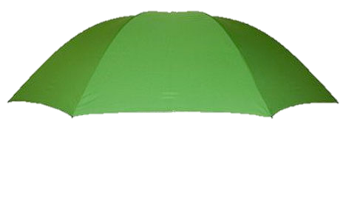
Computational Stochastic
Optimization
Stochastic programming
Stochastic search
Model predictive control
Optimal control
Reinforcement learning
On-policy learning
Markov decision processes
Simulation optimization
Policy search

