Slide 1
Approximate Dynamic Programming
and Policy Search:
Does anything work?
Rutgers Applied Probability Workshop
June 6, 2014
Warren B. Powell
Daniel R. Jiang
with contributions from:
Daniel Salas
Vincent Pham
Warren Scott
© 2014 Warren B. Powell, Princeton University

Slide 2
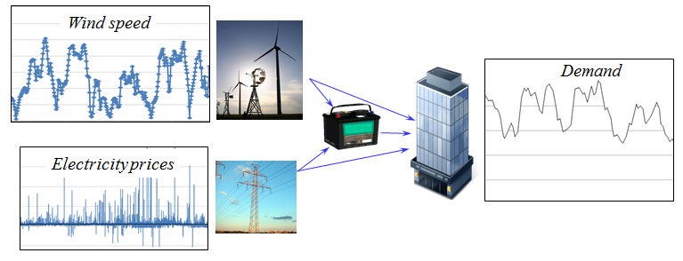
Storage problems
How much energy to store in a battery to handle the volatility of wind and spot prices to meet demands?

Slide 3
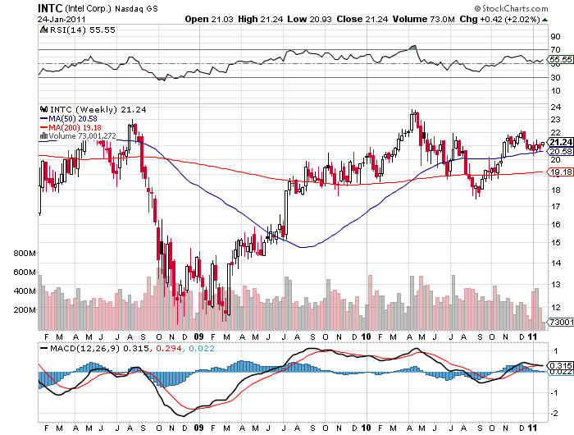


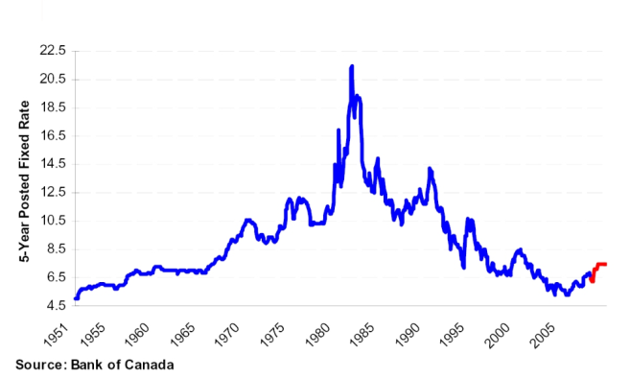
Storage problems
How much money should we hold in cash given variable market returns and interest rates to meet the needs of a business?
Stock prices
Bonds

Slide 4
Storage problems
Elements of a “storage problem”
  Controllable scalar state giving the amount in storage:
    Decision may be to deposit money, charge a battery, chill the water, release water from the reservoir.
    There may also be exogenous changes (deposits/withdrawals)
  Multidimensional “state of the world” variable that evolves exogenously:
    Prices
    Interest rates
    Weather
    Demand/loads
  Other features:
    Problem may be time-dependent (and finite horizon) or stationary
    We may have access to forecasts of future

Slide 5



Storage problems
Dynamics are captured by the transition function:
  Controllable resource (scalar):
  Exogenous state variables:
Slide 5
Notes:
5

Slide 6
Stochastic optimization models
The objective function
  With deterministic problems, we want to find the best decision.
  With stochastic problems, we want to find the best function (policy) for making a decision.
Expectation over all
random outcomes
Cost function
State variable
Finding the best policy
Decision function (policy)

Slide 7
Four classes of policies
1) Policy function approximations (PFAs)
  Lookup tables, rules, parametric functions
2) Cost function approximation (CFAs)
3) Policies based on value function approximations (VFAs)
4) Lookahead policies (a.k.a. model predictive control)
  Deterministic lookahead (rolling horizon procedures)
  Stochastic lookahead (stochastic programming,MCTS)

Slide 8
Value iteration
Classical backward dynamic programming
  The three curses of dimensionality
The action
space
The outcome space
The state space

Slide 9
A storage problem
Energy storage with stochastic prices, supplies and demands.

Slide 10
A storage problem
Bellman’s optimality equation

Slide 11
Managing a water reservoir
Backward dynamic programming in one dimension

Slide 12
Managing cash in a mutual fund
Dynamic programming in multiple dimensions

Slide 13
Approximate dynamic programming
Algorithmic strategies:
  Approximate value iteration
    Mimics backward dynamic programming
  Approximate policy iteration
    Mimics policy iteration
  Policy search
    Based on the field of stochastic search

Slide 14
Approximate value iteration
  Step 1: Start with a pre-decision state
  Step 2: Solve the deterministic optimization using
  an approximate value function:
  to obtain .
  Step 3: Update the value function approximation
  Step 4: Obtain Monte Carlo sample of and
  compute the next pre-decision state:
  Step 5: Return to step 1.
Deterministic
optimization
Recursive
statistics
Simulation
“on policy learning”
Notes:
14

Slide 15
Approximate value iteration
  Step 1: Start with a pre-decision state
  Step 2: Solve the deterministic optimization using
  an approximate value function:
  to obtain .
  Step 3: Update the value function approximation
  Step 4: Obtain Monte Carlo sample of and
  compute the next pre-decision state:
  Step 5: Return to step 1.
Deterministic
optimization
Recursive
statistics
Simulation
Notes:
15

Slide 16
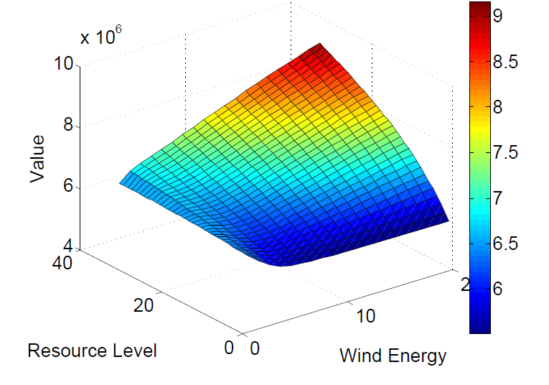
Approximate value iteration
The true (discretized) value function

Slide 17
Outline
Least squares approximate policy iteration
Direct policy search
Approximate policy iteration using machine learning
Exploiting concavity
Exploiting monotonicity
Closing thoughts

Slide 18
Approximate dynamic programming
Classical approximate dynamic programming
  We can estimate the value of being in a state using
  Use linear regression to estimate .
  Our policy is then given by
  This is known as Bellman error minimization.

Slide 19


Approximate dynamic programming
Least squares policy iteration (Lagoudakis and Parr)
  Bellman’s equation:
  … is equivalent to (for a fixed policy)
  Rearranging gives:
  … where “X” is our explanatory variable. But we cannot compute this exactly (due to the expectation) so we can sample it.

Slide 20
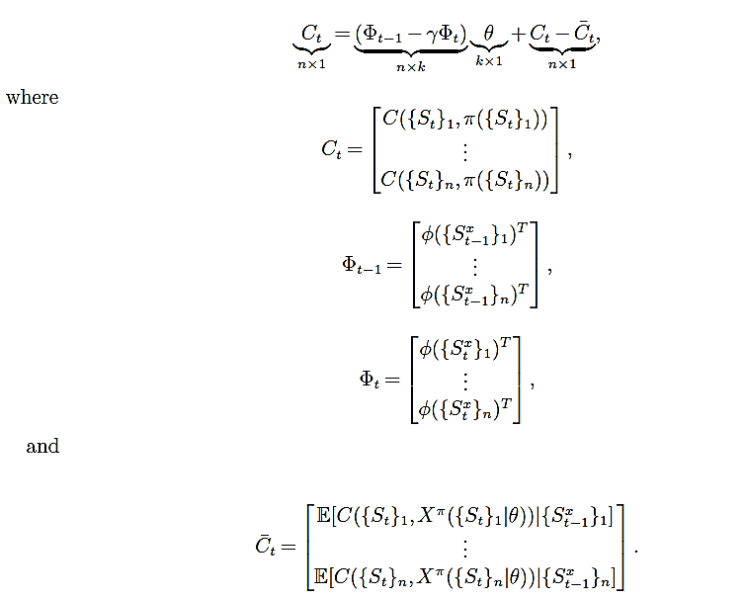
Approximate dynamic programming
… in matrix form:

Slide 21
Approximate dynamic programming
First issue:
  This is known as an “errors-in-variable” model, which produces biased estimates of . We can correct the bias using instrumental variables.
Sample state, compute basis functions.
Simulate next state and compute basis functions

Slide 22
Approximate dynamic programming
Second issue:
  Bellman’s optimality equation written using basis functions:
  … does not possess a fixed point (result due to van Roy and de Farias). This is the reason that classical Bellman error minimization using basis functions:
  …does not work. Instead we have to use projected Bellman error:
Projection operator onto the space spanned by the basis functions.

Slide 23
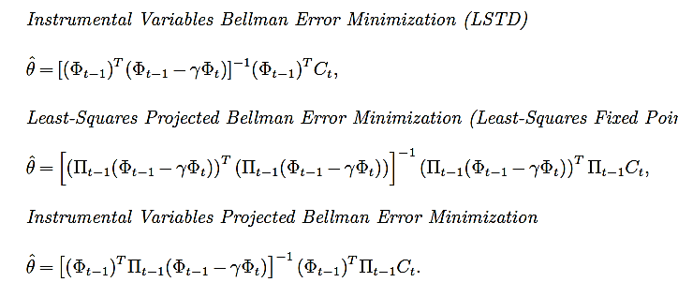
Approximate dynamic programming
Surprising result:
  Theorem (W. Scott and W.B.P.) Bellman error using instrumental variables and projected Bellman error minimization are the same!

Slide 24
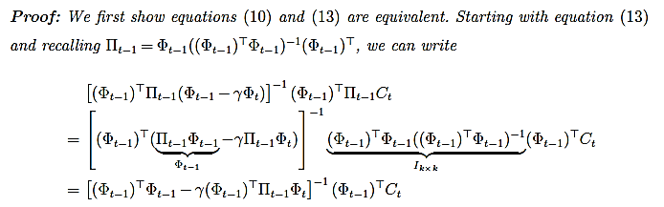
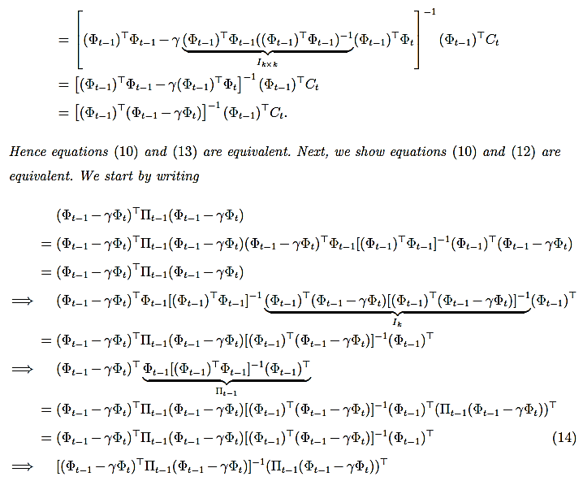

Slide 25
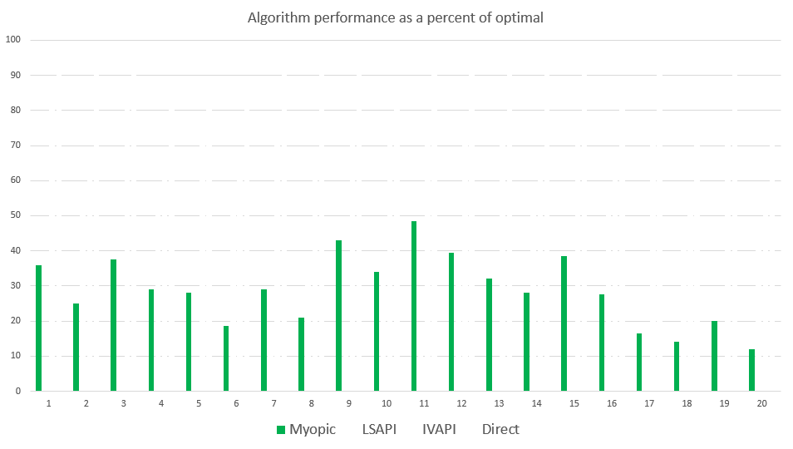
Optimizing storage
For benchmark datasets, see: http:www.castlelab.princeton.edu/datasets.htm

Slide 26
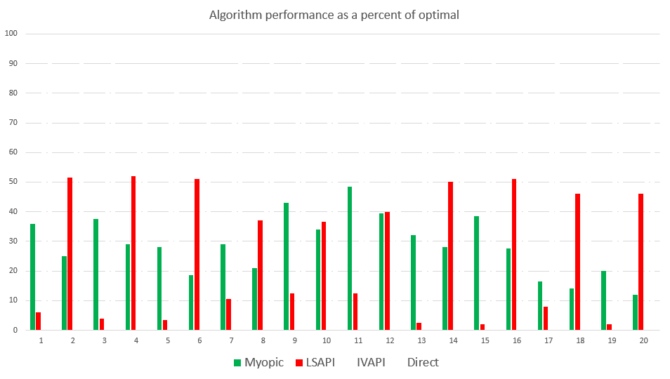
Optimizing storage
For benchmark datasets, see: http:www.castlelab.princeton.edu/datasets.htm

Slide 27
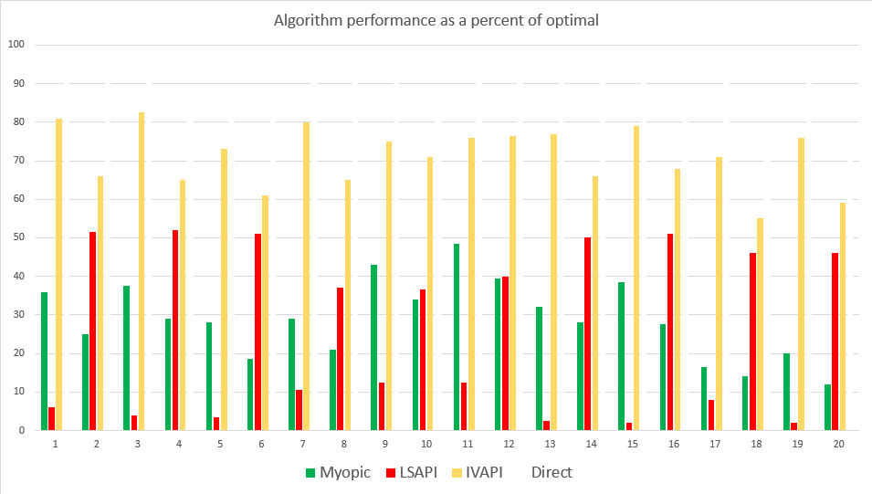
Optimizing storage
For benchmark datasets, see: http:www.castlelab.princeton.edu/datasets.htm

Slide 28
Outline
Least squares approximate policy iteration
Direct policy search
Approximate policy iteration using machine learning
Exploiting concavity
Exploiting monotonicity
Closing thoughts

Slide 29
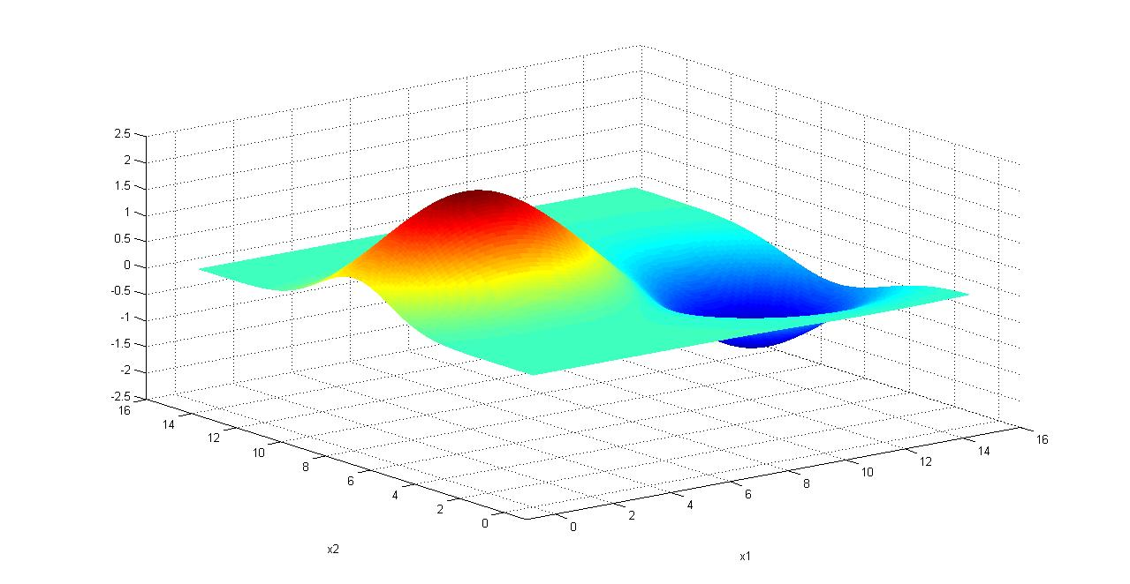
Policy search
Finding the best policy (“policy search”)
  Assume our policy is given by
  We wish to maximize the function
Error correction
term
Notes:
29

Slide 30
Policy search
A number of fields work on this problem under different names:
  Stochastic search
  Simulation optimization
  Black box optimization
  Sequential kriging
  Global optimization
  Open loop control
  Optimization of expensive functions
  Bandit problems (for on-line learning)
  Optimal learning

Slide 31

Policy search
For benchmark datasets, see: http:www.castlelab.princeton.edu/datasets.htm

Slide 32
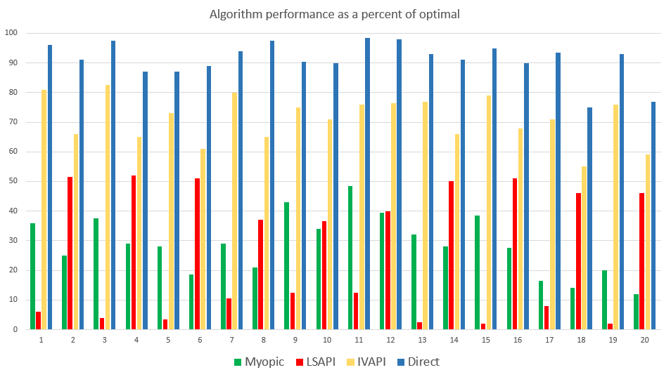
Policy search
For benchmark datasets, see: http:www.castlelab.princeton.edu/datasets.htm

Slide 33
Outline
Least squares approximate policy iteration
Direct policy search
Approximate policy iteration using machine learning
Exploiting concavity
Exploiting monotonicity
Closing thoughts

Slide 34
Approximate policy iteration
  Step 1: Start with a pre-decision state
  Step 2: Inner loop: Do for m=1,…,M:
  Step 2a: Solve the deterministic optimization using
  an approximate value function:
  to obtain .
  Step 2b: Update the value function approximation
  Step 2c: Obtain Monte Carlo sample of and
  compute the next pre-decision state:
  Step 3: Update using and return to step 1.
Notes:
34

Slide 35
Approximate policy iteration
Machine learning methods (coded in R)
  SVR - Support vector regression with Gaussian radial basis kernel
  LBF – Weighted linear combination of polynomial basis functions
  GPR – Gaussian process regression with Gaussian RBF
  LPR – Kernel smoothing with second-order local polynomial fit
  DC-R – Dirichlet clouds – Local parametric regression.
  TRE – Regression trees with constant local fit.

Slide 36
Approximate policy iteration
Test problem sets
  Linear Gaussian control
    L1 = Linear quadratic regulation
    Remaining problems are nonquadratic
  Finite horizon energy storage problems (Salas benchmark problems)
    100 time-period problems
    Value functions are fitted for each time period

Slide 37
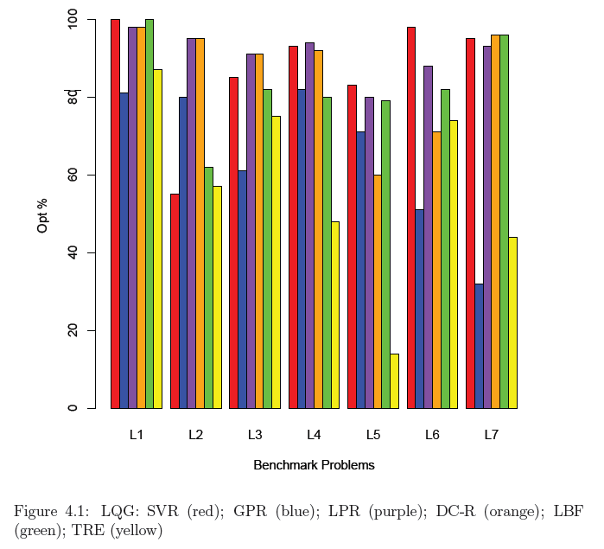
Linear Gaussian control
100
80
60
40
20
0
LBF – regression trees
LBF – linear basis functions
LPR – kernel smoothing
DC-R – local parametric regression
GPR - Gaussian process regression
SVR - Support vector regression

Slide 38
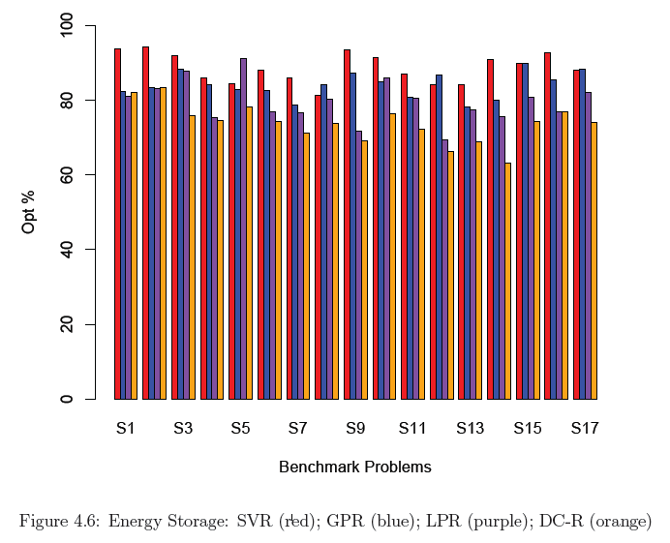
Energy storage applications
100
80
60
40
20
0
DC-R – local parametric regression
LPR – kernel smoothing
GPR - Gaussian process regression
SVR - Support vector regression

Slide 39
Approximate policy iteration
A tale of two distributions
  The sampling distribution, which governs the likelihood that we sample a state.
  The learning distribution, which is the distribution of states we would visit given the current policy
State S
Notes:
39

Slide 40
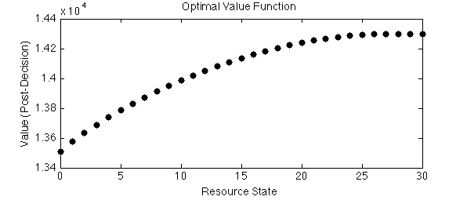
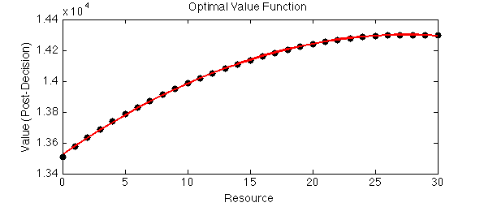
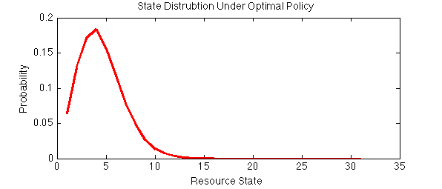
Approximate policy iteration
Using the optimal value function
Optimal value function
…with quadratic fit
Now we are going to use the optimal policy to fit approximate value functions and watch the stability.
State distribution using
optimal policy

Slide 41
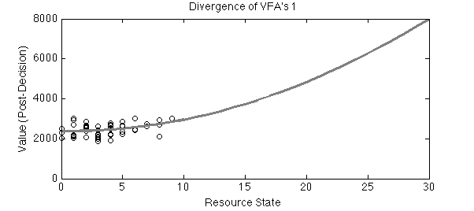
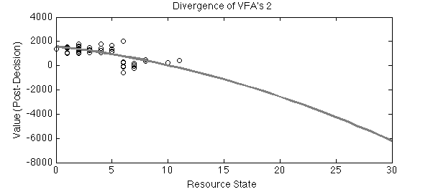
Approximate policy iteration
Policy evaluation: 500 samples (problem only has 31 states!)
After 50 policy improvements with optimal distribution: divergence in sequence of VFA’s, 40%-70% optimality.
After 50 policy improvements with uniform distribution: stable VFAs, 90% optimality.
State distribution using
optimal policy
VFA estimated after 50 policy iterations
VFA estimated after 51 policy iterations

Slide 42
Outline
Least squares approximate policy iteration
Direct policy search
Approximate policy iteration using machine learning
Exploiting concavity
Exploiting monotonicity
Closing thoughts

Slide 43
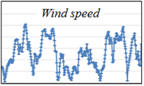
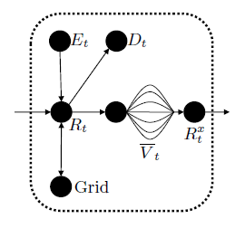
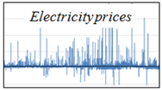
Exploiting concavity
Bellman’s optimality equation
  With pre-decision state:
  With post-decision state:
Inventory held over from previous time period

Slide 44
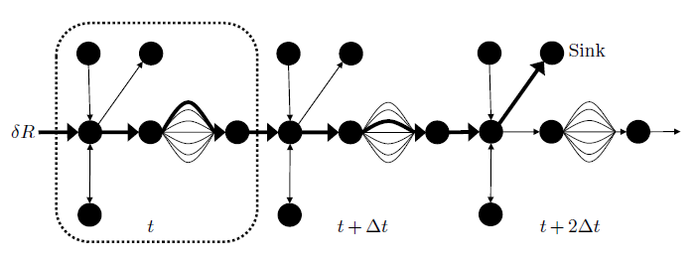
Exploiting concavity
We update the piecewise linear value functions by computing estimates of slopes using a backward pass:
  The cost along the marginal path is the derivative of the simulation with respect to the flow perturbation.

Slide 45
Exploiting concavity
Derivatives are used to estimate a piecewise linear approximation

Slide 46
Exploiting concavity
Convergence results for piecewise linear, concave functions:
  Godfrey, G. and W.B. Powell, "An Adaptive, Distribution-Free Algorithm for the Newsvendor Problem with Censored Demands, with Application to Inventory and Distribution Problems," Management Science, Vol. 47, No. 8, pp. 1101-1112, (2001).
  Topaloglu, H. and W.B. Powell, “An Algorithm for Approximating Piecewise Linear Concave Functions from Sample Gradients,” Operations Research Letters, Vol. 31, No. 1, pp. 66-76 (2003).
  Powell, W.B., A. Ruszczynski and H. Topaloglu, “Learning Algorithms for Separable Approximations of Stochastic Optimization Problems,” Mathematics of Operations Research, Vol 29, No. 4, pp. 814-836 (2004).
Convergence results for storage problems
  J. Nascimento, W. B. Powell, “An Optimal Approximate Dynamic Programming Algorithm for Concave, Scalar Storage Problems with Vector-Valued Controls,” IEEE Transactions on Automatic Control, Vol. 58, No. 12, pp. 2995-3010 (2013)
  Powell, W.B., A. Ruszczynski and H. Topaloglu, “Learning Algorithms for Separable Approximations of Stochastic Optimization Problems,” Mathematics of Operations Research, Vol 29, No. 4, pp. 814-836 (2004).
  Nascimento, J. and W. B. Powell, “An Optimal Approximate Dynamic Programming Algorithm for the Lagged Asset Acquisition Problem,” Mathematics of Operations Research, (2009).

Slide 47
Exploiting concavity
Percent of optimal
Storage problem

Slide 48
Exploiting concavity
Percent of optimal
Storage problem

Slide 49
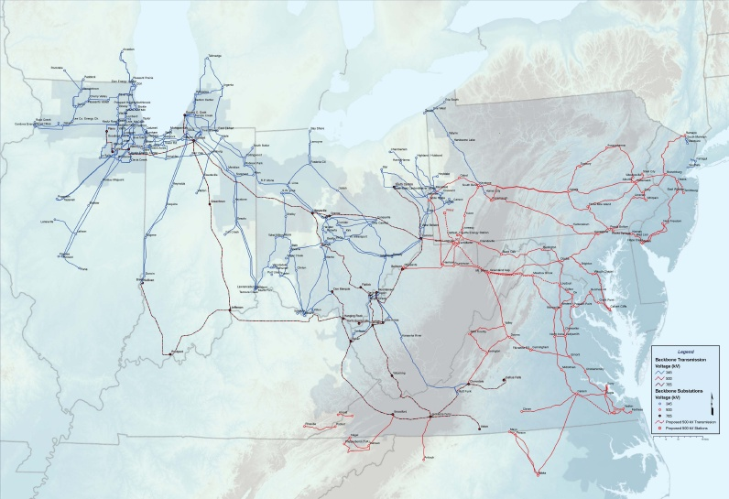
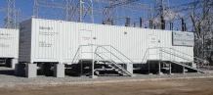
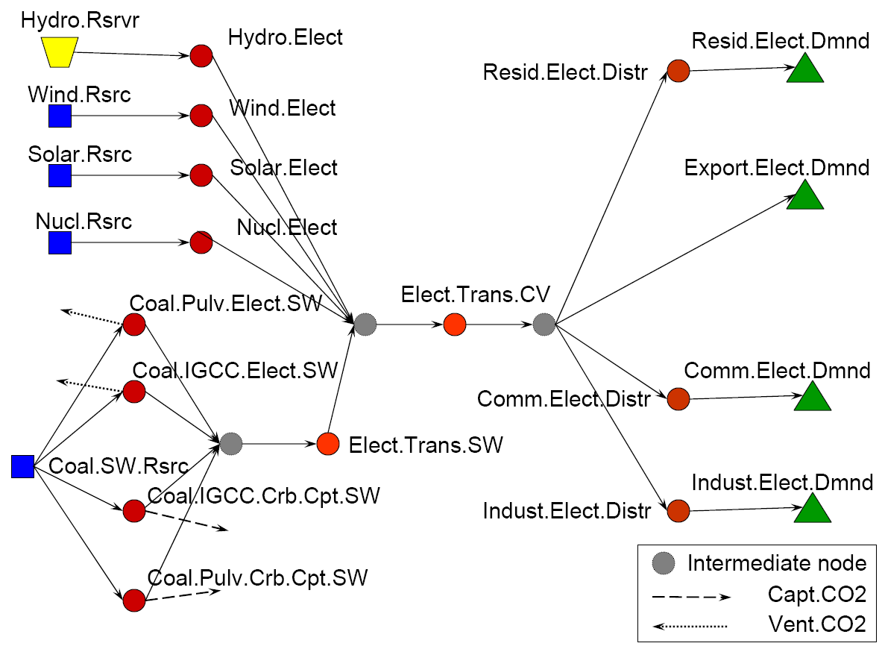
Grid level storage
Slide 49
Notes:
49
This slide is animated to show how we are graphically depicting the hourly dispatch problem. Transition to next slide.

Slide 50
Grid level storage
ADP (blue) vs. LP optimal (black)

Slide 51
Exploiting concavity
The problem of dealing with state of the world
  Temperature, interest rates, …
State of the world

Slide 52
Exploiting concavity
Active area of research. Key ideas center on different methods for clustering.
State of the world
Query state
Lauren Hannah, W.B. Powell, D. Dunson, “Semi-Convex Regression for Metamodeling-Based Optimization,” SIAM J. on Optimization, Vol. 24, No. 2, pp. 573-597, (2014).

Slide 53
Outline
Least squares approximate policy iteration
Direct policy search
Approximate policy iteration using machine learning
Exploiting concavity
Exploiting monotonicity
Closing thoughts

Slide 54
Hour-ahead biding
Bid is placed at 1pm, consisting of charge and discharge prices between 2pm and 3pm.
1pm
2pm
3pm

Slide 55
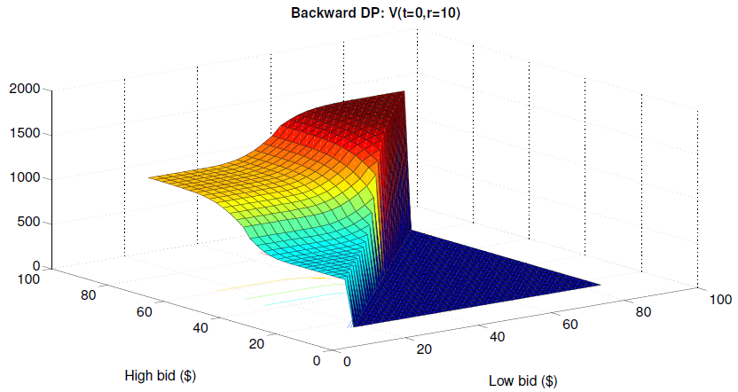
A bidding problem
The exact value function

Slide 56
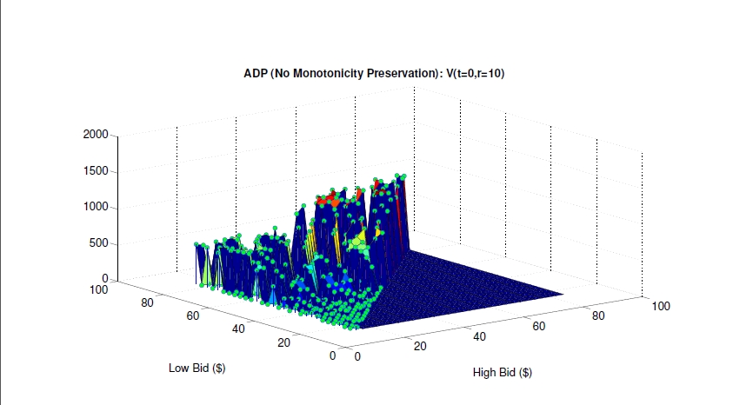
A bidding problem
Approximate value function
without monotonicity

Slide 57
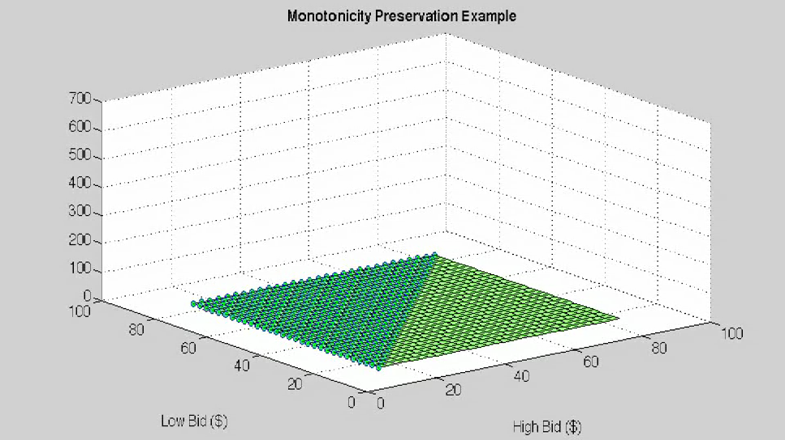
A bidding problem

Slide 58
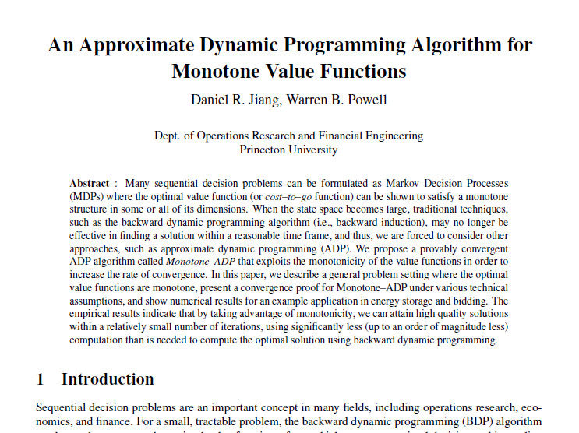

Slide 59
Outline
Least squares approximate policy iteration
Direct policy search
Approximate policy iteration using machine learning
Exploiting concavity
Exploiting monotonicity
Closing thoughts

Slide 60
Observations
  Approximate value iteration using a linear model can produce very poor results under the best of circumstances, and potentially terrible results.
  Least squares approximate value iteration, a highly regarded classic algorithm by Lagoudakis and Parr, works poorly.
  Approximate policy iteration is OK with support vector regression, but below expectation for such a simple problem.
  Basic lookup table by itself works poorly
  Lookup table with structure works very well:
    Convexity – Does not require explicit exploration
    Monotonicity – Does require explicit exploration
    but limited to very low dimensional information state.
  So, we can conclude that nothing works reliably in a way that would scale to more complex problems!

Slide 61
